Slide 1
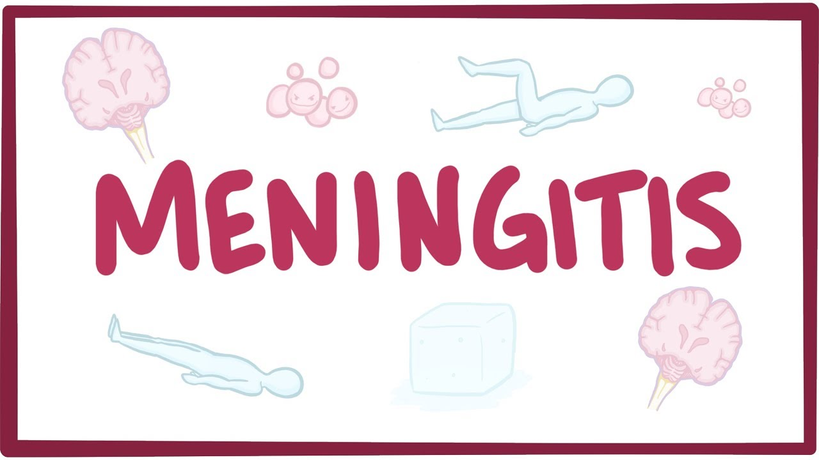

Slide 3
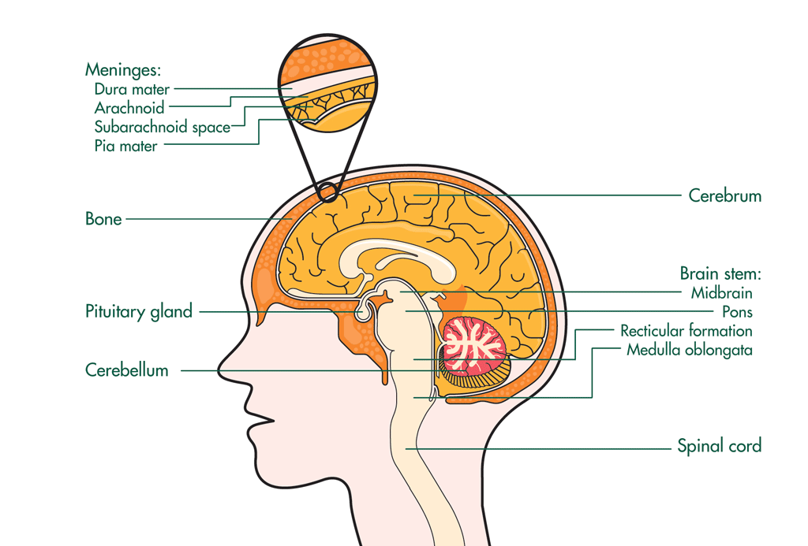
Meningis
Meninges

Slide 4
Infective meningitis
Is an inflammation of the arachnoid and pia mater.
Causes: either bacteria, viruses, fungi or protozoa in the CSF.
Infective meningitis is associated with significant mortality and risk of serious sequelae in survivors.

Slide 5
Pathogenesis
1-Hematogenous spread of organisms (the most common mechanism)
2-By contiguous spread from a parameningeal focus (e.g., sinusitis or otitis media).
3-By direct bacterial inoculation, as occurs with head trauma or neurosurgery.

Slide 6
Transitions
In case of Contiguous spread, bacterial meningitis are preceded by nasopharyngeal colonization of the host by the bacterial pathogen. In susceptible individuals, the bacteria are transport across nasopharyngeal cells into the bloodstream leading to bacteraeamia with subsequent meningeal invasion.
In most cases of neonatal meningitis, infection is acquired from the maternal genital tract around the time of delivery, but transmission between patients can also occur in hospitals.

Slide 7
Aetiology
Meningitis is predominantly a disease of young children, and elderly.
Two bacteria, N. meningitidis and S. pneumoniae, account for about 75% of cases.
The pattern of micro-organisms causing meningitis is related to the age of the patient and the presence of underlying disease.

Slide 8
TABLE 2. Bacterial Meningitis: Most Likely and Empirical Therapy by Age Group
Age Commonly Affected | Most Likely Organisms | Empirical Therapy
Newborn-1 month | Gram-negative entericsª Group B Streptococcus Listeria monocytogenes | Ampicillin + cefotaxime or ceftriaxone or aminoglycoside
1 month-4 yr | H. influenzea N. meningitidis S. pneumoniae | Cefotaxime or ceftriaxone + vancomycin^{b}
5-29 yr | N. meningitidis S. pneumoniae H. influenzae | Cefotaxime or ceftriaxone + vancomycin^{b}
30-60 yr | S. pneumoniae N. meningitidis | Cefotaxime or ceftriaxone + vancomycin^{b}
>60 yr | S. pneumoniae Gram-negative enterics L. monocytogenes | Ampicillin + cefotaxime or ceftriaxone + vancomycin^{b}
ª Escherichia coli, Klebsiella spp., Enterobacter spp. common. ^{b} Vancomycin use should be based on local incidence of penicillin-resistant S. pneumoniae and until cefotaxime or ceftriaxone minimum inhibitory concentration results are available.

Slide 9
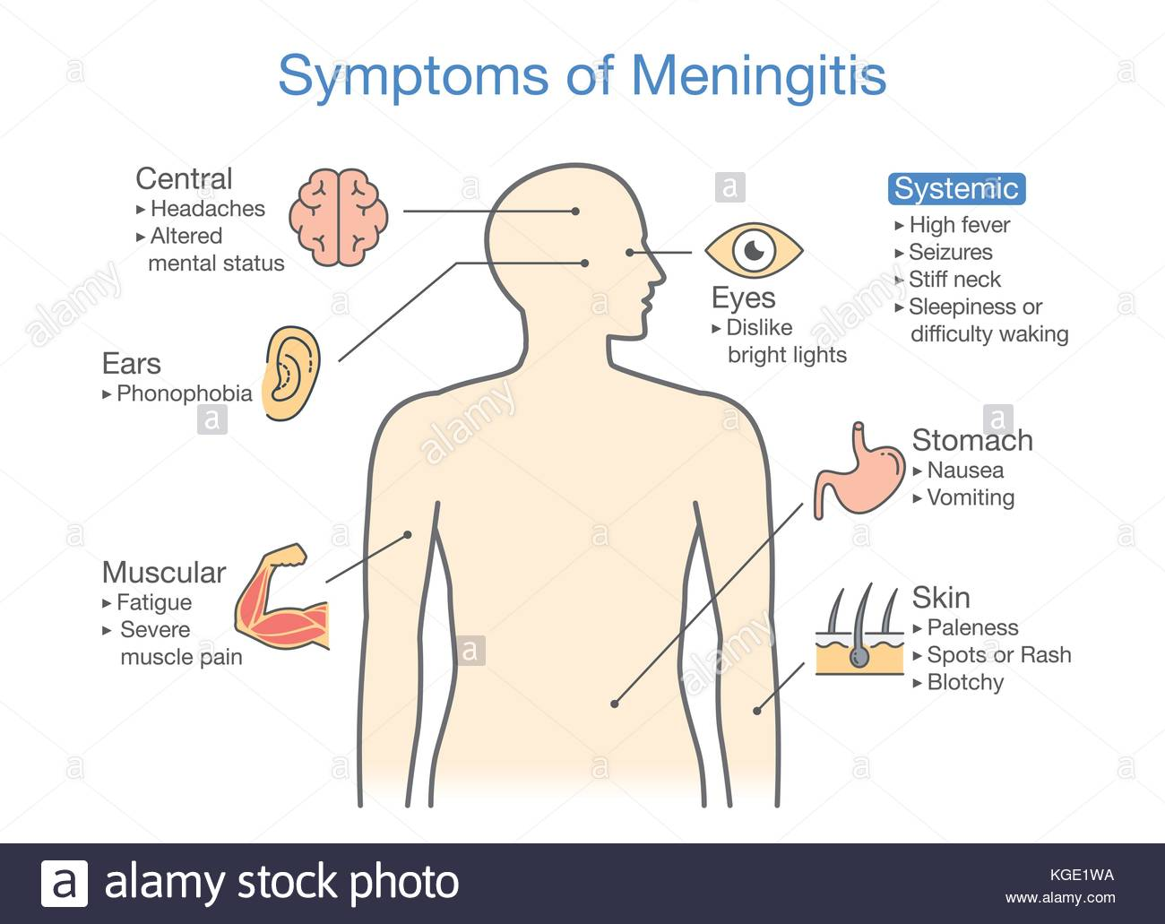

Slide 10
Clinical Presentations
Adults with meningitis typically present with the classic triad of fever, neck stiffness, and altered mental status. Other symptoms are headache, photophobia, nausea and vomiting, rash, and seizures
Infants often have nonspecific symptoms, e.g., irritability, crying, vomiting , seizures, or altered sleeping or eating patterns. Focal signs such as seizures or a bulging fontanelle usually only occur at a late stage.
Viral meningitis usually presents with acute onset of lowgrade fever, headache, photophobia and neck stiffness. (Unless they develop encephalitis, patients usually remain alert and oriented).

Slide 11
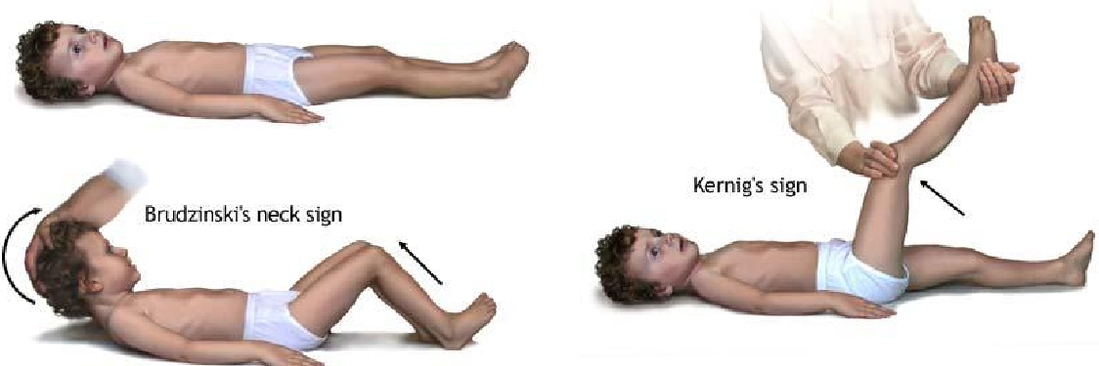
Physical Examinations

Slide 12
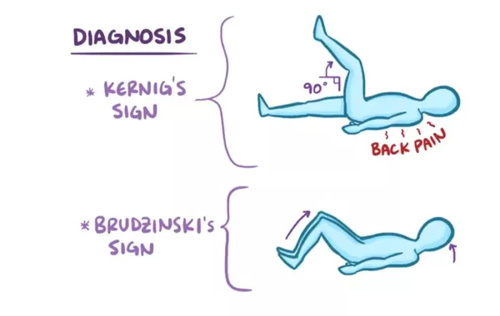

Slide 13
Diagnosis
1- History and physical examination.
2- Blood sample
3- Lumbar puncture: measure pressure, analyze WBC, protein and glucose.
4- polymerase chain reaction (PCR) molecular amplification techniques used to detect meningococci, pneumococci, Mycobacterium tuberculosis and various viruses, including herpes simplex viruses and enteroviruses.

Slide 14
CSF examination

Slide 15
Managemaent
Treatment goals are to
Ameliorate signs and symptoms,
Eradicate infection,
Prevent the development of neurological sequelae such as seizures, deafness, coma, and death

Slide 16
Selection of antibacterial
The antimicrobial therapy of meningitis requires attainment of adequate levels of bactericidal agents within the CSF.
The passage of antibiotics into CSF is dependent on the degree of meningeal inflammation and integrity of the blood–brain barrier created by capillary endothelial cells,

Slide 17
Antimicrobials fall into three categories according to their ability to penetrate the CSF:
Those that penetrate even when the meninges are not inflamed, for example chloramphenicol, metronidazole, isoniazid and pyrazinamide
Those that generally penetrate only when the meninges are inflamed, and used in high doses, for example most β-lactam antibiotics, the quinolones and rifampicin
Those that penetrate poorly under all circumstances, including the aminoglycosides, vancomycin and erythromycin.

Slide 18
Recommended regimens
Empiric Treatment
Antimicrobial therapy given prior to the availability of microbiologic culture results .
The selection of empiric antibiotic based on the patient’s age, allergies, and any comorbidities.
Empiric antibiotics should be started as soon as possible and continued for at least 48 hours to 72 hours or until the diagnosis of bacterial meningitis can be ruled out

Slide 19
For the purpose of selecting empiric antimicrobial therapy, patients with acute bacterial meningitis can be categorised into broad groups:

Slide 20
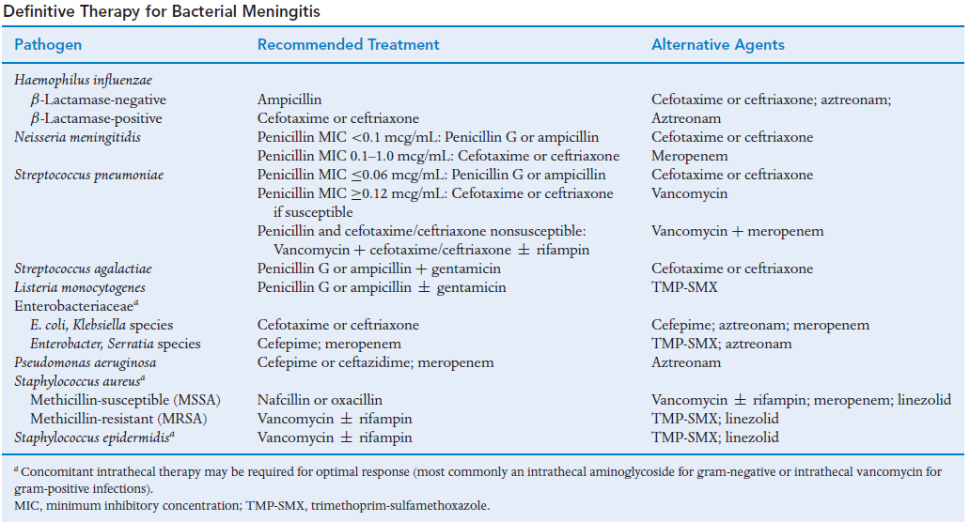

Slide 21
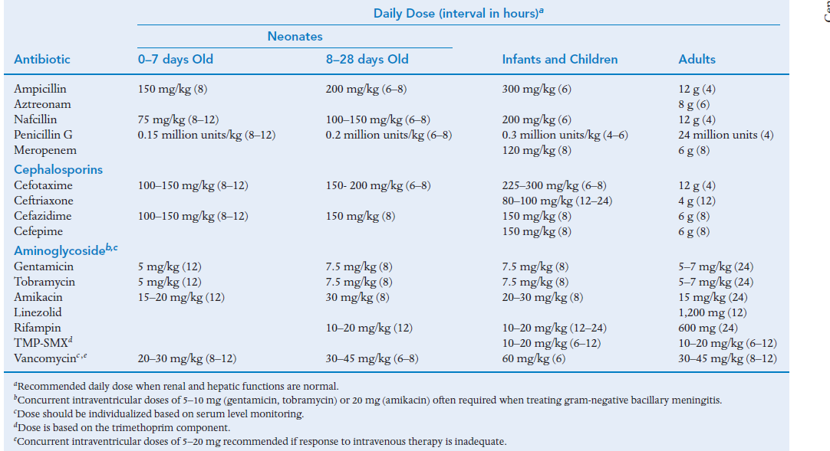

Slide 22
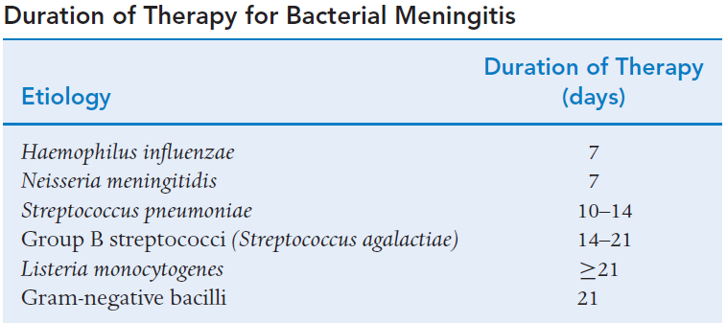

Slide 23
Steroids as adjunctive therapy in bacterial meningitis.
Corticosteroids, and in particular dexamethasone,
Regulate many components of the inflammatory response and also lower CSF hydrostatic pressure.
However, by reducing inflammation and restoring the blood–brain barrier, they may reduce CSF penetration of antibiotics.
The use of adjunctive dexamethasone is now recommended for children and adults with community-acquired bacterial meningitis, regardless of bacterial Aetiology
Should be initiated before or with the first dose of antibiotics and continued for 4 days.

Slide 24
Chemoprophylaxis
Meningitis can spread between family members and other close contacts;
Risky members should receive chemoprophylaxis as soon as possible, preferably within 24 h.

Slide 25
Vaccination
Introduction into the routine immunisation schedule of against
H. influenzae type b,
N. meningitidis group C and
S. pneumoniae serotypes has markedly reduced the incidence of meningitis due to these bacteria.

Slide 26
Cryptococcus Neoformans
The most common form of fungal meningitis.
Is a major cause of morbidity and mortality in immunosuppressed patients.
Amphotericin B is the drug of choice for treatment of acute C. neoformans meningitis.
Amphotericin combined with flucytosine, is more effective than amphotericin alone

Slide 27
Viral Encephalitis
The most common viral pathogens are enteroviruses, which cause approximately 85% of cases of viral CNS infections.
Most cases of enteroviral meningitis or encephalitis are self-limiting with supportive treatment.

Slide 28
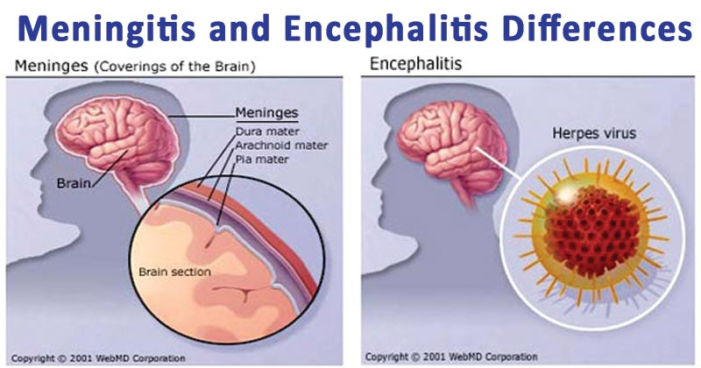

Slide 29

Thank U…

