Slide 1

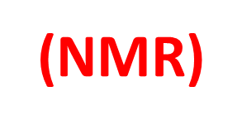
Assis.Prof.Dr.Mohammed Hassan
Part 3

Slide 2
¹³C-NMR
What can we deduce about molecular structure from ¹³C-NMR spectrum?
Information from carbon¹³C NMR spectrum
Number of signals: equivalent carbons and molecular symmetry
Chemical shift: presence of high EN atoms or pi electron clouds
Integration: ratios of equivalent carbons
Coupling: number of neighbors

Slide 3
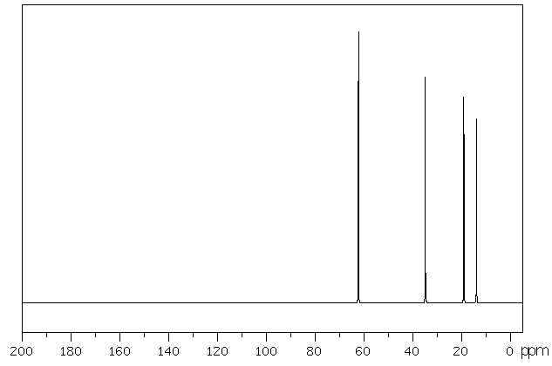
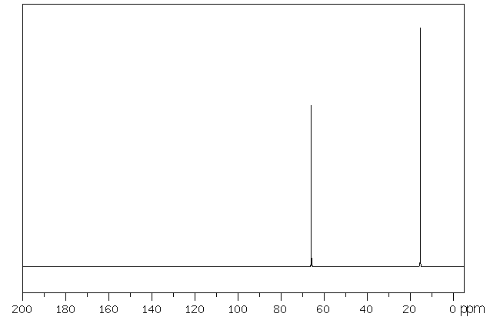
¹³C-NMR: Number of Signals
Number of ¹³C-NMR signals reveals equivalent carbons
One signal per unique carbon type
Reveals molecular symmetry
Examples
CH₃CH₂CH₂CH₂OH
No equivalent carbons
Four ¹³C-NMR signals
CH₃CH₂OCH₂CH₃
2 x CH₃ equivalent
2 x CH₂ equivalent
Two ¹³C-NMR signals

Slide 4
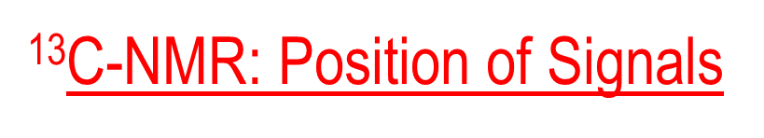
Factors that affect chemical shifts:
Chemical shift affected by nearby electronegative atoms
  Carbons bonded to electronegative atoms absorb downfield from typical alkane carbons
Hybridization of carbon atoms
  sp³-hybridized carbons generally absorb from 0 to 90 δ
  sp²-hybridized carbons generally absorb from 110 to 220 δ
  C=O carbons absorb from 160 to 220 δ

Slide 5
¹³C-NMR: Position of Signals
Position of signal relative to reference = chemical shift
¹³C-NMR reference = TMS = 0.00 ppm
¹³C-NMR chemical shift range = 0 - 250 ppm
Downfield shifts caused by electronegative atoms and pi electron clouds
Example: HOCH₂CH₂CH₂CH₃
OH does not have carbon
↓
no ¹³C-NMR OH signal

Slide 6
¹³C-NMR: Position of Signals
Trends
RCH₃ < R₂CH₂ < R₃CH
EN atoms cause downfield shift
Pi bonds cause downfield shift
C=O 160-210 ppm

Slide 7
¹³C NMR CHEMICAL SHIFT
CORRELATION CHART

Slide 8
¹³C-NMR: Integration
¹H-NMR: Integration reveals relative number of hydrogens per signal
Rarely useful due to slow relaxation time for ¹³C
time for nucleus to relax from
excited spin state to ground state

Slide 9
¹³C-NMR: Spin-Spin Coupling
Spin-spin coupling of nuclei causes splitting of NMR signal
Only nuclei with I ≠ 0 can couple
Examples: ¹H with ¹H, ¹H with ¹³C, ¹³C with ¹³C
¹H NMR: splitting reveals number of H neighbors
¹³C-NMR: limited to nuclei separated by just one sigma bond; no pi bond
“free spacers”
¹H
Coupling observed
¹³C
No coupling: too far apart
Coupling occurs but signal very weak:
low probability for two adjacent ¹³C
1.1% x 1.1% = 0.012%
¹³C
No coupling: ¹²C has I = 0
¹²C
Conclusions
Carbon signal split by attached hydrogens (one bond coupling)
No other coupling important

Slide 10
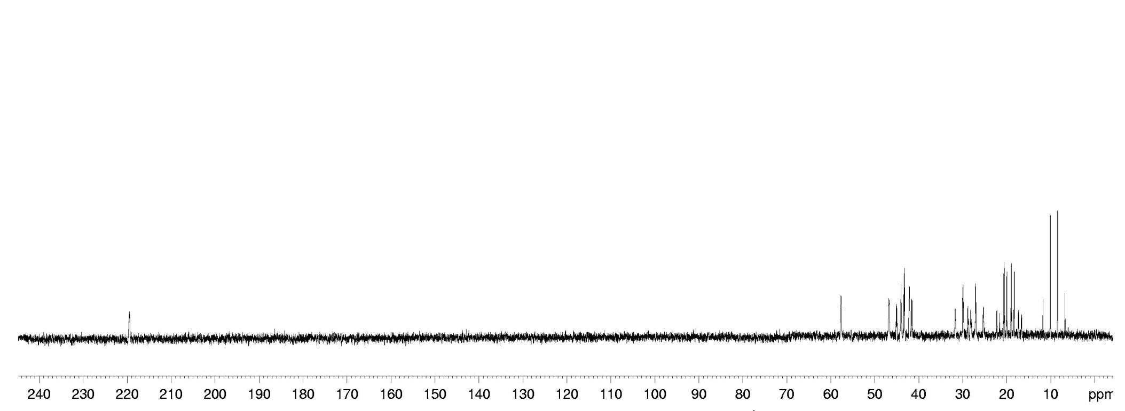
¹H-¹³C Splitting Patterns
Carbon signal split by attached hydrogens
N+1 splitting rule obeyed
Example
Quartet
Triplet
Doublet
Singlet
How can we simply this?

Slide 11
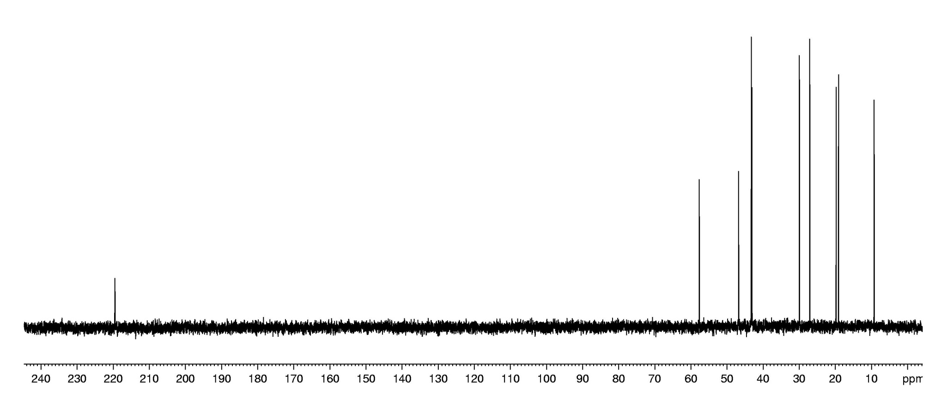
Simplification of Complex Splitting Patterns
Broadband decoupling: all C-H coupling is suppressed
All split signals become singlets
Signal intensity increases; less time required to obtain spectrum
Proton decoupled

Slide 12
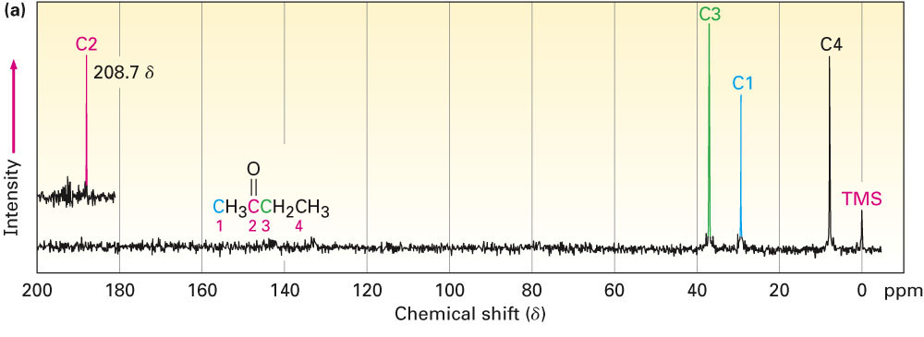
⁻¹³C spectrum for butan-2-one
Butan-2-one contains 4 chemically nonequivalent carbon atoms
-Carbonyl carbons (C=O) are always found at the low-field end of the spectrum from 160 to 220 δ

Slide 13
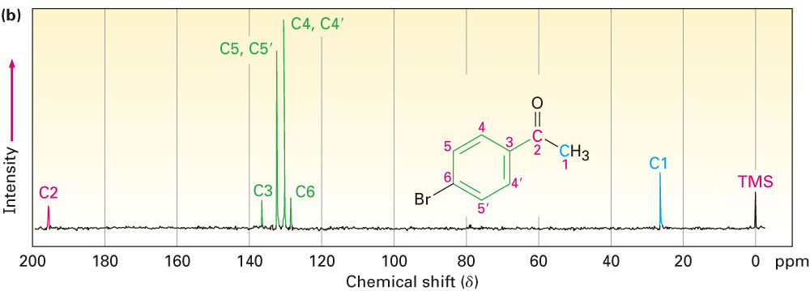
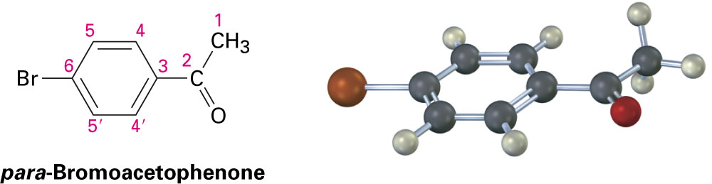
¹³C NMR spectrum of p-bromoacetophenone shows only six absorptions, even though the molecule contains eight carbons. A molecular plane of symmetry makes ring carbons 4 and 4′, and ring carbons 5 and 5′ equivalent. Thus, six ring carbons show only four absorptions

Slide 14
Predicting Chemical Shifts in ¹³C NMR Spectra
At what approximate positions would you expect ethyl acrylate, H₂C=CHCO₂CH₂CH₃, to show ¹³C NMR absorptions?
Strategy
Identify the distinct carbons in the molecule, and note whether each is alkyl, vinylic, aromatic, or in a carbonyl group. Then predict where each absorbs.

Slide 15
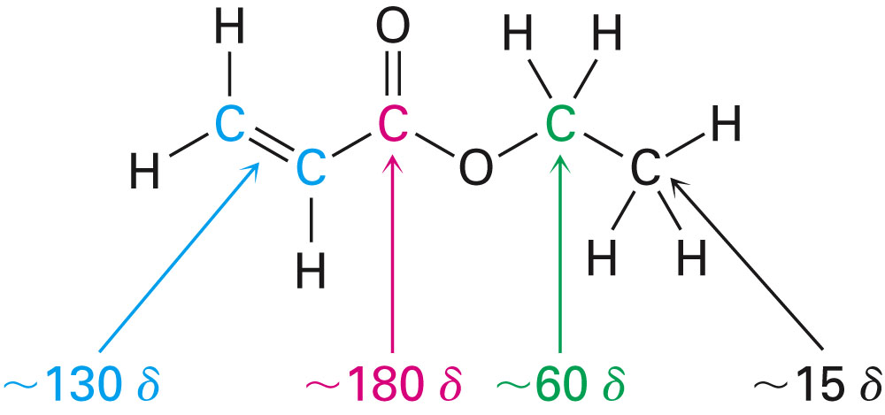
Solution
Ethyl acrylate has four distinct carbons: two C=C, one C=O, one C(O)-C, and one alkyl C. From Figure, the likely absorptions are
The actual absorptions are at 14.1, 60.5,130.3, and 166.0 δ

Slide 16
DEPT ¹³C NMR Spectroscopy
Distortionless Enhancement by Polarization Transfer (DEPT-NMR) experiment
Run in three stages
  Ordinary broadband-decoupled spectrum
    Locates chemical shifts of all carbons
  DEPT-90
    Only signals due to CH carbons appear
  DEPT-135
    CH₃ and CH resonances appear positive
    CH₂ signals appear as negative signals (below the baseline)
Used to determine number of hydrogens attached to each carbon

Slide 17
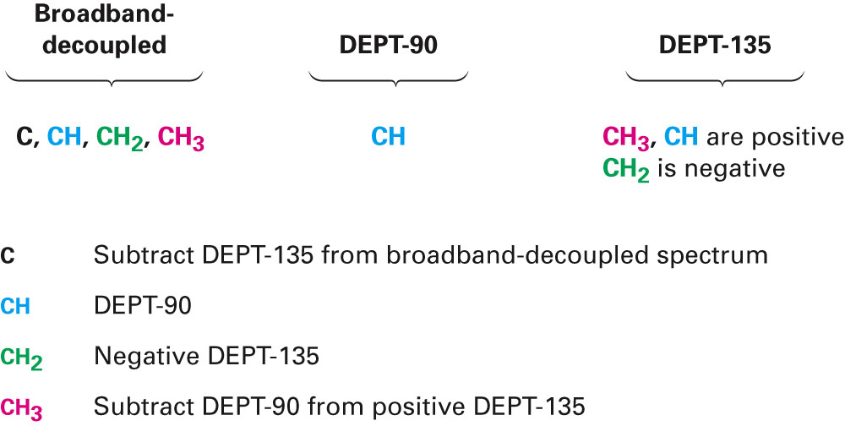
Summary of signals in the three stage DEPT experiment

Slide 18
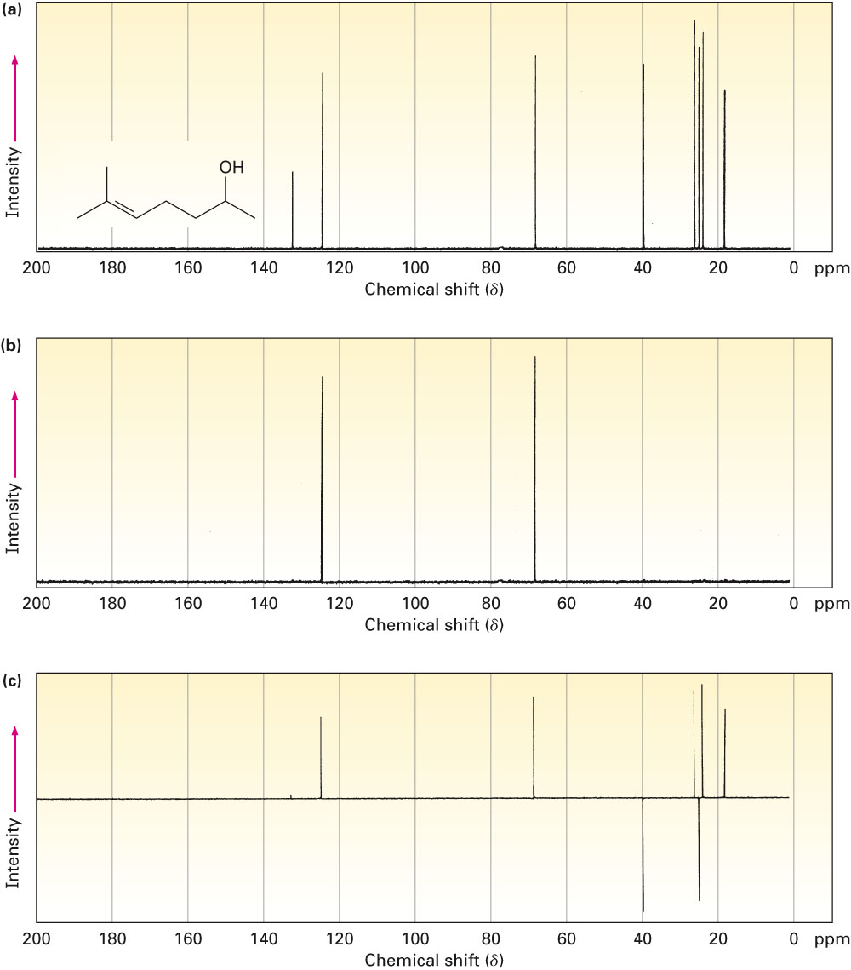
Ordinary broadband-decoupled spectrum showing signals for all eight of 6-methylhept-5-en-2-ol
DEPT-90 spectrum showing signals only for the two C-H carbons
DEPT-135 spectrum showing positive signals for the two CH carbons and the three CH₃ carbons and negative signals for the two CH₂ carbons

Slide 19
Assigning a Chemical Structure from a ¹³C NMR Spectrum
Propose a structure for an alcohol, C₄H₁₀O, that has the following ¹³C NMR spectral data:
  Broadband-decoupled ¹³C NMR: 19.0, 31.7, 69.5 δ
  DEPT-90: 31.7 δ
  DEPT-135: positive peak at 19.0 δ, negative peak at 69.5 δ

Slide 20
Strategy
-Begin by noting that the unknown alcohol has four carbon atoms, yet has only three NMR absorption, which implies that two carbons must be equivalent
-Two of the absorptions are in the typical alkane region (19.0 and 31.7 d) while one is in the region of a carbon bonded to an electronegative atom (69.5 d) – oxygen in this instance
-The DEPT-90 spectrum tells us that the alkyl carbon at 31.7 d is tertiary (CH); the DEPT-135 spectrum tells us that the alkyl carbon at 19.0 d is a methyl (CH3) and that the carbon bonded to oxygen (69.5 d) is secondary (CH2)
-The two equivalent carbons are probably both methyls bonded to the same tertiary carbon, (CH3)2CH-

Slide 21
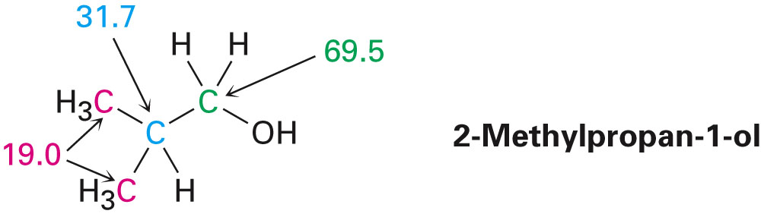
Solution
We can now put the pieces together to propose a structure:

Slide 22
Propose the structures of the following compound from
the data given below:
1.Compound A C₅H₁₁Br
Broadband-decoupled 13C NMR: 22, 28, 34 and43
DEPT-90: 28
DEPT-135: positive peak at 22 and 28, negative peak at 34
And 43.

Slide 23
-has 5 carbon atoms, yet has only four NMR absorption, which implies that two carbons must be equivalent
-Three of the absorptions are in the typical alkane region (22, 28 and 34 ) while one is in the region of a carbon bonded to an electronegative atom (43) – halide in this instance
-The DEPT-90 spectrum tells us that the alkyl carbon at 28 is tertiary (CH);
-The DEPT-135 spectrum tells us that the alkyl carbon at 22 is a methyl (CH3) and that the carbon bonded to halide (43) is secondary (CH2)
-The two equivalent carbons are probably both methyls bonded to the same tertiary carbon, (CH3)2CH-
-The compound is 3-methyl butyl bromide.

Slide 24
2.Compound A C₅H₁₁Br
Broadband-decoupled 13C NMR: 10, 32,40 and 67
DEPT-135: negative peak at 40 positive 10 and 32

Slide 25
-has 5 carbon atoms, yet has only four NMR absorption, which implies that two carbons must be equivalent
-Three of the absorptions are in the typical alkane region (10, 32 and 40 ) while one is in the region of a carbon bonded to an electronegative atom (67) – halide in this instance
-The DEPT-135 spectrum tells us that the alkyl carbon at 10, 32 are a methyl (CH3) and that the carbon bonded to halide (67) is quaternary.
-The two equivalent carbons are probably both methyls bonded to the same quaternary carbon, (CH3)2C-
-The compound is 2-Bromo-2-methyl butane.

Slide 26
3.Compound A C₅H₁₁Br
Broadband-decoupled 13C NMR: 12, 22,30, 33and 40
DEPT-135: negative peaks at 22, 30, 33 and 40.

Slide 27
-has 5 carbon atoms, yet has five NMR absorption,
-Fourth of the absorptions are in the typical alkane region (12, 22, 30 and 33) while one is in the region of a carbon bonded to an electronegative atom (40) – halide in this instance
-The DEPT-135 spectrum tells us that the alkyl carbon at 12 is a methyl (CH3) and that the other carbon are CH2 and one of them bonded to halide (40) .
-The compound is n-pentyl bromide.

