Slide 1
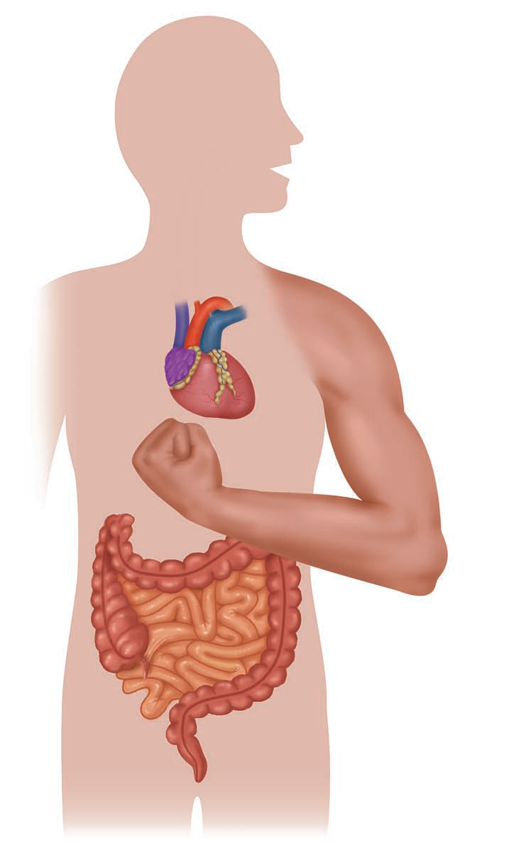
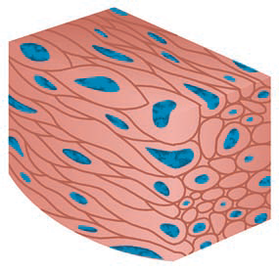
Muscle Tissue

Slide 2
Muscle cells are structurally and functionally specialized for contraction, which contain two types of special protein filaments called myofilaments; including thin filaments containing actin and thick filaments containing myosin.

Slide 3
There are types of muscles:-
Skeletal muscles fibers: is found mainly in association with bones.
Cardiac muscles fibers: is found exclusively in the walls of the heart.
Smooth muscle fibers: is found mainly in the walls of hollow organs (eg, intestines and blood vessels).
All muscle tissues consist of elongated cells called fibers.
The cytoplasm of muscle cells is called sarcoplasm and the surrounding cell membrane or plasma lemma is called sarcolemma.
Each muscle fiber sarcoplasm contains numerous myofibrils, which contain two types of contractile protein filaments, actin and myosin.

Slide 4
Smooth Muscle | Cardiac Muscle | Skeletal Muscle | Features
No | Yes | Yes | Striations
Short, spindle shaped | Short, branched | Long, cylindrical, unbranched | Fibers
Single, central in cell | Single, central in cell | Multiple, peripheral in cell | Nuclei
No | Intercalated disks | No | Cell junctions
Yes, mitosis | No | Yes, satellite cells | Regeneration
Involuntary | Involuntary | Voluntary movement | Main function

Slide 5
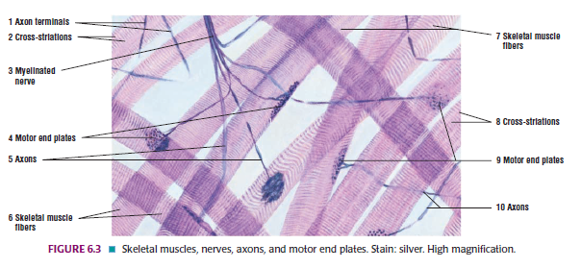

Slide 6
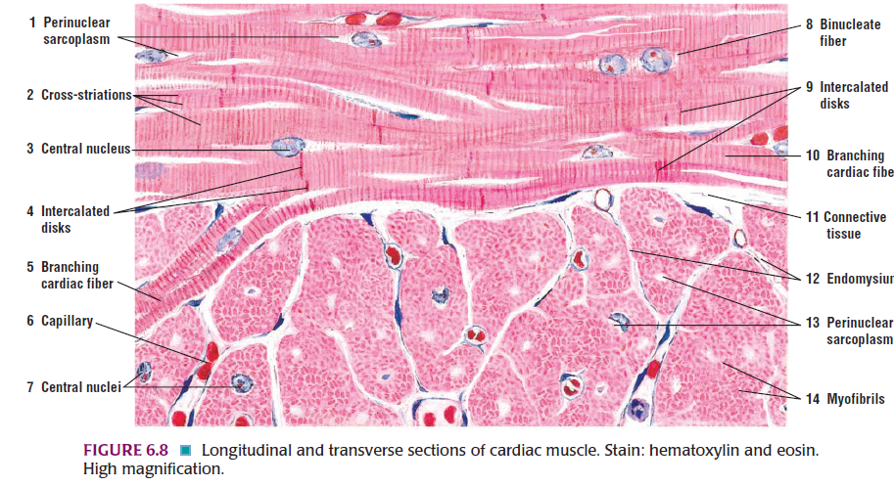

Slide 7
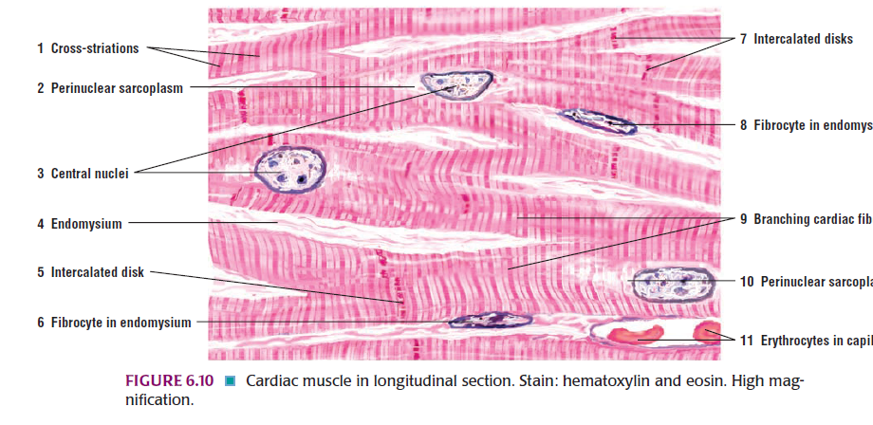

Slide 8
