Slide 1
The Bones

Slide 2
Bones of the skeleton are organs that contain several different tissues
Bones are dominated by bone tissue but also contain Nervous tissue Blood tissue and vessels ,Cartilage in articular cartilages ,Epithelial tissue lining the blood vessels.

Slide 3
Bone function
Support
Protection (protect internal organs)
Movement (provide leverage system for skeletal muscles, tendons, ligaments and joints)
Mineral homeostasis (bones act as reserves of minerals important for the body like calcium or phosphorus)
Hematopoiesis: blood cell formation
Storage of adipose tissue: yellow marrow

Slide 4
Classification of Bone: Bones vary in shape and size
Bones are classified by their shape as long, short, flat, or irregular bone
Bones differ in the distribution of compact and spongy osseous tissues

Slide 5
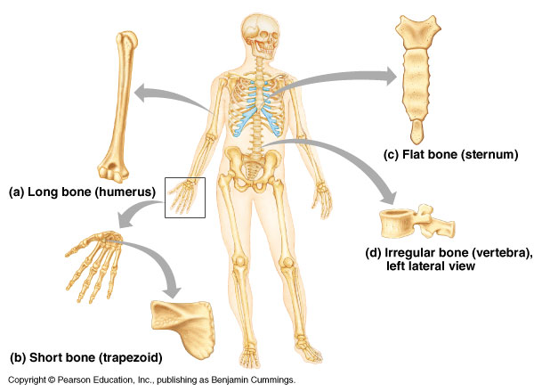

Slide 6
Long bones
Long bones have a long shaft and two distinct ends
Classification is based on shape not size.
Short Bones
Short bones are roughly cubelike
Thin compact bone layer surrounding spongy bone mass
Short bones are often carpal, tarsal and sesamoid bones
Flat bones are thin, flattened and usually curved
Parallel layer of compact bone with spongy bone layer between Skull, sternum and ribs are example.
Irregular bones don’t fit into the previous categories
Complicated shapes, Consist of spongy bone with a thin layer of compact
Examples are hip bones & vertabrae

Slide 7
Bone anatomy
Diaphysis: long shaft of bone
Epiphysis: ends of bone
Epiphyseal plate: growth plate
Metaphysis: b/w epiphysis and diaphysis
Articular cartilage: covers epiphysis
Periosteum: bone covering (pain sensitive)
Sharpey’s fibers: periosteum attaches to underlying bone
Medullary cavity: Hollow chamber in bone
- red marrow produces blood cells
- yellow marrow is adipose
Endosteum: thin layer lining the medullary cavity

Slide 8
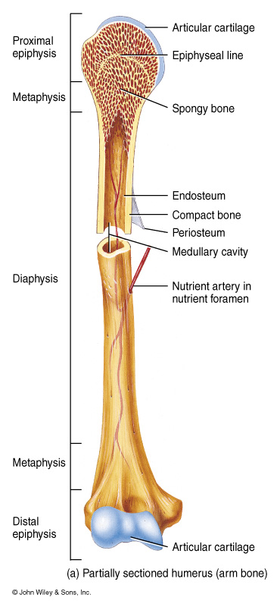

Slide 9
Blood and nerve supply of bone
Bone is supplied with blood by:
Periosteal arteries accompanied by nerves supply the periosteum and compact bone
Epiphyseal veins carry blood away from long bones nerves accompany the blood vessels that supply bones.
The periosteum is rich in sensory nerves sensitive to tearing or tension

Slide 10
Hematopoietic Tissue
The hematopoietic tissue, red marrow, is typically found within the cavities of spongy bone of long bones and in the diploe of flat bones these cavities are referred to as red marrow cavities. in infants the medullary cavity and all areas of spongy bone contain red bone marrow
In the adult the medullary cavity contains fat that extends into the epiphysis and there is little red marrow present in spongy bone cavities blood cell production occurs only in the head of the femur and humerous most blood cell production occurs in the diploe areas of the sternum and hip yellow marrow can revert to red marrow if the person becomes very anemic

Slide 11
There are two types of mature bone:
1. Compact - which is found in the shafts of long bones (diaphyses). This makes up 80% of all bone, also called cortical bone, is the hard, stiff, smooth, thin, white bone tissue that surrounds all bones in the human body. It is also called osseous tissue or cortical bone and it provides structure and support for an organism as part of its skeleton, in addition to being a location for the storage of minerals like calcium. About 80% of the weight of the human skeleton comes from compact bone.

Slide 12
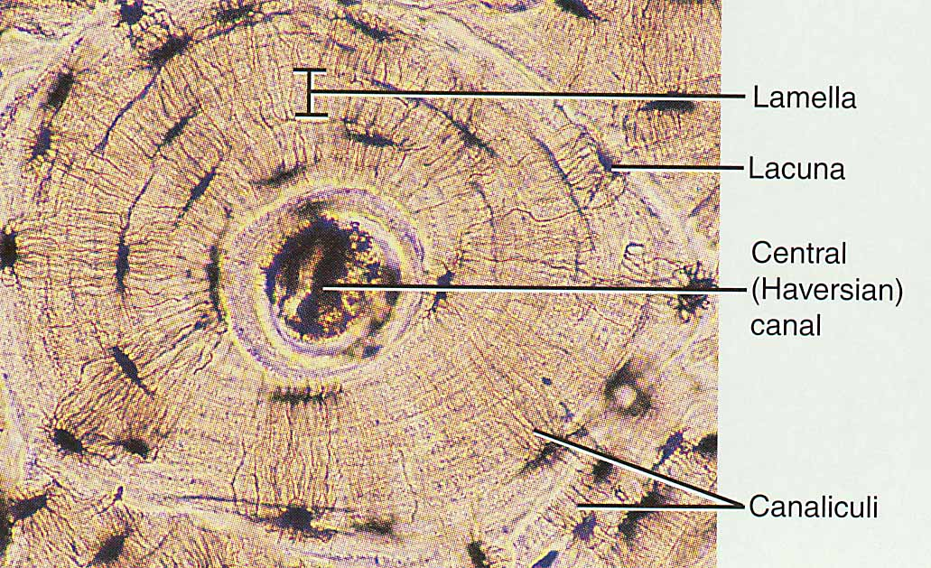

Slide 13
2. Spongy (cancellous) bone - which is found at the ends of long bones (in the epiphysis). This makes up 20% of all bone. This type of bone contains red bone marrow and a network of bony trabeculae.
Spongy bone is the tissue that makes up the interior of bones; compact bone is the tissue that forms the surface of bones. In long bones, spongy bone forms the interior of the epiphyses; the diaphysis (shaft) consists of compact bone surrounding the central marrow cavity.

Slide 14
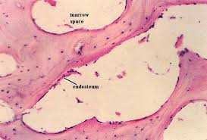

Slide 15
Four cell types make up osseous tissue
Osteoprogenitor cells,Osteoblasts,Osteocytes,Osteoclasts.
Osteoprogenitor cells:
- derived from mesenchyme, all connective tissue is derived
- unspecialized stem cells, undergo mitosis and develop into osteoblasts, found on inner surface of periosteum and endosteum.
Osteoblasts:
- bone forming cells, found on surface of bone (arrow), no ability to mitotically divide, collagen secretors
Osteocytes: mature bone cells. derived form osteoblasts , do not secrete matrix material, cellular duties include exchange of nutrients and waste with blood.
Osteoclasts
- bone resorbing cells, bone surface, growth, maintenance and bone repair

Slide 16
Bone formation
The process of bone formation is called ossification
Bone formation occurs in four situations:
1) Formation of bone in an embryo
2) Growth of bones until adulthood
3) Remodeling of bone
4) Repair of fractures

Slide 17
Formation of Bone in an Embryo
Cartilage formation and ossification occurs during the sixth week of embryonic development with two pattern

Slide 18
Intramembranous Ossification
Flat bones of the skull and mandible are formed in this way “Soft spots” that help the fetal skull pass through the birth canal later become ossified forming the skull ,intramembranous ossification: a group of mesenchymal cells within a highly vascularized area of the embryonic connective tissue proliferates and differentiates directly into preosteoblasts and then into osteoblasts.

Slide 19
Intramembranous ossification follows four steps: (a) Mesenchymal cells group into clusters, differentiate into osteoblasts, and ossification centers form. (b) Secreted osteoid traps osteoblasts, which then become osteocytes. (c) Trabecular matrix and periosteum form.

Slide 20
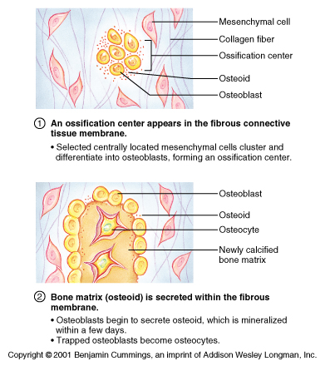

Slide 21
    Endochondral ossification
    Most bones form by the process of endochondral ossification .The mechanism responsible for the formation of all long bones of the axial skeleton. The replacement of cartilage by bone Most bones of the body are formed in this way including long bones.
    This process occurs at three main sites: the physis, the epiphysis, and the cuboidal bones of the carpus and tarsus.
    Process begins late in the second month of development
    Process uses hyaline cartilage “bones” as the pattern for bone construction
    During this process cartilage is broken down as ossification proceeds

Slide 22
1)Formation of a bone collar around hyaline cartilage model
2) Osteoblasts of the new periosteum secrete osteoid against the hyaline cartilage along the diaphysis
Cartilage in the center of the diaphysis calcifies
Calcification of cartilage blocks nutrients and chondrocytes die
Matrix deteriorates and cavities develop
Bones stabilized by collar; growth occurs at epiphysis
3)Invasion of the internal cavities by the periosteal bud and spongy bone
Bud contains nutrient artery & vein, lymphatics, nerve fibers, red marrow elements, osteoblasts and osteoclasts

Slide 23
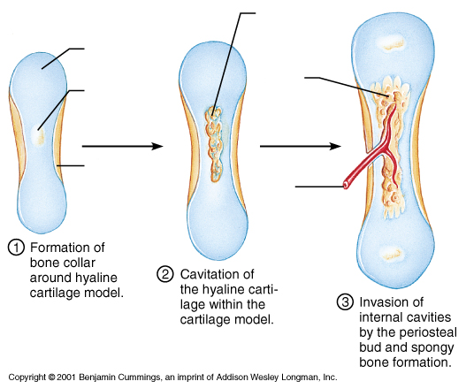

Slide 24
4) Formation of the medullary cavity as ossification continues
5)Secondary ossification centers form in epiphyses
Cartilage in epiphyses calcifies and deteriorates opening cavities for entry of periosteal bud

Slide 26
Postnatal bone growth
During infancy and youth bone growth occurs entirely by interstitialgrowth of the epiphyseal plates bones grow in thickness by appositional growth bones stop growing during adolescence or in early adulthood some facial bones such as the nose or lower jaw continue to grow throughout life

Slide 27
