Slide 1
Medical Microbiology
4th lecture
Dr Fitua Al-Saedi

Slide 2
Clostridium Species
The clostridia are large anaerobic, spore-forming, gram-positive, motile rods.
Many decompose proteins or form toxins, and some do both.
Their natural habitat is the soil or the intestinal tract of animals and humans, where they live as saprophytes.
There are four medically important species;
Clostridium botulinum (botulism)
Clostridium tetani (tetanus)
Clostridium perfringes (gas gangrene)
Clostridium difficile (pseudomembranous colitis, antibiotic- associated diarrhea (AAD) .

Slide 3
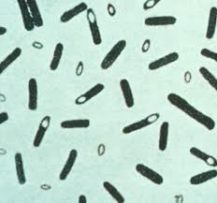
Clostridium botulinum
C. botulinum is a large anaerobic bacillus that forms subterminal endospores.
C. botulinum, causes the disease botulism.
It is found in soil and occasionally in animal
feces.
Spores of the organism are highly resistant to heat, withstanding 100°C for several hours. Heat resistance is diminished at acid pH or high salt concentration.

Slide 4
Toxins
Seven antigenic varieties of toxin (serotypes A–G) are known.
Types A, B, E, and F are the principal causes of human illness.
Types A and B have been associated with a variety of foods and type E predominantly with fish products.
Type C produces limber neck in birds; type D causes botulism in mammals. Type G is not associated with disease.
Botulinum toxins have three domains. Two of the domains facilitate binding to and entry of toxin into the nerve cell. The third domain is the toxin which is a 150 kDa protein that is cleaved into a heavy chain (H, 100 kDa) and a light chain (L, 50 kDa) that are linked by a disulfide bond.
The lethal dose for a human is probably about 1–2 μg/kg.
The toxins are destroyed by heating for 20 minutes at 100°C.
Block the release of acetylcholine, the principal neurotransmitter at the neuromuscular junction, causing muscle paralysis.

Slide 5
Pathogenesis
Botulism is a serious illness that causes flaccid paralysis of muscles.
Foodborne botulism: most cases of botulism represent an intoxication resulting from the ingestion of food in which C. botulinum has grown and produced toxin.
The most common offenders are spiced, smoked, vacuum packed or canned alkaline foods that are eaten without cooking.
In such foods, spores of C. botulinum germinate; that is, under anaerobic conditions, vegetative forms grow and produce toxin.
In infant botulism, honey is the most frequent vehicle of infection. The pathogenesis differs from the way that adults acquire infection. The infant ingests the spores of C. botulinum, and the spores germinate within the intestinal tract. The vegetative cells produce toxin as they multiply; the neurotoxin then gets absorbed into the bloodstream.
Wound botulism is the result of tissue contamination with spores and is seen primarily in injection drug users.
Very rarely, inhalational botulism occurs when toxin enters the respiratory tract.

Slide 6
Laboratory Diagnosis
Toxin can often be demonstrated in serum, gastric secretions, stool, wound swabs and pus from the patient, and toxin may be found in leftover food.
Mouse bioassay.
ELISA
PCR

Slide 7
Treatment
Intensive care is key in the management of patients with botulism. Suitable respiration must be maintained by mechanical ventilation if necessary and in severe cases may need to be maintained for up to 8 weeks. These measures have reduced the mortality rate from 65% to below 25%.
Antitoxin: antitoxin does not reverse the paralysis, but if administered early, it can prevent its advancement.
Botulinum immune globulin (BIG) is used to treat infant.

Slide 8
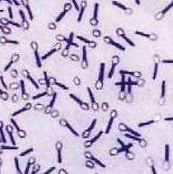
Clostridium tetani
Morphology and Physiology-
• Long thin gram-positive organism
• Round terminal spore gives drumstick appearance
• Motile by peritrichous flagella
• grow on blood agar or cooked meat medium with swarming
• beta-hemolysis exhibited by isolated colonies.

Slide 9
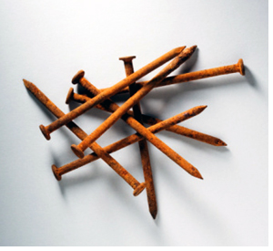
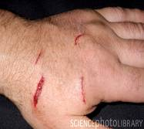
Tetanus is acquired through contact with the environment.
  The mode of entry is wounds ((such as those caused by rusty nails)

Slide 10
Toxin
-The vegetative cells of C. tetani produce the plasmid-encoded toxin tetanospasmin (150 kDa).
-Sensitive to heat. ineffective after 65℃, 30min
- The toxin is produced during cell growth. It migrates along neural paths from a local wound to sites of action in the central nervous system.
-Toxin blocks release of inhibitory neurotransmitters; continuous stimulation by excitatory transmitters
muscle spasms (spastic paralysis), (trismus (lockjaw), risus sardonicus, opisthotonos, cardiac arrhythmias, fluctuations in blood pressure.

Slide 11
Prevention and Treatment
The results of treatment of tetanus are not satisfactory. Therefore, prevention is all important. Prevention of tetanus depends on:
(1) Active immunization with toxoids,
A combined vaccine, DPT vaccine, which includes
vaccines against diphtheria, pertussis, and tetanus.
(2) aggressive wound care,
(3) prophylactic use of antitoxin.
(4) administration of penicillin.

Slide 12
C. Perfringens
• Large, rectangular bacilli (rod) staining gram-positive
• Spores are ovoid and sub terminal.

Slide 13
Toxins
The alpha toxin of C. perfringens type A is a lecithinase, splits lecithin (an important constituent of cell membranes). Alpha toxin also aggregates platelets, destruction of viable tissue (gas gangrene).
The theta toxin; cytolysins that act by forming pores in cell membranes.
Epsilon toxin is a protein that causes edema, and hemorrhage
DNase and hyaluronidase, collagenase.
some strains of C perfringens produce enterotoxin (C. perfringens enterotoxin, CPE) that cause food poisoning.

Slide 14
Pathogenesis
Gas gangrene occurs when spores reach tissue either by contamination from soil and feces. The spores germinate, vegetative cells multiply, ferment carbohydrates present in
tissue, and produce gas.
Food poisoning usually follows the ingestion of bacterial cells that have grown in warmed meat dishes. The toxin forms when the organisms germinate in the gut, with the onset of diarrhea –usually without vomitting or fever--- in 6-18 hours.
Uterine infections

Slide 15
Diagnostic Laboratory Tests
Specimens consist of material from wounds, pus, and tissue.
Gram Stain The presence of large gram-positive rods in Gram-stained smears suggests gas gangrene clostridia; spores are not regularly present.
Lecithinase activity is evaluated by the precipitate formed around colonies on egg yolk media.
stormy" fermentation of milk due to large amounts of acid and gas from lactose
double zone of hemolysis on blood agar.

Slide 16
Treatment
The most important aspect of treatment is the removal of necrotic tissue (surgical debridement)
Administration of antimicrobial drugs, particularly penicillin, is begun at the same time.
Hyperbaric oxygen may be of help in the medical management of clostridial tissue infections.
Antitoxins.

Slide 17
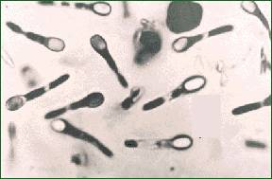
Clostridium difficile
A spore-forming anaerobic rods (bacillus), gram-positive.
C. difficile causes antibiotic-associated diarrhea (AAD) and pseudomembranous colitis in humans.
Administration of antibiotics results in proliferation of drug-resistant C difficile that produces two toxins:
Toxin A, a potent enterotoxin that also has some cytotoxic activity, binds to the brush border membrane of the gut at receptor sites.
Toxin B is a potent cytotoxin.
The methods in detecting C. difficile toxins are:
enzyme immunoassay (EIA).
enzyme-linked immunosorbent assay (ELISA).

