Slide 1
Medical Microbiology
3rd lecture
Dr Fitua Al-Saedi

Slide 2
Bacillus Species
The genus Bacillus includes large aerobic,
spore-forming, Gram-positive rods occurring in chains.
Most members of this genus are saprophytic organisms
prevalent in soil, water, air and on vegetation,
such as Bacillus subtilis & B. cereus .
Some are insect pathogens, such as B. thuringiensis . This
organism is also capable of causing disease in humans.
B. cereus can grow in foods and cause food poisoning by producing either an enterotoxin (diarrhea) or an emetic toxin (vomiting).
B. anthracis, which causes anthrax, is the principal pathogen
of the genus.

Slide 3
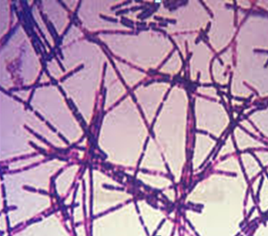
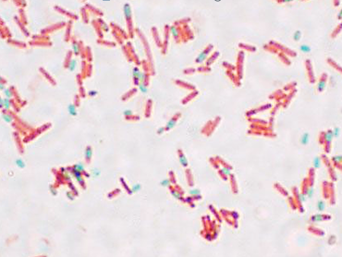
Morphology and identification
A. Typical Organisms
The typical cells, measuring 1 × 3–4 μm, have square ends and are arranged in long chains; spores are located in the center of the bacterial cell.

Slide 4
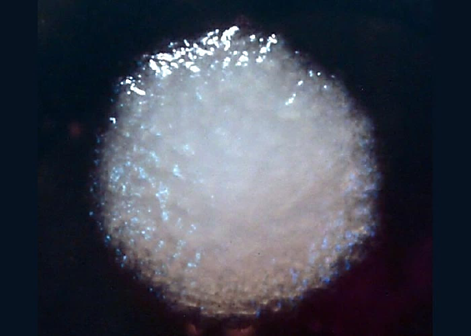
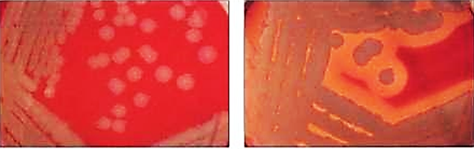

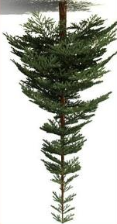
…..Morphology and identification
B. Culture
Colonies of B. anthracis are flat or slightly convex with irregular edge and have a
ground-glass appearance in transmitted light.
Bacillus cereus colonies are large flat and dry.
Hemolysis is uncommon with
B anthracis but common with B cereus.
B. anthracis
B. cereus
Gelatin is liquefied by B. cereus.
B. anthracis growth in gelatin stabs resembles an inverted fir tree.

Slide 5
C. growth Characteristics
The bacilli use simple sources of nitrogen and carbon for energy and growth.
The spores are resistant to environmental changes, withstand dry heat and certain chemical disinfectants for moderate periods, and persist for years in dry earth. Animal products contaminated with anthrax spores (eg, hides, bristles, hair, wool, bone) can be sterilized by autoclaving.

Slide 6
Bacillus anthracis
Pathogenesis
Anthrax is primarily a disease of herbivores—goats, sheep, cattle, horses, and so on; other animals (eg, rats) are relatively resistant to the infection.
In animals, the entry of spores is via mouth and the gastrointestinal tract.
Clinical infections in humans,
Humans become infected incidentally by contact with infected animals or their products. B anthracis causes three categories of disease in humans depending on the point of entry of the spores:
Cutaneous anthrax (95%) : the infection is usually acquired
by the entry of spores through injured skin.
inhalation anthrax or wool sorters’ disease (5%): inhalation of the spores from the dust of wool, hair, or hides.
Gastrointestinal anthrax (rare): the infection is acquired by ingestion of contaminated meat.

Slide 7
Virulence factors
The poly-d-glutamic acid capsule is anti-phagocytic. The capsule gene is present on a plasmid, pXO2.
Anthrax toxins are made up of three proteins:
Protective antigen (PA),
Edema factor (EF),
Lethal factor (LF).
PA binds to specific cell receptors, and after proteolytic activation,
it forms a membrane channel that mediates entry of EF and LF into the cell. EF with PA, it forms a toxin known as edema toxin.
LF plus PA form lethal toxin, which is a major virulence factor and cause of death in infected animals and humans. The anthrax toxin genes are encoded on plasmid, pXO1.

Slide 8
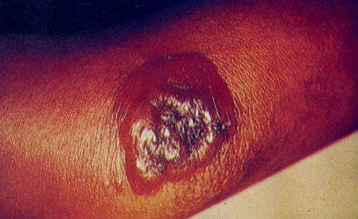
Cutaneous anthrax
-95% human cases are cutaneous
infections
-1 to 5 days after contact
-Small, pruritic, non-painful papule at inoculation site
-Papule develops into hemorrhagic vesicle & ruptures
-Slow-healing painless ulcer covered with black eschar surrounded by edema
Infection may spread to lymphatics .
-Septicemia may develop.

Slide 9
Diagnostic Laboratory Tests
Specimens to be examined are fluid or pus from a local lesion, blood, pleural fluid, and cerebrospinal fluid in inhalational anthrax associated with sepsis and stool or other
intestinal contents in the case of gastrointestinal anthrax.
Stained smears
Gram stain show chains of large gram-positive rods
Culture
When grown on blood agar plates, the organisms produce
Non-hemolytic gray to white, tenacious colonies with a rough
texture and a ground-glass appearance. Comma-shaped
outgrowths (Medusa head, “curled hair”) may project from
the colony.
In semisolid medium, anthrax bacilli are always non-motile.

Slide 10
…..Diagnostic Laboratory Tests
Clinical laboratories that recover large gram-positive rods from blood, cerebrospinal fluid, or suspicious skin lesions, which phenotypically match the description of B anthracis as mentioned, should immediately contact their public health laboratory and send the organism for confirmation.
Definitive identification requires lysis by a specific anthrax -bacteriophage,
Detection of the capsule by fluorescent antibody,
identification of toxin genes by polymerase chain reaction (PCR),
- Enzyme-linked immunoassay (ELISA)

Slide 11
Vaccines
(AVA BioThrax)
In the United States, the current FDA-approved vaccine (AVA BioThrax) is made from the supernatant of a cell free culture of an unencapsulated but toxigenic strain of B. anthracis.
Dosage:
The dose schedule is 0.5 mL administered intramuscularly
at 0, and 4 weeks and then at 6, 12, and 18 months followed by annual boosters. The vaccine is available only to the U.S.
Department of Defense and to persons at risk for repeated exposure to B anthracis.
Raxibacumab is a human monoclonal antibody against Bacillus anthracis protective antigen PA

Slide 12
Treatment
Ciprofloxacin
Penicillin G, along with gentamicin or streptomycin.

Slide 13
Bacillus cereus
Produces emetic toxin and enterotoxins.
Food poisoning caused by B cereus has two distinct forms,
Emetic type, which is associated with fried rice.
nausea, vomiting, abdominal cramps, and occasionally diarrhea
Incubation period 1–5 hours.
Diarrheal type, which is associated with meat dishes and sauces.
Incubation period of 1–24 hours
diarrhea with abdominal pain and cramps; fever and
vomiting are uncommon.
Eye infections,
Endocarditis, meningitis, osteomyelitis, and pneumonia.

Slide 14
Treatment
Vancomycin or
Clindamycin with or without an aminoglycoside.

Slide 15
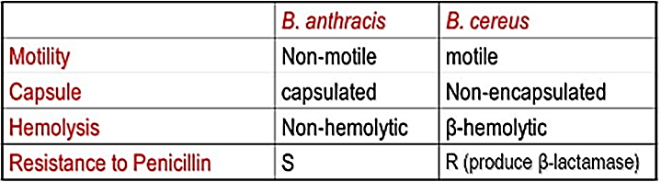
Differences between B. anthracis and B. cereus

