Slide 1
English Language
1st stage
Dr Fitua Al-Saedi

Slide 2
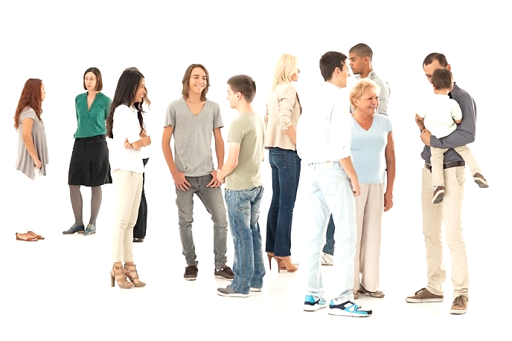
How to Confidently Introduce Yourself in English
1. Break the Ice
“Break the ice” is a common English expression. It means “to get comfortable with someone.”
The easiest way: just say hello and your name.
Ahmed: Hello. I’m Ahmed
Emily: Hello, I’m Emily.
Ahmed: Nice to meet you.

Slide 3
How to Confidently Introduce Yourself in English
Another good way to break the ice is to ask for very basic information. This gives you a reason for starting the conversation.
Here are some examples:
Excuse me, do you know what time it is?
Sorry to bother you, but where is the meeting?
Excuse me, are you going to the library?
Another great ice breaker is a compliment
I love your dress.
You have a beautiful cat.
Is that your car? I really like it.

Slide 4
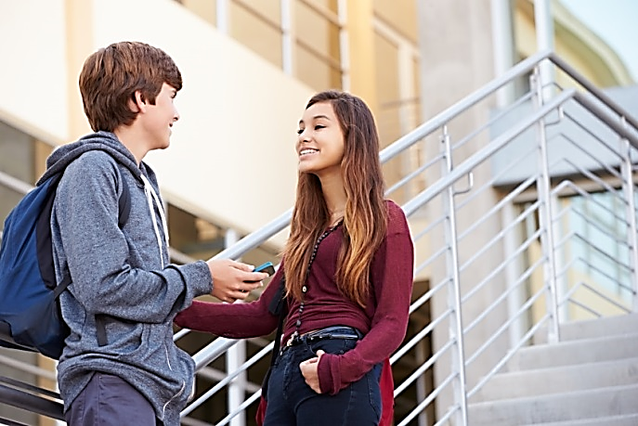
How to Confidently Introduce Yourself in English
2. Ask Follow-up Questions
You need to keep the conversation going.
To do this, have more simple questions ready.
Here are some examples:
How are you?
Where are you from?
Are you having a good time?

Slide 5

How to Confidently Introduce Yourself in English
3. Listen and Ask More Questions
4. Smile and Be Confident

Slide 6

Read the following:
Pablo Hello. I’m Pablo. What's your name?
Ahmed My name’s Ahmed
Pablo Hello, Ahmed
Stand up and practice
Hello. I’m-----------.
What's your name?
My name’s -------------.
Grammar Spot
I'm= I am
Name’s= Name is
What's= What is

Slide 7
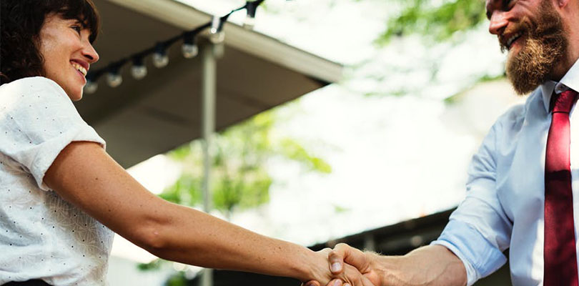
Read the following:
Judy Hello. My name’s Judy.
Robert Hello. I'm Robert.
Nice to meet you
Judy And you.
Practice in pairs
A Hello. My name’s -------
B Hello. I'm ----------------
Nice to meet you
A And you.

Slide 8
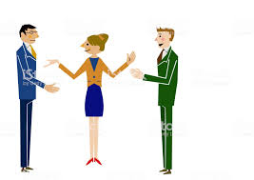
Pablo Ben, this is Ahmed.
Ahmed, this is Ben.
Ahmed Hello, Ben.
Ben Hello, Ahmed.
Practice in group of three
---------------, this is ----------------
----------, this is ------------
Hello, ------------------------
Hello, ------------------------

Slide 9
How are you?
Pablo Hi, Ben. How are you?
Ben Fine, thanks, Pablo. And you?
Pablo I'm OK, thanks.
Pablo Hello, Ben. How are you?
Ben Very well, thank you. How are you?
Pablo Fine.

Slide 10
Complete conversations
A Hello. ---------- name’s Anna.
----------------your name?
B ------- ------------- Marie.
A Max, -----------------------is Carla.
B Hi, Carla.
C Hello, Max. --------------------- to meet you.
A Hi, Eda.----------- are you?
B Fine, thanks, David.
And -----------?
A ----------------well, thanks.

Slide 11
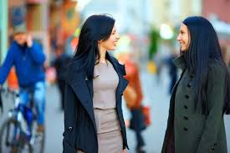
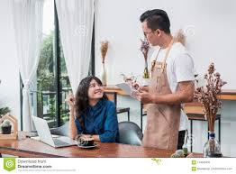
Every Day English
A Good morning
B Good morning
What a lovely day!
A Good afternoon
B Good afternoon
A cup of tea, please.
A Goodbye
B Bye! See you later.
B Have a nice day.
A Good night
B Good night! Sleep well.

Slide 12

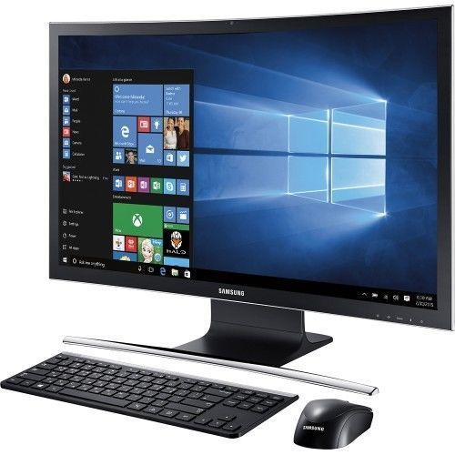
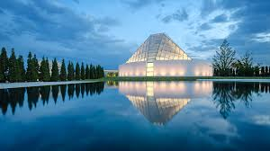
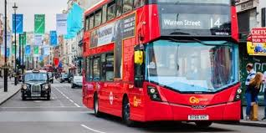
What's this in English?
It’s a book.
Grammar spot
It’s = It is
Practise
What's this in English?
It’s a---------.
photograph
bus
television

Slide 13
Plurals
Most singular nouns are made plural by simply putting an -s at the end. There are many different rules regarding pluralization depending on what letter a noun ends in. Irregular nouns do not follow plural noun rules, so they must be memorized or looked up in the dictionary.
Plural Noun Rules
To make regular nouns plural, add ‑s to the end.
cat – cats
house – houses
If the singular noun ends in ‑s, -ss, -sh, -ch, -x, or -z, add ‑es to the end to make it plural.
truss – trusses
bus – buses
marsh – marshes
lunch – lunches
tax – taxes
blitz – blitzes

Slide 14
In some cases, singular nouns ending in -s or -z, require that you double the -s or -z prior to adding the -es for pluralization.
fez – fezzes
gas –gasses
If the noun ends with ‑f or ‑fe, the f is often changed to ‑ve before adding the -s to form the plural version.
wife – wives
wolf – wolves
Exceptions:
roof – roofs
belief – beliefs
chef – chefs
chief – chiefs

Slide 15
If a singular noun ends in ‑y and the letter before the -y is a consonant, change the ending to ‑ies to make the noun plural.
city – cities
If the singular noun ends in -y and the letter before the -y is a vowel (o,a,I,e,u) , simply add an -s to make it plural.
ray – rays
boy – boys
If the singular noun ends in ‑o, add ‑es to make it plural.
tomato – tomatoes
Exceptions:
photo – photos
piano – pianos
halo – halos

Slide 16
If the singular noun ends in ‑us, the plural ending is frequently ‑i.
cactus – cacti
focus – foci
If the singular noun ends in ‑is, the plural ending is ‑es.
analysis – analyses
ellipsis – ellipses
If the singular noun ends in ‑on, the plural ending is ‑a.
phenomenon – phenomena
criterion – criteria
Some nouns don’t change at all when they’re pluralized.
sheep – sheep
series – series
species – species
deer –deer

Slide 17
Plural Noun Rules for Irregular Nouns
Irregular nouns follow no specific rules, so it’s best to memorize these or look up the proper pluralization in the dictionary.
child – children
goose – geese
man – men
woman – women
tooth – teeth
foot – feet
mouse – mice
person – people

Slide 18
Quiz
Choose the correct form of the noun in each sentence.
1)I have three (child, children).
2)There are five (man, men) and one (woman, women).
3)(Baby, Babies) play with bottles as toys.
4)I put two big (potato, potatoes) in the lunch box.
5)I saw a (mouse, mice) running by.
6)There are few (bus, buses) on the road today.

Slide 19

Your World
Where are you from?
I'm from Iraq.
What's her name?
Her name’s Miki.
Where's she from?
She's from Japan.
What’s his name?
His name’s Ahmed.
Where's he from?
He’s from Egypt.
Grammar Spot
Where’s= where is
He's= He is
She's = She is

Slide 20
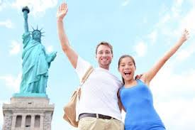
Reading
Claude and Holly from Montreal, in Canada. They are on holiday in New York City. Holly is from Canada and Claude is from France. They are Married. Holly is a teacher. Her school is in the centre of Montreal. Claude is a doctor. His hospital is in the centre of Montreal, too.
Complete the sentences
1- Holly is from -------------------------in Canda.
2- She's a ----------------------------------.
3- Her -------------------------------in the centre of Montreal.
4- Claude is from --------------------------.
5- He’s a ---------------------------------.
6- His hospital is in the ---------------------------of Montreal.
7- They ------------------------------in New York.
8 They are-------------------------.

Slide 21

Look at
Look at the weather!
It’s awful.
Look at the building!
It’s fantastic.
Practice
Look at the --------------------.
It’s --------------------------------.

