Slide 1
Limits and Continuity
. Overview Mathematicians of the seventeenth century were keenly interested in the study of motion for objects on or near the earth and the motion of planets and stars. This study involved both the speed of the object and its direction of motion at any instant, and they knew the direction at a given instant was along a line tangent to the path of motion.
The concept of a limit is fundamental to finding the velocity of a moving object and the tangent to a curve. In this chapter we develop the limit, first intuitively and then formally.
We use limits to describe the way a function varies. Some functions vary continuously; small changes in x produce only small changes in ƒ(x). Other functions can have values that jump, vary erratically, or tend to increase or decrease without bound.

Slide 2
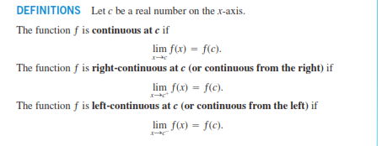
Continuous Funcation

Slide 3
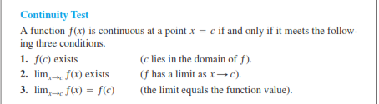

Slide 4
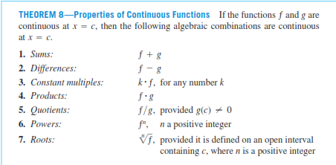

Slide 5


