Slide 1
Statistics
Introduction And Definitions

Slide 2
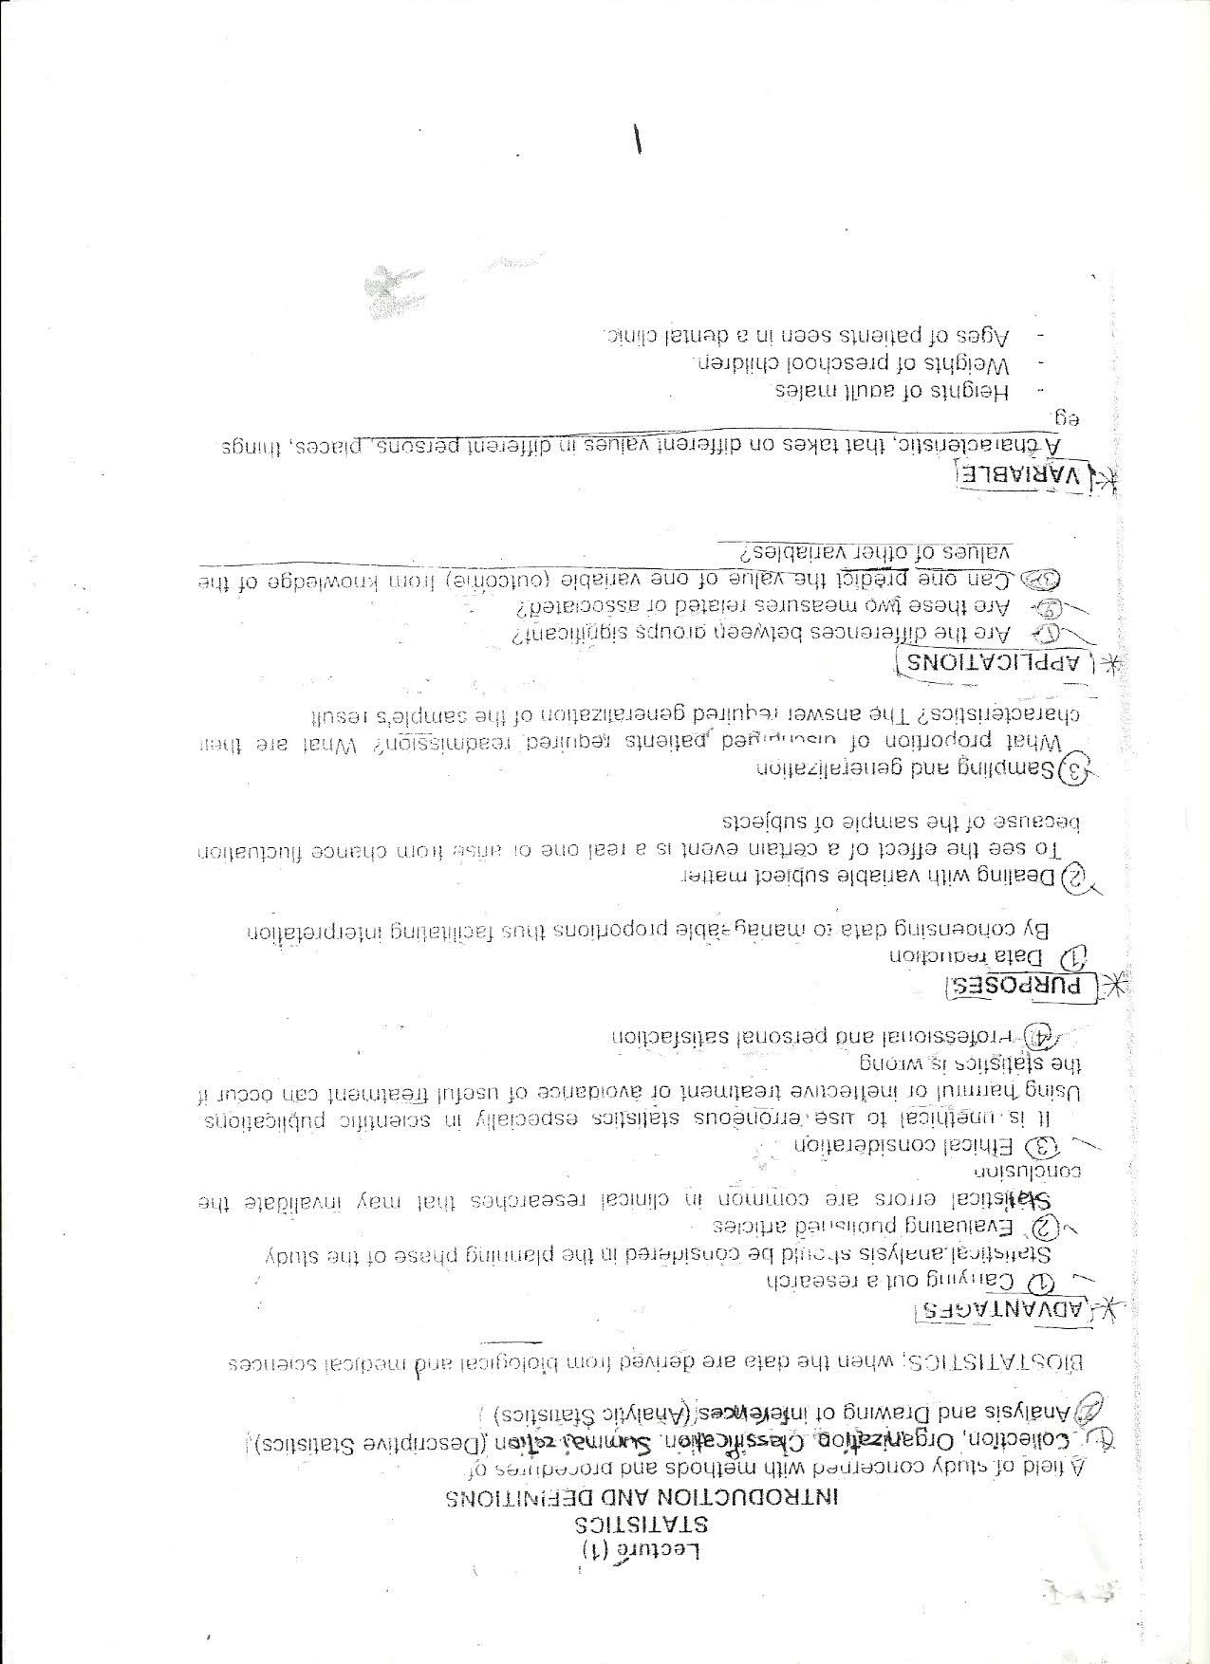

Slide 3
