Slide 1
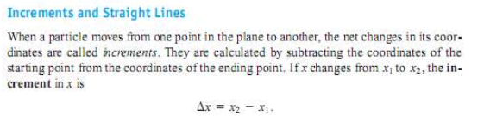
1.3 Slope and equation for lines

Slide 2
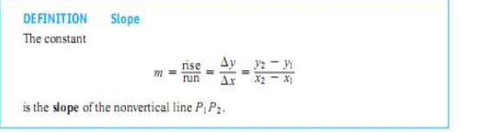
Slope

Slide 3
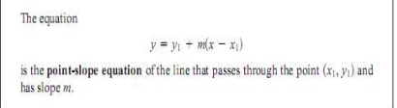
Equation of line

Slide 4

Equation of line

Slide 5
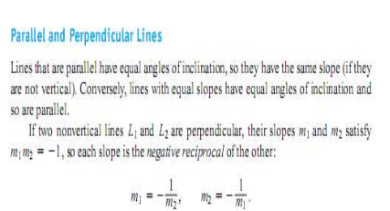
Slope

Slide 6
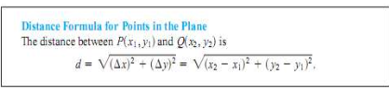
Distance between to points

