Slide 1
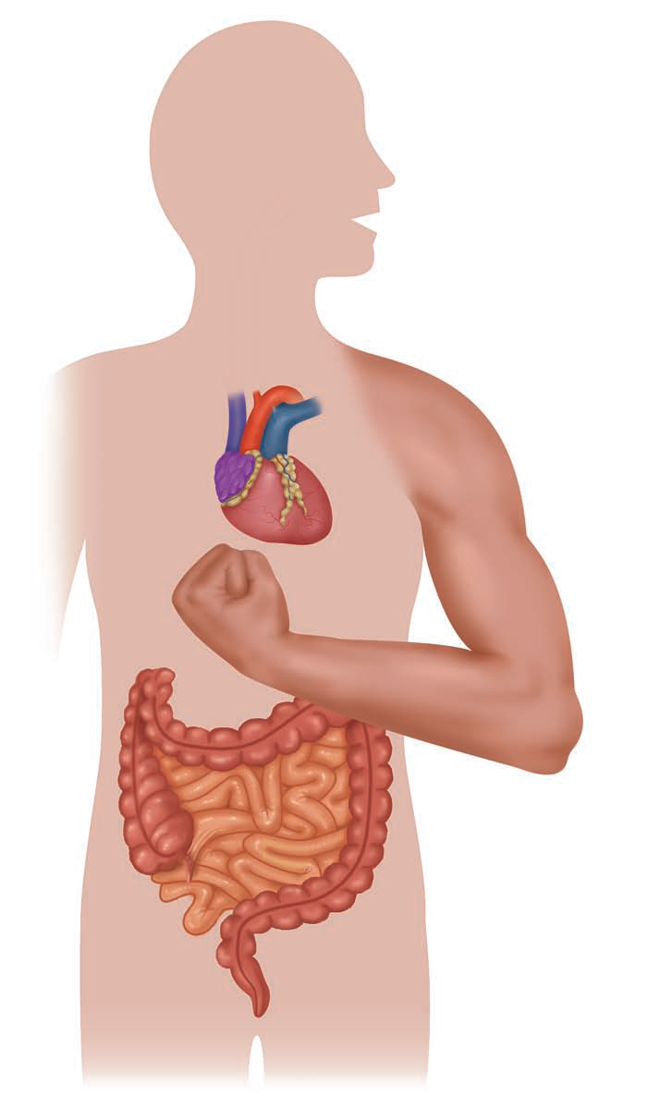
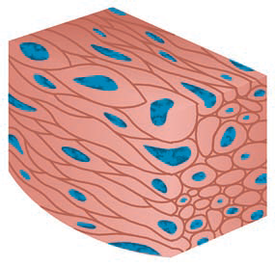
Muscle Tissue

Slide 2
Muscle cells are structurally and functionally specialized for contraction, which contain two types of special protein filaments called myofilaments; including thin filaments containing actin and thick filaments containing myosin.

Slide 3
There are types of muscles:-
Skeletal muscles fibers: is found mainly in association with bones.
Cardiac muscles fibers: is found exclusively in the walls of the heart .
Smooth muscle fibers: is found mainly in the walls of hollow organs (eg, intestines and blood vessels).
All muscle tissues consist of elongated cells called fibers.
The cytoplasm of muscle cells is called sarcoplasm and the surrounding cell membrane or plasma lemma is called sarcolemma.
Each muscle fiber sarcoplasm contains numerous myofibrils, which contain two types of contractile protein filaments, actin and myosin.

Slide 4
Smooth Muscle | Cardiac Muscle | Skeletal Muscle | Features
No | Yes | Yes | Striations
Short, spindle shaped | Short, branched | Long, cylindrical, unbranched | Fibers
Single, central in cell | Single, central in cell | Multiple, peripheral in cell | Nuclei
No | Intercalated disks | No | Cell junctions
Yes, mitosis | No | Yes, satellite cells | Regeneration
Involuntary | Involuntary | Voluntary movement | Main function

Slide 5
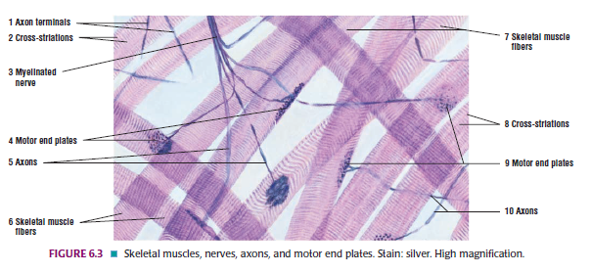

Slide 6
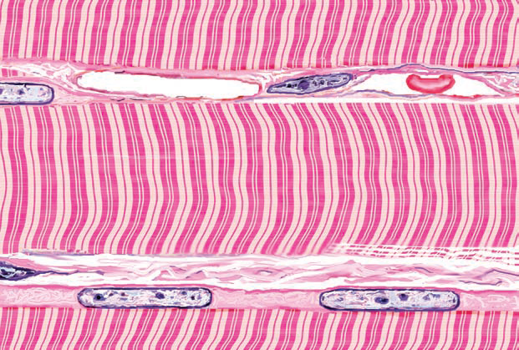
Transmission Electron Microscopy of Skeletal Muscle
I band
Z lines
A band
M line
Sarcomere

Slide 7
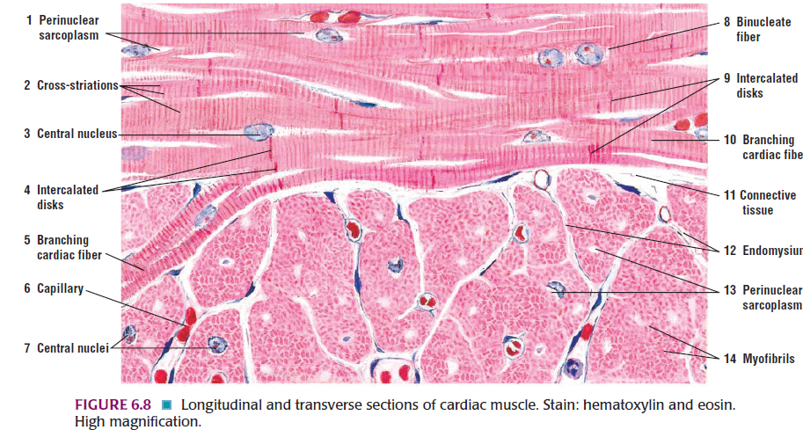

Slide 8
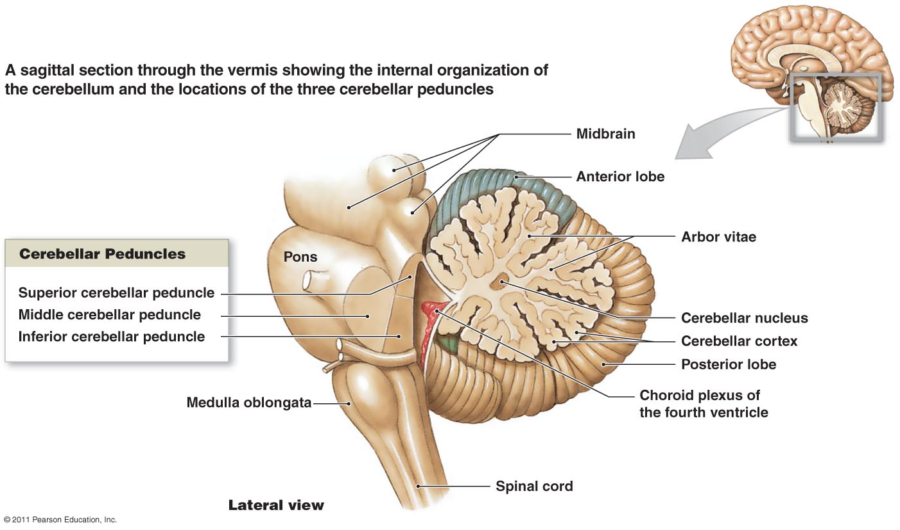
The Mammalian Nervous System
Nervous Tiss

Slide 9
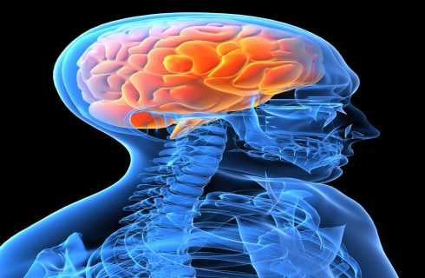
Nervous Tissue
What is the Human Nervous System?
Nervous system (NS) is the most complex but by body weight is one of the smallest organ systems
The function of the nervous system (N.S )is to receive stimuli from outside or inside and transferring them toward highly specialized central part and spinal cord.
nervous system is divided into:
1-Central nervous system CNS represented (brain and spinal cord).
2-Peripheral nervous system PNS represented (the nerve and ganglia.
There are two types of cells in c.N.S.:
A-Neuron (nerve cell).
B-Supportive cells or neuroglia.

Slide 10
Neuron
Neuron Has 4 Main Parts:
- Cell Body or Soma, Region Around The Nucleus
- Dendrites, Branch From The Soma And Each Branch Has Fine Processes Called Dendritic Spines
- Axon, Elongated Process Attached To The Soma
- Synaptic Terminals, End of The Axon That Communicates With Another Cell
Some Axons Are Surrounded By A Lipid-rich Sheath Called Myelin, Which Facilitates The Rapid Conduction Of Action Potentials.

Slide 11
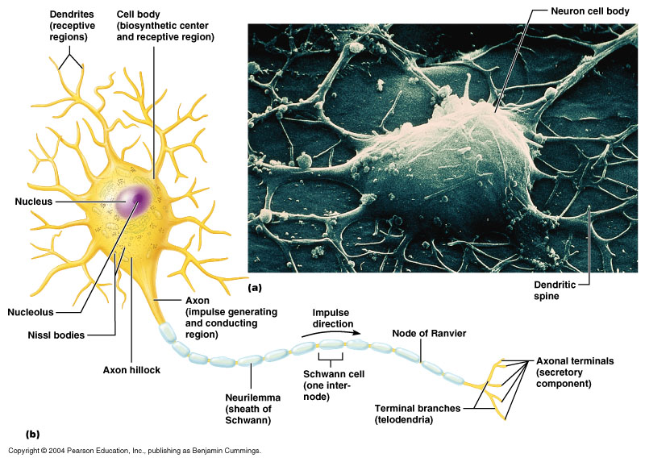

Slide 12
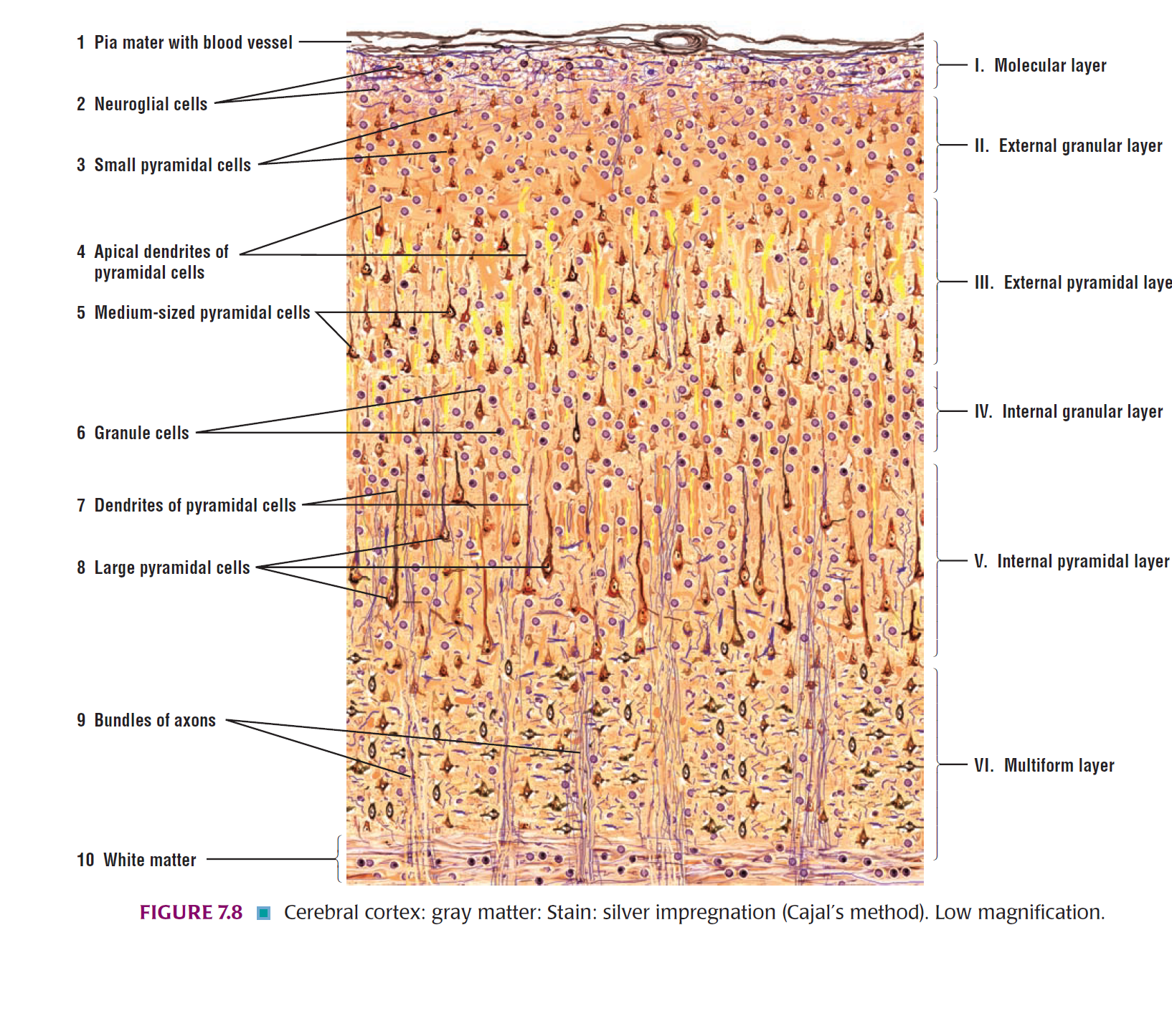
Various forms of neurons.
Pyramidal cell from the cerebral cortex.
B. Cerebellar Purkinje cell.

Slide 13
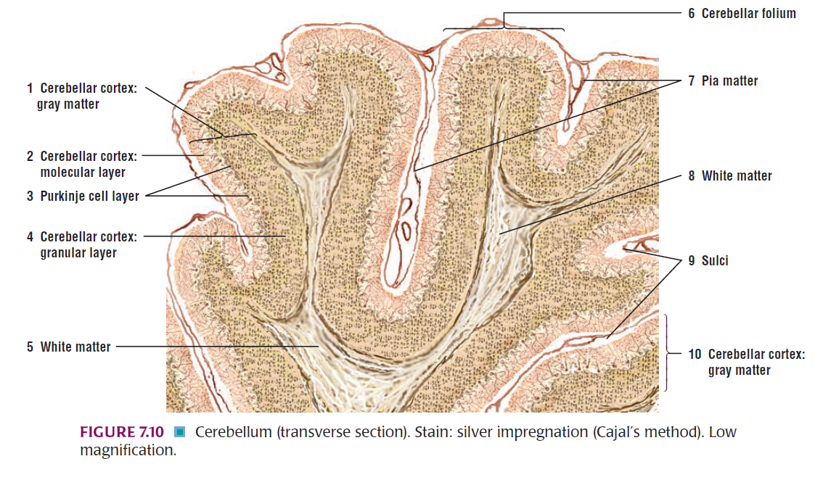

Slide 14
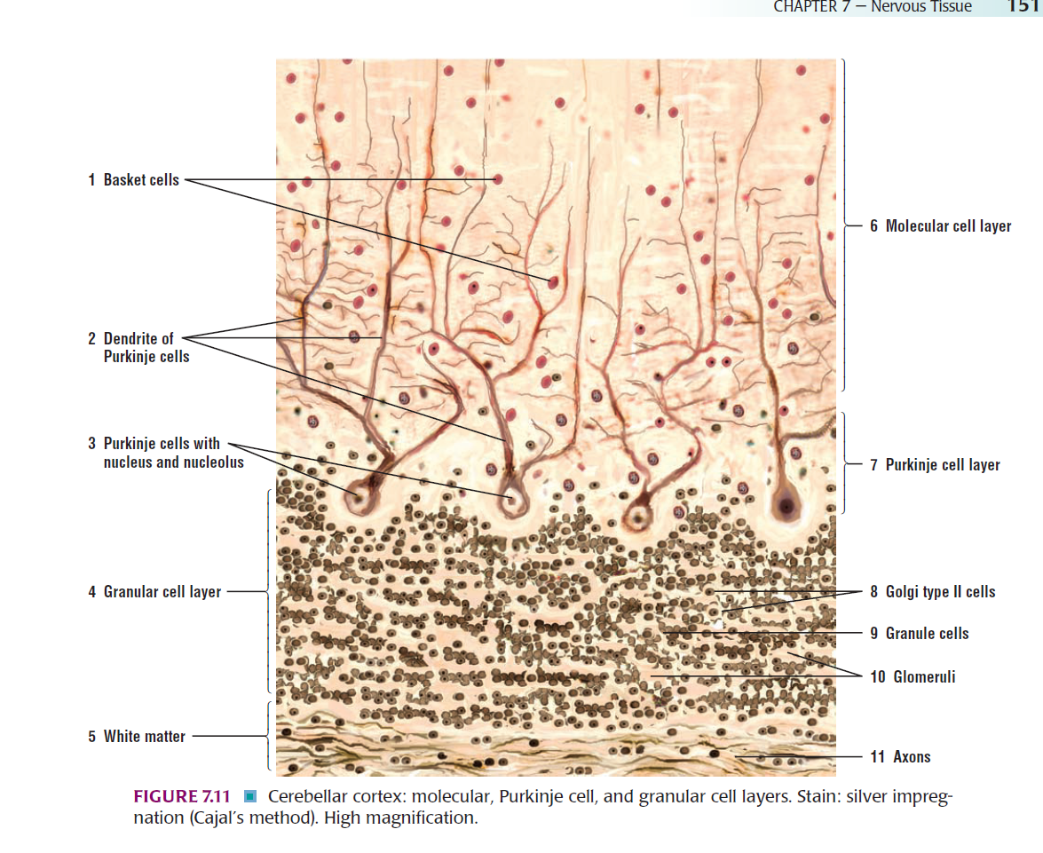

Slide 15
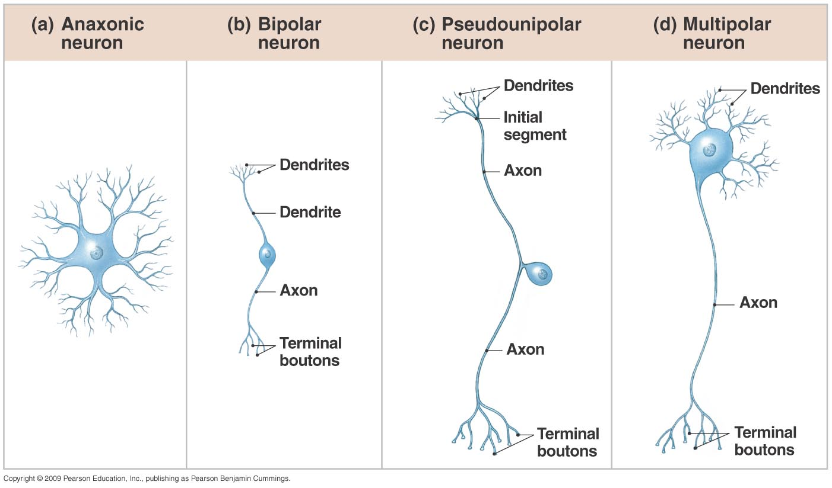
Figure 13.10 A Structural Classification of Neurons
Copyright © 2009 Pearson Education, Inc., publishing as Pearson Benjamin Cummings

Slide 16
NEUROGLIA
Six types of cells
4 in CNS
2 in PNS

Slide 17
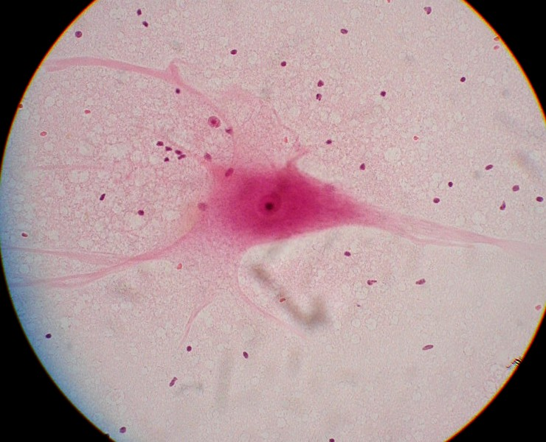
Neuronal cell under light microscope

Slide 18
Thank you

