Slide 2
Voltage-gated ion channels Transmembrane ion channels regulated by changes in membrane potential
Ligand-gated ion channels Transmembrane ion channels that are regulated by interactions between neurotransmitters and their receptors (also called ionotropic receptors)
Metabotropic receptors G-protein-coupled receptors that respond to neurotransmitters either by a direct action of G proteins on ion channels or by G-protein-enzyme activation that leads to formation of diffusible second messengers
EPSP Excitatory postsynaptic potential; a depolarizing potential change
IPSP Inhibitory postsynaptic potential; a hyperpolarizing potential change
Synaptic mimicry Ability of an administered chemical to mimic the actions of the natural neurotransmitter: a criterion for identification of a putative neurotransmitter

Slide 6
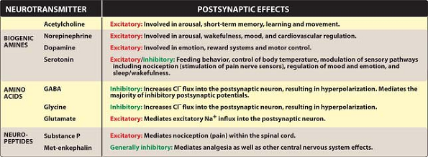

Slide 7
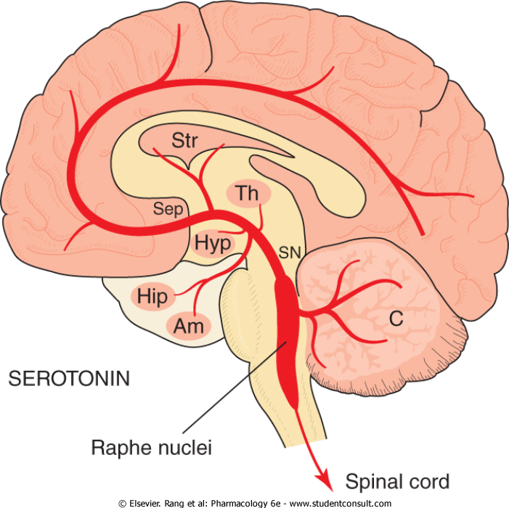

Slide 8
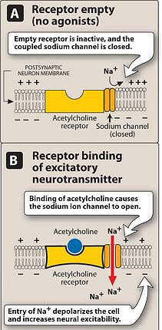

Slide 10
Checklist When you complete this chapter, you should be able to: Explain the difference between voltage-gated and ligand-gated ion channels. List the criteria for accepting a chemical as a neurotransmitter. Identify the major excitatory and inhibitory CNS neurotransmitters in the CNS. Identify the sites of drug action at synapses and the mechanisms by which drugs modulate synaptic transmission. Give an example of a CNS drug that influences neurotransmitter functions at the level of (a) synthesis, (b) metabolism, (c) release, (d) reuptake, and (e) receptor.

