Slide 3
High-Yield Terms to Learn
Abstinence syndrome A term used to describe the signs and symptoms that occur on withdrawal of a drug in a dependent person
Addiction Compulsive drug-using behavior in which the person uses the drug for personal satisfaction, often in the face of known risks to health; formerly termed psychological dependence
Controlled substance A drug deemed to have abuse liability that is listed on governmental Schedules of Controlled Substances.ª Such schedules categorize illicit drugs, control prescribing practices, and mandate penalties for illegal possession, manufacture, and sale of listed drugs. Controlled substance schedules are presumed to reflect current attitudes toward substance abuse; therefore, which drugs are regulated depends on a social judgment
Dependence A state characterized by signs and symptoms, frequently the opposite of those caused by a drug, when it is withdrawn from chronic use or when the dose is abruptly lowered; formerly termed physical or physiologic dependence
Designer drug A synthetic derivative of a drug, with slightly modified structure but no major change in pharmacodynamic action. Circumvention of the Schedules of Controlled Drugs is a motivation for the illicit synthesis of designer drugs
Tolerance A decreased response to a drug, necessitating larger doses to achieve the same effect. This can result from increased disposition of the drug (metabolic tolerance), an ability to compensate for the effects of a drug (behavioral tolerance), or changes in receptor or effector systems involved in drug actions (functional tolerance)

Slide 4
Schedules of controlled drugs.ª
I :No medical use; high addiction potential, Flunitrazepam, heroin, LSD, mescaline, PCP, MDA, MDMA, STP
II: Medical use; high addiction potential, barbiturates, strong opioids Amphetamines, cocaine, methylphenidate, short acting
III: Medical use; moderate abuse potential moderate, opioid agonists Anabolic steroids, barbiturates, dronabinol, ketamine
IV :Medical use; low abuse potential, Benzodiazepines, chloral hydrate, mild stimulants (eg, phentermine, sibutramine), most hypnotics (eg, zaleplon, zolpidem), weak opioids

Slide 5
Signs and symptoms of overdose and withdrawal from selected drugs of abuse.
Amphetamines, methylphenidate, cocaineª Agitation, hypertension, tachycardia, delusions, hallucinations, hyperthermia, seizures, death Apathy, irritability, increased sleep time, disorientation, depression
Barbiturates, benzodiazepines,
ethanol^{b} Slurred speech, "drunken" behavior, dilated pupils, weak and rapid pulse, clammy skin, shallow respiration, coma, death Anxiety, insomnia, delirium, tremors, seizures, death
Heroin, other strong opioids
Constricted pupils, clammy skin, nausea, drowsiness, respiratory depression, coma, death Nausea, chills, cramps, lacrimation, rhinorrhea, yawning, hyperpnea, tremor

Slide 8
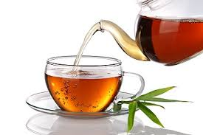

Slide 9
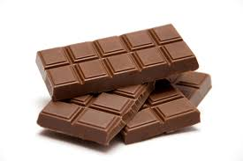

Slide 10
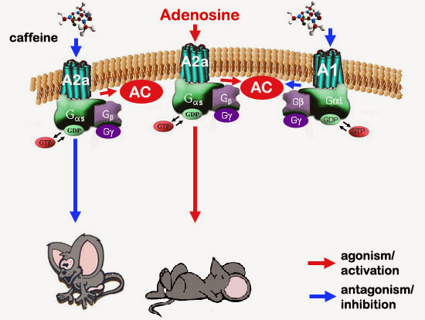

Slide 14
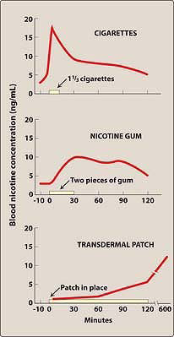

Slide 16
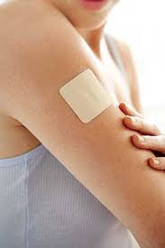

Slide 17
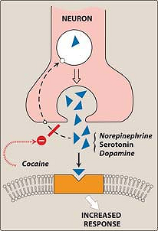

Slide 20
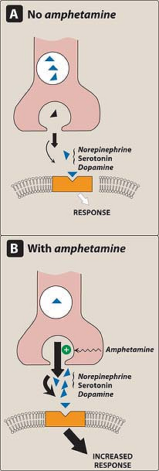

Slide 22
Checklist
When you complete this chapter, you should be able to:
Identify the major drugs that are commonly abused.
Describe the signs and symptoms of overdose with, and withdrawal from, CNS stimulants, opioid analgesics, and sedative-hypnotics, including ethanol.
Describe the general principles of the management of overdose of commonly abused drugs.
Identify the most likely causes of death from commonly abused drugs.

Slide 23
A very agitated young male was brought to the emergency room by the police. Psychiatric examination
revealed that he had snorted cocaine several times in the past few days, the last time being 10 hours
previously. He was given a drug that sedated him, and he fell asleep. The drug that was used to counter this
patient's apparent cocaine wihdrawal was very likely:
A. Phenobarbital.
B. Lorazepam.
C. Cocaine.
D. Hydroxyzine.
E. Fluoxetine.

