Slide 2
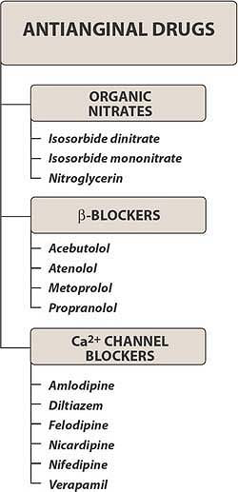

Slide 3
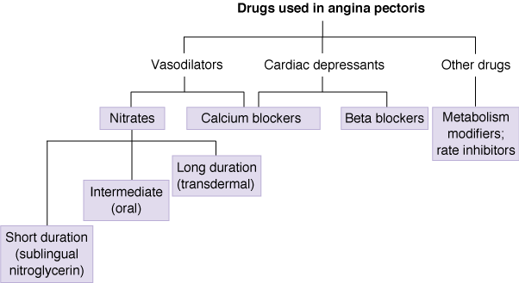

Slide 4
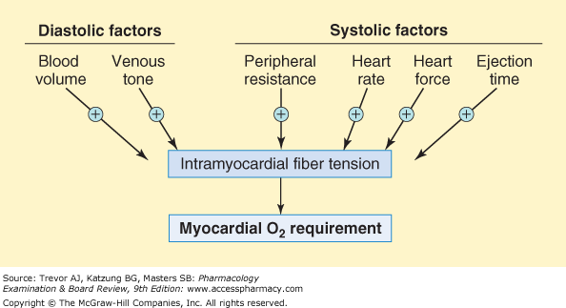

Slide 5
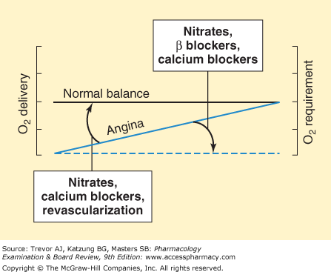

Slide 7
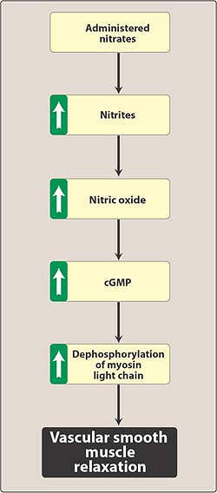

Slide 8
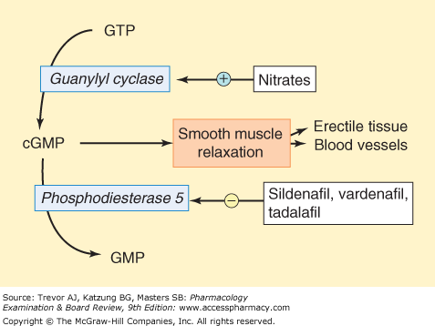

Slide 9
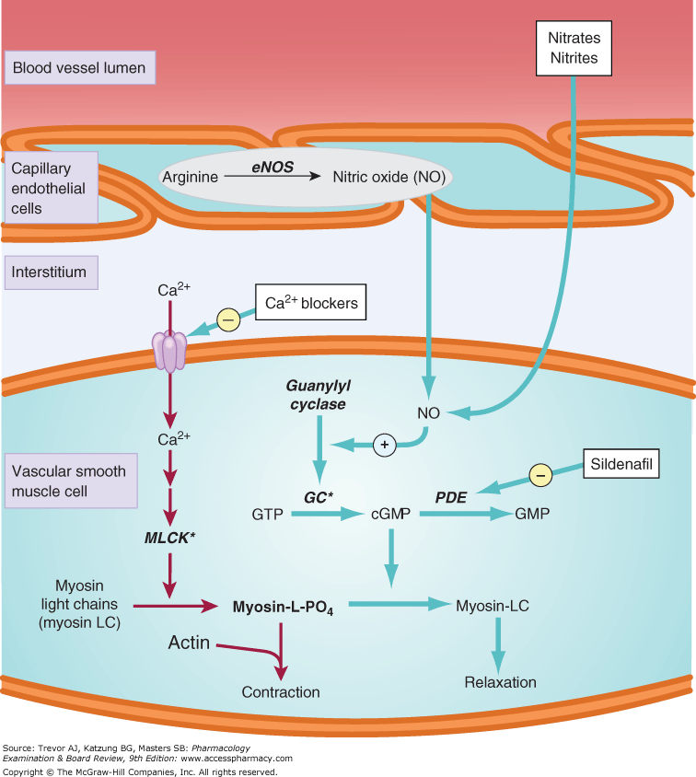

Slide 10
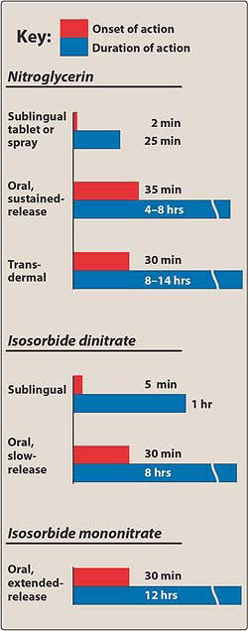

Slide 11
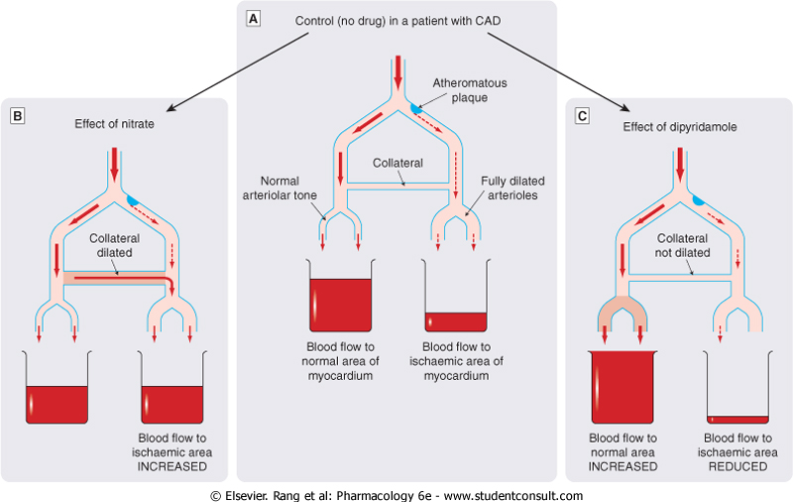

Slide 12
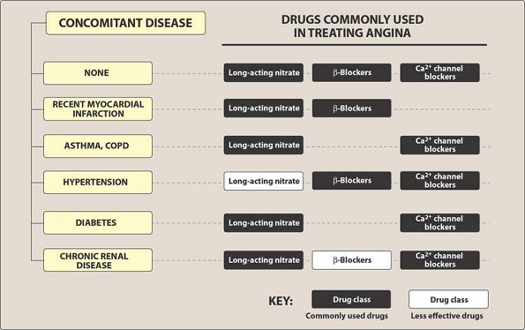

Slide 14
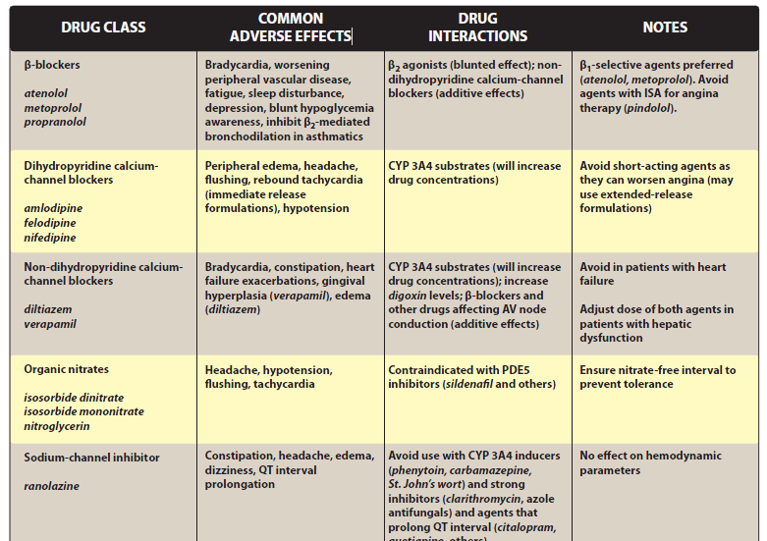

Slide 15
Checklist
When you complete this chapter, you should be able to:
Describe the pathophysiology of effort angina and vasospastic angina.
List the major determinants of cardiac oxygen consumption.
List the strategies and drug targets for relief of anginal pain.
Contrast the therapeutic and adverse effects of nitrates, blockers, and calcium channel blockers when used for angina.
Explain why the combination of a nitrate with a blocker or a calcium channel blocker may be more effective than either alone.
Explain why the combination of a nitrate and sildenafil is potentially dangerous.
Contrast the effects of medical therapy and surgical therapy of angina.

Slide 16
A 68-year-old man has been successfully treated for exercise-induced angina for several years. He
recently has been complaining about being awakened at night with chest pain. Which of the following drugs
would be useful in preventing this patient's nocturnal angina?
A. Amyl nitrite.
B. Nitroglycerin (sublingual).
C. Nitroglycerin (transdermal).
D. Esmolol.
E. Hydralazine.

