Slide 1
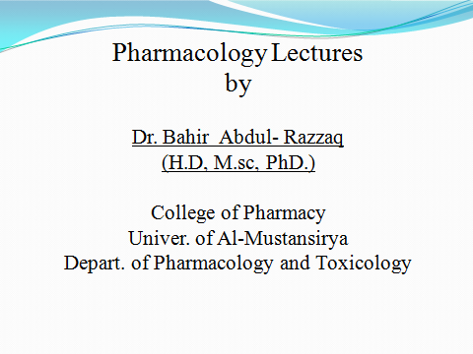

Slide 2
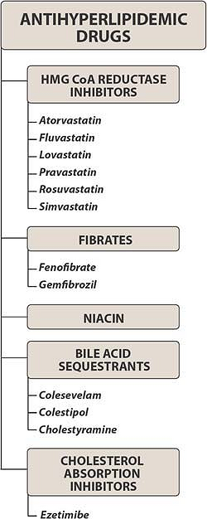

Slide 3
Lipoproteins Macromolecular complexes in the blood that transport lipids
Apolipoproteins Proteins on the surface of lipoproteins; they play critical roles in the regulation of lipoprotein metabolism and uptake into cells
Low-density lipoprotein (LDL) Cholesterol-rich lipoprotein whose regulated uptake by hepatocytes and other cells requires functional LDL receptors; an elevated LDL concentration is associated with atherosclerosis
High-density lipoprotein (HDL) Cholesterol-rich lipoprotein that transports cholesterol from the tissues to the liver; a low concentration is associated with atherosclerosis
Very-low-density lipoprotein (VLDL) Triglyceride- and cholesterol-rich lipoprotein secreted by the liver that transports triglycerides to the periphery; precursor of LDL
HMG-CoA reductase 3-Hydroxy-3-methylglutaryl-coenzyme A reductase; the enzyme that catalyzes the rate-limiting step in cholesterol biosynthesis
Lipoprotein lipase (LPL) An enzyme found primarily on the surface of endothelial cells that releases free fatty acids from triglycerides in lipoproteins; the free fatty acids are taken up into cells
Proliferator-activated receptor-alpha (PPAR-) Member of a family of nuclear transcription regulators that participate in the regulation of metabolic processes; target of the fibrate drugs

Slide 4
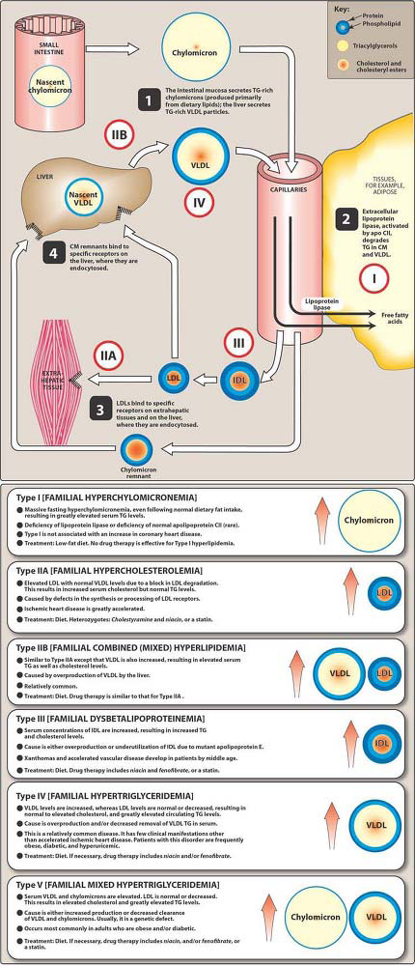

Slide 5
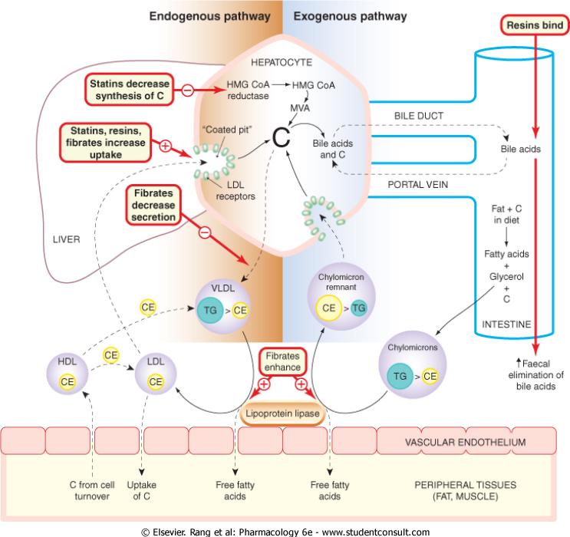

Slide 7
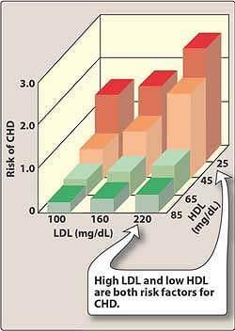

Slide 8
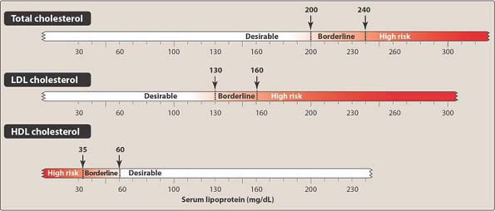

Slide 9
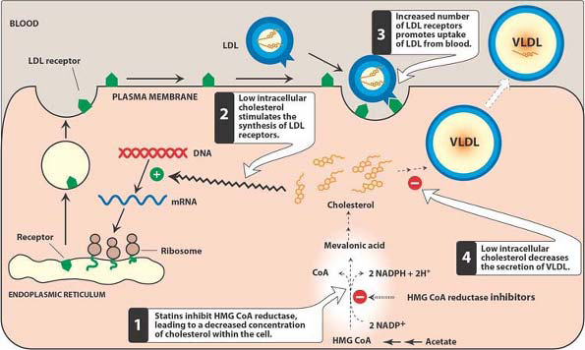

Slide 10
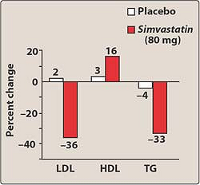

Slide 11
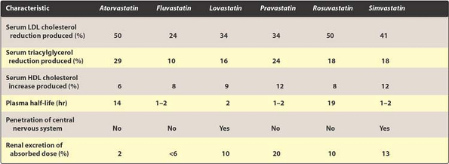

Slide 12
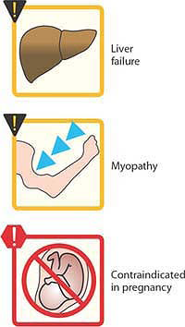

Slide 13
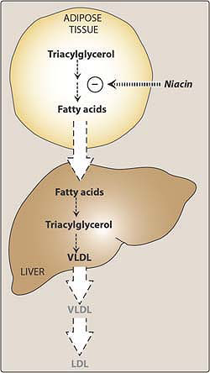

Slide 14
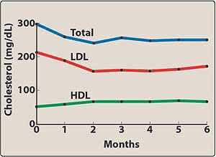

Slide 15
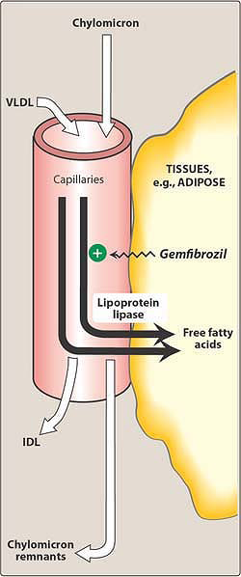

Slide 16
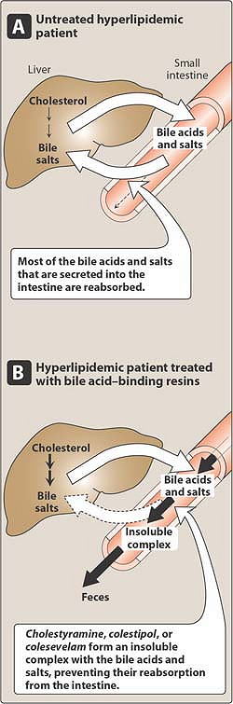

Slide 17
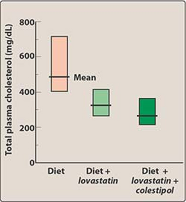

Slide 18
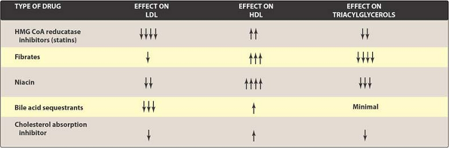

Slide 19
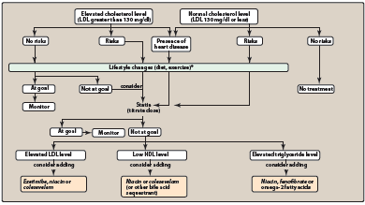

Slide 20
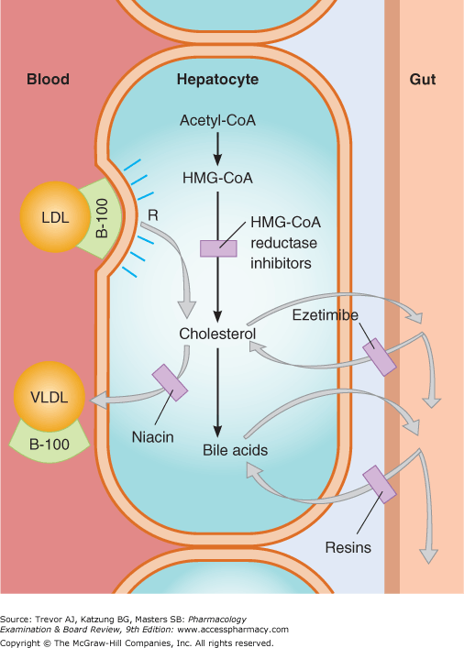

Slide 21
Checklist
When you complete this chapter, you should be able to:
Describe the proposed role of lipoproteins in the formation of atherosclerotic plaques.
Describe the dietary management of hyperlipidemia.
List the 5 main classes of drugs used to treat hyperlipidemia. For each, describe the mechanism of action, effects on serum lipid concentrations, and adverse effects.
On the basis of a set of baseline serum lipid values, propose a rational drug treatment regimen.
Argue the merits of combined drug therapy for some diseases, and list 3 rational drug combinations.

Slide 22
Which one of the following drugs causes a decrease in liver triacylglycerol synthesis by limiting available
free fatty acids needed as building blocks for this pathway?
A. Niacin.
B. Fenofibrate.
C. Cholestyramine.
D. Gemfibrozil.
E. Lovastatin.

