Slide 2
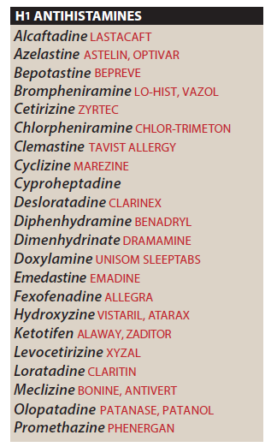

Slide 3
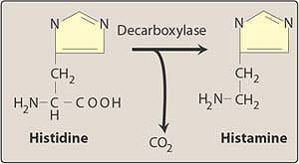

Slide 5
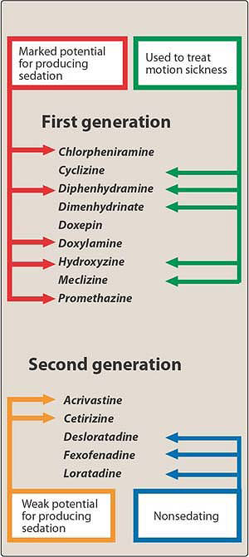

Slide 6
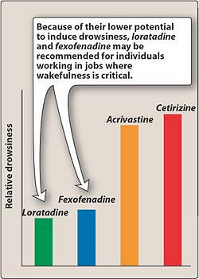

Slide 7
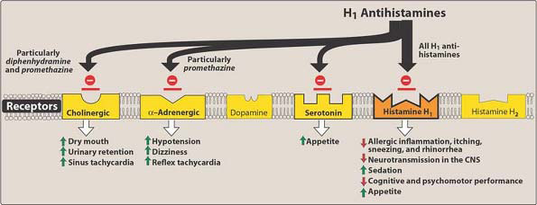

Slide 9
Checklist
When you complete this chapter, you should be able to:
List the major organ system effects of histamine and serotonin.
Describe the pharmacology of the 2 generations and 3 subgroups of H₁ antihistamines; list prototypical agents for each subgroup.
Describe the pharmacology of the H₂ antihistamines; name 2 members of this group.
Describe the action and indication for the use of sumatriptan.
Describe one 5-HT₂ and one 5-HT₃ antagonist and their major applications.
List the major organ system effects of the ergot alkaloids.
Describe the major clinical applications and toxicities of the ergot drugs.

Slide 10
Which one of the following drugs could significantly
impair the ability to drive an automobile?
A. Diphenhydramine.
B. Ergotamine.
C. Fexofenadine.
D. Ranitidine.
E. Sumatriptan.

