Slide 1
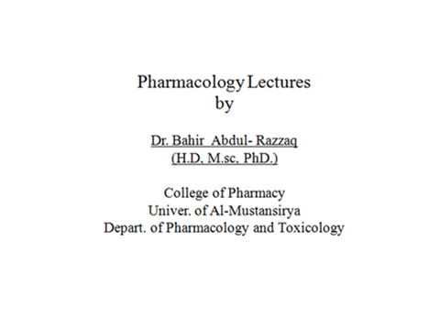

Slide 4
Acid-peptic disease A group of disorders involving erosion or ulceration of the mucosal lining of the gastrointestinal tract; includes GERD, gastric and duodenal ulcers, nonulcer dyspepsia, and stress-related gastritis
Antiemetic A drug that reduces nausea and vomiting
Gastroesophageal reflux disease (GERD) Esophageal irritation or inflammation due to reflux of stomach acid; also known as heartburn
Gastroparesis Paralysis of the muscles of the stomach and possibly other parts of the gastrointestinal tract due to damage to gastrointestinal nerves or muscle; common in advanced diabetes and advanced Parkinson disease
Inflammatory bowel disease (IBD) Inflammatory disorder involving irritation and ulceration of the colon and rectum (ulcerative colitis) or the colon plus more proximal parts of the gastrointestinal tract (Crohn's disease)
Irritable bowel syndrome (IBS) Disease of unknown origin characterized by episodes of abdominal discomfort and abnormal bowel function (diarrhea, constipation, or both)
Prokinetic A drug that promotes gastrointestinal motility
Proton pump The parietal cell H⁺/K⁺ ATPase that uses the energy of ATP to secrete protons into the stomach (Figure 59–1); final common target of drugs that suppress acid secretion

Slide 6
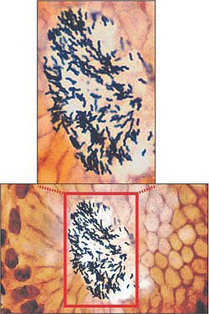

Slide 7
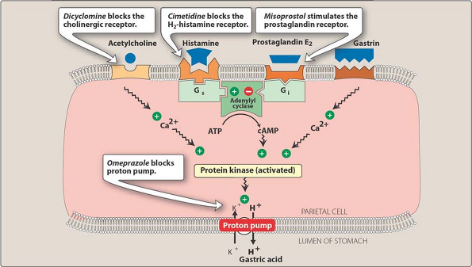

Slide 8
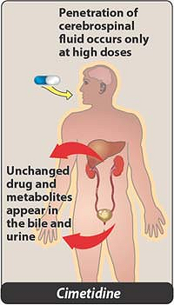

Slide 9
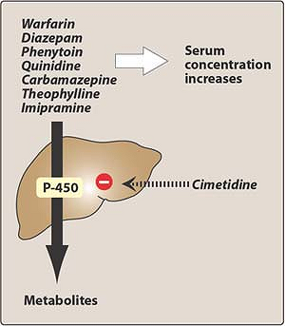

Slide 10
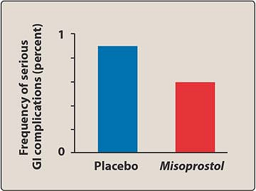

Slide 11
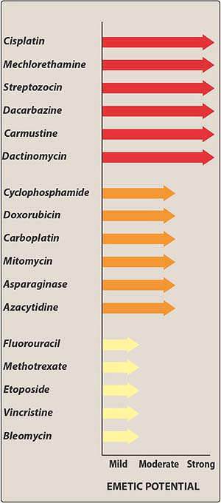

Slide 13
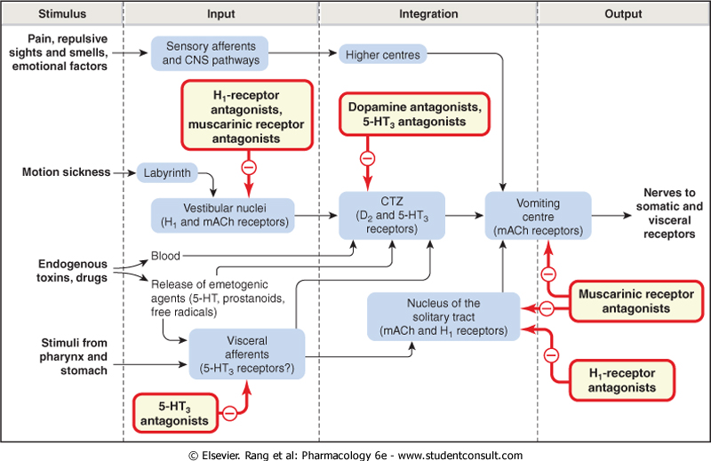

Slide 14
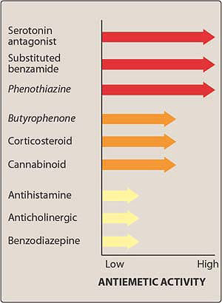

Slide 15
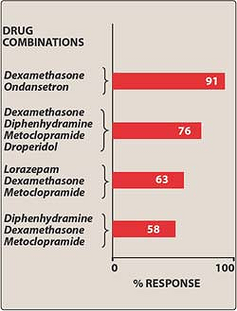

Slide 16
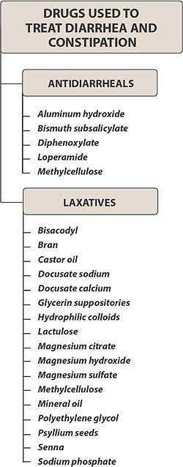

Slide 17
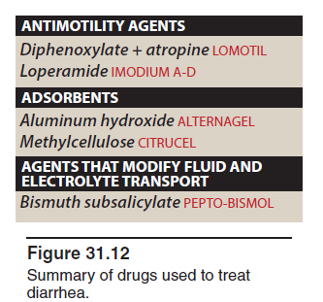

Slide 18
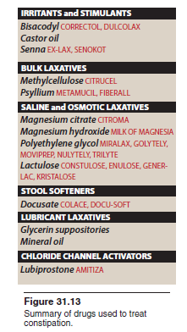

Slide 19
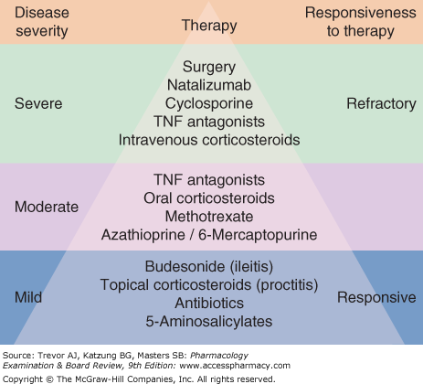

Slide 20
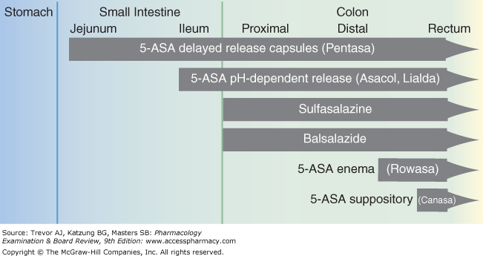

Slide 21
Checklist
When you complete this chapter, you should be able to:
Identify 5 different groups of drugs used in peptic ulcer disease.
Describe the mechanism of action of omeprazole and related drugs.
List 7 different drugs used in the prevention of chemotherapy- or radiation-induced emesis and identify the receptors with which they interact.
Describe the mechanism of action, clinical uses, and adverse effects of metoclopramide.
Identify 2 drugs commonly used as antidiarrheal agents and 4 drugs with different mechanisms that are used as laxatives.
Identify drugs used in the management of inflammatory bowel disease and irritable bowel syndrome.

Slide 22
A couple celebrating their fortieth wedding anniversary
is given a trip to Peru to visit Machu Picchu. Due
to past experiences while traveling, they ask their
doctor to prescribe an agent for diarrhea. Which of
the following would be effective?
A. Omeprazole.
B. Loperamide.
C. Famotidine.
D. Lorazepam.

