Slide 1
Gastrointestinal Tract Diseases
Protozoan and Helminth Diseases
A. Protozoan Diseases
1. Amebiasis
a. Caused by Entamoeba histolytica, amoeba: Sarcodina, has two forms: trophozoite and cyst
b. Transmitted by ingesting cysts from contaminated water or food
c. Type of disease: Causes dysentery, abdominal pain, fever, and
diarrhea. Trophozoites attach to walls of large intestine. In some cases
can also invade other tissues, especially the liver and lungs. (Travels to
these sites by way of peritoneum and diaphragm.)
d. Diagnosed by presence of cysts in feces. Some serological tests also
available.
e. Treated with drugs such as iodoquinol and metronidazole.
f. Prevented by proper sanitation, safe drinking water, adequate cooking
of food.

Slide 2
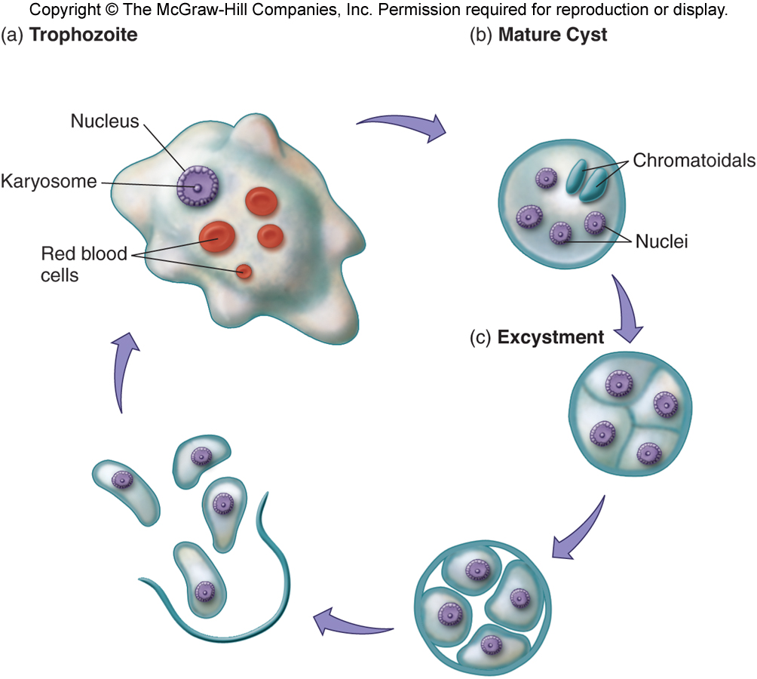
Entamoeba histolytica life cycle

Slide 3
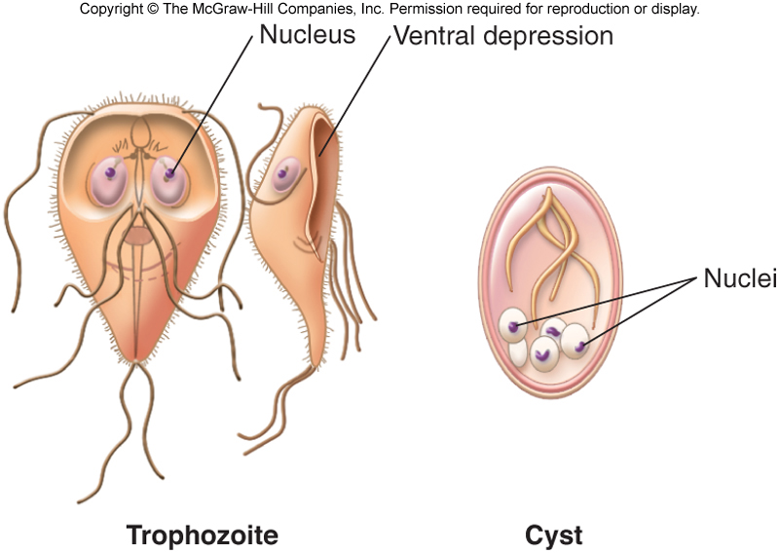
2. Giardiasis:
a. Caused by Giardia lamblia, a flagellated protozoan. (both amoebas and
Giardia have cyst and trophozoite forms in life cycle)
b. Infects the small intestine. Causes diarrhea, abdominal pain, flatulence,
and muscular weakness.
c. Transmitted by oral/fecal route. By contaminated food or water, by
fomites, close contact. Wide host range will contaminate streams and
rivers. Sometimes called “hikers disease.” . cysts are ingested,excysted,
trophozoites formed.
d. Treated with metronidazole. Prevention: same
Giardia - flagellate

Slide 4
B. Helminthes:
Many important helminthes are transmitted through the gastro-intestinal tract and the infections they give rise to can be classified as in the following table:

Slide 5
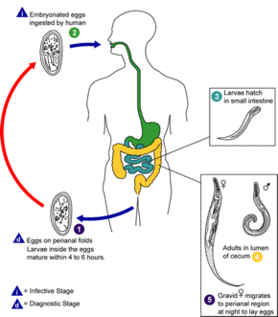
1. Pin worm:
a. Caused by Enterobius vermicularis, a round worm. (Nematode)
b. Common childhood infestation – “a family affair” Causes itching and
irritation.
c. Spread by eggs (ova). Female lays eggs outside the anus. Itching results
in scratching: eggs deposited anywhere hands touch. Ova are ingested;
develop into adult male and female worms in intestines.
d. Treated with anti-helminthic drugs. Caused by close contact, poor
hygiene.

Slide 6
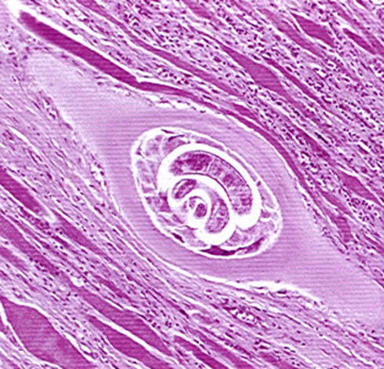
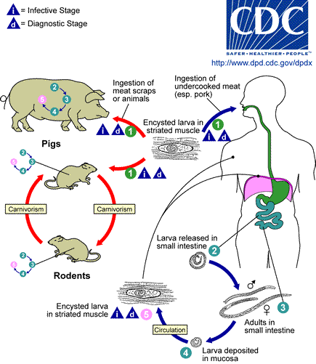
2. Trichinosis:
a. Caused by Trichinella spiralis, a roundworm.
b. Transmission: transmitted by eating meat infected with encysted larva.
Takes two hosts: Humans are usually infected by eating pork (or bear
meat) that has encysted larval forms in muscle tissue. When cyst was
eaten, it develops into larvae and adults.
c. Type of infection: The adults produce live larvae that migrate in blood
to organs and become encapsulated. Damage depends on the tissue
affected.
d. Prevented by eating non-infected meat, and by proper cooking of meat.

Slide 7
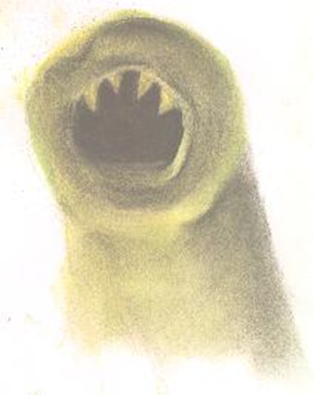
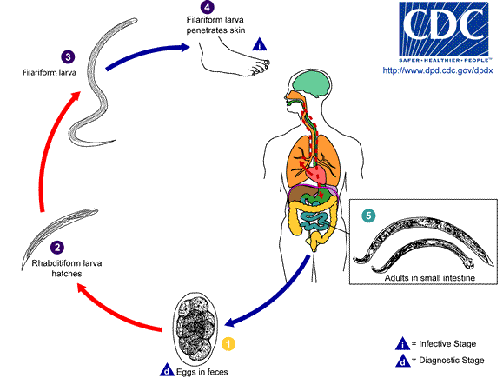
3. Hookworm
a. Necator americanus: another round worm.
b. Human is the host. Causes damage to the walls of the intestines,
where adult worms hook on and feed on blood supply. Can cause
anemia. Severe intestinal distress.
c. Transmitted by live larvae in soil: Life cycle: Ova are transmitted through feces. Ova will develop into larvae in the damp warm soil. The larvae will burrow into skin of human (usually skin between toes, if barefoot), migrate through the circulatory system, eventually coming back to intestines.
d. Can be prevented by proper sanitation and protective clothing.

Slide 8
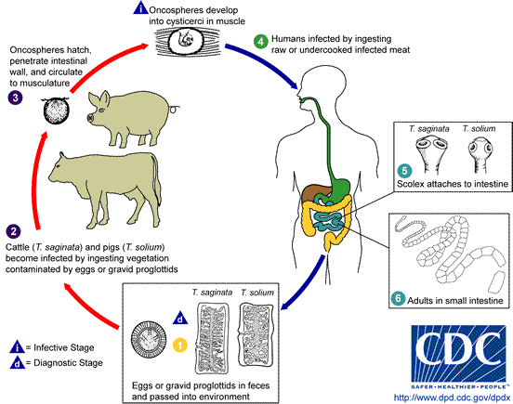
4. Tapeworm: Have both beef and pork tapeworms.
a. Beef: Taenia saginata, Pork: taenia solium.
b. Transmitted by eating encysted form (called cysticercus) in improperly
cooked meat. Need two hosts: the beef or pigs eat the cysts deposited
by from feces of humans. Cysts develop into larvae which encyst in
muscle tissue. Humans eat infected meat: cysts develop into larvae and
adults. Ova deposited in feces, thus a cylce.
c. Cause disease by draining nutrients; can cause intestinal blockage if in
large numbers. In case of pork tapeworm, humans can also be infected
by ova: causes cystircercus in human tissues.

Slide 9
