Slide 1
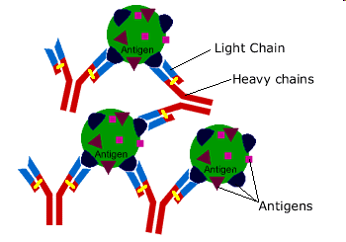
Antigen and Antibody
By: Dr. Suzan Y.

Slide 2
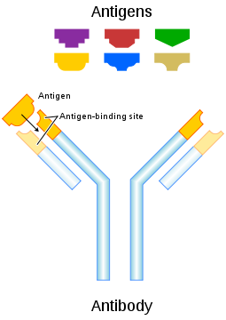
Antigen:
It s a substance that may be specifically bound by an antibody (Ab) molecule or T cell receptors (TCR). When this binding lead to the activation of B cells or T cells ,this substance is known as immunogen. There are some Ag do not induce immune response. So all immunogens are antigens, but not all antigens are immunogen .
Antigens can be proteins, polysaccharides, conjugates of lipids with : proteins (lipoproteins) and polysaccharides (glycolipids)

Slide 3
- The body recognizes antigens by the three-dimensional shapes or regions called antigenic determinants or epitopes. - Antigenic determinants may be mutivalent,or monovalent - Mutivalent antigens elicit a stronger immune response than monovalent antigens. - Multivalent antigen, variously called a hetrophil antigen, hetrologus antigen, or forssman antigen, can react with antibodies produced in response to different antigen

Slide 4
Properties of immunogens:
The ability of a substance to induce immune response is referred to as immunogenicity ,and the substance which induces the immune response is said to be immunogenic. the immune responses induced by an immunogen depend on many factors:
1- Foreingnness
2- Chemical composition
3- Molecular size
4- Chemical complexity
5- Genetic constitutes of the host
6- Route of entry of immunogen into the host
7- Dose of immunogen

Slide 5
Origin of Antigens
Antigens can be classified in order of their class
Exogenous antigens
are antigens that have entered the body from the outside , for example by inhalation, ingestion, or injection.
Endogenous antigens
are antigens that have been generated within cells as a result of normal cell metabolism, or because of viral or intracellular bacterial infection.

Slide 6
Autoantigens
- An autoantigen is usually a normal protein or complex of proteins (and sometimes DNA or RNA) that is recognized by the immune system of patients suffering from a specific autoimmune disease.
These antigens under normal conditions, not be targeted of the immune system, but due to mainly genetic and environmental factors, the normal immunological tolerance for such an antigen has been lost in these patients.

Slide 7
Haptens
very small compounds can elicit immune response only when coupled to largermolecule called a carrier.
Hapten is a greek word meaning to fasten. These are partial antigens. These are not immunogenic.
Hapten needs carrier proteins like albumin, globulin and synthetic polypeptide to become immunogenic.
Hapten (Hp)+Carrier Protein (Cp) →Hp+Cp-→Ab formation against hapten
Antibiotics, analgesics, penicilin and alpha-methyldopa
Therefore haptens are antigenic and not immunogenic

Slide 8
Adjuvant: Injecting an immunogen along with certain substances can increase the intensity of the immune responses to the immunogen. The substances, which enhances the immune response to immunogen are called adjuvant.
The mechanisms by which adjuvant can enhance the immune response include:
1- prolonging retention i.e, increase the time of exposure of host to immunogen.
2- increasing the effective size.
3- promoting immunological activities of immune cells.
4- stimulating the influx of immune cells to the site of administration.
Examples of commonly used adjuvant:
a- Complete Freund's adjuvant: A water –oil emulsion used in BCG vaccine ,act by mechanisms(1,3,4).
b- Aluminum –salts: fine particles of aluminum phosphate or aluminum hydroxyl ,act by mechanism(2)

Slide 9
Antibody: Antibody Structure
Antibodies are glycoprotein
Produced by B-cell
Are antigen-specific
Bind and inactivate foreign particles
The basic functional unit of each antibody is an immunoglobulin

Slide 10
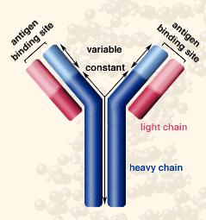
Y-shaped molecule
Each antibody consists of four polypeptides - two heavy chains and two light chains connected by disulfide bonds, joined to form a "Y" shaped molecule.

Slide 11
Heavy Chain
Each heavy chain has two regions, the constant region and the variable region
The constant region is identical in all antibodies of the same isotype, but differs in antibodies of different isotypes.
Light Chain
A light chain has two domains one constant domain and one variable domain
Each antibody contains two light chains that are always identical

Slide 12
Fab and Fc Regions
Some parts of an antibody have unique functions. The tips of the Y contain the site that bind antigen and, therefore. This region of the antibody is called the Fab (fragment, antigen binding).
The base of the Y plays a role in modulating immune cell activity. This region is called the Fc (Fragment, crystallizable) region, and is composed of two heavy chains.
Fc regions contain amino acid sequences that anchor the immunoglobulin to the cytoplasmic membranes of cells by binds to various cell receptors.
By binding to specific proteins the Fc region ensures that each antibody generates an appropriate immune response for a given antigen.

Slide 13
Although the general structure of all antibodies is very similar, a small region at the tip of the “Y” varies greatly among different antibodies
This variable region, composed of 110-130 amino acids, allowing millions of antibodies with slightly different tip structures, or antigen binding sites
The variable region includes the ends of the light and heavy chains.
Each antibody binds to a specific antigen; an interaction similar to a lock and key

Slide 14
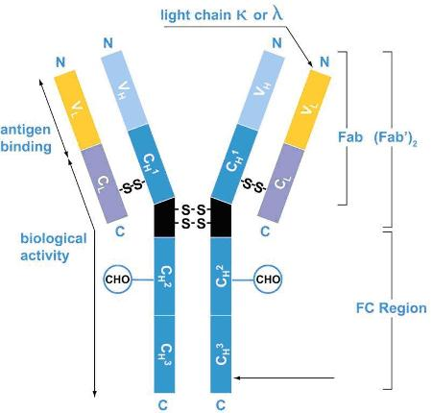

Slide 15
Antibody Isotypes
Name | Types | Description
IgA | 2 | Found in mucosal areas, such as the gut, respiratory tract and urogenital tract, and prevents colonization by pathogens. Also found in saliva, tears, and breast milk
IgD | 1 | Functions mainly as an antigen receptor on B cells that have not been exposed to antigens. Its function is less defined than other isotopes.
IgE | 1 | Binds to allergens and triggers histamine release from mast cells and basophile, and is involved in allergy. Also protects against parasitic worms
IgG | 4 | In its four forms, provides the majority of antibody-based immunity against invading pathogens. The only antibody capable of crossing the placenta to give passive immunity to fetus.
IgM | 1 | Expressed on the surface of B cells and in a secreted form with very high avidity. Eliminates pathogens in the early stages of B cell mediated (humoral) immunity before there is sufficient IgG

Slide 16
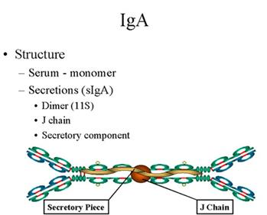
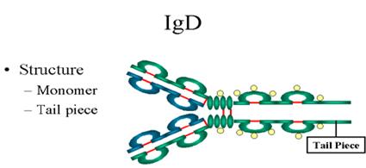
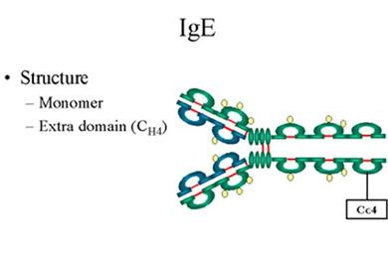
Immunoglobulin structure

Slide 17
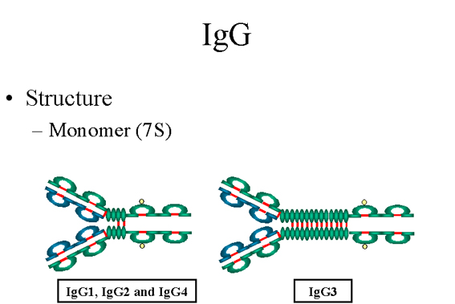
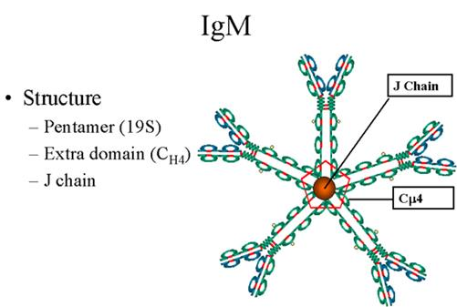

Slide 18
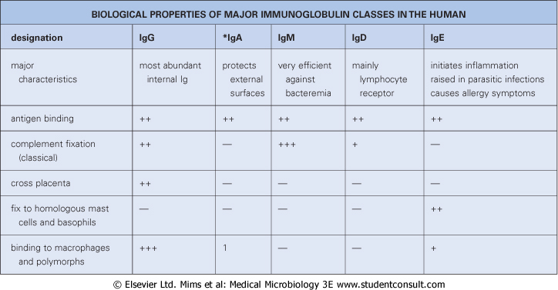

Slide 19
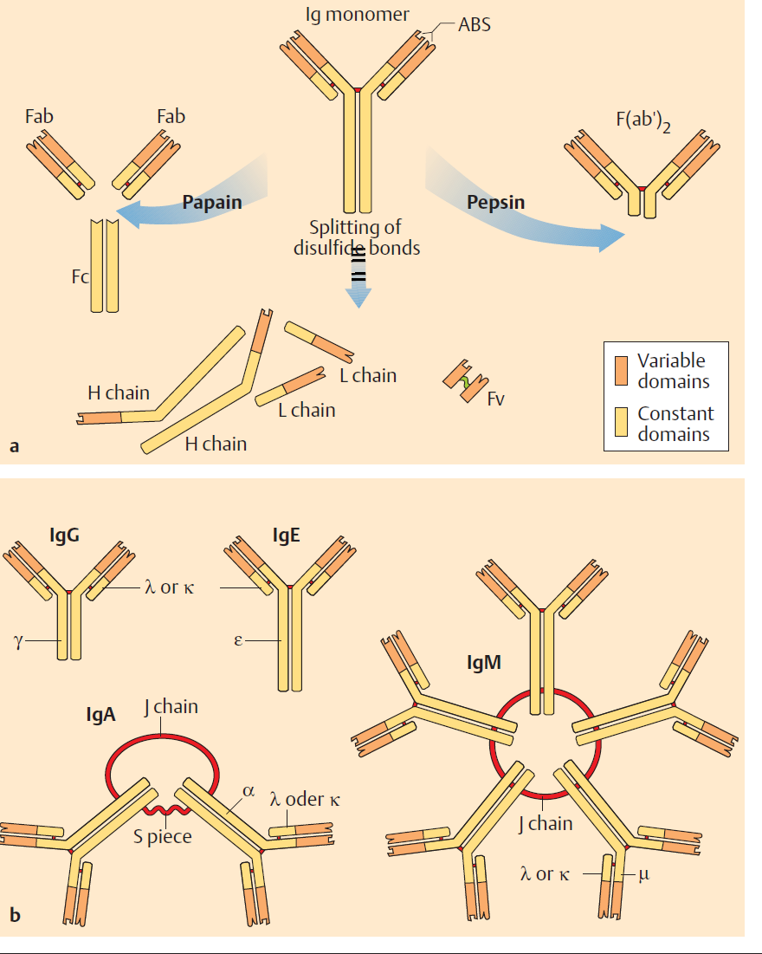
Immunoglobulin fragments

Slide 20
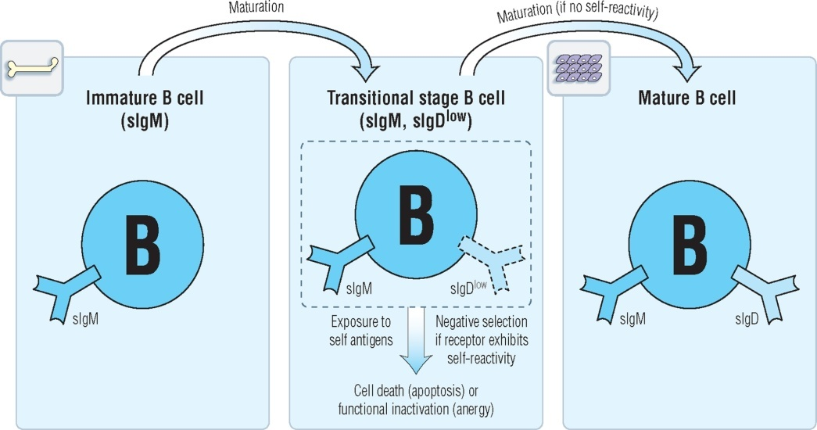
In the cours of B-cell maturation, IgD, IgM, disappear from the cell surface and instead IgM, IgG, IgE, or IgA is secreted by the cell. The process by which the function variable region appears in association with different heavy chain constant region is called heavy chain class switching

Slide 21
Function
Antibodies contribute to immunity in three ways:
they prevent pathogens from entering or damaging cells by binding to them
they stimulate removal of pathogens by macrophages and other cells by coating the pathogen
they trigger destruction of pathogens by stimulating other immune responses such as the complement pathway

Slide 22
Mechanisms of Antibody Action
Precipitation of soluble antigens
Agglutination of foreign cells
Neutralization
Enhanced phagocytosis
Complement activation leading to cell lysis
Stimulates inflammation

Slide 23
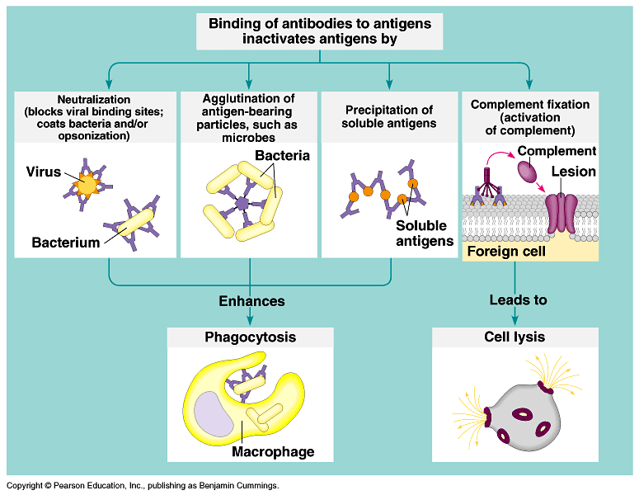
The binding of antibodies to antigens to form antigen-antibody complexes is the basis of several antigen disposal mechanisms.

Slide 24
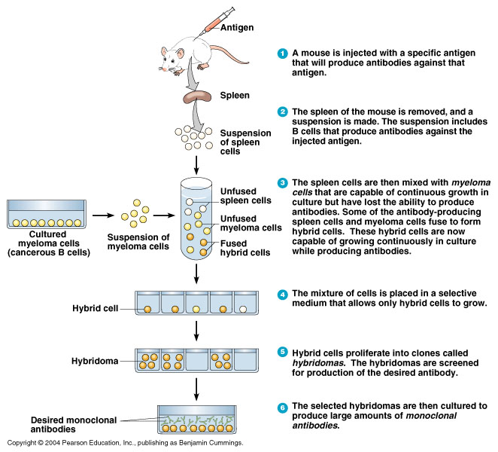
Monoclonal antibodies (antibdy reacts with single type of antigen)

