Slide 1
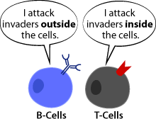
SPECIFIC IMMUNE RESPONSE
By: Dr. Suzan Y.

Slide 2
SPECIFIC COMPONENTS OF IMMUNE SYSTEM: LYMPHOCYTES
B-Lymphocytes (“B cells”)
T- Lymphocytes (“T cells”)
Natural Killer Cells (NK cells)
Memory Cells
Suppressor Cells
They have different functions in specific immunity.

Slide 3
B-LYMPHOCYTES
Mature in bone marrow, then carried to lymphoid tissue via blood stream and lymphatic circulation.
This process of maturation and migration takes place throughout life.
T-LYMPHOCYTES
Immature lymphocytes leave bone marrow during fetal and early neonatal life.
Go to thymus gland.
Mature there before they go on to other lymphoid tissues.
Also, and lymphocyte that is derived from one of these original T-lymphocytes via mitosis is also a T-lymphocyte.

Slide 4
Immune response
The immune system can mount two types of responses to antigens: a humoral response and a cell-mediated response.
Humoral immunity involves B cell activation and results from the production of antibodies that circulate in the blood plasma and lymph.
Circulating antibodies defend mainly against free bacteria, toxins, and viruses in the body fluids.
In cell-mediated immunity, T lymphocytes attack viruses and bacteria within infected cells and defend against fungi, protozoa, and parasitic worms.
They also attack “nonself” cancer and transplant cells.
The humoral and cell-mediated immune responses are linked by cell-signaling interactions, especially via helper T cells.

Slide 5
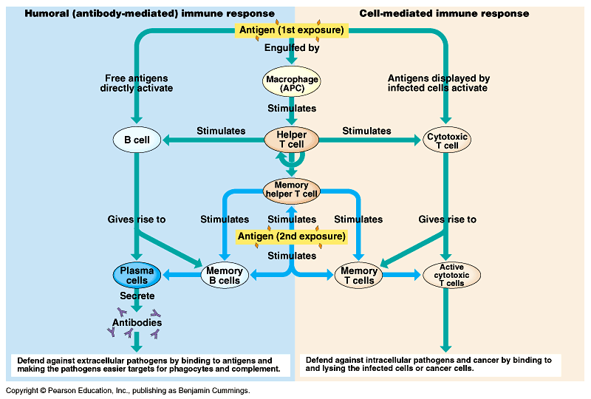

Slide 6
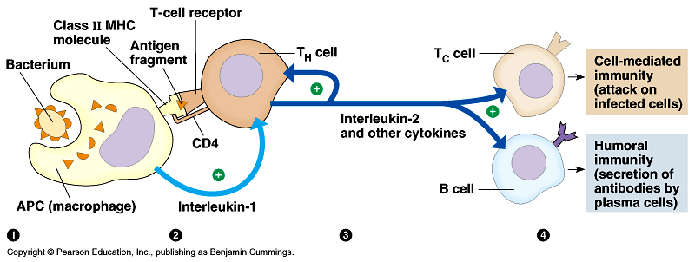
Both types of immune responses are initiated by interactions between antigen-presenting cells (APCs) and helper T cells.
The APCs, including macrophages and some B cells, tell the immune system, via helper T cells, that a foreign antigen is in the body.
At the heart of the interactions between APCs and helper T cells are class II MHC molecules produced by the APCs, which bind to foreign antigens.

Slide 7
An APC engulfs a bacterium and transports a fragment of it to the cell surface via a class II MHC molecule.
A specific T_{H} cell is activated by binding to the MHC-antigen complex on the surface of the APC.
Both CD4 proteins on the surface of the T_{H} cells and interleukin-1 secreted by the APC enhance activation.
When a helper T cell is selected by specific contact with the class II MHC-antigen complex on an APC, the T_{H} cell proliferates and differentiates into a clone of activated helper T cells and memory helper T cells.
Activated helper T cells secrete several different cytokines, proteins or peptides that stimulate other lymphocytes.
For example, the cytokine interleukin-2 (IL-2) helps B cells that have contacted antigen differentiate into antibody-secreting plasma cells.
-IL-2 also helps cytotoxic T cells become active killers

Slide 8
Role of cytotoxic T cells (counter intracellular pathogens)
Antigen-activated cytotoxic T lymphocytes kill cancers cells and cells infected by viruses and other intracellular pathogens.
This is mediated through class I MHC molecules.
All nucleated cells continuously produce class I MHC molecules, which capture a small fragment of one of the other proteins synthesized by that cell and carries it to the surface.
If the cell contains a replicating virus, class I MHC molecules expose foreign proteins that are synthesized in infected or abnormal cells to cytotoxic T cells.
This interaction is greatly enhanced by a T surface protein CD8 which helps keep the cells together while the T_{C} cell is activated.

Slide 9
A cytotoxic T cell is activated by specific contacts with class I MHC-antigen complexes on an infected cell and by IL-2 from a helper T cell.
The activated cytotoxic T cell differentiates into an active killer, which kills its target cell - the antigen-presenting cell - primarily by releasing perforin.
This protein forms pores into the target cell, which swells and eventually lyses.
The death of the infected cell not only deprives the pathogen of a place to reproduce, but it also exposes it to circulating antibodies, which mark it for disposal.
Once activated, the T_{C} cells kills other cells infected with the same pathogen.

Slide 10
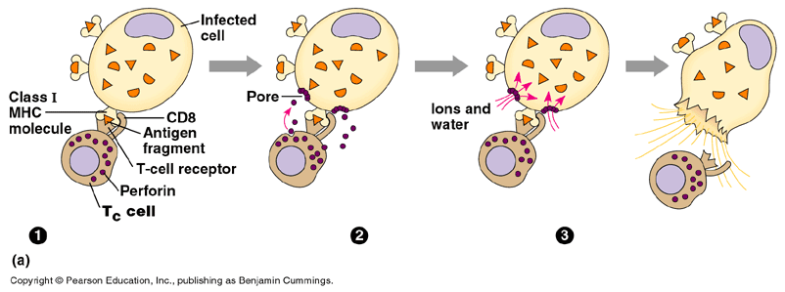

Slide 11
In the same way, T_{C} cells defend against malignant tumors.
Because tumor cells carry distinctive molecules not found on normal cells, they are identified as foreign by the immune system.
Class I MHC molecules on a tumor cell present fragments of tumor antigens to T_{C} cells.
Interestingly, certain cancers and viruses actively reduce the amount of class I MHC protein on affected cells so that they escape detection by T_{C} cells.
The body has a backup defense in the form of natural killer cells, part of the nonspecific defenses, which lyse virus-infected and cancer cells.

Slide 12
Humoral response,( B cells make antibodies against extracellular pathogens)
The humoral immune response is initiated when B cells bearing antigen receptors are selected by binding with specific antigens.
This is assisted by IL-2 and other cytokines secreted from helper T cells activated by the same antigen.
These B cells proliferate and differentiate into a clone of antibody-secreting plasma cells and a clone of memory B cells.

Slide 13
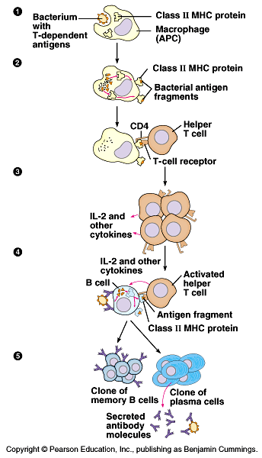
Many antigens (primarily proteins), called T-dependent antigens, can trigger a humoral immune response by B cells only with the participation of helper T cells.

Slide 14
Other antigens, such as polysaccharides and proteins with many identical polypeptides, function as T-independent antigens.
These include the polysaccharides of many bacterial capsules and the proteins of the bacterial flagella.
These antigens bind simultaneously to a number of membrane antibodies on the B cell surface.
This stimulates the B cell to generate antibody-secreting plasma cells without the help of IL-2.
While this response is an important defense against many bacteria, it generates a weaker response than T-dependent antigens and generates no memory cells.
Any given humoral response stimulates a variety of different B cells, each giving rise to a clone of thousands of plasma cells.
Each plasma cell is estimated to secrete about 2,000 antibody molecules per second over the cell’s - 4- to 5-day life span.

Slide 15
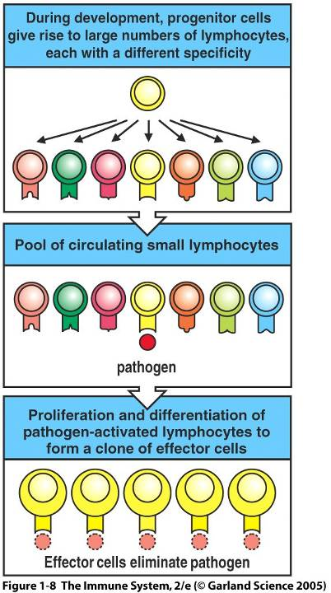
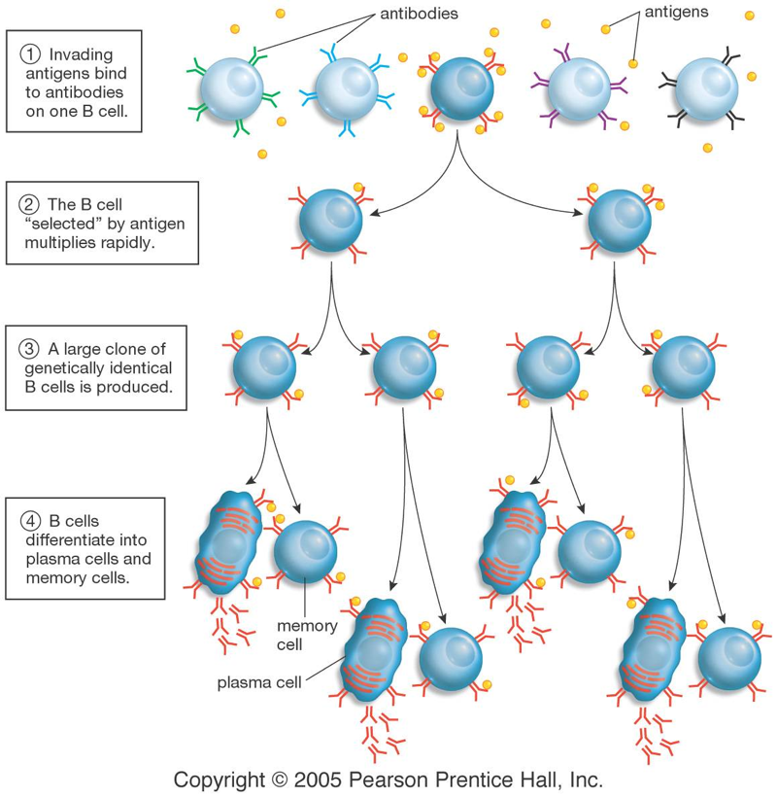
Clonal Selection

Slide 16
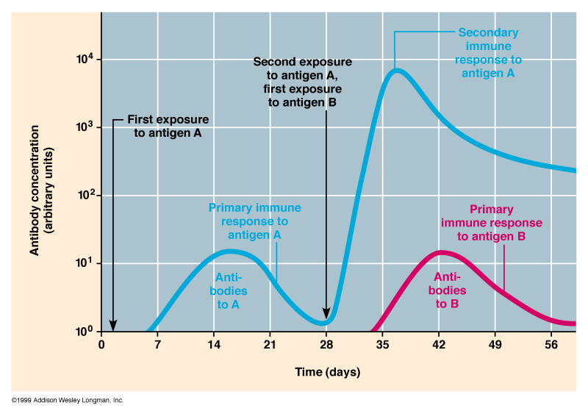
Antibody Response After Exposure to Antigen

Slide 17
Antigens that elicit a humoral immune response are typically the protein and polysaccharide surface components of microbes, incompatible transplanted tissues, or incompatible transfused cells.
In addition, for some humans, the proteins of foreign substances such as pollen or bee venom acts as antigens that induce an allergic, or hypersensitive humoral response.

