Slide 1
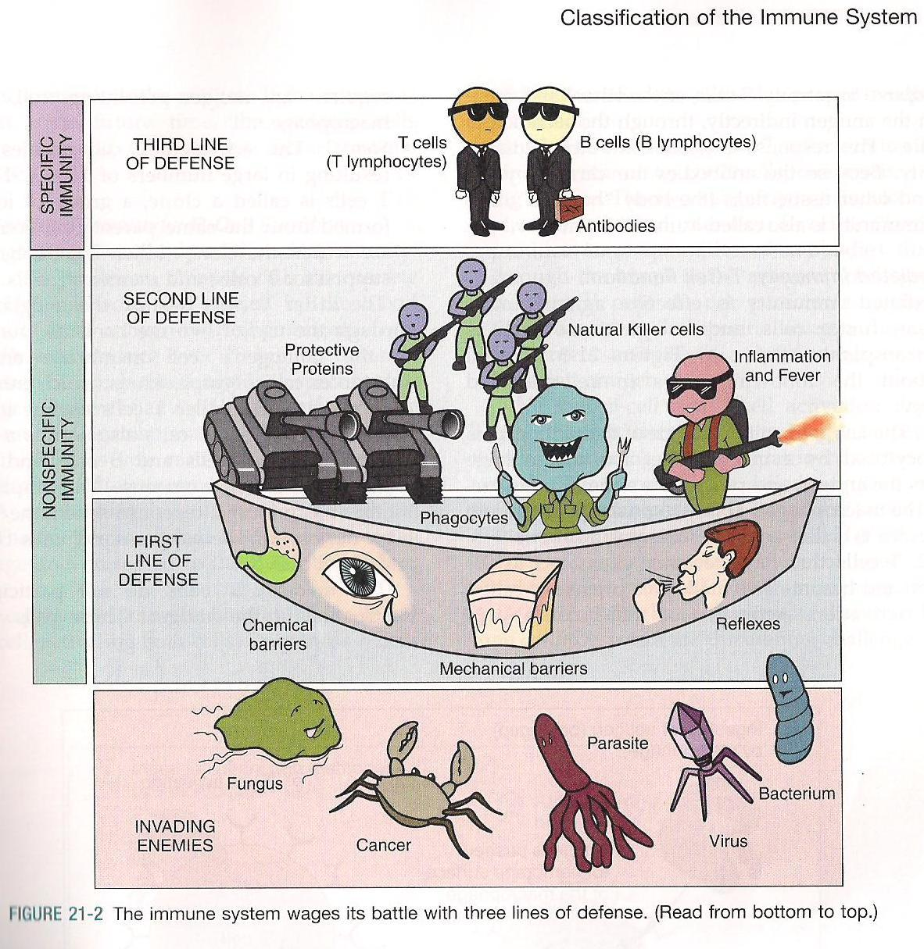
Nonspecific and Specific Immunity
By:
Dr. Suzan Yousif

Slide 2
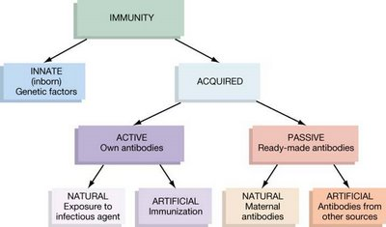
THE IMMUNE RESPONSE AND IMMUNITY
Immune response
  Innate (non-specific)
  Adaptive or Acquired (specific)

Slide 3
Defense Mechanisms
Immunity
  State of non-specific and specific protection
Nonspecific defense mechanisms |  | Specific defense mechanisms (immune system)
First line of defense | Second line of defense | Third line of defense
Skin Cilia Physiological factors | Phagocytic white blood cells The inflammatory response Antimicrobial substances | Lymphocytes antibodies

Slide 4
Nonspecific (Natural , Innate) Immunity: first line of defense
Composed of structural barriers to keep infectious agents out of the body.
  Intact skin
  Cilia
  Physiological factors.

Slide 5
Intact Skin
Difficult for a pathogen to penetrate,
  Composed from closely packed cells, multiple layering, contanious sheding of cells, Presence of keratin.
  Sweat creates high salt conditions, antibacterial enzyme (lysozyme).
  Oil layer, fatty acids and acid pH present makes an inhospitable environment for microorganisms.
Normal flora prevent other microorganisms from establishing an infection – “competitive exclusion”.

Slide 6
Body Coverings: The Skin
epidermis
sebaceous glands
sweat gland

Slide 7
Respiratory Tract
Upper Respiratory Tract
  Nasal hairs induce turbulence
  Mucous secretions trap particles
  Mucous stream to the base of tongue where material is swallowed
  Nasal secretions contain antimicrobial substances
  Upper respiratory tract contains large resident flora
Lower Respiratory Tract
  Particles trapped on mucous membranes of bronchi and bronchioles
  Beating action of cilia causes mucociliary stream to flow up into the pharynx where it is swallowed
  90% of particles removed by this way. Only smallest particles (<10µ in diameter) reach alveoli
Alveoli
  Alveolar macrophage rapidly phagocytize small particles

Slide 8
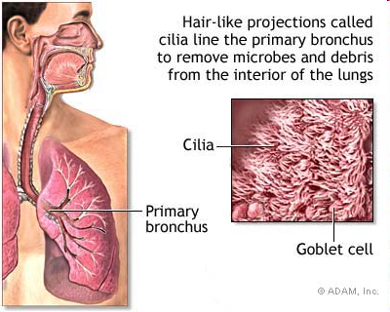
  Cilia
Mucous Membranes
cilia
mucus

Slide 9
Alimentary Tract
General defense mechanisms
  Mucous secretions
  Integrity of mucosal epithelium
  Peristaltic motions of the gut propel contents downward
  Secretory antibody and phagocytic cells
Stomach
  Generally sterile due to low pH
Small Intestine
  Upper portion contains few bacteria
  As distal end of ilieum is reached flora increases
Colon
  High numbers of microorganisms
  50-60% of fecal dry weight is bacteria

Slide 10
Genitourinary Tract
Male
  Frequent flushing action of urine
  Bactericidal substances from prostatic fluid
  pH of urine
  Bladder mucosal cells may be phagocytic
  Urinary sIgA
Female (Vagina)
  Large microbial population (lactobacilli)
  pH of urine
Eye
Flushing action of tears which drain through the lacrimal duct and deposit bacteria in nasopharynx
Tears contain a high concentration of lysozyme (effective against gram positive microorganisms

Slide 11
Factors Modify Defense Mechanisms
Age
Hormones
Drugs and chemicals
Malnutrition
Fatigue and stress
Genetic determinants

Slide 12
Nonspecific Immunity, Second line of defense
Phagocytosis:
When the pathogens can penetrate the first line of defense (due to wounds, burns or loss of epithelia)the cell of innate immunity play aroule.
Phagocytic cells
  Neutrophils and macrophages
  Natural Killer (NK) Cells: attack virus infected cells.
  The early responed phagocytic cells neutrophile followed by monocytic macrophages.

Slide 13
Phagocytosis
Initiation is caused by damage to the tissues, either by trauma or as a result of microbial multiplication.
Chemotaxis, attraction of leukocytes or other cells by chemicals.
Opsonization - Opsonization coating a pathogen by substances so as to enhance phagocytosis.
Adherence - firm contact between phagocyte and microorganism.
Engulfment into cytoplasm and enclosed in a vacuole.
Digestion enzymatic contents in vacuole destroy the microorganism.

Slide 14
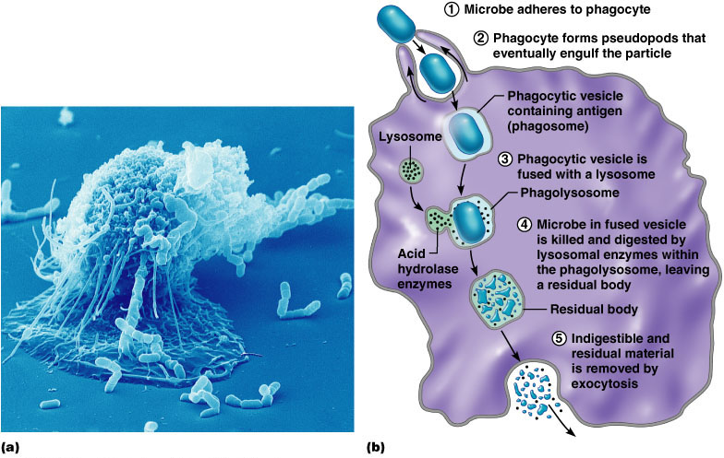
Mechanism of Phagocytosis
Macrophage

Slide 15
Inflammation
Inflammatory response : is aprotective response act to eliminate the initial cause of cell injury as well as the necrotic cells and tissues.
The mission of inflamation were completed by diluting, destroying or neutrilizing harmful agents(microbes and toxins) .
four classic signs of inflammation are redness, swelling, heat and pain.
Steps of inflammatory response:
  Dilation of capillaries (hyperemia) to increase blood flow to area
  Chemotaxis - chemicals released which cause phagocytic white cells to migrate to the area.
  Increased capillary permeability allowing white cells to go to injured area, a process known as “diapedesis”
  Formation of exudate - same composition as plasma and it contains antibacterial substances, phagocytic cells, and drugs and antibiotics, if present.

Slide 16
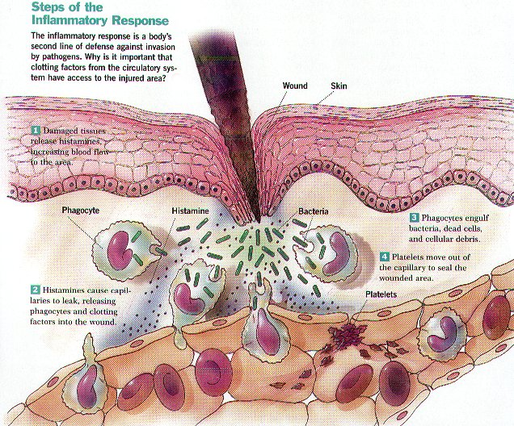
Inflammatory Response

Slide 17
Antimicrobial Substances
Third major kind of nonspecific cellular and chemical defense
Include many soluble tissue and serum substances help to suppress the grow of or kill microorganisms
Includes complement and interferon
Considered a second line of defense

Slide 18
Complement
A series of serum proteins involved in mediation of inflammation but also involved in
  opsonization,
  chemotaxis, and
  cell lysis.

Slide 19
Complement Types
Two major pathways.
Classical:
  11 proteins
    C1 – C9
      C1 actually 3 protein
  Initiation
    Antibodies bind to pathogen
    C1 binds to AP complex
    Complement activated in sequence.
Alternate Pathway
  Triggered by interaction of 3 plasma proteins
    Factors B, D, and P
    These interact with carbos on cell surface of
      Bacteria
      Parasites
      fungi

Slide 20
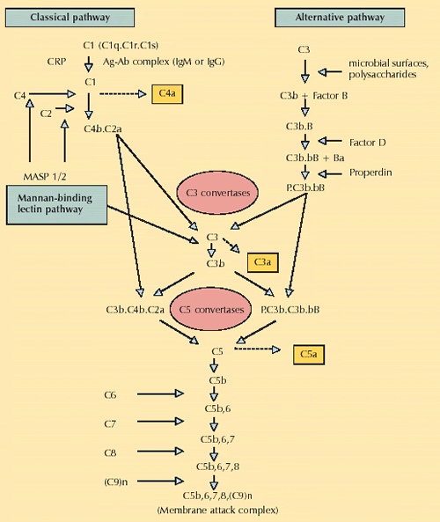

Slide 21
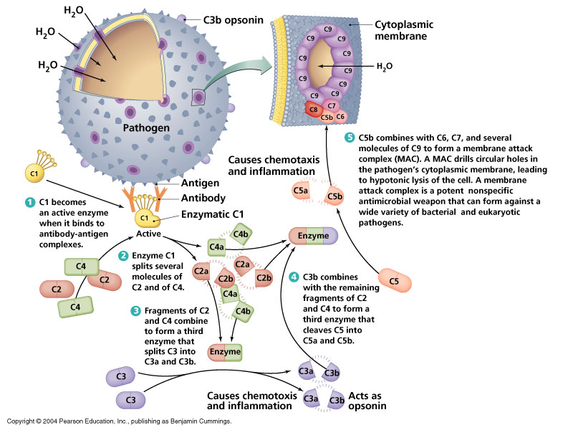

Slide 22
Complement Fragments
Complement fragments:
  Chemotaxis:
    Attract phagocytes.
  Opsinization:
    Phagocytes have receptors for C3_{b}.
    Form bridges between phagocyte and victim cell.
  Histamine release:
    Increase blood flow and capillary permeability.
    Bring in more phagocytes.

Slide 23
Interferon
Interferons
  Family of proteins which are important non-specific defense mechanisms against viral infections and cancer.
  Act as messengers that protect other cells in the vicinity from viral infection.
  Produced by most body cells, lymphocytes, NK cells
    inhibit viral replication.
    activates macrophages.

Slide 24
Fever
kind of nonspecific cellular and chemical defense.
Hypothalamus regulates body temp
  Thermoregulatory center.
Reset upward by endogenous pyrogen
  May be interleukin-1 beta
    First produced as a cytokine by WBCs
    Then produced by the brain.

Slide 25
Endogenous pyrogens:
Cell wall of gram –ve bacteria contains endotoxin.
Endotoxin stimulates monocytes and macrophages to release cytokines:
  Interleukin-1, interleukin-2, TNF (tumor necrosis factor):
  Increased activity of neutrophils.
  Produce fever, increase sleepiness, and decrease plasma iron.

Slide 26
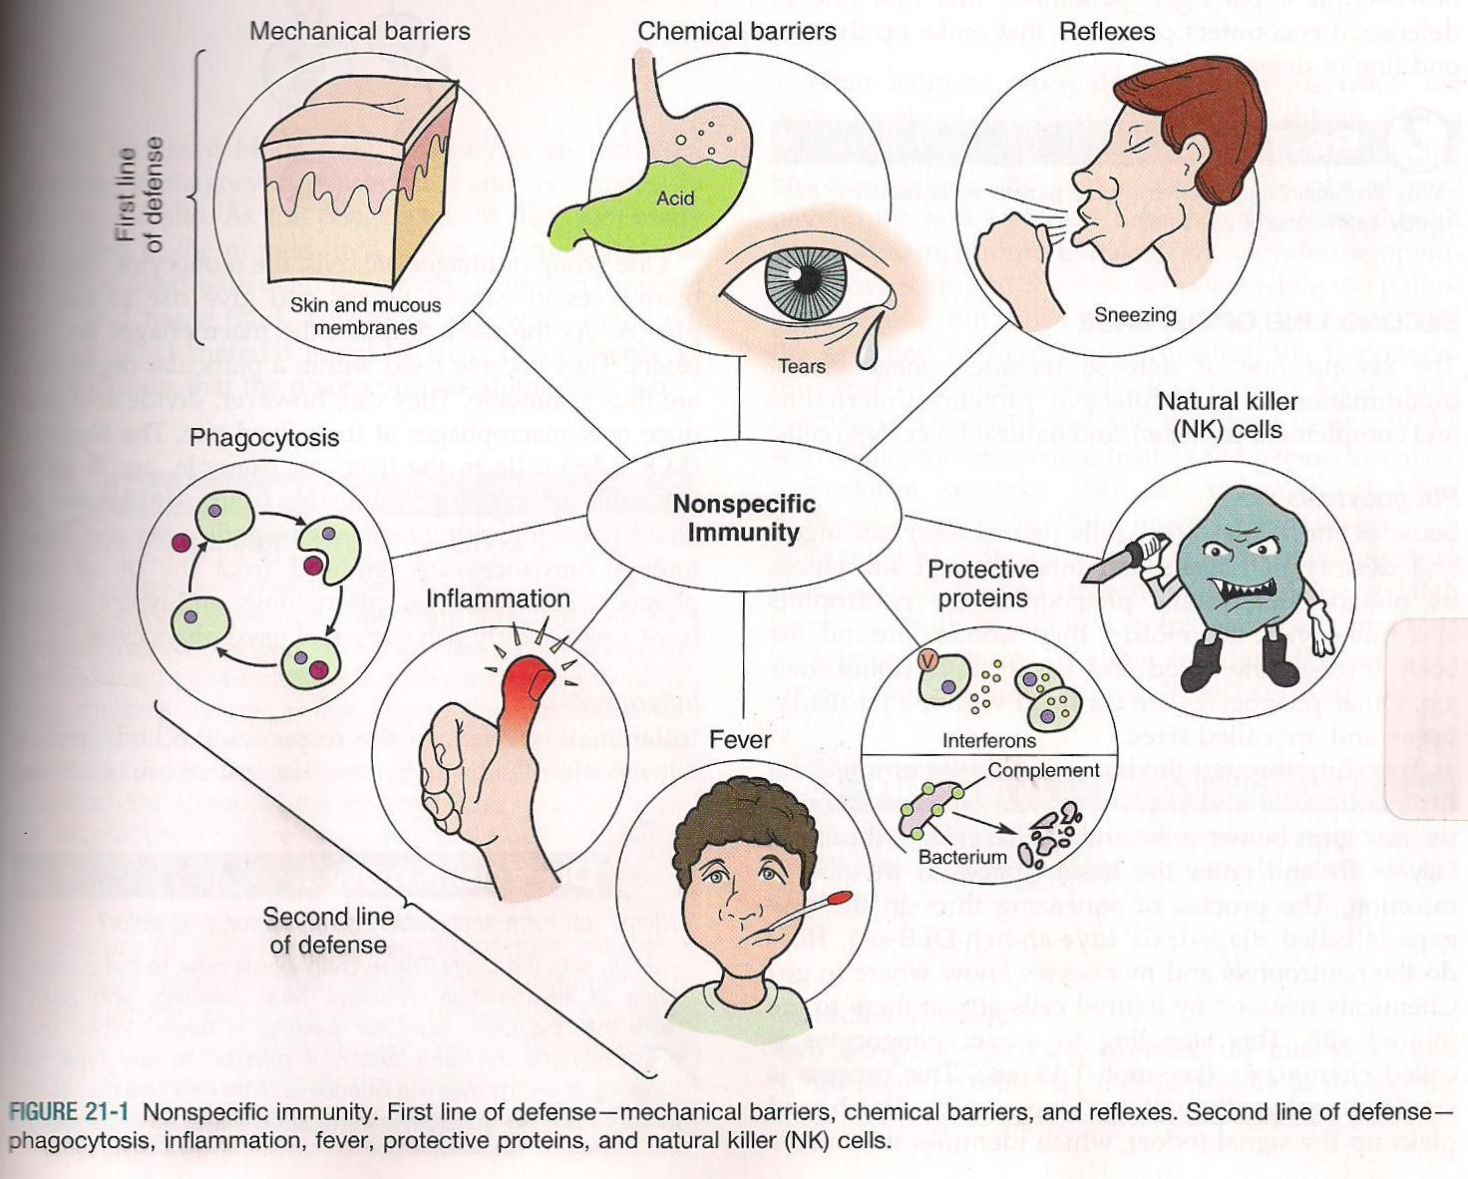

Slide 27
Specific defense mechanism immune system
Characteristics of Immunity
Recognition of self versus non-self
Response is specific
Retains a “memory” allowing an accelerated second response
Can respond to many different materials
Involves lymphocytes and antibodies
Cells involved in specific immunity are Lymphocytes
and Plasma cells

Slide 28
Types of Immunity
Active Immunity
Naturally-Acquired Active Immunity
Artificially-Acquired Active Immunity
Passive Immunity
Naturally-Acquired Passive Immunity
Artificially-Acquired Passive Immunity

Slide 29
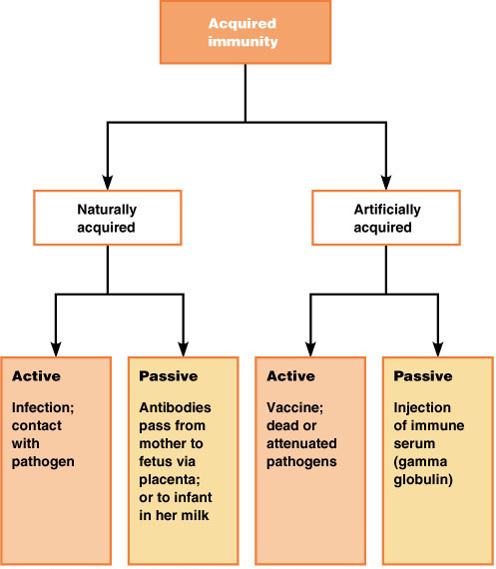
Types of Acquired Immunity

Slide 30
Active Immunity
The production of antibodies against a specific disease by the immune system.
Naturally acquired through disease
Artificially acquired through vaccination
  Vaccines include inactivated toxins, killed microbes, parts of microbes, and viable but weakened microbes.
Active immunity is usually permanent

Slide 31
Passive Immunity
Passive Immunity- Protection against disease through antibodies produced by another human being or animal.
Effective, but temporary
Ex. Maternal antibodies
Colostrum.

Slide 32
Passive immunity can be transferred artificially by injecting antibodies from an animal that is already immune to a disease into another animal.
  Rabies treatment: injection with antibodies against rabies virus that are both passive immunizations (the immediate fight) and active immunizations (longer term defense).

Slide 33
Comparison of Active & Passive Immunity
Active immunity
Produced actively by host’s immune system
Induced by infection or by immunogen
Durable effective protection
Immunity effective only after lag period
Immunological memory present
Booster effective
Not applicable in the immunodeficient
Passive immunity
Received passively, no active host participation
Readymade antibody transferred
Transient, less effective
Immediate immunity
No memory
Not effective
Applicable in immunodeficient

