Slide 1
IMMUNOLOGY AND THE IMMUNE SYSTEM
By:
Dr. Suzan Yousif

Slide 2
Immunology
  Study of the components and function of the immune system
Immune System
  Molecules, cells, tissues and organs which provide non-specific and specific protection against
    Microorganisms
    Microbial toxins
    Tumor cells
  Crucial to human survival
  The immune system characterized by:
  It can respond to the vast number of antigen
  Discriminate between self and non self
  It has memory

Slide 3
IMMUNE SYSTEM CONSIST OF:
  Primary (central) Lymphoid Organs in which Leukocytes develop (Bone marrow & Thymus)
  Secondary (peripheral) Lymphoid Organs & Tissues in which Immune Response occur which include:
- Lymph Nodes and Spleen
- Mucosa-Associated Lymphoid Tissue (MALT)
  Waldeyers Ring (Tonsil)
- Gut- Associated Lymphoid Tissue (GALT)
    Peyer’s patch
  Leukocytes in Blood
Mature in Marrow (B cell) or Thymus (T-cell)

Slide 4
The role of stem cells
Myeloid Stem cell give rise to:
  Monocyte → Macrophage
  Eosinophil
  Basophil
  Megakaryocyte → Platelet
  Erythroblast → Erythrocyte
Lymphoid Stem cell give rise to:
  Pre-B cell → Late pre-B cell → Immature B cell → Mature B cell → Plasma cell → Abs
  - Pre-T cell (enters Thymus) → Helper T cell + Cytotoxic T cell + TDTH cell
  NK cell
  After maturation in Thymus or Bone marrow, Lymphocytes migrate to Spleen + LNs + MALT

Slide 5
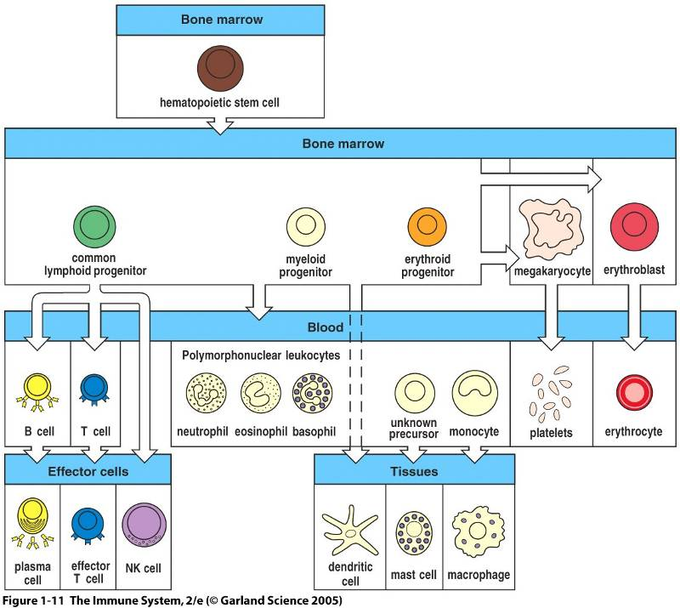

Slide 6
CELLS OF THE IMMUNE SYSTEM
MONOCYTES & MACROPHAGES
Control infections not overcome by Neutrophils
Associated with chronic infections
Main role in cell-mediated immunity
Act as Ag presenting cell to T-Lymphocyte
Monocytes → Macrophage with different names:
Kupffer cell in sinusoid of Liver
Alveolar macrophage in Lung
Microglial in Brain
Multinucleated Giant Cells formed by fusion of Macrophages

Slide 7
  MACROPHAGES & NEUTROPHILS
  Phagocytize Bacteria coated with Complement
DENTRITIC CELLS
Present in Blood, LNs, Epithelial cells
Digest & process Ag to present to T-cells
Examples:
  Langerhans cells (resides within Epithelium)
  Veild cells (Afferent Lymphatics)
  Interdigitating reticular cells (Spleen & LNs)

Slide 8
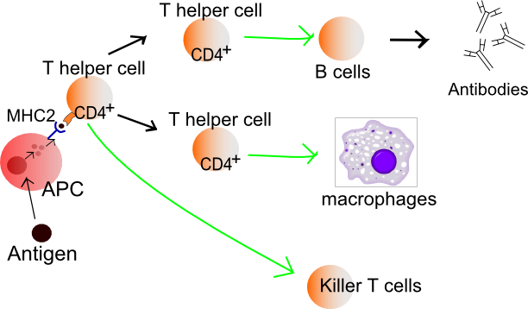

Slide 9
GRANULOCYTES
NEUTROPHILS (PMNs)
60% of leukocytes (white blood cells)
Have receptor for IgG & C3b
Release Matrix Metalloproteinase (MMP)
First to arrive in acute inflammation, actively killing bacteria, by generation of Hydrogen peroxide & Oxygen free radicals releasing LPS.
Cytoplasm contain Lysosomal Peroxidase + Acid Hydrolases
Cytoplasmic granules contain digestive enzyme (Myeloperoxidase) & Lactoferrin (binds Fe)

Slide 10
EOSIONPHILS (1 –3% of leukocytes)
Have receptors for Complement
Mostly in parasitic & allergic conditions
Contents & Functions: Histaminase Pyrogen (fever) Peroxidase (kill bacteria)
BASOPHILS (1% of leukocytes)
  Contain Histamine (hypersensitivity madiator)
Have receptors for Fc portion of IgE
IgE binding → degranulation → Histamine →allergic reactions

Slide 11
LYMPHOCYTES (30% of circulating WBC)
B Lymphocytes:
Differentiate into Plasma cells → Antibodies
Memory B cells:generated after exposure to Ag
Mature B cell: have surface IgM & IgD that bind Ag → cause B cell → Ab
T LYMPHOCYTES:
Helper T cells (CD4 positive)
Stimulate B-Lymphocytes → Plasma cell → Ab
Promote cytotoxic T- cell (CD8) response
Cytotoxic T cell (CD 8 +)
  Recognize Foreign Ag & Class 1 MHC
  Lyse virus infected cells & tumor cells

Slide 12
Natural killer (NK) cells (10 -15% of Lymphocytes)
Kill Tumor cells
Defend against Viral infections
Recognize Foreign Ag independent of MHC

