Slide 1
File tab – opens menus for opening and
saving Files, and modifying Excel Options
Quick Access Toolbar can be
customized to include icons to frequently
Used features such as Print Preview
Home Ribbon use to change fonts, justify text, insert
rows etc. Ribbons are organized into Groups of similar tasks
such as the Font group or the Number group. In addition, there
are other ribbons containing groups/buttons for laying out pages
using the review features etc.

Slide 2
Highlight your data, select a Chart type and Edit & its done!

Slide 3
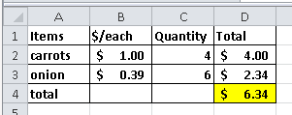
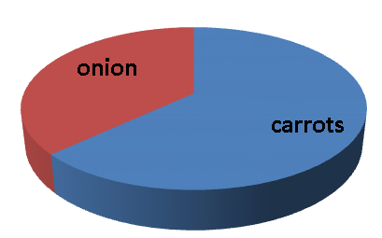
The “Power” of using Spreadsheet Applications
=B2*C2
Each entry can be related to other values by including cell referencing in formulas.
Formula values are automatically updated when a referenced value changes
Formulas can be copied
Charts can be easily generated

