Slide 1
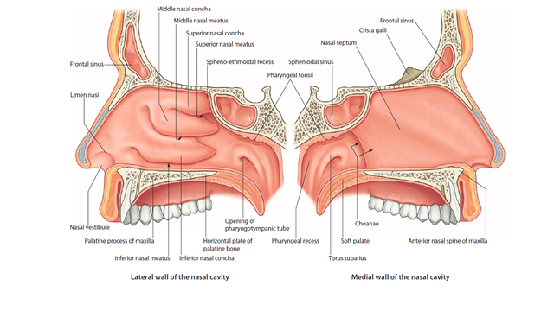
Nasal meatus openings
Superior Nasal Meatus Opening
Posterior ethmoidal air cells
Middle Nasal Meatus Opening
Frontal sinus
Anterior ethmoidal air cell of ethmoid sinus
Maxillary sinus
Middle ethmoidal air cell of ethmoid sinus
Inferior Nasal Meatus Openings
Nasolacrimal duct
Sphenoethmoidal recess drains the sphenoid sinus

Slide 2
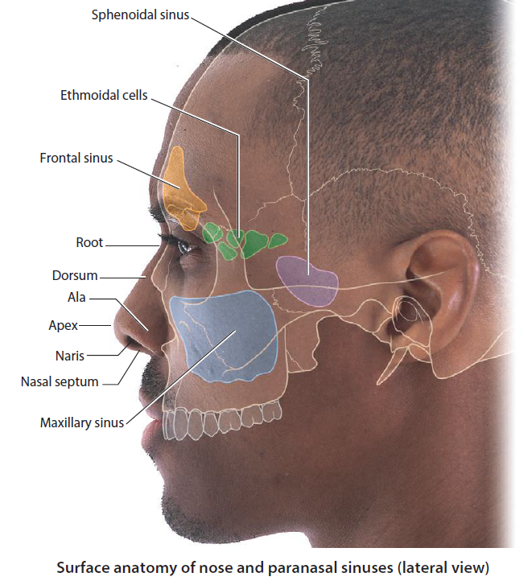
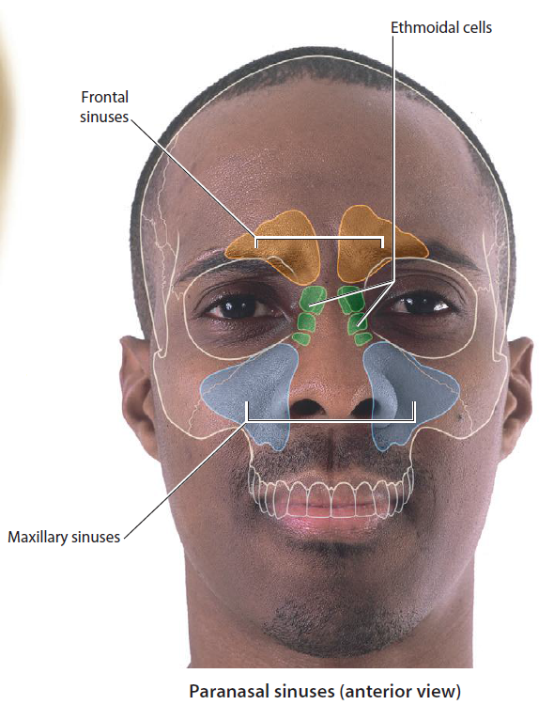

Slide 3
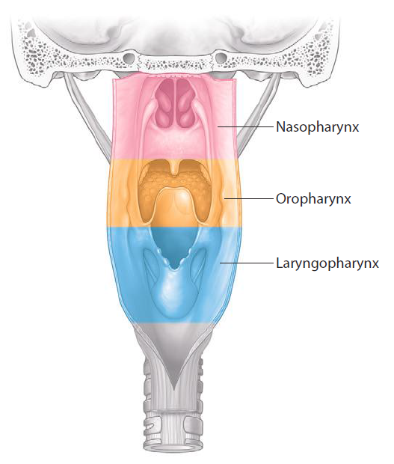
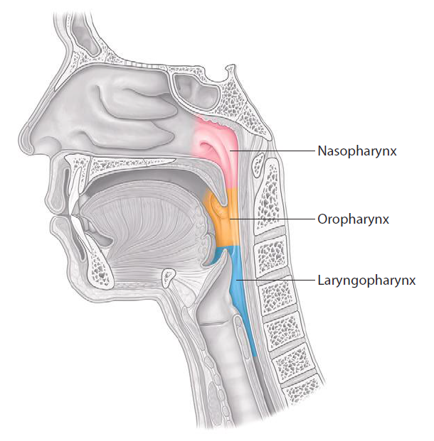
Parts of the Pharynx
Sagittal section
Posterior View

Slide 5
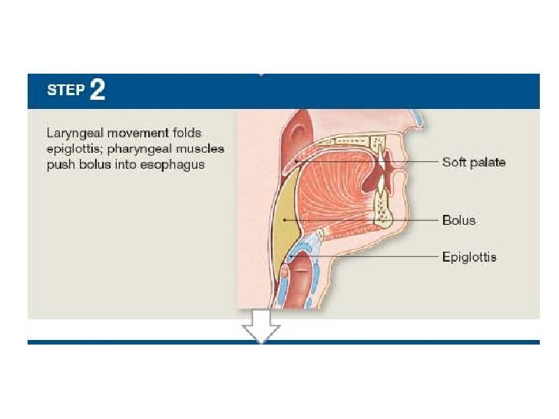

Slide 6
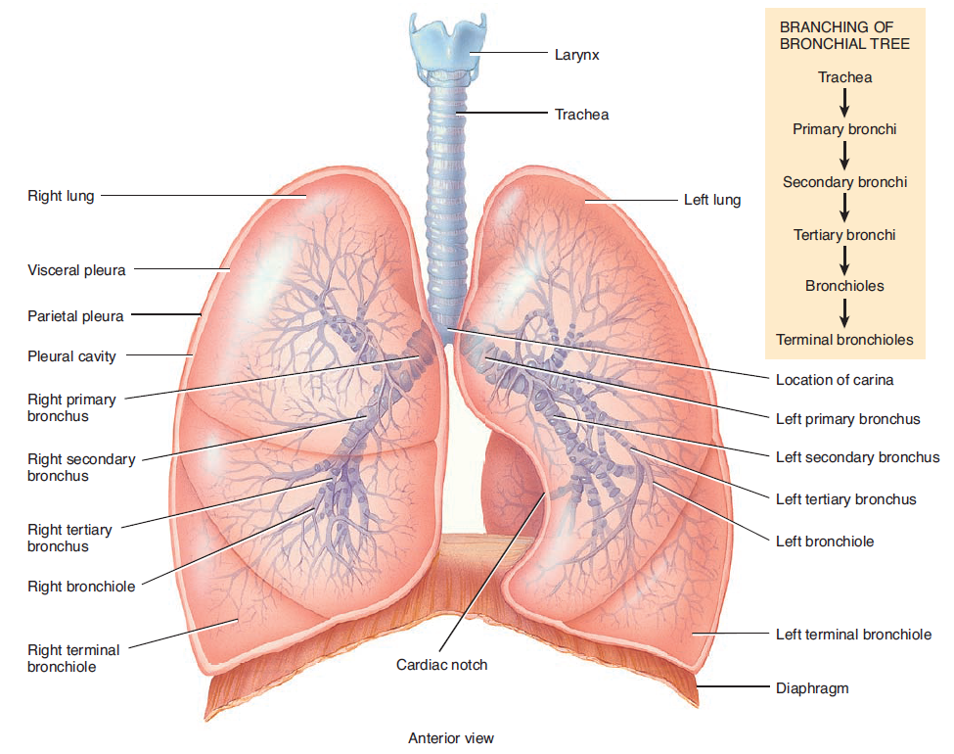
TRACHEA

