Slide 1
Advanced Pharmaceutical Analysis
Introduction to Spectroscopy
Dr. Mohammed Al Amiedy

Slide 2
Problem 1
The molecular formula (C₈H₁₀O) indicates four degrees of unsaturation, which is highly suggestive of an aromatic ring.
To determine the relative integration values, we divide each of the integration values by 9.1, giving a ratio of approximately
5 : 2 : 2 : 1.
Since the compound has ten protons, the numbers above are not only relative values, but they are also exact values.
Now let’s analyze each of the signals individually.

Slide 3
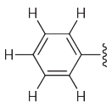
Problem 1
The signal just above 7 ppm confirms our suspicion of an aromatic ring.
This signal has an integration of 5H, indicating a monosubstituted aromatic ring:

Slide 4
Problem 1
The spectrum also exhibits two triplets (just below 3 ppm and just below 4 ppm), indicating two methylene groups connected to each other
Each of these signals appears more downfield than we might expect for a methylene group (1.2 ppm), so each of these methylene groups must be connected to a group that causes a deshielding effect.

Slide 5
Problem 1
If we inspect the two fragments that we have determined thus far (the monosubstituted aromatic ring and the methylene groups that neighbour each other), we will find that these two fragments account for nearly all of the atoms in the molecular formula (C₈H₁₀O).
We only need to account for one more proton and one oxygen atom.
The singlet at 2 ppm has an integration of 1, so this signal corresponds with only one proton (with no neighbours), so we conclude that the compound has an OH group.

Slide 6
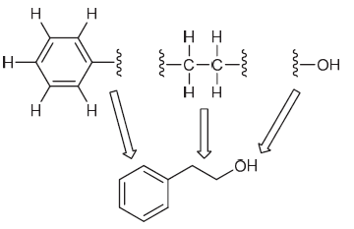
Problem 1

Slide 7
Problem 2
The molecular formula (C₇H₁₄O) indicates one degree of unsaturation, which means that the compound must possess either a double bond or a ring.
To determine the relative integration values, we divide each of the integration values by 10.8, giving a ratio of approximately 1 : 6.
This spectrum has the characteristic pattern of an isopropyl group (a doublet with a relative integration of 6 and a septet with a relative integration of 1).

Slide 8
Problem 2
An isopropyl group only contains seven protons, but there are fourteen protons in the compound (C₇H₁₄O).
We therefore conclude that the compound must contain two isopropyl groups, which are interchangeable by symmetry:
Notice that the two isopropyl groups account for all but one of the carbon atoms in the compound.
Therefore, there can only be one carbon atom in between the two isopropyl groups.

Slide 9
Problem 2
This carbon atom cannot have any protons, since we don’t see any other signals in the 1H NMR spectrum.
We must still account for one oxygen atom (C₇H₁₄O), and we said that the compound contains one degree of unsaturation.
This all points to a carbonyl group at the central position:
This structure is indeed consistent with the observed chemical shift at 2.7 ppm for the methine (CH) protons (1.7 + 1 = 2.7 ppm).

Slide 10
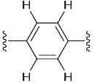
Problem 3
The molecular formula (C₁₀H₁₄O) indicates four degrees of unsaturation, which is highly suggestive of an aromatic ring.
The signals near 7 ppm are likely a result of aromatic protons.
Notice that the combined integration of these two signals is 4H.
This, together with the distinctive splitting pattern (a pair of doublets), suggests a 1,4-disubstituted aromatic ring:

Slide 11
Problem 3
The spectrum also exhibits a singlet with an integration of 9H (at approximately 1.4 ppm) which is characteristic of a tert-butyl group.
If we inspect the two fragments that we have determined thus far (the disubstituted aromatic ring and the tert-butyl group), we will find that these two fragments account for nearly all of the atoms in the molecular formula (C₁₀H₁₄O).

Slide 12
Problem 3
We only need to account for one more proton and one oxygen atom.
The peak just under 5 ppm has an integration of 1, so this signal corresponds with only one proton (with no neighbours), so we conclude that the compound has an OH group.
This signal is broad, which is often (although not always) the case for signals arising from OH groups.
There is only one way to assemble the three fragments:

Slide 13
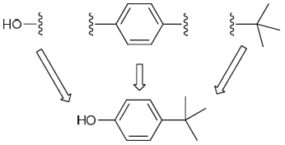
Problem 3

Slide 14
Problem 4
The molecular formula (C₄H₆O₂) indicates two degrees of unsaturation, which means that the compound must possess either two double bonds, or two rings, or one ring and one double bond, or a triple bond.
To determine the relative integration values, we divide each of the integration values by 19.46, giving a ratio of approximately 1 : 1 : 1.
The molecular formula indicates six protons (rather than three), so the relative integration values must correspond with two protons for each signal.

Slide 15
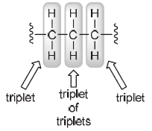
Problem 4
That is, the spectrum indicates the presence of three different methylene groups.
From the splitting patterns (a triplet, a triplet, and a triplet of triplets), we can conclude that the three methylene groups are connected to each other:

Slide 16
Problem 4
Now let’s focus on the chemical shifts of the triplets (2.4 ppm and 4.3 ppm).
Both signals are shifted downfield (relative to 1.2 ppm for a typical methylene group).
One of these signals is significantly shifted downfield, perhaps because it is next to an oxygen atom (after all, the molecular formula indicates that there are two oxygen atoms in the compound):

Slide 17
Problem 4
The other triplet is also shifted downfield, but the effect is weaker.
This seems consistent with the effect of a carbonyl group:
The central methylene group is beta to both the oxygen atom and the carbonyl group, and it feels the distant effects of both (explaining why that signal is shifted somewhat downfield itself).

Slide 18
Problem 5
The fragment above accounts for ALL of the atoms in the molecular formula, yet we are still missing one degree of unsaturation (the product must contain two degrees of unsaturation, but the fragment above has only one degree of unsaturation).
Therefore, we close the ends together, giving the following structure:

Slide 19
Problem 5
The molecular formula (C₉H₁₀O) indicates five degrees of unsaturation, which is highly suggestive of an aromatic ring, in addition to either one double bond or one ring.
To determine the relative integration values, we divide each of the integration values by 13.9, giving a ratio of approximately 1 : 1.5 : 1 : 1.5. Since the compound has ten protons, the numbers above must correspond with: 2 : 3 : 2 : 3
Now let’s analyze each of the signals individually.
The signals near 7 ppm are likely a result of aromatic protons.

Slide 20
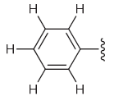
Problem 5
Notice that the combined integration of these signals is 5H, indicating a monosubstituted aromatic ring:
The spectrum also exhibits the characteristic pattern of an ethyl group (a quartet with an integration of 2 and a triplet with an integration of 3):

Slide 21
Problem 5
If we inspect the two fragments that we have determined thus far (the monosubstituted aromatic ring and the ethyl group), we will find that these two fragments account for nearly all of the atoms in the molecular formula (C₉H₁₀O).
We only need to account for one more carbon atom and one oxygen atom.
Let’s not forget that our structure still needs one more degree of unsaturation, suggesting a carbonyl group:

Slide 22
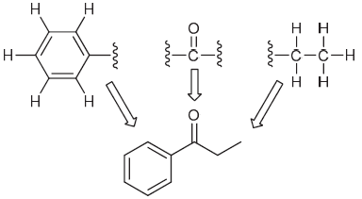
Problem 5

Slide 23
Problem 6
The molecular formula (C₅H₁₂O) indicates no degrees
of unsaturation, which means that the compound does not have a π bond or a ring.
To determine the relative integration values, we divide each of the integration values by 13.6, giving a ratio of approximately 1 : 2 : 6 : 3.
Since the compound has twelve protons, the numbers above are not only relative values, but they are also exact values.
Now let’s analyze each of the signals individually.

Slide 24
Problem 6
Let’s begin with the two signals that represent the characteristic pattern for an ethyl group (a quartet with an integration of 2 and a triplet with an integration of 3).
The singlet at 1.2 ppm has an integration of 6, indicating two methyl groups that can be interchanged via symmetry (and they cannot have any neighbouring protons).

Slide 25
Problem 6
The singlet at 2.2 ppm has an integration of 1, so this signal corresponds with only one proton (with no neighbours), so we conclude that this likely represents an OH group
If we inspect the fragments that we have determined thus far (an ethyl group, two methyl groups and an OH group), we will find that these fragments account for all of the atoms in the molecular formula (C₅H₁₀O) except for one carbon atom. Indeed, this carbon atom is necessary to connect all of the fragments, as shown

Slide 26
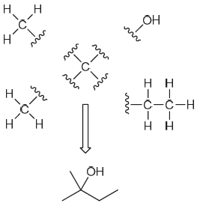
Problem 6

Slide 27
Problem 7
Begin by calculating the HDI. The molecular formula indicates 9 carbon atoms and 1 nitrogen atom.
These would require 21 hydrogen atoms in order to be fully saturated.
There are only 13 hydrogen atoms, so 8 hydrogen atoms are missing. Therefore, the HDI is 4.
This is a relatively large number, and it would be inefficient to think about all of the possible ways to have 4 degrees of unsaturation.

Slide 28
Problem 7
Anytime we encounter an HDI of 4 or more, we should be
on the lookout for an aromatic ring.
Keep this in mind when analyzing the spectrum, which we expect to exhibit aromatic protons (near 7 ppm).
Next, consider the number of signals and the integration value for each signal.
Be on the lookout for integration values that suggest the presence of symmetry.
For example, a signal with an integration of 4 would suggest two equivalent CH₂ groups.

Slide 29
Problem 7
The spectral data indicates a total of 6 signals.
Let’s begin with the pair of triplets just below 3 ppm, each of which has an integration of 2.
This suggests that there are two adjacent methylene groups.
The singlet near 4 ppm has an integration of 3 which suggests an isolated methyl group, likely connected to an electronegative oxygen atom.

Slide 30
Problem 7
A methoxy fragment, OCH3, seems likely.
Moving downfield, there are 2 doublets near 7 ppm, each of which has an integration of 2. This pattern is characteristic
of a 1,4-disubstituted benzene ring, bearing two different substituents (with different electronic demands).
In such a case, there are two types of aromatic protons, each of which has an integration of 2 and is split into a doublet by its one neighbour:

Slide 31
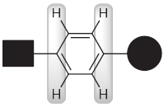
Problem 7
So far, we have the following three fragments:
These fragments collectively account for 9 carbon atoms, 11 hydrogen atoms, and 1 oxygen atom.

Slide 32
Problem 7
If we inspect the molecular formula, we see that we have accounted for all of the carbon atoms and the oxygen atom, but we must still account for 2 more hydrogen atoms and 1 nitrogen atom.
Therefore, we conclude that the broad singlet near 1 ppm is
likely to be an NH₂ group.
The NH₂ protons generally appear as broad signals between 0.5 and 5.0 ppm.
Next, we assemble the fragments.
There are two ways to connect the fragments in this case.

Slide 33
Problem 7
To distinguish between these two options, we consider chemical shifts.
Note that the adjacent methylene groups appear fairly close to one another, near 3 ppm, indicating that neither is attached to the highly electronegative and deshielding oxygen atom.

Slide 34
Problem 7
The first compound above shows a CH₂ group connected to oxygen, and we expect that compound to produce a triplet somewhere near 4 ppm, which is absent from the spectral data.
The second compound above has the two CH₂ groups connected to an aromatic ring and an NH₂ group, respectively, which is consistent with the observed chemical shifts of these triplets.

