Slide 1
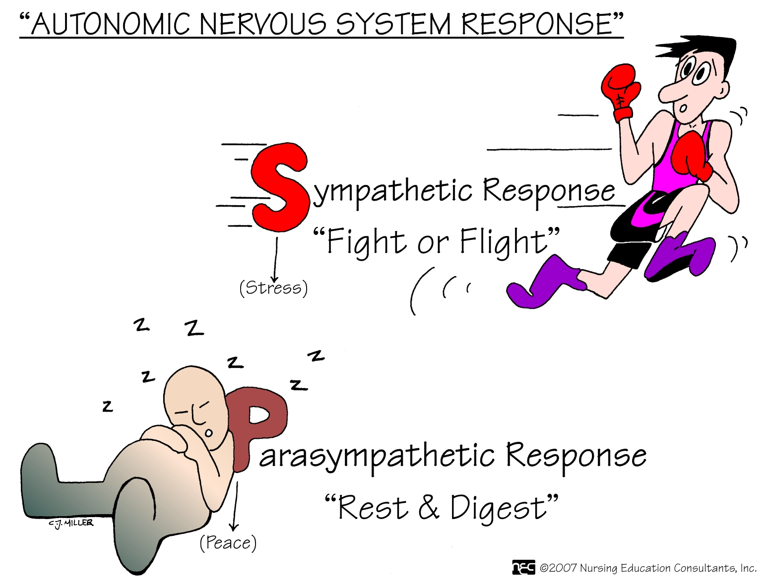


Slide 2
Cholinergic Agonists

Slide 5
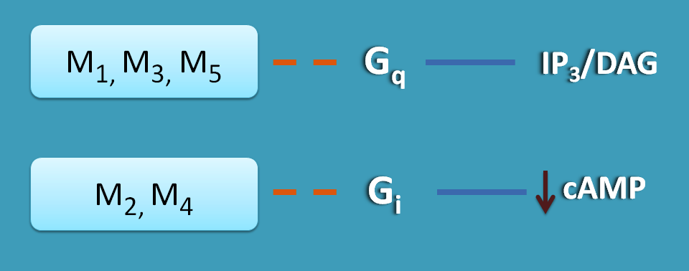

Slide 6
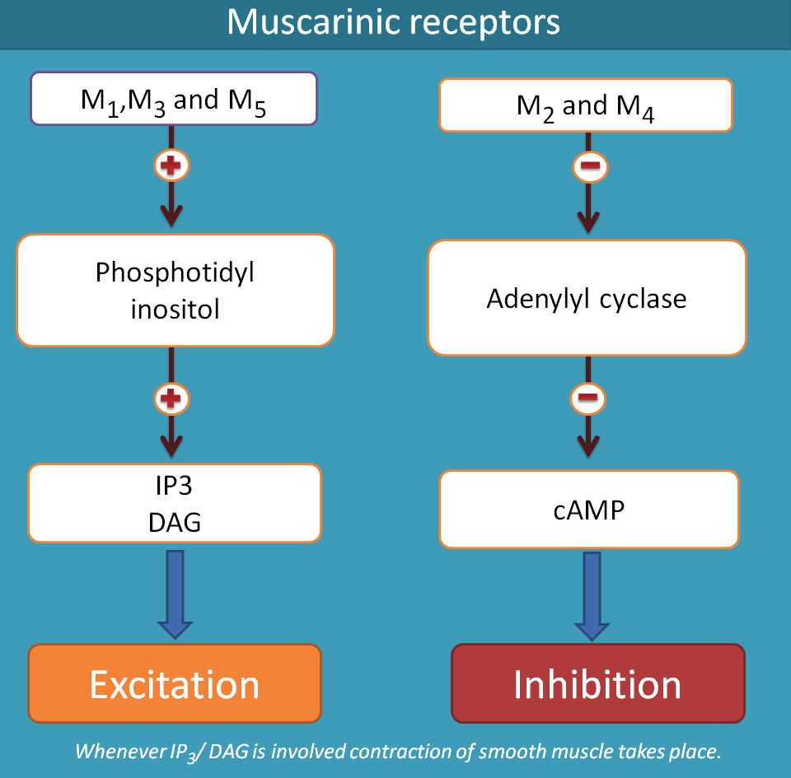

Slide 7
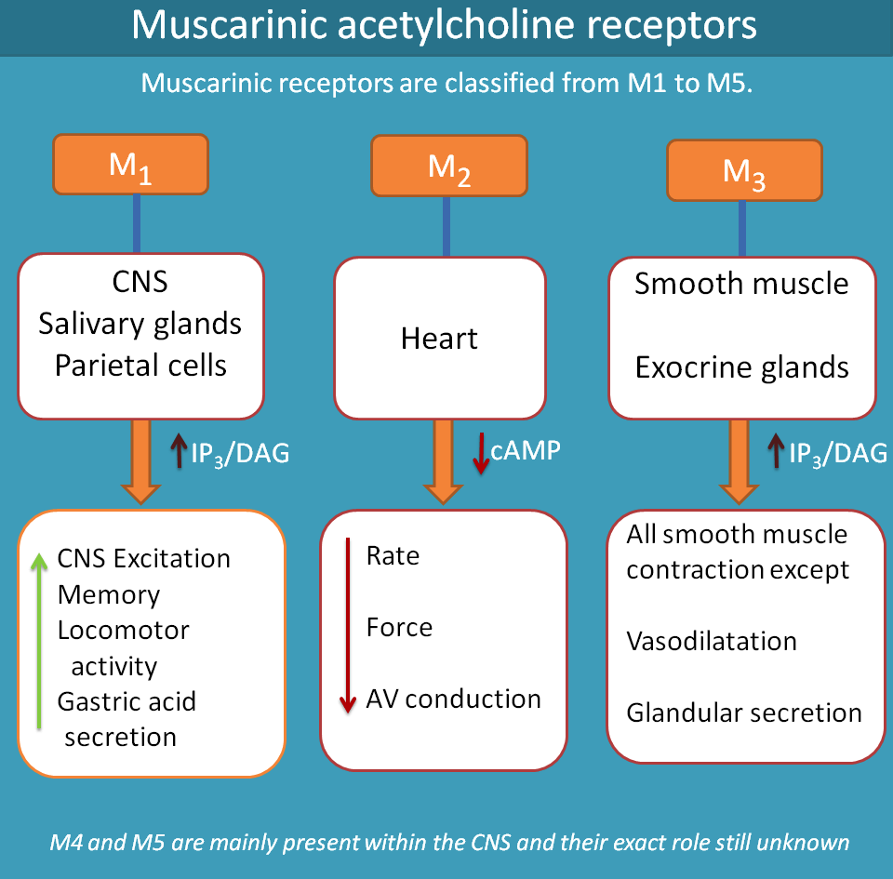

Slide 9
Direct-Acting Cholinomimetics
Direct-Acting Cholinergic Agonists (N & M)
Cholinergic agonists (parasympathomimetics) mimic the effects of ACh on cholinoceptors.
These agents broadly classified into:
Endogenous choline esters, Ach
Synthetic esters of choline, carbachol and bethanechol.
Naturally occurring alkaloids, nicotine, pilocarpine
All of the direct-acting cholinergic drugs have longer durations of action than acetylcholine
As a group, the direct-acting agonists show little specificity in their actions, which limits their clinical usefulness

Slide 10
Acetylcholine (Ach)
Quaternary ammonium compound --------
Site of action --------
Both muscarinic and nicotinic activity
Therapeutic uses -----
HR & CO (vagal stimulation).
Effect of IV Ach on:
Heart: ------------ due to -----------------

Slide 11
II. Blood Pressure
Injection of Ach
vasodilation and lowering BP ( indirect mechanism of action)
activates M₃ receptors on endothelial cells lining SM of BVs
production of nitric oxide from arginine
NO diffuses to vascular SM stimulates PK G production
hyperpolarization (SM relaxation through PDE-3 inhibition)

Slide 12
III. Other Actions of ACh
GIT: increases salivary secretion and stimulates intestinal secretions and motility.
Bronchiolar secretions are also enhanced.
Genitourinary tract: the tone of the detrusor urinae muscle is increased, causing expulsion of urine.
Eye, stimulating ciliary muscle contraction for near vision
Constriction of the pupillae sphincter muscle, causing miosis
Acetylcholine (1% solution) is instilled into the anterior chamber of the eye to produce miosis during ophthalmic surgery.

Slide 13
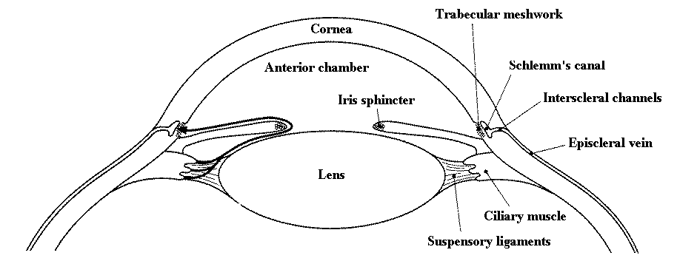
The Eye
The Eye

Slide 14
Adverse Effects of Cholinomimetics

Slide 15
Bethanechol
Structurally related to Ach (in which the acetate is replaced by carbamate and the choline is methylated).
Not hydrolyzed by AChE (addition of carbonic acid), / inactivated by other esterases.
lacks N actions / have strong M activity
Major actions / SMs of the bladder & GIT.
Duration of action of about 1 hour.

Slide 16
Bethanechol (cont.)
Actions:
Direct effect on MRs, intestinal motility & tone???
Detrusor Ms of the bladder ??? whereas the trigone & sphincter ???
Therapeutic applications:
Stimulate the atonic bladder, particularly in postpartum or postoperative, nonobstructive urinary retention.
Neurogenic atony ( poor muscular condition )
Megacolon (Hypertrophy & dilation of colon with prolonged constipation).
Adverse effects: generalized cholinergic stimulation (?????)

Slide 17
Carbachol (carbamylcholine)
Potent M & N agonist
Ester of carbamic acid / poor substrate of AChE
Actions:
On both the CVS & GIT (???)
Release of Epi / adrenal medulla
Miosis and a spasm of accommodation ???
Therapeutic uses:
Rarely used therapeutically ??? except as a miotic / glaucoma
Adverse effects: at ophthalmic doses ???

Slide 18
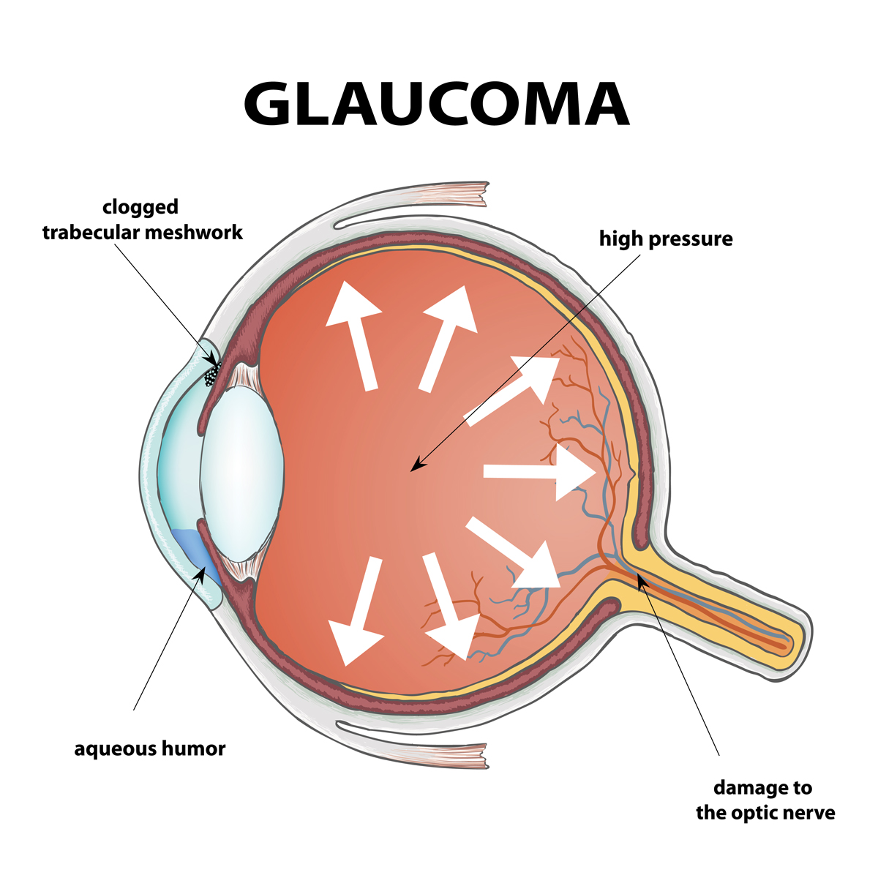
Glaucoma
A disease that damages optic nerve.
Occurs when extra fluid increases the pressure on the front chamber of the eye.
A leading cause of blindness for people over 60 years old
Blindness can often be prevented with early treatment.

Slide 19
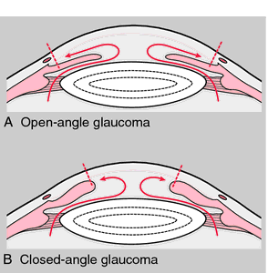
Types of glaucoma
Primary open-angle glaucoma
Most common, occurs gradually, where the eye does not drain fluid
Eye pressure builds and starts to damage the optic nerve.
Painless and causes no vision changes at first.
Angle-closure glaucoma (also called “closed-angle glaucoma” or “narrow-angle glaucoma”, acute)
The iris is very close to the drainage angle in the eye.
The iris can end up blocking the drainage angle, eye pressure rises very quickly.

Slide 20
Pilocarpine
Alkaloid / 3◦ amine /stable to hydrolysis by AChE
Less potent than Ach / high penetration to CNS
M agonist used in ophthalmology.
Miosis and contraction of the ciliary muscle, spasm of accommodation
Stimulator of sweat, tears, and saliva
Beneficial in promoting salivation in patients with xerostomia resulting from irradiation of the head and neck
Sjögren syndrome (immune system attacks the glands that make tears and saliva (spit). The damage keeps these glands from working right and causes dry eyes and dry mouth)

Slide 21
Pilocarpine (cont.)
Drug of choice for emergency lowering IOP of both open-angle and angle-closure glaucoma
Within a few minutes, lasts 4 to 8 hours, and can be repeated
Topical carbonic anhydrase inhibitors, such as dorzolamide and β-adrenergic blockers such as timolol, are effective in treating glaucoma but are not used for emergency lowering of intraocular pressure
The miotic action of pilocarpine is also useful in reversing mydriasis due to atropine

Slide 22
Pilocarpine (cont.)
Adverse effects:
blurred vision, night blindness
Poisoning with this agent is characterized by exaggeration of various parasympathetic effects, including profuse sweating (diaphoresis) and salivation.
Parenteral atropine, at doses that can cross the blood–brain barrier, is administered to counteract the toxicity of pilocarpine.

Slide 24
Indirect Cholinergic Agonists Anticholinesterases (Reversible)

Slide 25
Edrophonium
Short acting 4◦ amine (10-20 min) due to renal excretion
Used in the diagnosis of myasthenia gravis.
IV injection of edrophonium leads to a rapid increase in muscle strength
Care must be taken / cholinergic crisis. (atropine is the antidote)
Used to reverse nondepolarizing NMJ

Slide 26
Physostigmine
Natural 3◦ amine, 30 min – 2 hrs (intermediate)
intestinal and bladder motility / atony of either organ
Topically on the eye, miosis and spasm of accommodation, as well as IOP used to treat glaucoma / pilocarpine is more effective.
Used for overdoses of drugs with anticholinergic actions, such as atropine, phenothiazines, and tricyclic antidepressants.
Adverse effects:
CNS / convulsions when high doses are used
Bradycardia and a fall in CO may also occur.
Paralysis of skeletal muscle.

Slide 27
Pyridostigmine and ambenomium:
cholinesterase inhibitors that are used in the chronic management of myasthenia gravis.
Adverse effects similar to those of neostigmine
Tacrine, donepezil, rivastigmine, and galantamine:
patients with Alzheimer's disease have a deficiency of cholinergic neurons in the CNS
led to the development of anticholinesterases as possible remedies for the loss of cognitive function
Tacrine was the first to become available, but it has been replaced by the others because of its hepatotoxicity.
Donepezil, Rivastigmine, & Galantamine / delay the progression disease, none can stop its progression
Gastrointestinal distress is their primary adverse effect

Slide 28
Irreversible Anti-Cholinesterase Agents
(Indirect –Acting Cholinergic Agonists)
Synthetic organophosphate cpds
Bind covalently
Used for military & agriculture
Echothiophate
Organophosphate covalently binds via its phosphate group at the active site of AChE / permanently inactivated
Restoration of AChE activity ???
Aging / impossible for chemical reactivators

Slide 29
Actions: generalized cholinergic stimulation, paralysis of motor function (causing breathing difficulties), and convulsions
Miosis, decrease IOP
Atropine in high dosages can reverse many of the peripheral and some of the central muscarinic effects of echothiophate.
Therapeutic uses:
treatment of open-angle glaucoma/rarely used

Slide 30
Irreversible AChE inhibitors (mostly organophosphate compounds) are used as agricultural insecticides /led to numerous cases of accidental poisoning with these agents
frequently used for suicidal and homicidal purposes
Organophosphate nerve gases, e.g. Sarin used as agents of warfare and chemical terrorism
Toxicity with these agents is manifested as nicotinic and muscarinic signs and symptoms (cholinergic crisis

Slide 31
Reactivation of acetylcholinesterase
Pralidoxime (2-PAM) can reactivate inhibited AChE
Unable to penetrate into the CNS and therefore is not useful in treating the CNS effects of organophosphates
If given before aging / reverse both M & N peripheral effects of organophosphates, but not the CNS effects
With the newer nerve agents that produce aging of the enzyme complex within seconds
Pralidoxime is a weak AChE inhibitor and, at higher doses, may cause side effects similar to other AChE inhibitors

Slide 32
Other treatments
Atropine ???
Diazepam is also administered to reduce the persistent convulsion caused by these agents
General supportive measures, such as maintenance of patient airway, oxygen supply, and artificial respiration

