Slide 1
Lecture 6
Delivery of proteins
Alternative route of administration

Slide 2
Alternative Route of Administration
Parenteral administration has disadvantages (needles, injection, skill) compared to other possible routes.
Therefore, systemic delivery of recombinant proteins by alternative routes of administration (apart from the GI tract) has been studied extensively.
the nose, lungs, rectum, oral cavity, and skin have been selected as potential sites of application.

Slide 3
The potential pros and cons for different relevant routes
Nasal
Advantage:
Easily accessible
Fast uptake
Proven track record with a number of “conventional” drugs
Probably lower proteolytic activity than in the GI tract
Avoidance of first pass effect
Spatial containment of absorption enhancers is possible

Slide 4
Nasal
Disadvantage:
Reproducibility (in particular under pathological conditions)
Safety (e.g., cilliary movement)
Low bioavailability for proteins

Slide 5
Pulmonary
Advantage:
Relative easy to access
Fast uptake
Proven track record with “conventional” drugs
Substantial fractions of insulin are absorbed
Lower proteolytic activity than in the GI tract
Avoidance of hepatic first pass effect
Spatial containment of absorption enhancer(?)

Slide 6
Pulmonary
Disadvantage:
Reproducibility (in particular under pathological conditions, smoker/non-smoker)
Safety (e.g., immunogenicity)
Presence of macrophages in the lung with affinity for particulates

Slide 7
Rectal
Advantage:
Easily accessible
Partial avoidance of hepatic first pass
Probably lower proteolytic activity than in the upper parts of GI tract
Spatial containment of absorption enhancers is possible
Proven track record with a number of “conventional” drugs
Disadvantage:
Low bioavailability for proteins

Slide 8
Buccal
Advantage:
Easily accessible
Avoidance of hepatic first pass
Probably lower proteolytic activity than in the lower parts of the GI tract
Spatial containment of absorption enhancer is possible
Option to remove formulation if necessary
Buccal
Disadvantage:
Low bioavailability of proteins
No proven track record yet (?)

Slide 9
Transdermal
Advantage:
Easily accessible
Avoidance of hepatic first pass
Removal of formulation if necessary is possible
Spatial containment of absorption enhancers
Proven track record with “conventional” drugs
Sustained/controlled release possible
Disadvantage:
Low bioavailability of proteins

Slide 10
Conclusion
The nasal, buccal, rectal, and transdermal routes all have been shown to be of little clinical relevance if systemic action is required, and if simple protein formulations without an absorption enhancing technology are used.
In general, bioavailability is too low and varies too much! The pulmonary route may be the exception to this rule.

Slide 11
The following Table presents the bioavailability in rats of intratracheally administered protein solutions with a wide range of molecular weights
Absorption was strongly protein dependent, with no clear relationship with its molecular weight.

Slide 12
Absolute bioavailability of a number of proteins (intratracheal vs. IV) in rats
Absolute bioavaliability (%) | No. of AA | Mwt kDa | Molecule
> 56 | 165 | 20 | Α-interferon
> 20 | 84 | 9 | PTH-84
40 | 34 | 4.2 | PTH-34
17 | 32 | 3.4 | Calcitonin (human)
17 | 32 | 3.4 | Calcitonin (salmon)
< 1 | 29 | 3.4 | Glucagons
< 1 | 28 | 3.1 | Somatostatin

Slide 13
In human the drug should be inhaled instead of intratracheally administered.
The delivery of insulin to Type I (juvenile onset) and Type II (adult onset) diabetics has been extensively studied and clinical phase III trials evaluating efficacy and safety have been performed or are ongoing.
The first pulmonary insulin formulation was approved by FDA in January 2006 (Exubera®).

Slide 14
Pulmonary inhalation of insulin is specifically tested for meal time glucose control.
Uptake of insulin is faster than after a regular SC insulin injection (5-60 minutes versus 60-180 minutes).
The reproducibility of the blood glucose response to inhaled insulin was equivalent to SC injected insulin, but patients preferred inhalation over SC injection.

Slide 15
Inhalation technology plays a critical role when considering the prospect of the pulmonary route for the systemic delivery of therapeutic proteins.
Dry powder inhalers and nebulizers (Nebulizers are machines that transform liquid medication into a mist for inhalation) are being tested.

Slide 16
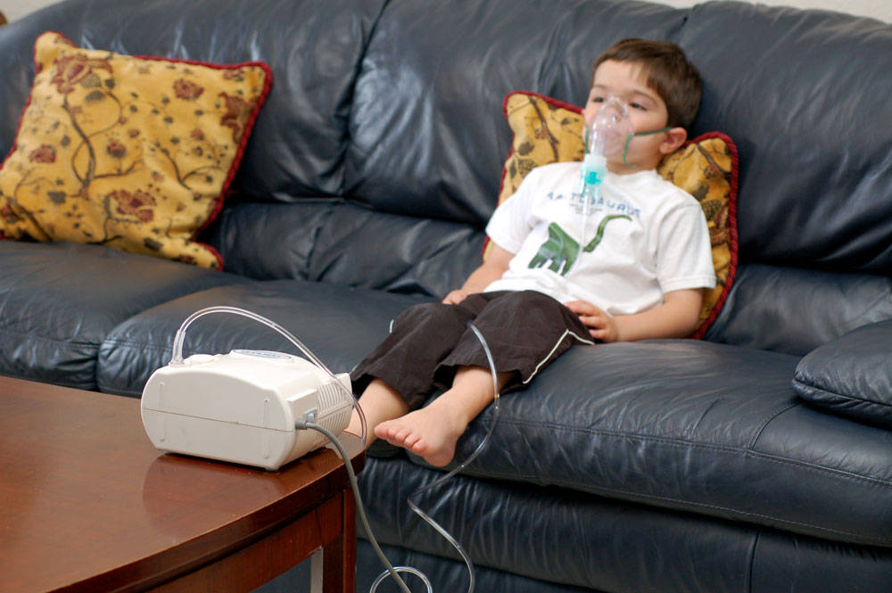
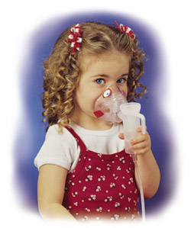
Nebulizers

Slide 17
The fraction of insulin that is ultimately absorbed depends on:
The fraction of the inhaled/ nebulised dose that is actually leaving the device,
The fraction that is actually deposited in the lung, and
The fraction that is being absorbed, i.e., total relative uptake (TO%)

Slide 18
TO % = % uptake from device x % deposited in the lungs x % actually absorbed from the lungs.
TO % for estimated to be about 10%.
The fraction of insulin that is absorbed from the lung is estimated to be around 20%.
These figures demonstrate that insulin absorption via the lung may be a promising route; but the fraction absorbed is small.

Slide 19
Therefore, different approaches have been evaluated to increase bioavailability of the pulmonary and other non-parenteral routes of administration .
The goal is to develop a system that temporarily decreases the absorption barrier resistance with minimum and acceptable safety concerns.

Slide 20
Approaches to enhance bioavailability of proteins
Classified according to proposed mechanism of action
Increase the permeability of the absorption barrier: Addition of fatty acids/phospholipids, bile salts, enamine derivatives of phyenylglycine, ester and ether type (non)-ionic detergents, saponins, salicylate derivatives of fusidic acid or glycyrrhizinic acid, or methylated β cyclodextrins Through iontophoresis By using liposomes Decrease peptidase activity at the site of absorption and along the “absorption route”: aportinin, bacitracin, soybean tyrosine inhibitor, boroleucin, borovaline Enhance resistance against degradation by modification of the molecular structure Prolongation of exposure time (e.g., bio-adhesion technologies)

Slide 21
Examples of Absorption Enhancing Effects effect of glycocholate (absorption enhancer) on nasal bioavailability of some proteins and peptides.
Bioavailability (%) |  | No. of AA | Molecule
With glycocholate | Without glycocholate
70-90 | < 1 | 29 | Glucagon
15-20 | < 1 | 32 | Calcitonin
10-30 | < 1 | 51 | Insulin
7-8 | < 1 | 191 | Met-hgH

Slide 22
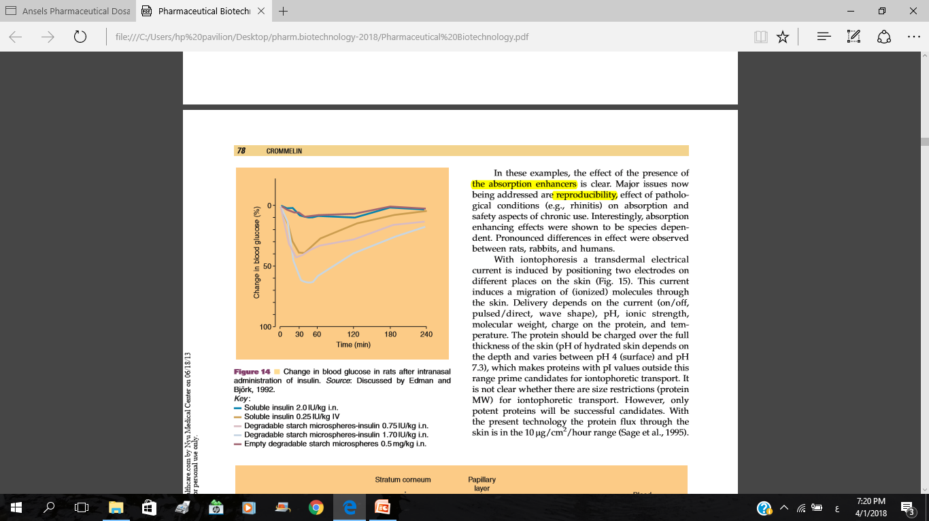

Slide 23
In these examples, the effect of the presence of the absorption enhancers is clear.
Major issues now being addressed are reproducibility, effect of pathological conditions (e.g., rhinitis) on absorption and safety aspects of chronic use.
Interestingly, absorption enhancing effects were shown to be species dependent.
Pronounced differences in effect were observed between rats, rabbits, and humans.

Slide 24
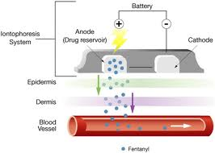
Iontophoresis
With iontophoresis a transdermal electrical current is induced by positioning two electrodes on different places on the skin.

Slide 25
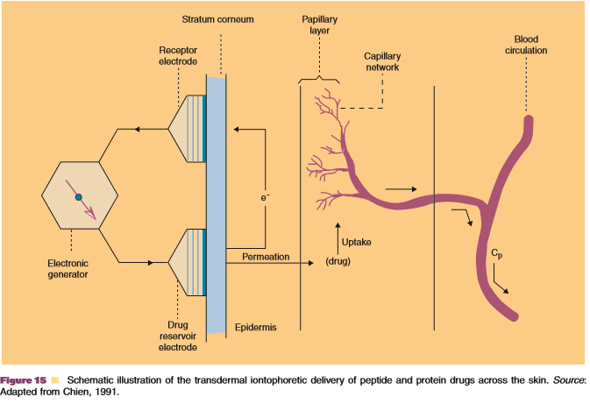

Slide 26
This current induces a migration of (ionized) molecules through the skin.
Delivery depends on the current (on/off, pulsed/direct, wave shape), pH, ionic strength, molecular weight, charge on the protein, and temperature.
The protein should be charged over the full thickness of the skin (pH of hydrated skin depends on the depth and varies between pH 4 (surface) and pH 7.3), which makes proteins with pI values outside this range prime candidates for iontophoretic transport.

Slide 27
It is not clear whether there are size restrictions (protein MW) for iontophoretic transport. However, only potent proteins will be successful candidates. With the present technology the protein flux through the skin is in the 10 µg/cm²/hour range.

Slide 28
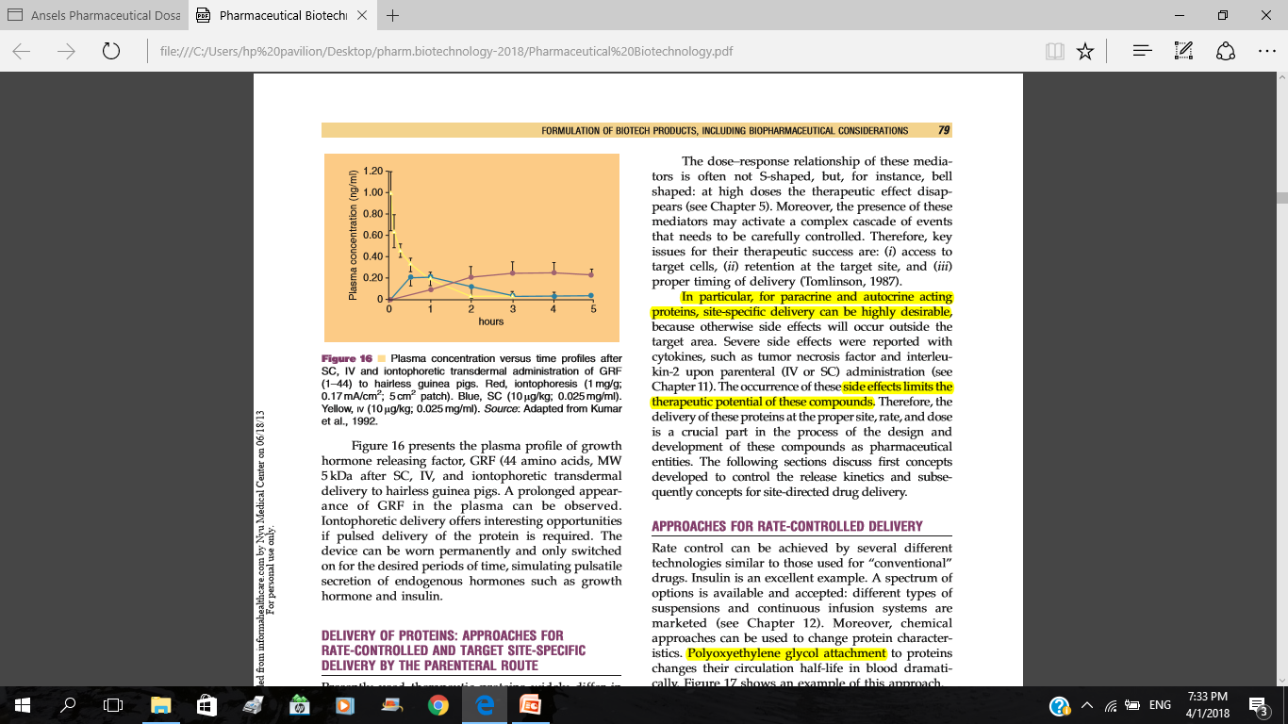

Slide 29
The figure presents the plasma profile of growth hormone releasing factor, GRF (44 amino acids, MW 5kDa after SC, IV, and iontophoretic transdermal delivery to hairless guinea pigs.
A prolonged appearance of GRF in the plasma can be observed.
Iontophoretic delivery offers interesting opportunities if pulsed delivery of the protein is required.
The device can be worn permanently and only switched on for the desired periods of time, simulating pulsatile secretion of endogenous hormones such as growth hormone and insulin.

Slide 30
Liposomes
Liposomes are microscopic vesicles that consist of an aqueous center with a phospholipid membrane;
phospholipids contain a glycerol bonded to 2 fatty acids and a phosphate group with a polar head.
The fatty acid portion of this biomolecule is hydrophobic and is located toward the outside of the lipid bilayer whereas the phosphate group is hydrophilic and faces the aqueous interior.
These phospholipid walls are identical to those that comprise other human cell membranes.
Liposomes can differ in size, with a range in diameter between 15-3500 nm, and they can be found in unilamellar or multilamellar forms.

Slide 31
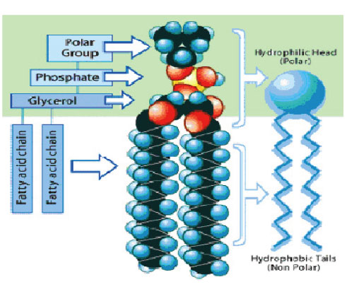
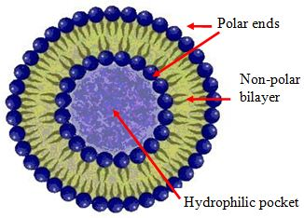
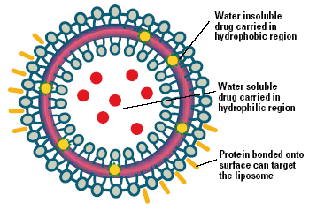
Liposomes

Slide 32
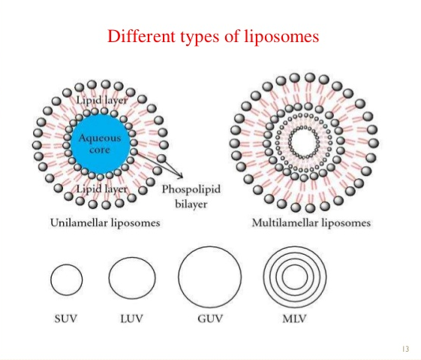

Slide 33
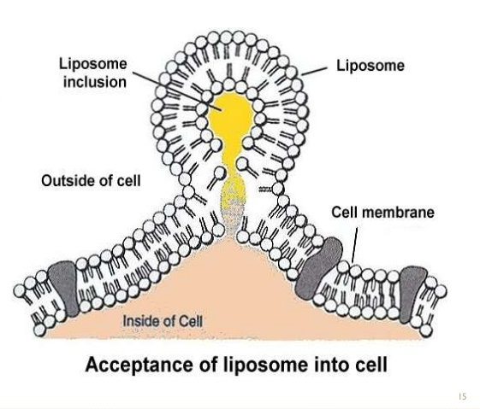

Slide 34
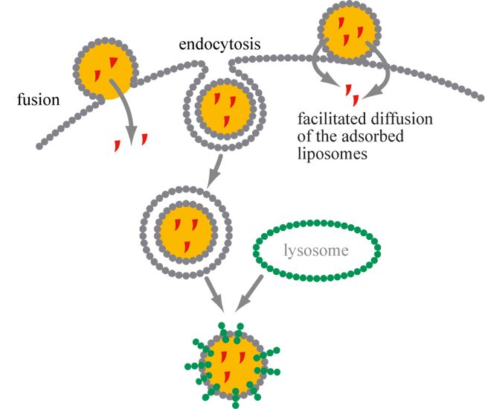

Slide 35
Insulin has traditionally been an injectable preparation which is a common barrier to its use, and as a result, since the discovery of insulin in the 1920s, new strategies for its delivery by routes other than intravenous and subcutaneous (SC) injection have been investigated.

Slide 36
Many pharmaceutical companies doing research in the field to develop an inhalational preparation announced the termination of product development following the poor acceptance and risk of lung cancer of the first US FDA approved inhaled insulin product, Exubera®.
This formulation produced cough, dyspnoea (difficulty in breathing), increased sputum, and epistaxis (nosebleed), and was contraindicated in patients with chronic obstructive pulmonary disease (COPD) and asthma

Slide 37
Technosphere insulin: a new inhaled insulin
MannKind Corporation has developed a powdered formulation of insulin with a higher percentage of absorption from the lungs. This product, Afrezza® (Technosphere® insulin), appears to have overcome some of the barriers that contributed to the withdrawal of Exubera® and is currently under review by the FDA.

Slide 38
Technosphere insulin is a new inhaled insulin preparation which mimics normal prandial insulin release. It decreases post-prandial blood glucose (PPG) levels and has good glycaemic control with significantly lesser hypoglycaemia.
Current data show that this formulation has no impact on pulmonary function
Long-term safety studies with regard to
pulmonary function and risk for development of lung carcinoma need to be monitored
The FDA is currently reviewing Technosphere insulin for use in both type 1 and type 2 diabetes

Slide 39
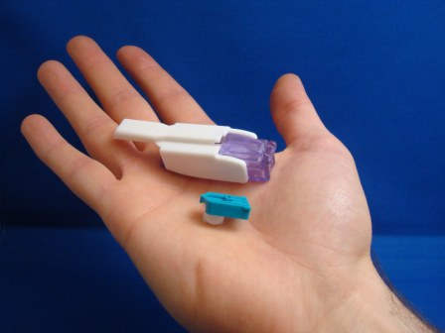
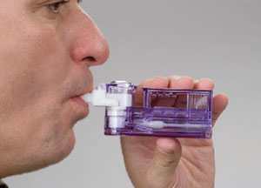
Technosphere® insulin

