Slide 1
Thermodynamics
Thermodynamics is the science that bind heat with energy and work.

Slide 2
Thermodynamics is controlled by four laws that are called the four laws of thermodynamics.
Heat and temperature.
Work and energy.

Slide 3
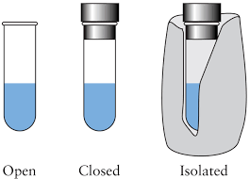
First law of thermodynamics
First law of thermodynamics states that energy is conserved. That means that energy can`t be created or consumed.
In another form, energy changes of an isolated system is constant.

Slide 4
First law of thermodynamics
ΔU = Q – W
Where U is the internal energy of a closed system.
Q is amount of heat that is supplied to the system.
W is the work that is done by the system on the surroundings.
ΔU = U₂ – U_{1.}
If there is no change in volume, it means no work
W=0; ΔU= Q.

Slide 5
Second law of thermodynamics
Second law of thermodynamics states that at any spontaneous process in an isolated system the state of entropy (S) never decreases, ΔS ≥ 0; in irreversible process ΔS > 0, but in reversible process entropy remains constant , i.e. , ΔS = 0.
What is entropy?
Entropy is a measure of disorder of a system.

Slide 6
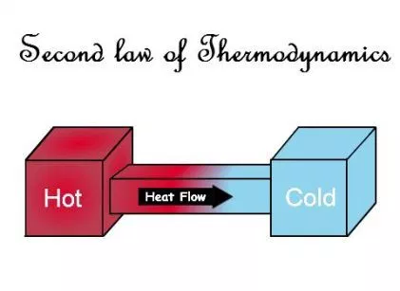
ΔS = ΔQ/T (joule/K°) .
In irreversible process S₂ > S₁
in reversible process S is constant, S₂ = S₁.

Slide 9
Entropy may decrease locally at some region within the isolated system. How can this statement be justified? a) this cannot be possible b) this is possible because entropy of an isolated system can decrease. c) it must be compensated by a greater increase of entropy somewhere within the system. d) none of the mentioned

Slide 11
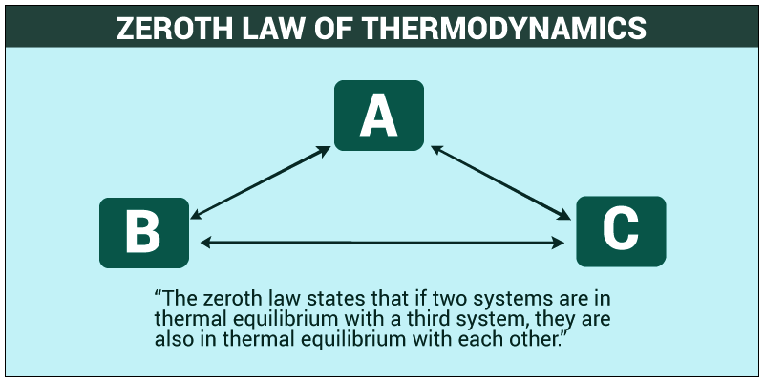
Zeroth law of thermodynamics
If each of two systems is in thermal equilibrium with a third one ( in contact), they are in thermal equilibrium with each other. This case is said to be “ equivalence relation”.

Slide 12
Third law of thirmodynamics
As a system approaches to absolute zero, al processes in the system cease and entropy approaches to a minimal value.

