Slide 1
Gasses laws

Slide 2
Boyle's law
Boyle observed that volume of a given mass of a real gas is inversely proportional to its pressure at constant temperature and in a closed system.
In another form, product of pressure and volume of a given mass of a gas is constant , at constant temperature.
P V = C where C is constant
P₁ V₁ = P₂ V₂ ------------ (1)

Slide 3
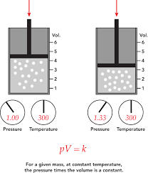

Slide 4
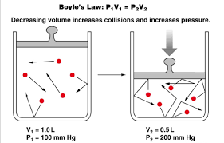

Slide 5
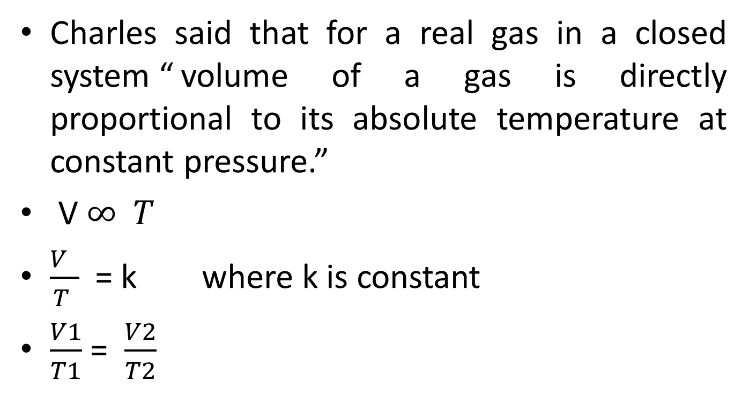
Charles law
Charles said that for a real gas in a closed system “ volume of a gas is directly proportional to its absolute temperature at constant pressure.”
V $∞ T$
$\frac{V }{T }$= k where k is constant
$\frac{V1}{T1}$ = $\frac{V2}{T2}$

Slide 6
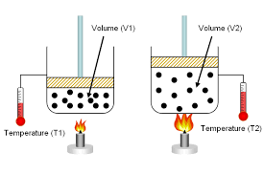

Slide 7
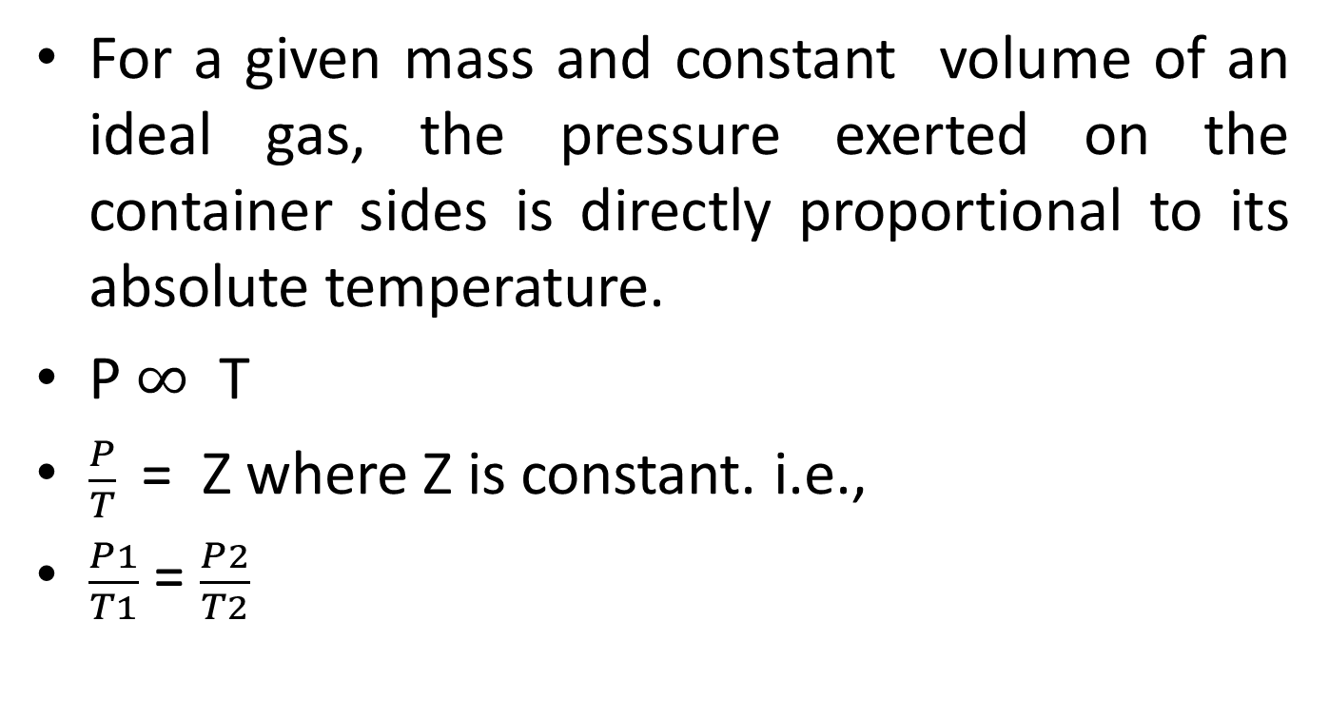
Gay-lusaac`s law
For a given mass and constant volume of an ideal gas, the pressure exerted on the container sides is directly proportional to its absolute temperature.
P $∞$ T
$\frac{P}{T}$ = Z where Z is constant. i.e.,
$\frac{P1}{T1}$ = $\frac{P2}{T2}$

Slide 8
Since 1 atm = 760 torr when we multiply by (1 atm) / (760 torr) we have simply multiplied by 1.

Slide 9
the general equation
We can combine the previous laws in one equation:
PV= n R T
N is number of moles
R is the general gasses constant.
This equation is for ideal gas not for real gas because this equation assumed the molecules of gas as points and there are no forces among molecules, i. e., motion is elastic.

Slide 10
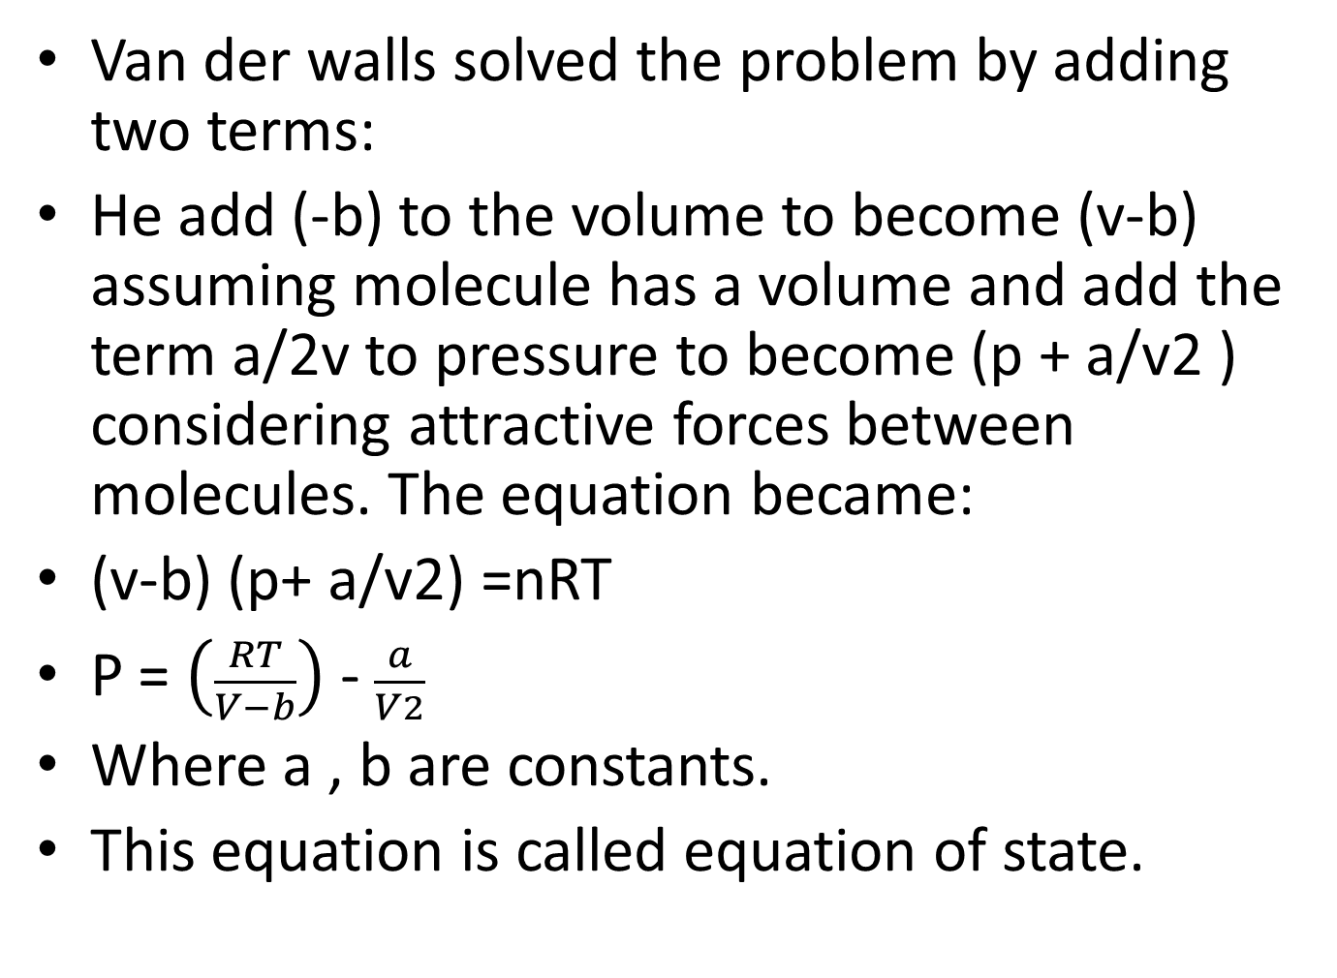
Real equation
Van der walls solved the problem by adding two terms:
He add (-b) to the volume to become (v-b) assuming molecule has a volume and add the term a/2v to pressure to become (p + a/v2 ) considering attractive forces between molecules. The equation became:
(v-b) (p+ a/v2) =nRT
P = $\left(\frac{RT}{V−b}\right)$ - $\frac{a}{V2}$
Where a , b are constants.
This equation is called equation of state.

