Slide 1
Respiratory infections
Arranged by:
Lec. Hadeel Dalman

Slide 2
Respiratory tract infections
Upper respiratory tract infections
Lower respiratory tract infections

Slide 3
Upper respiratory tract infections
Colds and flu
Influenza
Sore throat (pharyngitis)
Acute epiglottitis
Otitis media
Acute sinusitis

Slide 4
Lower respiratory infections
Acute bronchitis and acute exacerbations of COPD
Bronchiolitis
Pneumonia
Severe acute respiratory syndrome
Cystic fibrosis

Slide 5
For each case you need to know the followings:
Definition
Causative organisms
Clinical features
Diagnosis
Treatment

Slide 6
Upper respiratory tract infections

Slide 7
Influenza
True influenza is caused by one of the influenza viruses (influenza A, B or rarely C).
Characterised by severe malaise and myalgia
Potentially complicated by life-threatening secondary bacterial infections such as staphylococcal pneumonia.
No Coryzal symptoms

Slide 8
Treatment
Prophylaxis
Prevention
and Treatment
influenza vaccine…
neuraminidase inhibitors (NAIs)
include agents such as zanamivir and oseltamivir.
The anti-Parkinsonian drug amantadine, which has activity against influenza A virus, is not recommended.

Slide 9
Coryzal symptoms
Sore throat or throat irritation.
Runny nose (increased mucus production) or postnasal drip.
Sneezing.
Nasal and sinus blockage (thick mucus and debris) or congestion with or without sinus pressure.
Headache.
Cough.
Mild fever.
Watery eyes or redness and/or itchiness of eyes.

Slide 10
Sore throat (pharyngitis)
Most cases are viral
Epstein–Barr virus (EBV), which causes glandular fever
The only common bacterial cause of sore throat is Streptococcus pyogenes (β-haemolytic Streptococcus),

Slide 11
Clinical features
sore throat often associated with fever and the usual symptoms of the common cold.
In more severe cases----marked inflammation of the pharynx with a whitish exudate on the tonsils, plus enlarged and tender cervical lymph nodes.
May accompaniments with otitis media, peritonsillar abscess and sinusitis.

Slide 12
Diagnosis
Diagnosis
Throat Swab
to distinguish the streptococcal sore throat from viral infections.
directed towards detecting β-haemolytic streptococci.
Serological test
to detect antibodies to EBV

Slide 13
Treatment
Viral sore throat is directed at symptomatic relief, for example with rest, antipyretics and aspirin gargles.
Bacterial sore throat need Antibiotic treatment also reduces the incidence of non-suppurative complications

Slide 14
Streptococcal Sore Throat
there are three treatment strategies:
1. give antibiotics to all patients with suspected streptococcal infection and do not investigate unless symptoms persist
2. give antibiotics to all patients with suspected streptococcal infection but stop them if a throat swab is negative, or
3. wait for throat swab culture results before starting antibiotics.

Slide 15
Antibiotics effective against S. pyogenes include
Penicillins,
Cephalosporins
Macrolides (less effective)

Slide 16
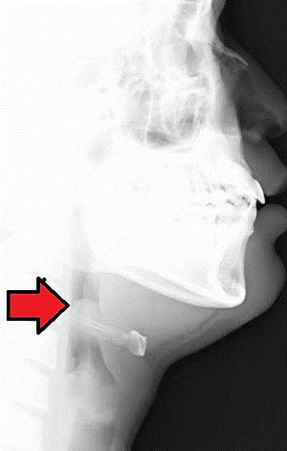
Acute epiglottitis
A medical emergency of rapidly progressive cellulitis of the epiglottis and adjacent structures.
Local swelling has the potential to cause rapid-onset airway obstruction,
Common patient is a child between 2 and 4 years old.

Slide 17
Causative organisms:
Haemophilus influenzae type b (Hib) mainly,
Pneumococci, streptococci and staphylococci (less).
Clinical feature:
Fever
Difficulty speaking and breathing.
Drooling because of impaired swallowing.
Diagnosis:
By visualization of the epiglottis as ‘cherry-red’.
By Microbiological confirmation by culturing the epiglottis and the blood (but not until the airway is secure).

Slide 18
Treatment
Treatment of choice is a cephalosporin (third-generation cephalosporin such as cefotaxime or ceftriaxone).
High-dose parenteral amoxicillin may be substituted (amoxicillin resistance among encapsulated H. influenza)

Slide 19
Otitis Media
Inflammation of the middle ear (otitis media) is a common condition seen most frequently in children under 3 years of age.
Caused by influenza virus and rhinoviruses (mainly)
S. pneumoniae and H. influenza
Moraxella catarrhalis and S. pyogenes account for a smaller proportion of cases,

Slide 20
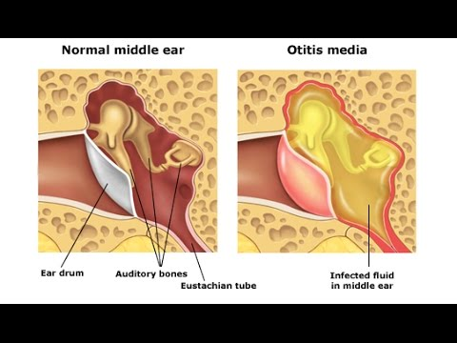

Slide 21
Clinical features
Ear pain, which may be severe.
If the drum perforates, the pain is relieved and a purulent discharge may follow.
There may be a degree of hearing impairment plus non-specific symptoms such as fever or vomiting.
Complications include mastoiditis, meningitis and, particularly, septicaemia and disseminated infection.

Slide 22
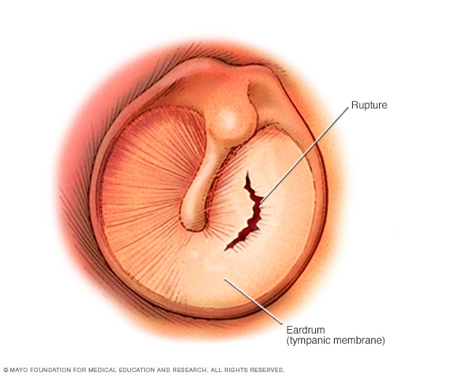

Slide 23
Diagnosis
The diagnosis of otitis media is essentially made clinically and laboratory investigations have little role to play.
A swab of the external auditory canal---- if the drum is perforated. For this reason, a causative
Organism is rarely isolated and treatment has to be given empirically.

Slide 24
Treatment
If antibiotic treatment is to be given, it should be effective against the three main bacterial pathogens: S. pneumoniae, H. influenza and S. pyogenes.
Amoxicillin or Ampicillin
Later-generation Cephalosporin

Slide 25
Acute Sinusitis
Normally, the paranasal sinuses are sterile but they can become infected following damage to the mucous membrane which lines them.
Usually occurs following a viral URTI but is sometimes associated with the presence of dental disease.
Same organisms which cause otitis media S. aureus,

Slide 26
Clinical features & Diagnosis
Facial pain and tenderness,
Often accompanied by headache and a purulent nasal discharge.
Complications include frontal bone osteomyelitis, meningitis and brain abscess.
Diagnosis:
No specific test.
Therapeutic sinus washouts may yield specimens for microbiological culture.

Slide 27
Treatment
Since the causative organisms are the same as those found in otitis media, the same recommendations for treatment apply.
Amoxicillin/clavulanate or Doxycycline
If associated with dental disease, and in such cases, the addition of metronidazole

Slide 28
Lower respiratory infections

Slide 29
Acute bronchitis
Bronchitis means inflammation of the bronchi.
Acute bronchitis, which is usually infective.
Chronic bronchitis, which is a chronic inflammatory condition characterized by thickened, edematous bronchial mucosa with mucus gland hypertrophy and usually caused by smoking.
The importance of chronic bronchitis is that it renders the patient more susceptible to acute infections and more likely to suffer respiratory compromise as a result.

Slide 30
Causative organisms:
Viruses such as rhinovirus, coronavirus, adenovirus and influenza virus.
Bacteria such as Bordetella pertussis, Mycoplasma pneumoniae and Chlamydophila pneumonia, S. pneumoniae, H. influenzae and M. catarrhalis
Clinical features:
Cough (productive of purulent sputum), that is,
Phlegm (yellow or green), the color reflecting the presence of pus cells.
Wheezing and breathlessness
Diagnosis:
A sputum sample should be sent for bacteriology, as this will allow antibiotic sensitivity tests to be performed on potential pathogens.

Slide 31
Treatment
EMPIRIC ANTIBIOTIC TREATMENT:
First-line agents
Doxycycline
Amoxicillin
Second-line agents
Co-amoxiclav
Clarithromycin
Cefixime

Slide 32
Bronchiolitis
Characterised by inflammatory changes in the small bronchi and bronchioles, but not by consolidation.
It is recognised as a disease of infants in the first year of life, in whom a small degree of airway narrowing can have a dramatic effect on airflow.
Caused by:
respiratory syncytial virus (RSV),
hMPV, parainfluenza viruses,
rhinoviruses, adenoviruses
M. pneumonia.

Slide 33
Clinical Feature:
Fever and
Coryzal symptoms
Progresses to wheezing, respiratory distress and hypoxia
Diagnosis:
Immunofluorescence and/or
Viral culture of respiratory secretions,
Treatment:
Supportive consists of oxygen, adequate hydration and ventilatory assistance
Severe cases of respiratory syncytial virus disease may be treated with ribavirin, administered by nebuliser.

Slide 34
Pneumonia
Pneumonia is defined as inflammation of the lung parenchyma, that is, of the alveoli rather than the bronchi or bronchioles, of infective origin and characterised by consolidation.
Pneumonia is often classified clinically into
Lobar pneumonia,
Bronchopneumonia,
Atypical pneumonia.

Slide 35
Community-acquired pneumonia (CAP)
Causative organisms
S. pneumoniae, the pneumococcus, which can cause both lobar and bronchopneumonia, and non-capsulate strains of H. influenzae which usually give rise to bronchopneumonia.
Viral, Influenza can cause a primary viral pneumonia as well as be complicated by secondary bacterial (particularly staphylococcal) pneumonia,
chickenpox can be complicated by primary varicella pneumonia particularly in adults, and
Cytomegalovirus is capable of causing a variety of infections, including pneumonia,

Slide 36
Atypical Pneumonias
A heterogeneous group of diseases which nevertheless have several clinical features in common and which are clinically distinct from the classic picture of pneumococcal pneumonia.
The atypical pneumonias are characterised clinically by fever, systemic symptoms and a dry cough, radiologically by widespread patchy consolidation in both lungs and biochemically by abnormalities in liver enzymes and perhaps evidence of inappropriate antidiuretic hormone secretion, evident as a low plasma sodium.

Slide 37
Clinical features
Pneumococcal lobar pneumonia presents with a cough, initially dry but later producing purulent or blood-stained, rust-coloured sputum, together with dyspnoea,
fever and pleuritic chest pain.
The peripheral white blood cell count is usually raised and the patient may be bacteraemic.
The chest X-ray shows consolidation confined to one or more lobes (or segments of lobes) of the lungs.

Slide 38
Clinical features
Bronchopneumonia presents with productive cough and breathlessness, and
patchy consolidation on the chest X-ray usually in the bases of both lungs.
This disease is very common and is typically seen in patients with severe COPD or in those who are frail and terminally ill. In fact, pneumonia has been described as the old man's friend because it is a relatively painless cause of death.

Slide 39
Diagnosis
Sputum culture (dependent upon the quality of the specimen)
Bronchoscopy and bronchoalveolar lavage. (Lavage fluid, being uncontaminated by mouth flora)
Blood cultures
Plasma and urine testing for pneumococcal antigen
Viruses may be detected by immunofluorescence, by viral culture or by polymerase chain reaction (PCR),

Slide 40
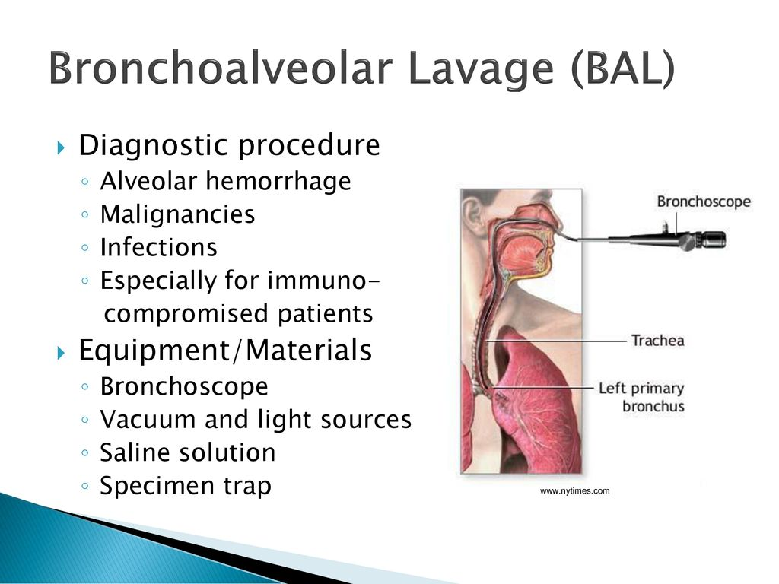

Slide 41
Empiric
treatment
Targeted treatment

Slide 42
Hospital-acquired pneumonia (HAP)
Nosocomial pneumonia accounts for 10–15% of all hospital-acquired infections,
Usually presenting with sepsis and/or respiratory failure.
Up to 50% of cases are acquired on intensive care units.
Predisposing features include stroke, mechanical ventilation, chronic lung disease, recent surgery and previous antibiotic exposure.

Slide 43
Causative organisms:
Gram-negative bacilli (Enterobacteriaceae, Pseudomonas spp.
and Acinetobacter spp.) and S. aureus, including MRSA.
Diagnosis:
Sputum is commonly sent for culture (it may be contaminated by mouth flora. If the patient has received antibiotics, the normal mouth flora is often replaced by resistant organisms such as staphylococci or Gram-negative bacilli, making the interpretation of culture results difficult).
Bronchoalveolar lavage is often more helpful.
Blood cultures may be positive.

Slide 44
The choice of antibiotics will be influenced by:
preceding antibiotic therapy,
the duration of hospital admission
Macrolide would be added if Legionnaire's disease was suspected and,
Metronidazole would be required for suspected anaerobic infection.

Slide 45
Aspiration pneumonia
Initiated by inhalation of stomach contents contaminated by bacteria from the mouth.
Risk factors include alcohol, hypnotic drugs and general anaesthesia,
Make a patient vomit while unconscious.
Gastric acid is very destructive to lung tissue and leads to severe tissue necrosis.
Damaged tissue is then prone to secondary infection often with abscess formation.
Treatment with metronidazole plus amoxicillin is usually adequate,

Slide 46
Severe acute respiratory syndrome (SARS)
Caused by a coronavirus (SARS-associated coronavirus).
Clinically it causes pneumonitis, presenting with a flu-like prodrome
progressing to dyspnoea, dry cough.
Treatment is largely supportive (ventilatory support).

Slide 47
Cystic fibrosis (CF)
Is an inherited, autosomal recessive disease
Is due to a defect in the transport of ions in and out of cells.
This leads to changes in the consistency and chemical composition of exocrine secretions,
In the lungs is manifest by the production of very sticky, tenacious mucus which is difficult to clear by mucociliary action.
The production of such mucus leads to airway obstruction with resulting infection.

Slide 48
Infecting organisms
S. aureus, H. influenzae are the most common In infants and young children,
P. aeruginosa forolder than 5.
Gram-negative bacteria are seen, such as Escherichia coli.
Clinical features
persistent cough and copious and purulent sputum.
Breathless
fever, increased cough
Eventually, chronic pulmonary infection leads to respiratory insufficiency,
Cardiac failure and death.

Slide 49
Treatment
In a children
Anti-staphylococci, such as flucloxacillin or erythromycin can be used.
P. aeruginosa
oral ciprofloxacin and a nebulised antibiotic such as colistin.
For chronically colonised patients,
regular prophylactic intravenous β-lactam/aminoglycoside combination such as ceftazidime plus tobramycin.
Meropenem or a quinolone are usually reserved for treatment failures or when resistant organisms are encountered.

Slide 50
Notes…
Patients with cystic fibrosis need larger doses of aminoglycosides because have a rapid clearance more than other patients.
Parenteral therapy as inhaled (nebulised) antibiotics use for treatment of acute exacerbations and for longer-term use in an attempt to reduce the Pseudomonas load. Agents which have been administered in this way include colistin, tobramycin and other aminoglycosides, carbenicillin and ceftazidime.

