Slide 1
Pharmaceutical chemistry
Antibacterial Antibiotics
Macrolides
Assist . Prof . Karima F. Ali
AL-Mustansiriyah university
College of pharmacy

Slide 2
Macrolides
The macrolide antibiotics have three common chemical characteristics:
(a) a large lactone ring (which prompted the name macrolide),
(b) a ketone group
(c) a glycosidically linked amino sugar.
Usually, the lactone ring has 12, 14, or 16 atoms in it, and it is often unsaturated, with an olefinic group conjugated with the ketone function.

Slide 3
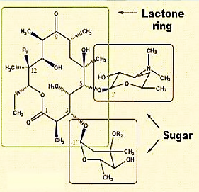

Slide 4
Mechanism of Action and Resistance
Some details of the mechanism of antibacterial action of erythromycin are known. It binds selectively to a specific site on the 50S ribosomal subunit to prevent the translocation step of bacterial protein synthesis. It does not bind to mammalian ribosomes. Broadly based, nonspecific resistance to the antibacterial action of erythromycin among many species of Gram-negative bacilli appears to be largely related to the inability of the antibiotic to penetrate the cell walls of these organisms

Slide 5
Spectrum of Activity
The spectrum of antibacterial activity of the more potent macrolides, such as erythromycin, resembles that of penicillin.
The macrolides are generally effective against most species of Gram-positive bacteria, both cocci and bacilli, and exhibit useful effectiveness against Gram-negative cocci, especially Neisseria spp. Many of the macrolides are also effective against Treponema pallidum.

Slide 6
Products
Erythromycin
The commercial product is erythromycin A, which differs from its biosynthetic precursor, erythromycin B, in having a hydroxyl group at the 12-position of the aglycone.
The amino sugar attached through a glycosidic link to C- 5 is desosamine, a structure found in several other macrolide antibiotics.
The B analog is more acid stable but has only about 80% of the activity of erythromycin.
The C analog differs from erythromycin by the replacement of the methoxyl group on the cladinose moiety with a hydrogen atom. It appears to be as active as erythromycin but is present in very small amounts in fermentation liquors..

Slide 7
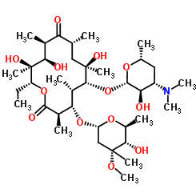
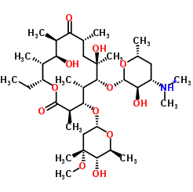
Erythromycin A
Erythromycin B
The amino sugar attached through a glycosidic link to C-5 is desosamine, a structure found in several other macrolide antibiotics. The tertiary amine of desosamine (3,4,6- trideoxy-3 dimethyl amino-D-xylo-hexose) confers a basic character to erythromycin and provides the means by which acid salts may be prepared.

Slide 8
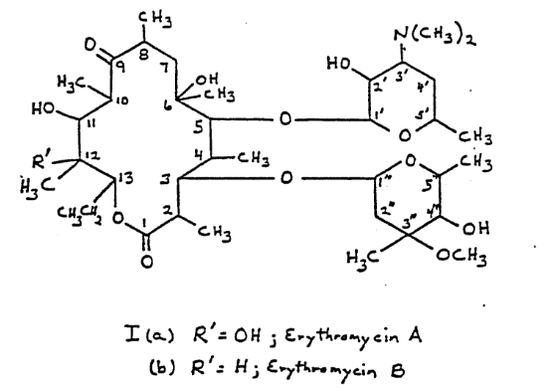

Slide 9
The other carbohydrate structure linked as a glycoside to C-3 is called cladinose (2,3,6- trideoxy-3-methoxy -3-C-methyl-L-ribo-hexose) and is unique to the erythromycin molecule.
Erythromycin is unstable in acid media. The C6 hydroxyl group reversibly attack the C-9 ketone giving rise to a hemiketal intermediate. Dehydration prevents regeneration of parent erythromycin and the C-12 hydroxyl group can subsequently add to produce a spiro-ketal species.

Slide 10
Erythromycin has been chemically modified with primarily two different goals in mind:
Increase either its water or its lipid solubility for parenteral dosage forms and
Increase its acid stability (and possibly its lipid solubility) for improved oral absorption.
The nucleophilic functionality of 6-hydroxyl group Initiate Erythromycin degradation.
If the size of the group kept small so as not to affect the ribosomal binding.

Slide 11
Modified derivatives of the antibiotic are of two types:
1. acid salts of the dimethyl amino group of the desosamine moiety (e.g., the glucoheptonate, the lactobionate, and the stearate)
2. esters of the 2՝-hydroxyl group of the desosamine (e.g., the ethylsuccinate and the propionate, available as the lauryl sulfate salt and known as the estolate). The stearate salt and the ethylsuccinate and propionate esters are used in oral dose forms intended to improve absorption of the antibiotic. The stearate releases erythromycin base in the intestinal tract, which is then absorbed.

Slide 12
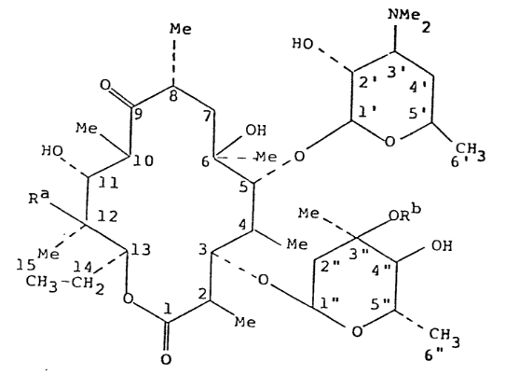
Erythromycin

Slide 13
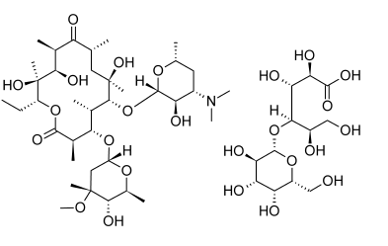
1. Acid salts of the dimethyl amino group:
Erythromycin Lactobionate
Erythromycin lactobionate is a water-soluble salt prepared
by reacting erythromycin base with lactobiono-ծ-lactone.

Slide 14
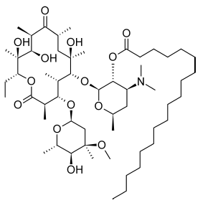
2. Esters of the 2՝-hydroxyl group
Erythromycin stearate (Ethril, Wyamycin S, Erypar) is the stearic acid salt of erythromycin. It is film coated to protect it from acid degradation in the stomach. In the alkaline pH of the duodenum, the free base is liberated from the stearate and absorbed.
Erythromycin Stearate

Slide 15
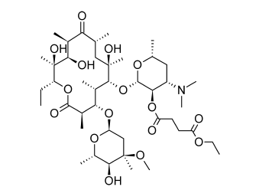
Erythromycin Ethylsuccinate (EES, Pediamycin, EryPed) is the Ethylsuccinate mixed ester of erythromycin in which the 2՝-hydroxyl group of the desosamine is esterified. It is absorbed as the ester and hydrolyzed slowly in the body to form erythromycin.
Erythromycin Ethylsuccinate

Slide 16
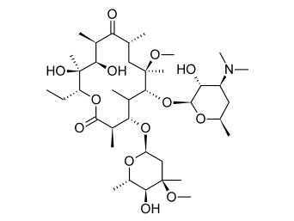
3. Methylation of the 6-hydroxyl group:
Clarithromycin
The simple methylation of the 6-hydroxyl group of erythromycin creates a semisynthetic derivative that fully retains the antibacterial properties of the parent antibiotic, with markedly increased acid stability and oral bioavailability and reduced GI side effects associated with erythromycin.
Clarithromycin

Slide 17
Azithromycin
Azithromycin (Zithromax) is a semisynthetic derivative of erythromycin, prepared by Beckman rearrangement of the corresponding oxime, followed by N methylation and reduction of the resulting ring-expanded lactam. It is a prototype of a series of nitrogen-containing, 15-membered ring macrolides known as azalides. Removal of the 9-keto group coupled with incorporation of a weakly basic tertiary amine nitrogen function into the macrolide ring increases the stability of azithromycin to acid-catalyzed degradation

Slide 18
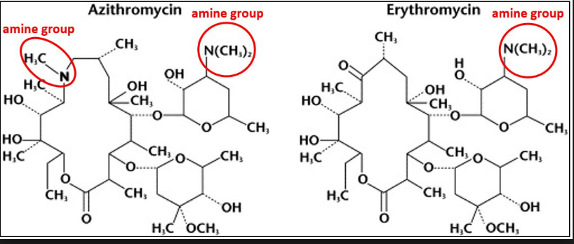
These changes also increase the lipid solubility of the molecule, thereby conferring unique pharmacokinetic and microbiological properties

Slide 19
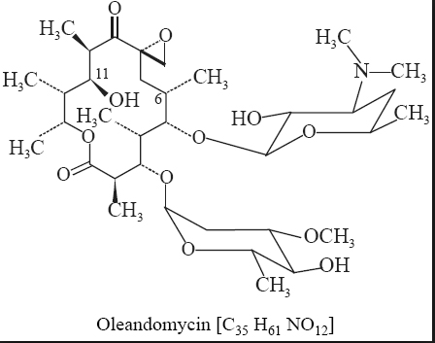
Oleandomycin, as its triacetyl derivative. Its structure consists of two sugars and a 14-member lactone ring designated an oleandolide.. The sugars are linked glycosidically to the positions 3 and 5, respectively, of oleandolide. Oleandomycin contains three hydroxyl groups that are subject to acylation, one in each of the sugars and one in the oleandolide.

Slide 20
Lincomycins
The lincomycins are sulfur-containing antibiotics isolated from Streptomyces lincolnensis.
Extensive efforts to modify the lincomycin structure to improve its antibacterial and pharmacological properties resulted in the preparation of the 7-chloro-7-deoxy derivative Clindamycin.
Clindamycin appears to have the greater antibacterial potency and better pharmacokinetic properties.

Slide 21
Lincomycin-related antibiotics differ in structure at one or more of three positions of the lincomycin structure:
(a) the N-methyl of the hygric acid moiety is substituted by a hydrogen
(b) the n-propyl group of the hygric acid moiety is substituted by an ethyl group
(c) the thiomethyl ether of theα-thiolincosamide moiety is substituted by a thioethyl ether.

Slide 22
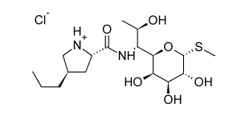
Lincomycin Hydrochloride
The structure contains a basic function, the pyrrolidine nitrogen, by which water-soluble salts with an apparent pKa of 7.6 may be formed.

Slide 23
Lincomycin binds to the 50S ribosomal subunit to inhibit protein synthesis. Its action may be bacteriostatic or bactericidal depending on various factors, including the concentration of the antibiotic.
When subjected to hydrazinolysis, lincomycin is
cleaved at its amide bond into trans-L-4-n-propylhygric acid (the pyrrolidine moiety) and methyl α-thiolincosamide (the sugar moiety).
.

Slide 24
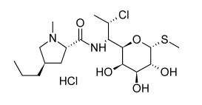
Clindamycin Hydrochloride
Replacement of the 7(R)-hydroxy group of lincomycin by chlorine with inversion of configuration resulted in a compound with enhanced antibacterial activity in vitro. Clinical experience with this semisynthetic derivative, clindamycin, 7(S)-chloro-7- deoxylincomycin (Cleocin), released in 1970, has established that its superiority over lincomycin is even greater in vivo. Changes in the -thiolincosamide portion of the molecule seem to decrease activity markedly.

Slide 25
Polypeptides
Among the most powerful bactericidal antibiotics are those
that possess a polypeptide structure. Antibiotics of the polypeptide class differ widely in their mechanisms of action and antimicrobial properties.
Bacitracin and vancomycin interfere with bacterial cell wall
synthesis and are effective only against Gram-positive bacteria.
Neither antibiotic apparently can penetrate the outer
envelope of Gram-negative bacteria. Both the gramicidins
and the polymyxins interfere with cell membrane functions
in bacteria. However, the gramicidins are effective primarily
against Gram-positive bacteria, whereas the polymyxins are
effective only against Gram-negative species.

Slide 26
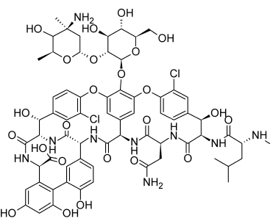
Vancomycin

Slide 27
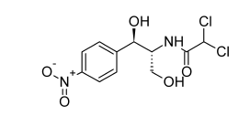
Unclassified antibiotics
Chloramphenicol
The first of the widely used broad-spectrum antibiotics. It possesses two chiral carbon atoms in the acylamidopropanediol chain. Biological activity resides almost exclusively in the D-threo isomer; the L-threo and the D- and L-erythro isomers are virtually inactive. Numerous structural analogs of chloramphenicol have been synthesized to provide a basis for correlation of structure to antibiotic action.

Slide 28
It appears that the p-nitrophenyl group may be replaced by other aryl structures without appreciable loss in activity. Substitution on the phenyl ring with several different types of groups for the nitro group, a very unusual structure in biological products, does not greatly decrease activity. All such compounds yet tested are less active than chloramphenicol. Modification of the side chain shows that it possesses high
specificity in structure for antibiotic action.
Conversion of the alcohol group on C-1 of the side chain to a keto group causes appreciable loss in activity.

Slide 29
The metabolism of chloramphenicol has been investigated
thoroughly. The main path involves formation of
the 3-O-glucuronide. Minor reactions include reduction of
the p-nitro group to the aromatic amine, hydrolysis of the
amide, and hydrolysis of the -chloracetamido group, followed
by reduction to give the corresponding -hydroxyacetyl
derivative.

