Slide 1
Pharmaceutical chemistry Antibacterial Antibiotics Β-lactam antibiotics
Assist . Prof . Karima F. Ali
AL-Mustansiriyah university
College of pharmacy

Slide 2
Introduction
In 1942, Waksman proposed the widely cited definition that “an antibiotic or antibiotic substance is a substance produced by microorganisms, which has the capacity of inhibiting the growth and even of destroying other microorganisms.”
Later proposal shave sought both to expand and to restrict the definition to include any substance produced by a living organism that is capable of inhibiting the growth or survival of one or more species of microorganisms in low concentrations.

Slide 3
The advances made by medicinal chemists to modify naturally occurring antibiotics and to prepare synthetic analogs necessitated the inclusion of semisynthetic and synthetic derivatives in the definition. Therefore, a substance is classified as an antibiotic if the following conditions are met:
1. It is a product of metabolism (although it may be duplicated or even have been anticipated by chemical synthesis).
2. It is a synthetic product produced as a structural analog of a naturally occurring antibiotic.

Slide 4
3. It antagonizes the growth or survival of one or more
species of microorganisms.
4. It is effective in low concentrations.
Antibiotic: Chemical produced by a microorganism that kills or inhibits the growth of another microorganism
Antimicrobial agent: Chemical that kills or inhibits the growth of microorganisms

Slide 5
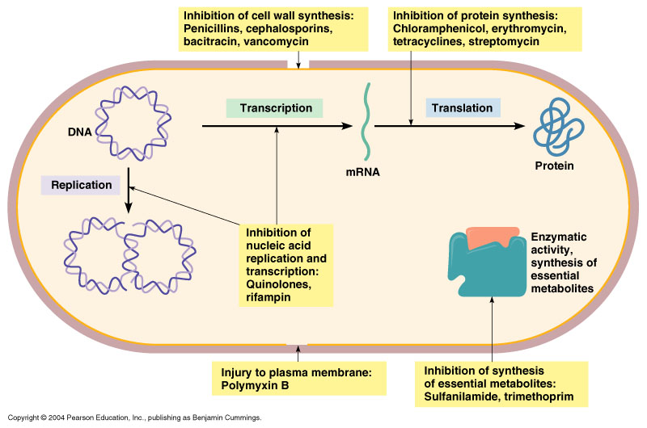
Mechanism of action

Slide 6
Β-lactam antibiotics
Antibiotics that possess the β-lactam (a four-membered cyclic amide) ring structure are the dominant class of agents currently used for the chemotherapy of bacterial infections.
The first antibiotic to be used in therapy, penicillin (penicillin G or benzyl penicillin), and a close biosynthetic relative, phenoxy methyl penicillin (penicillin V), remain the agents of choice for the treatment of infections caused by most species of Gram-positive bacteria.

Slide 7
The key structural feature of the penicillins is the four-membered β-lactam ring; this structural moiety is essential for penicillin's antibacterial activity. The β-lactam ring is itself fused to a five-membered thiazolidine ring. The fusion of these two rings causes the β-lactam ring to be more reactive than monocyclic β-lactams because the two fused rings distort the β-lactam amide bond and therefore remove the resonance stabilization normally found in these chemical bonds.

Slide 8
Mechanism of Action
selective inhibition of bacterial cell wall synthesis. Specifically, the basic mechanism involved is inhibition of the biosynthesis of the dipeptidoglycan that provides strength and rigidity to the cell wall. Penicillins and cephalosporins acylate a specific bacterial D-trans peptidase, target the penicillin-binding proteins or PBPs - a group of enzymes found anchored in the cell membrane, which are involved in the cross-linking of the bacterial cell wall. thereby rendering it inactive for its role in forming peptide cross-links of two linear peptidoglycan strands by trans peptidation and loss of D-alanine.

Slide 9
Mechanism of β-Lactam Drugs
The amide of the β-lactam ring is unusually reactive due to ring strain and a conformational arrangement which does not allow the lone pair of the nitrogen to interact with the double bond of the carbonyl.
Because of this fused four five ring system this carbonyl Carbone more partially positive , more ectrophilic and more reactive. So that why β-lactam ring easily hydrolyzed.
Two factors make β-lactam reactive
1. There is not as much resonance stabilization
2. Ring strain

Slide 10
β-Lactams acylate the hydroxyl group on the serine residue of PBP active site in an irreversible manner.
This reaction is further aided by the oxyanion hole, which stabilizes the tetrahedral intermediate and thereby reduces the transition state energy.
-OH act as nucleophile and going to attack carbonyl Carbone which is more electrophilic than the most amide.

Slide 12
Mechanism of β-Lactam Drugs
The hydroxyl attacks the amide and forms a tetrahedral intermediate.

Slide 13
Mechanism of β-Lactam Drugs
The tetrahedral intermediate collapses, the amide bond is broken, and the nitrogen is reduced.

Slide 14
Mechanism of β-Lactam Drugs
The PBP is now covalently bound by the drug and cannot perform the cross linking action.

Slide 15
Bacterial Resistance
most species of Gram-negative bacilli, are naturally resistant to the action of penicillins. Other normally sensitive species can develop penicillin resistance (either through natural selection of resistant individuals or through mutation).
The most important biochemical mechanism of penicillin resistance is the bacterial elaboration of enzymes that inactivate penicillins. Such enzymes, which have been given the nonspecific name penicillinases, are of two general types: β- lactamases and acylases.

Slide 16
By far, the more important of these are the β-lactamases, enzymes that catalyze the hydrolytic opening of the β-lactam ring of penicillins to produce inactive penicilloic acids.
Specific acylases (enzymes that can hydrolyze the acylamino side chain of penicillins) have been obtained from several species of Gram-negative bacteria
Another important resistance mechanism, especially in
Gram-negative bacteria, is decreased permeability to penicillins. Alteration of the number or nature of porins in the cell envelope also could be an important mechanism of antibiotic resistance

Slide 17
Penicillinase (b Lactamase)

Slide 18
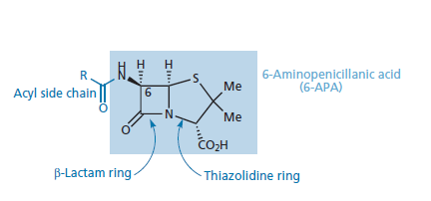
The penicillins
Several closely related compounds produced. These compounds differ chemically in the acid moiety of the amide side chain.
Variations in this moiety produce differences in antibiotic effect and in physicochemical properties, including stability.

Slide 19
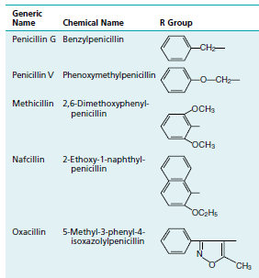
Structure of penicillins

Slide 20
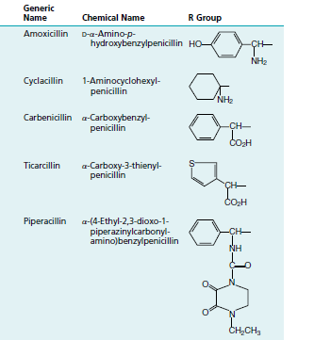

Slide 22
Nomenclature
The Chemical Abstracts system initiates the numbering with the sulfur atom and assigns the ring nitrogen the 4-position. Thus, penicillins are named as 4-thia-l-azabicycloheptanes, according to this system. The numbering system adopted by the USP is the reverse of the Chemical Abstracts procedure, assigning number 1 to the nitrogen atom and number 4 to the sulfur atom. The name “penam” used for the unsubstituted bicyclic system, including the amide carbonyl group, with one of the foregoing numbering systems

Slide 23
Thus, penicillins generally are designated according to the Chemical Abstracts system as 5- acylamino-2,2-dimethylpenam-3-carboxylic
Uses the name “penicillanic acid” to describe the ring system with substituents that are generally present (i.e., 2,2-dimethyl and 3-carboxyl).

Slide 24
Stereochemistry
The penicillin molecule contains three chiral carbon atoms (C-3, C-5, and C-6). All naturally occurring and microbiologically active synthetic and semisynthetic penicillins have the same absolute configuration about these three centers.
The carbon atom bearing the acylamino group (C-6) has the L configuration, whereas the carbon to which the carboxyl group is attached has the D configuration. Thus, the acylamino and carboxyl groups are trans to each other, with the former in the α and the latter in the β orientation relative to the penam ring system.

Slide 25
The atoms composing the 6-aminopenicillanic acid (6-APA) portion of the structure are derived biosynthetically from two amino acids, L-cysteine (S-1, C-5, C-6, C-7, and 6-amino) and L-valine (2,2-dimethyl, C-2, C-3, N-4, and 3-carboxyl).
The absolute stereochemistry of the penicillins is designated 3S:5R:6R

Slide 26
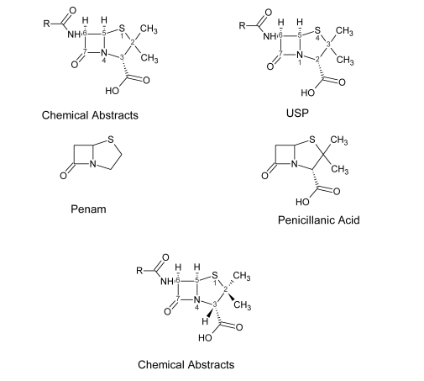

Slide 27
Modification of β-Lactams
β-Lactam type antibiotics can be modified at various positions to improve their ability to:
-be administered orally (survive acidic conditions)
-be tolerated by the patient (allergies)
-penetrate the outer membrane of Gram (-) bacteria
-prevent hydrolysis by β-lactamases
-acylate the PBPs of resistant species (there are many different PBPs)

Slide 28
penicillins- natural
Natural penicillins are those which can be obtained directly from the penicillium mold and do not require further modification. Many species of bacteria are now resistant to these penicillins.
Penicillin G
not orally active

Slide 29
Penicillin V
Penicillin V is produced when phenoxyacetic acid rather than phenylacetic acid is introduced to the penicillium culture. Adding the oxygen decreases the nucleophilicity of the carbonyl group, making penicillin V acid stable and orally viable.

Slide 30
Production
All commercially available β-lactams are initially produced through the fermentation of bacteria.
Bacteria assemble the penicillin molecule from L-AAA, L-valine, and L-cysteine in three steps using ACV synthase, IPN synthase, and acyl transferase.

Slide 31
Penicillin Biosynthetic Pathway

Slide 32
Chemical Degradation
The solubility and other physicochemical properties of the penicillins are affected by the nature of the acyl side chain and by the cations used to make salts of the acid. Most penicillins are acids with pKa values in the range of 2.5 to 3.0, but some are amphoteric.
The free acids are not suitable for oral or parenteral administration. The sodium and potassium salts of most penicillins, however, are soluble in water and readily absorbed orally or parenterally.

Slide 33
3. β-lactam carbonyl group of penicillin readily undergoes nucleophilic attack by water or (especially) hydroxide ion to form the inactive penicilloic acid, which is reasonably stable in neutral to alkaline solutions but readily undergoes decarboxylation and further hydrolytic reactions in acidic solutions.
4. Other nucleophiles, such as hydroxylamines, alkylamines, and alcohols, open the β-lactam ring to form the corresponding hydroxamic acids, amides, and esters. It has been speculated that one of the causes of penicillin allergy may be the formation of antigenic penicilloyl proteins in vivo by the reaction of

Slide 34
nucleophilic groups (e.g., Ɛ-amino) on specific body proteins with the β-lactam carbonyl group.
5. In strongly acidic solutions (pH 3), penicillin undergoes a complex series of reactions leading to various inactive degradation products .The first step appears to involve rearrangement to the penicillanic acid. This process is initiated by protonation of the β-lactam nitrogen, followed by nucleophilic attack of the acyl oxygen atom on the β-lactam carbonyl carbon. The subsequent opening of the β -lactam ring destabilizes the thiazoline ring, which then also suffers acid-catalyzed ring opening to form the penicillanic acid.

Slide 35
Penicillin G in acidic conditions
Penicillin G could not be administered orally due to the acidic conditions of the stomach.

Slide 37
Acid-catalyzed degradation
In the stomach contributes strongly to the poor oral absorption of penicillin. Thus, efforts to obtain penicillins with improved pharmacokinetic and microbiological properties have focused on acyl functionalities that would minimize sensitivity of the β-lactam ring to acid hydrolysis while maintaining antibacterial activity.
Substitution of an electron-withdrawing group in the α-
position of benzylpenicillin markedly stabilizes the penicillin to acid-catalyzed hydrolysis.

Slide 39
Semi-Synthetic Penicillins
The acyl side chain of the penicillin molecule can be cleaved using enzyme or chemical methods to produce 6-APA, which can further be used to produce semi-synthetic penicillins or cephalosporins
75% of the penicillin produced is modified in this manner

Slide 40
Penicillins- Anti staphylococcal
Penicillins which have bulky side groups can block the β-Lactamases which hydrolyze the lactam ring.

Slide 41
Methicillin
Methicillin was the first penicillin developed with this type of modification, Methicillin sodium is particularly resistant to inactivation by the penicillinase found in staphylococci and somewhat
more resistant than penicillin G to penicillinase from Bacillus cereus. The absence of the benzyl methylene group of penicillin G and the steric protection afforded by the 2- and 6-methoxy groups make this compound particularly resistant to enzymatic hydrolysis.

Slide 42
Methicillin is acid sensitive and has been improved upon by adding electron withdrawing groups, as was done in penicillin V, resulting in drugs such as oxacillin and nafcillin. In oxacillin the steric effects of the 3-phenyl and 5-methyl groups of the isoxazolyl ring prevent the binding of this penicillin to the β-lactamase active site and, thereby, protect the lactam ring from degradation in much the same way as has been suggested for methicillin.
It is also relatively resistant to acid hydrolysis and, therefore, may be administered orally with good effect.

Slide 43
The substitution of chlorine atoms on ortho or on both carbons ortho to the position of attachment of the phenyl ring to the isoxazole ring enhances the activity and the stability of Cloxacillin , Dicloxacillin sodium, by enhancing its oral absorption, leading to higher plasma levels.
Nafcillin sodium, 6-(2-ethoxy-1-naphthyl)penicillin sodium (Unipen), is another semisynthetic penicillin that resulted from the search for penicillinase-resistant compounds. Like methicillin, nafcillin has substituents in positions ortho to the point of attachment of the aromatic ring to the carboxamide group of penicillin. No doubt, the ethoxy group and the second ring of the naphthalene group play steric roles in stabilizing nafcillin against penicillinase

Slide 44
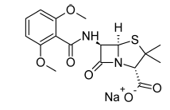
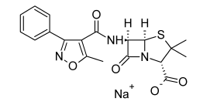
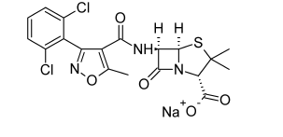
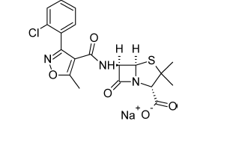
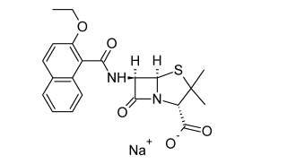
Oxacillin Sodium
Methicillin Sodium
Dicloxacillin Sodium
Cloxacillin sodium
Nafcillin Sodium

Slide 45
Penicillins- Amino penicillins
In order to increase the range of activity, the penicillin has been modified to have more hydrophilic groups, allowing the drug to penetrate into Gram (-) bacteria via the porins.
Ampicillin R=Phenyl
Amoxicillin R= Phenyl -OH

Slide 46
Ampicillin
6-[D-α-amino phenyl acetamido]penicillanic acid, D-α-amino benzyl penicillin an antibacterial spectrum broader than that of penicillin G. Obviously, the α-amino group plays an important role in the broader activity, but the mechanism for its action is unknown. It has been suggested that the amino group confers an ability to cross cell wall barriers that are impenetrable to other penicillins.
D-(-)-Ampicillin, prepared from D-(-)-α-amino phenylacetic acid, is significantly more active than L-(+)-ampicillin.

Slide 47
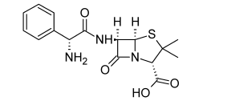
Ampicillin is not resistant to penicillinase, and it produces the allergic reactions
Ampicillin is water soluble and stable in acid.
The protonated α-amino group of ampicillin has a pKa of 7.3 and thus it is protonated extensively in acidic media, which explains ampicillin’s stability to acid hydrolysis and instability to alkaline hydrolysis.
Ampicillin

Slide 48
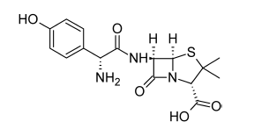
Amoxicillin
is simply the p-hydroxy
analog of ampicillin, prepared by acylation of 6-APA with p-hydroxy phenyl glycine.
Its antibacterial spectrum is nearly identical with that of
ampicillin, and like ampicillin, it is resistant to acid, susceptible to alkaline and β-lactamase hydrolysis, and
weakly protein bound. Early clinical reports indicated that orally administered amoxicillin possesses significant advantages over ampicillin, including more complete GI absorption

Slide 49
Β-lactamase inhibitors
The discovery of the naturally occurring, mechanism based inhibitor Clavulanic acid, which causes potent and progressive inactivation of β-lactamases has created renewed interest in β-lactam combination therapy.
This interest has led to the design and synthesis of additional mechanism-based β-lactamase inhibitors, such as sulbactam and tazobactam, and the isolation of naturally occurring β-lactams, such as the Thienamycins, which both inhibit β-lactamases and interact with PBPs.

Slide 50
Clavulanate Potassium
Clavulanic acid is an antibiotic isolated from Streptomyces clavuligeris. Structurally, it is a 1-oxopenam lacking the 6-acylamino side chain of penicillins but possessing a 2- hydroxyethylidene moiety at C-2. Clavulanic acid exhibits very weak antibacterial activity, comparable with that of 6-APA and, therefore, is not useful as an antibiotic. It is, however, a potent inhibitor of S. aureus β-lactamase and plasmid-mediated β-lactamases elaborated by Gram negative bacilli.

Slide 51
Combinations of amoxicillin and the potassium salt of clavulanic acid are available (Augmentin) in various fixed-dose oral dosage forms intended for the treatment of skin, respiratory, ear, and urinary tract infections caused by β-lactamase–producing bacterial strains.

Slide 52
Carbapenems
Carbapenems are a potent class of β-lactams which attack a wide range of PBPs, have low toxicity, and are much more resistant to β-lactamases than the penicillins or cephalosporins.
Carbapenems contain a β-lactam ring (cyclic amide) fused to a five-membered ring. Carbapenems differ in structure from penicillins in that within the five-membered ring a sulfur is replaced by a carbon atom (C1) and an unsaturation is present between C2 and C3 in the five-membered ring.

Slide 54
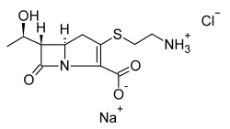
Thienamycin
Thienamycin is a novel β-lactam antibiotic first isolated and identified by researchers at Merck from fermentation of cultures of Streptomyces cattleya.
It is resistant to inactivation by most β-lactamases elaborated by Gram-negative and Gram positive bacteria and, therefore, is effective against many strains resistant to penicillins and cephalosporins. Due to its highly unstable nature this drug and its derivatives are created through synthesis, not bacterial fermentation.

Slide 55
The side chain is unique in two respects:
1- Hydroxyethyl group instead of the familiar acylamino side chain, and it is oriented to the bicyclic ring system rather than having the usual orientation of the penicillins and cephalosporins.
2- Aminoethylthioether function at C-2.
The absolute stereochemistry of Thienamycin has been determined to be 5R:6S:8S.
An unfortunate property of Thienamycin is its chemical instability in solution. It is more susceptible to hydrolysis in both acidic and alkaline solutions than most β-lactam antibiotics, because of the strained nature of its fused ring system containing an endocyclic double bond

Slide 56
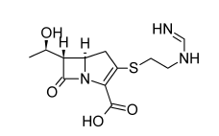
Imipenem–Cilastatin
The most successful of a series of chemically stable derivatives of Thienamycin in which the primary amino group is converted to a non nucleophilic basic function.

Slide 57
Imipenem retains the extraordinary broad-spectrum antibacterial properties of Thienamycin.
Its bactericidal activity results from the inhibition of cell wall synthesis associated with bonding to PBPs 1b and 2.
Imipenem is very stable to most β-lactamases. It is an inhibitor of β-lactamases from certain Gram-negative bacteria resistant to other -lactam antibiotics

Slide 58
Newer Carbapenems
structure–activity studies established the critical importance of:
The position of the double bond
The 3-carboxyl group
The 6-α-hydroxy ethyl side chain for both broad spectrum antibacterial activity and β-lactamase stability in Carbapenems. Modifications, therefore, have concentrated on variations at positions 1 and 2 of the carbapenem nucleus.
The incorporation of a α-methyl group at the1position gives the carbapenem stability to hydrolysis by renal DHP-I.

Slide 59
Substituents at the 2-position, however, appear to affect primarily the spectrum of antibacterial activity of the Carbapenem by influencing penetration into bacteria.
The capability of Carbapenems to exist as zwitterionic structures resulting from the combined features of a basic amine function attached to the 2-position and the 3-carboxyl group, may enable these molecules to enter bacteria via their charged porin channels.

Slide 60
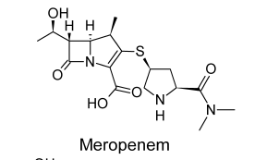
Newer Carbapenems
Meropenem
Meropenem is a second-generation carbapenem that, to
date, has undergone the most extensive clinical evaluation. Like imipenem, Meropenem is not active orally. Meropenem exhibits greater potency against Gram-negative and anaerobic bacteria than does imipenem, but it is slightly less active against most Gram-positive species.

Slide 61
Cephalosporins
Cephalosporins were discovered shortly after penicillin entered into widespread product, but not developed till the 1960’s.
Cephalosporins are similar to penicillins but have a 6 member dihydrothiazine ring instead of a 5 member thiazolidine ring.
7-aminocephalosporanic acid (7-ACA) can be obtained from bacteria, but it is easier to expand the ring system of 7-APA because it is so widely produced.

Slide 62
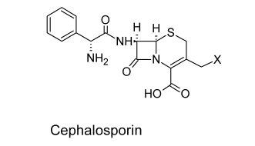
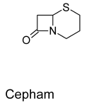
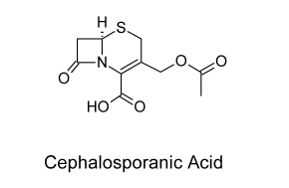
Cephalosporins
Unlike penicillin, cephalosporins have two side chains which can be easily modified. Cephalosporins are also more difficult for β-lactamases to hydrolyze.

Slide 63
Mechanism of Cephalosporins
The acetoxy group (or other R group) will leave when the drug acylates the PBP.

Slide 64
Semisynthetic Derivatives
To date, the more useful semisynthetic modifications of the basic 7-ACA nucleus have resulted from acylations of the 7- amino group with different acids or nucleophilic substitution or reduction of the acetoxyl group.
Structure–activity relationships
The presence of an allylic acetoxyl function in the 3-position, however, provides a reactive site at which various 7-acylaminocephalosporanic acid structures can easily
be varied by nucleophilic displacement reactions.

Slide 65
In the preparation of semisynthetic cephalosporins, the following improvements are sought:
(a) increased acid stability
(b) improved pharmacokinetic properties, particularly better oral absorption,
(c) broadened antimicrobial spectrum
(d) increased activity against resistant microorganisms (as a result of resistance to enzymatic destruction, improved penetration, increased receptor affinity, etc.)
(e) decreased allergenicity
(f) increased tolerance after parenteral administration.

Slide 66
β-Lactamase Resistance
The susceptibility of cephalosporins to various lactamases
varies considerably with the source and properties of these enzymes.
Cephalosporins are significantly less sensitive than all but the β-lactamase–resistant penicillins to hydrolysis by the enzymes from S. aureus and Bacillus subtilis.
The“penicillinase” resistance of cephalosporins appears to be a property of the bicyclic cephem ring system rather than of
the acyl group.
The different cephalosporins exhibit considerable variation in rates of hydrolysis by the enzyme, cephalothin and cefoxitin are the most resistant, and cephaloridine and cefazolin are the least resistant.

Slide 67
The introduction of polar substituents in the aminoacyl moiety of cephalosporins appears to confer stability to some β-lactamases.
Cefamandole which contain an hydroxy phenyl acetyl (or mandoyl) group and Ceforanide, which has an o-amino phenyl acetyl group, are resistant to a few β-lactamases.
Steric factors also may be important because Cefoperazone, an acylureido cephalosporin that contains the same 4-ethyl-2,3-dioxo-1 piperazinyl carbonyl group present in piperacillin, is resistant to many β- lactamases.

Slide 68
Oddly enough, piperacillin is hydrolyzed by most of these enzymes.β-lactamases
Two structural features confer broadly based resistance to β-lactamases among the cephalosporins:
an alkoximino function in the aminoacyl group and
a methoxyl substituent at the 7-position of the cephem nucleus having stereochemistry.

Slide 69
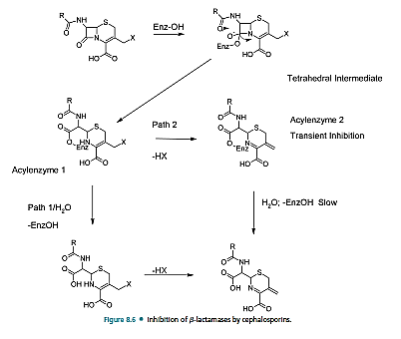

Slide 70
Oral Cephalosporins
The oral activity conferred by the phenyl glycyl substituent is attributed to increased acid stability of the lactam ring, resulting from the presence of
a protonated amino group on the 7-acylamino portion of the molecule. Carrier mediated transport of these dipeptide-like, zwitterionic cephalosporins is also an important factor in their excellent oral activity.
The situation, then, is analogous to that of the α-amino benzylpenicillins (e.g., ampicillin). Also important for high acid stability (and, therefore, good oral activity) of the cephalosporins is the absence of the leaving group at the 3-position.

Slide 71
Parenteral Cephalosporins
Hydrolysis of the ester function, catalyzed by hepatic and renal esterases, is responsible for some in vivo inactivation of parenteral cephalosporins containing a 3-acetoxymethyl substituent (e.g., cephalothin, cephapirin, and cefotaxime).
Parenteral cephalosporins lacking a hydrolyzable group at the 3-position are not subject to hydrolysis by esterases. Cephradine is the only cephalosporin that is used both orally and parenterally.

Slide 72
Classification
Cephalosporins are divided into first-, second-, third-, and fourth-generation agents, based roughly on their time of discovery and their antimicrobial properties
In general, progression from first to fourth generation is associated with a broadening of the Gram-negative antibacterial spectrum, some reduction in activity against Gram-positive organisms, and enhanced resistance to β- lactamases. Individual cephalosporins differ in their pharmacokinetic properties, especially plasma protein binding and half-life, but the structural bases for these differences are not obvious.

Slide 73
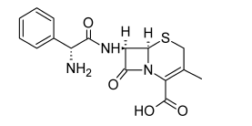
Products
First Generation
Cephalexin
Cephalexin,7α-(D-amino-α-phenylacetamido)-3-methyl cephemcarboxylic acid (Keflex, Keforal), was designed purposely as an orally active, semisynthetic cephalosporin.
The α-amino group of cephalexin renders it acid stable, and reduction of the 3-acetoxymethyl to a methyl group circumvents reaction at that site. It is freely soluble in water, resistant to acid, and absorbed well orally. Food does not interfere with its absorption.

Slide 74
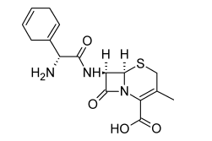
Cephradine
Cephradine (Anspor, Velosef )
is the only cephalosporin
derivative available in both oral and parenteral dosage
forms. It closely resembles cephalexin chemically (it may be regarded as a partially hydrogenated derivative of cephalexin) and has very similar antibacterial and pharmacokinetic properties.
Cephradine is stable to acid and absorbed almost completely after oral administration

Slide 75
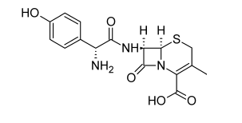
Cefadroxil
Cefadroxil (Duricef) is an orally active semisynthetic
D-hydroxylphenylglycyl moiety. The main advantage claimed for Cefadroxil is its somewhat prolonged duration of action, which permits once-a-day dosing. The prolonged duration of action of this compound is related to relatively slow urinary excretion of the drug compared with other cephalosporins,

Slide 76
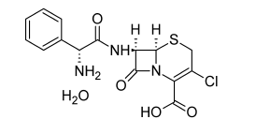
Cefaclor
Cefaclor (Ceclor) is an orally active semisynthetic Cephalosporin.
It differs structurally from cephalexin in that the 3-methyl group has been replaced by a chlorine atom. Cefaclor is moderately
stable in acid and achieves enough oral absorption to provide
effective plasma levels (equal to about two-thirds of those
obtained with cephalexin).

Slide 77
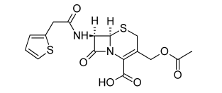
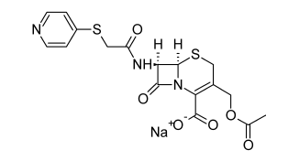
Parenterally products
cephalothin cephaloridine
The oral inactivation of cephalosporins has been attributed to two causes: instability of the β-lactam ring to acid hydrolysis (cephalothin and cephaloridine) and solvolysis or microbial
transformation of the 3-methylacetoxy group (cephalothin,
cephaloglycin).
3-methylacetoxy group

Slide 78
Its spectrum of activity is broader than that of penicillin G and more similar to that of ampicillin. Unlike ampicillin, cephalothin is resistant to penicillinase produced by S. aureus and provides an alternative to the use of penicillinase-resistant penicillins for the treatment of infections caused by such strains.
Cephalothin is absorbed poorly from the GI tract and
must be administered parenterally for systemic infections.

Slide 79
Cefazolin Sodium, Sterile
Cefazolin (Ancef, Kefzol)
is one of a series of semisynthetic cephalosporins in which the C-3 acetoxy function has been replaced by a thiol-containing heterocycle—here, 5-methyl-2-thio-1,3,4-thiadiazole. It also contains the somewhat unusual tetrazolylacetyl acylating group. It is active only by parenteral administration

Slide 80
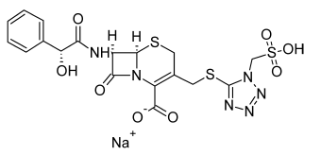
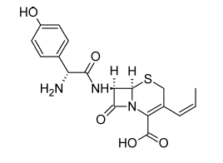
Second-generation
Cefprozil Cefonicid Sodium
Cefprozil (Cefzil) is an orally active second-generation
cephalosporin that is similar in structure and antibacterial spectrum to cefadroxil.
Cefonicid is unique among the second-generation
cephalosporins in that it has an unusually long serum half life of approximately 4.5 hour

Slide 81
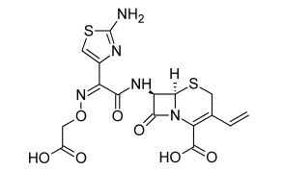
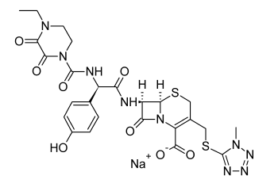
Third-generation
Cefixime
Cefoperazone
Cefoperazone (Cefobid) is a third-generation anti pseudomonal cephalosporin that resembles piperacillin chemically and microbiologically.
Cefixime (Suprax) is the first orally active, third-generation cephalosporin.

Slide 82
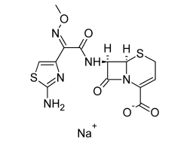
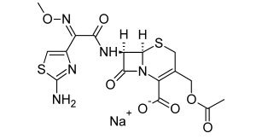
Cefotaxime Sodium and Ceftizoxime
Cefotaxime Ceftizoxime
Cefotaxime (Claforan) was the first third-generation cephalosporin to be introduced.
It possesses excellent broad-spectrum activity against Gram-positive and Gram negative aerobic and anaerobic bacteria.
Ceftizoxime (Cefizox) is a third-generation cephalosporin
that was introduced in 1984. It must be administered on a thrice-daily dosing schedule because of its relatively short half-life.

Slide 83
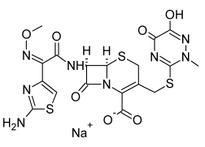
Ceftriaxone Disodium, Sterile
Ceftriaxone (Rocephin) is a β-lactamase–resistant
cephalosporin with an extremely long serum half-life.
Once-daily dosing suffices for most indications. Two factors contribute to the prolonged duration of action of ceftriaxone: high protein binding in the plasma and slow urinary excretion.
Ceftriaxone

Slide 84
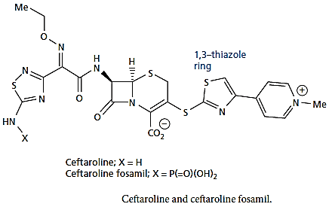
Fifth-generation cephalosporins
Ceftaroline fosamil is a fifth-generation cephalosporin that has activity against various strains of MRSA methicillin resistant Staphylococcus aureus and multi-resistant Streptococcus pneumonia (MDRSP). It acts as a prodrug for ceftaroline , and the 1,3-thiazole ring is thought to be important for its activity against MRSA.

