Slide 1
Clinical pharmacy laboratory DM
Done by:A.L
Zahraa Abudl-Ghani

Slide 2
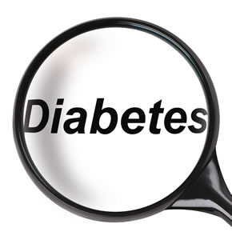

Slide 3
Type I (IDDM):-
The disease characterized by an absolute deficiency of insulin caused by massive Beta cell destruction, the pancreas fails to respond to glucose.
IDDM shows classic symptoms of insulin deficiency (polydipsia, polyphagia, polyuria, and weight loss).
Type I diabetics require exogenous insulin and characterized by hyperglycemia and life threatening ketoacidosis.
The goal in administration exogenous insulin to control hyperglycemia, avoid ketoacidosis, and to avoid long-term complications.
Because insulin is a polypeptide, it is degraded in the GIT if taken orally. It therefore is generally administered by subcutaneous injection, or intravenously for regular insulin in emergency cases, insulin infusion is also contributed.

Slide 4
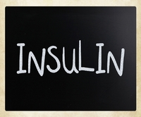
Management of T1DM

Slide 5
Insulins
Insulin plays a key role in the regulation of carbohydrate, fat, and protein metabolism.
It is a polypeptide hormone of complex structure.
There are differences in the amino-acid sequence of animal insulins, human insulins and the human insulin analogues.
Insulin may be extracted from pork pancreas and purified by crystallisation; it may also be extracted from beef pancreas, but beef insulins are now rarely used. Human sequence insulin may be produced semi synthetically by enzymatic modification of porcine insulin or biosynthetically by recombinant DNA technology using bacteria or yeast .

Slide 6
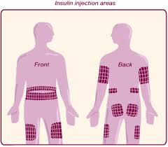
Insulin is usually injected into the upper arms, thighs, buttocks, or abdomen; absorption from a limb site may be increased if the limb is
used in strenuous exercise after the injection

Slide 7
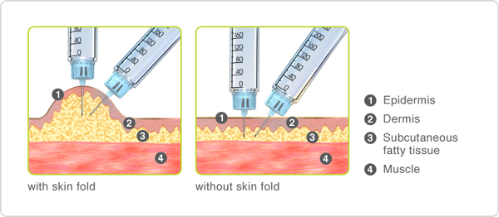

Slide 8
Insulin is needed by
1-All patients with ketoacidosis
2-Most patients with rapid onset of symptoms
3- Substantial loss of weight
4- Weakness
5-ketonuria
6-Afirst-degree relative who has type 1 diabetes.
7-Insulin is also needed for type 2 diabetes when other methods have failed to achieve good control.
8-Temporarily in the presence of inter current illness or peri operatively.
9-Pregnant women with type 2 diabetes may be treated with insulin when diet alone fails.

Slide 9
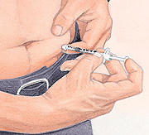
Generally subcutaneous insulin injections cause few problems;
1- hypoglycemia
2-lipodystrophy may occur but can be minimized by using
different injection sites in rotation. Local allergic reactions
are rare.

Slide 10
-Symptoms of hypoglycemia are:
A-Autonomic symptoms: palms and generalized sweating, hunger, palpitation, tremor, and anxiety.
B-Neurological symptoms: confusion, agitation, fainting, decreased attention.
While in case of severe hypoglycemia: unconsciousness, or convulsion.
Symptoms | hypoglycemia
Autonomic symptoms mainly. | mild
Autonomic and neurological symptoms | Moderate
unconsciousness, or convulsion. | severe
[May be asymptomatic] ,nightmares, morning headache, tingling of lips and tongue | Nocturnal

Slide 11
Insulin preparations can be divided into 3 types:
1-Those of short duration which have a relatively rapid onset of action, namely soluble insulin and the rapid-insulin analogues, insulin aspart. Insulin glulisine, and insulin lispro.
2-Intermediate action, e.g. isophane insulin;
3-Those whose action is slower in onset and lasts for long periods: e.g. protamine zinc insulin, insulin detemir, and insulin glargine.
-The duration of action of a particular type of insulin varies considerably from one patient to another, and needs to be assessed individually.
- Mixtures of insulin preparations may be required.
- Treatment should be started with a short-acting insulin (e.g. soluble insulin) or a rapid-acting insulin analogue (e.g. insulin a spart) given before meals with intermediate-acting or long-acting insulin once or twice daily.

Slide 12
Alternatively: For those who have difficulty with, or prefer not to use, multiple injection regimens, a mixture of premixed short-acting insulin or rapid-acting insulin analogue with an intermediate-acting or long-acting insulin (most commonly in a proportion of 30% soluble insulin and 70% isophane insulin) can be given once or twice daily.
The dose of short-acting or rapid-acting insulin (or the proportion of the short-acting soluble insulin component in premixed insulin) can be increased in those with excessive postprandial hyperglycaemia. The dose of insulin is increased gradually according to the patient’s individual requirements, taking care to avoid troublesome hypoglycaemic reactions.
Insulin requirements may be increased by infection, stress, accidental or surgical trauma, and during puberty.
Requirements may be decreased in those with certain endocrine disorders (e.g. Addison’s disease, hypopituitarism), or in coeliac disease.
.

Slide 13
Examples of recommended insulin regimens
1. Multiple injection regimen: short-acting insulin or
rapid-acting insulin analogue, before meals. With
intermediate-acting or long-acting insulin, once or
twice daily.
2. Short-acting insulin or rapid-acting insulin analogue mixed with intermediate-acting or long-acting insulin, once or twice daily (before meals).
3. Intermediate-acting or long-acting insulin, once or
twice daily. With or without short-acting insulin or
rapid-acting insulin before meals;
4. Continuous subcutaneous insulin infusion

Slide 14
Diabetes and surgery
Perioperative control of blood-glucose concentrations in patients with type 1 diabetes is achieved via an adjustable, continuous, intravenous infusion of insulin in general, the following steps should be followed
1. Give an injection of the patient’s usual insulin on the night before the operation.
2. Early on the day of the operation, start an intravenous
infusion of glucose containing potassium chloride
(provided that the patient is not hyperkalaemic) and the rate of the insulin infusion should be adjusted according to blood-glucose concentration (frequent monitoring necessary)
Once the patient starts to eat and drink, give subcutaneous insulin before breakfast and stop intravenous insulin 30 minutes later.

Slide 15
Route(S) | Appearance | Duration | peak | Onset (hours) | Type of insulin
S.C, I.V⁽⁵⁾ | Clear صافي | 3-6⁽²⁾ | 1-2⁽²⁾ | 15-30 minutes⁽²⁾ | Rapid-acting insulin Insulin Lispro, Insulin aspart, and insulin glulisine
S.C, I.V, And I.M⁽⁵⁾ | Clear صافي | 6-8⁽³⁾ | 2-4⁽¹⁾ | 0.5-1.0⁽¹⁾ | Short-acting insulin ويسمى ايضا (soluble, regular ,neutral)
S.C⁽⁵⁾ only | Cloudy خابط Cloudy خابط | 18-24⁽³⁾ 18-24⁽³⁾ | 6-14⁽¹⁾ 6-14⁽¹⁾ | 1-2⁽¹⁾ 1-3⁽¹⁾ | Intermediate-acting insulin Isophane* insulin also called NPH(neutral protamine hagedorn) Lente
S.C⁽⁵⁾ only | Cloudy خابط Clear صافي | 24-36⁽¹⁾ 24⁽¹⁾ | 18-24⁽¹⁾ No peak | 4-6⁽³⁾ 4-6⁽³⁾ | long-acting insulin Ultrlente(insulin zinc susp., protamine zinc sup.) Insulin Glargine

Slide 18
Short-acting insulins
-Soluble insulin is a short-acting form of insulin.
-given15 to 30 minutes before meals.
-Soluble insulin is the most appropriate form of insulin for
use in diabetic emergencies e.g. diabetic ketoacidosis and at the time of surgery. It can be given intravenously and
intramuscularly, as well as subcutaneously.

Slide 19
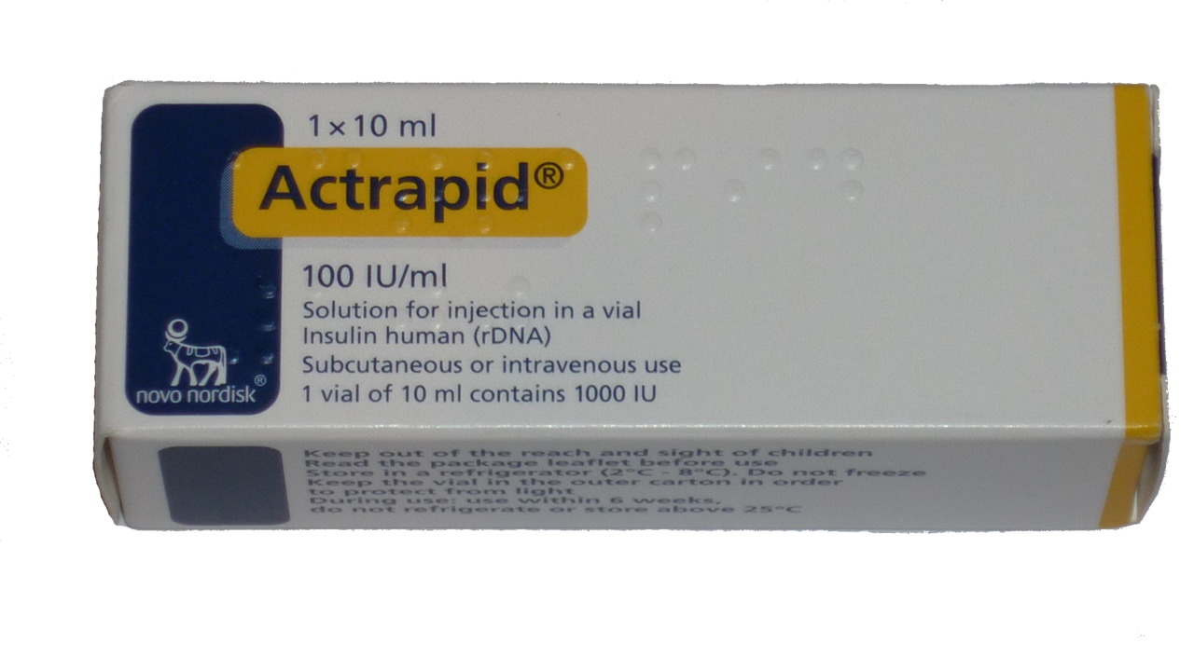
S.A.I

Slide 20
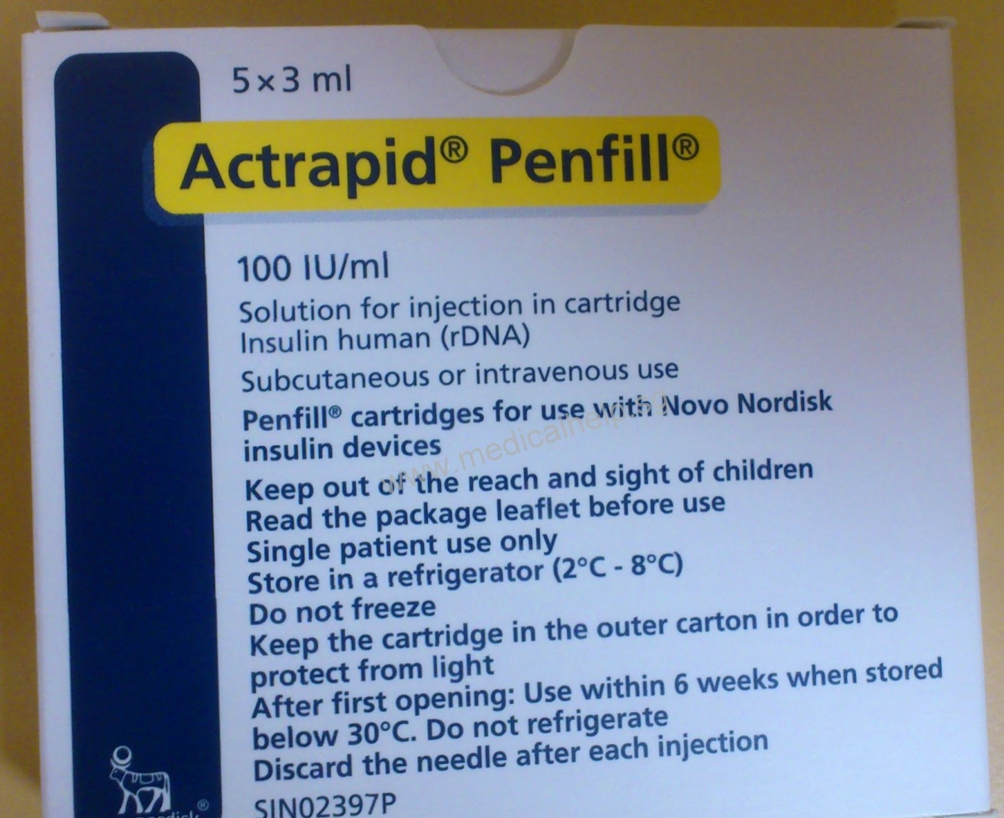

Slide 21
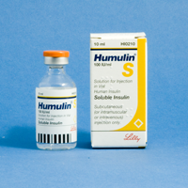

Slide 22
The rapid-acting human insulin analogues
Insulin aspart, Insulin glulisine, and Insulin lispro have a rapid onset and shorter duration of action than soluble insulin;
as a result, compared to soluble insulin, fasting and pre prandial blood glucose concentrations are a little higher, postprandial blood-glucose concentration is a little lower, and hypoglycaemia occurs slightly less frequently.
Subcutaneous injection of insulin analogues may be convenient for those who wish to inject shortly before or, when necessary, shortly after a meal. They can also help those susceptible to hypoglycaemia before lunch and those who eat late in the evening and are prone to nocturnal hypoglycaemia.

Slide 23
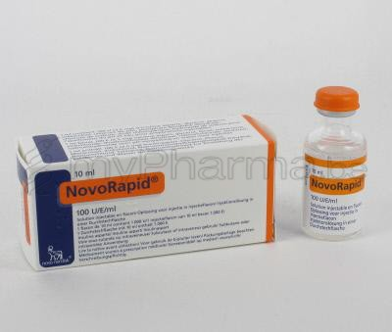
Insulin aspart
They administered by subcutaneous infusion. Insulin aspart and insulin lispro can be administered intravenously and can be used as alternatives to soluble insulin for diabetic emergencies and at the time of surgery.

Slide 24
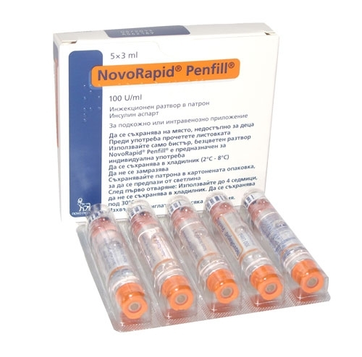

Slide 25
Insulin glulisine

Slide 26
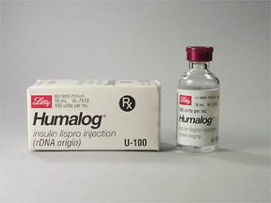
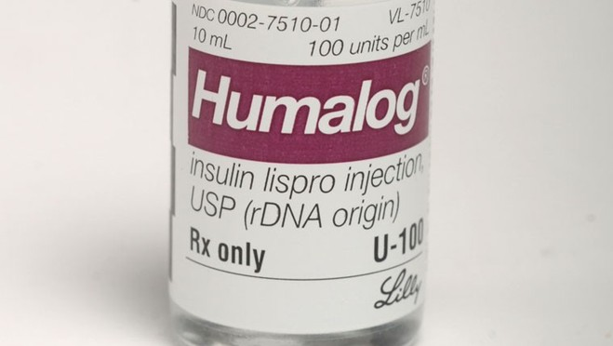
Insulin lispro

Slide 27
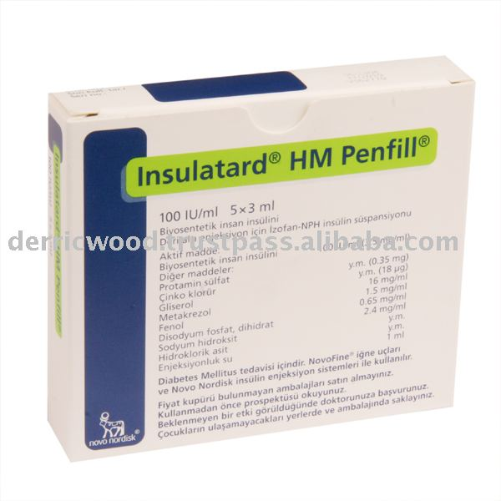
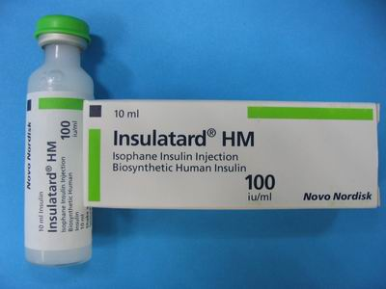
I.A.I[neutral protamin hygydron] NPH
Sterile buffered suspension of either porcine or human insulin
complexed with protamine sulfate (or another suitable
protamine)

Slide 28
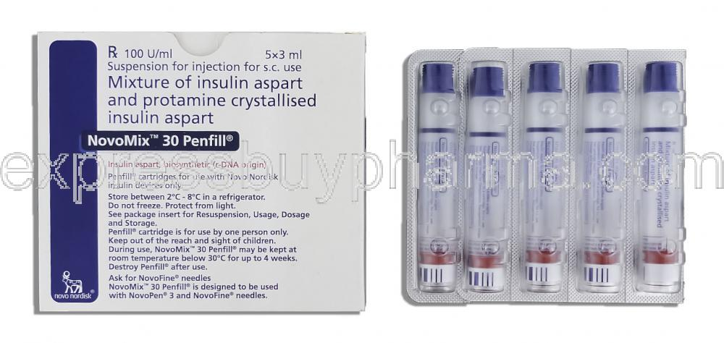
Biphasic insulin aspart

Slide 29
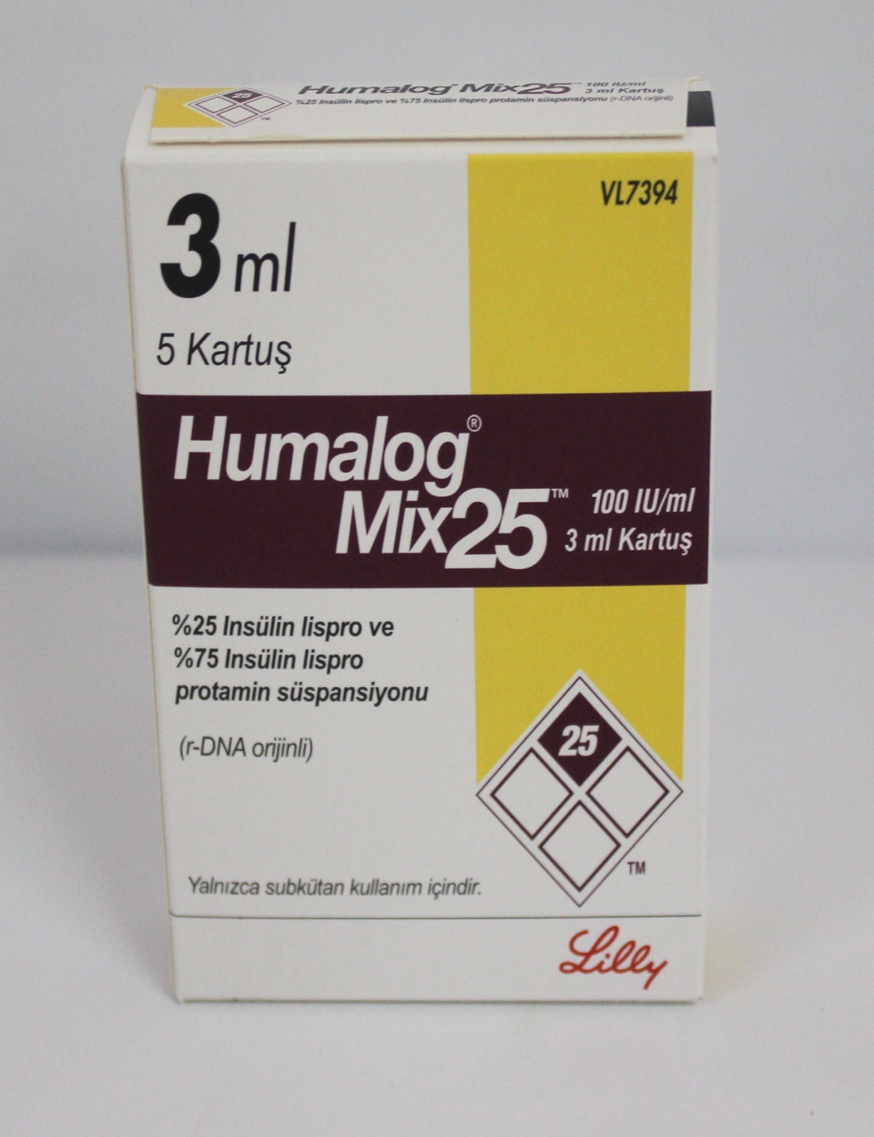
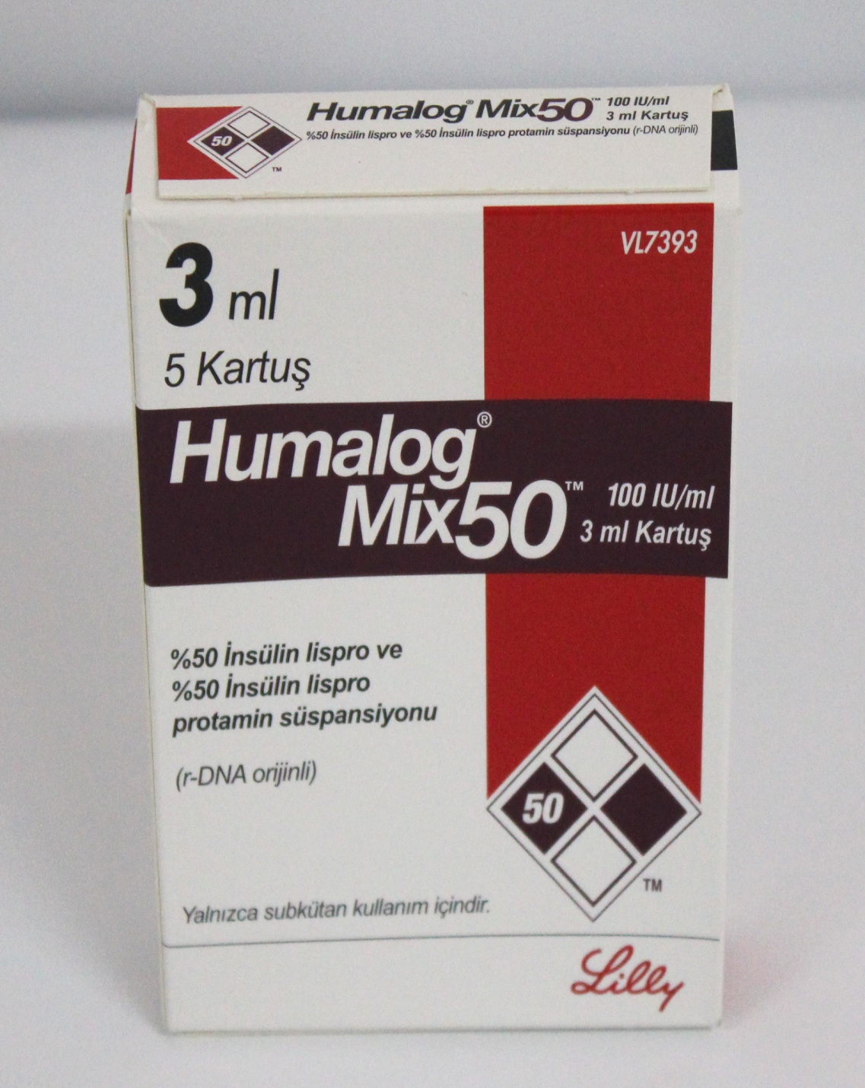
Biphasic insulin lispro

Slide 30
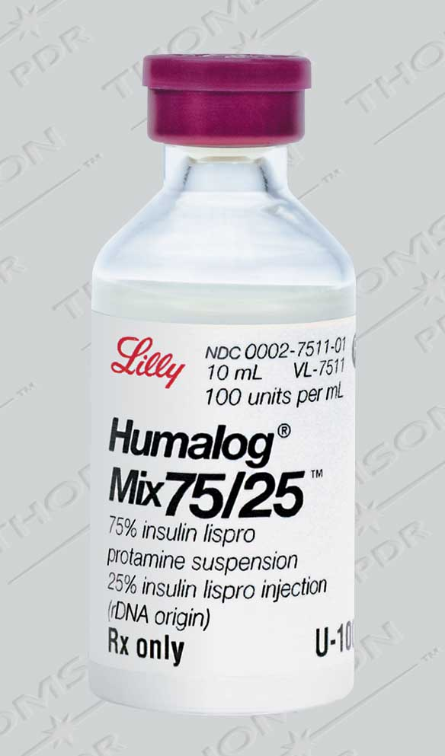

Slide 31
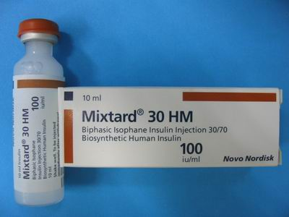

Slide 32
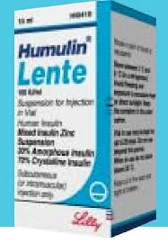

Slide 33
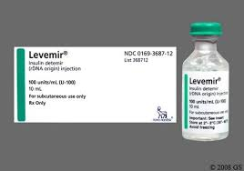
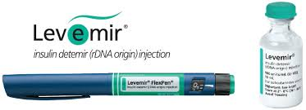
L.A.I

Slide 34
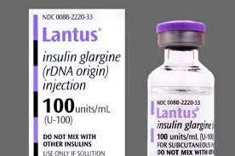

Slide 35
Insulin glargine is accepted for restricted use
for the treatment of type 1 diabetes:
in those who are at risk of or experience unacceptable frequency or severity of nocturnal hypoglycaemia on attempting to achieve better hypoglycaemic control during treatment with other insulins
.as a once daily insulin therapy for patients who require
a carer to administer their insulin
It is not recommended for routine use in patients with
type 2 diabetes unless they suffer from recurrent episodes of hypoglycaemia or require assistance with their insulin injections.

Slide 36
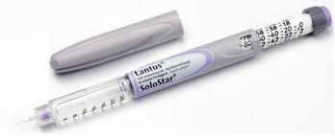
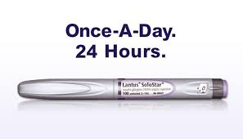

Slide 37
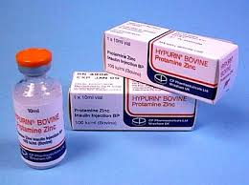
insulin zinc susp., protamine zinc susp

