Slide 1
Drugs Affecting the Autonomic Nervous System

Slide 2
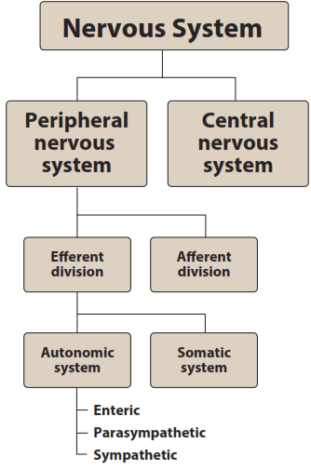

Slide 3
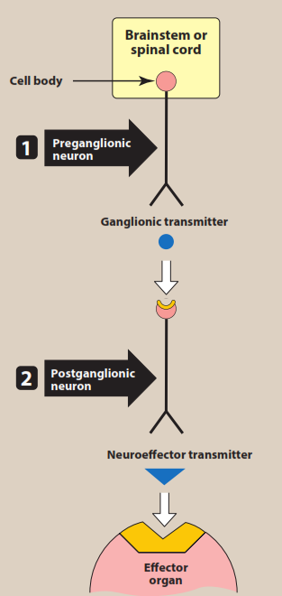
Thoracic and lumbar regions

Slide 4
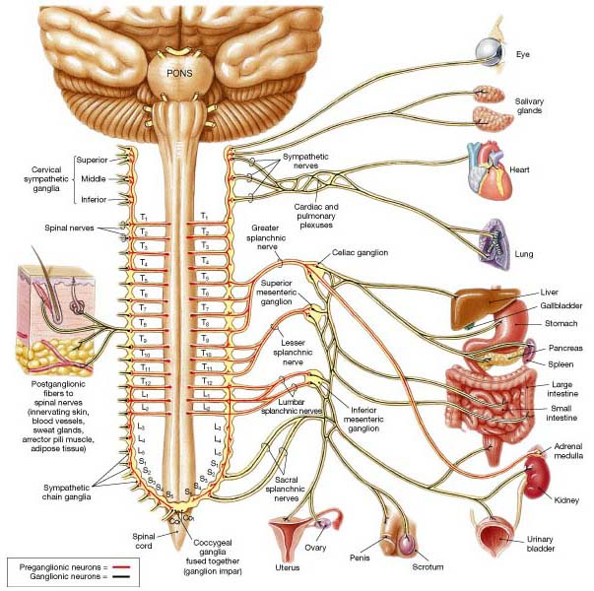
Sympathetic Neurons
Thoracic & lumbar region (T1 to L2)

Slide 5
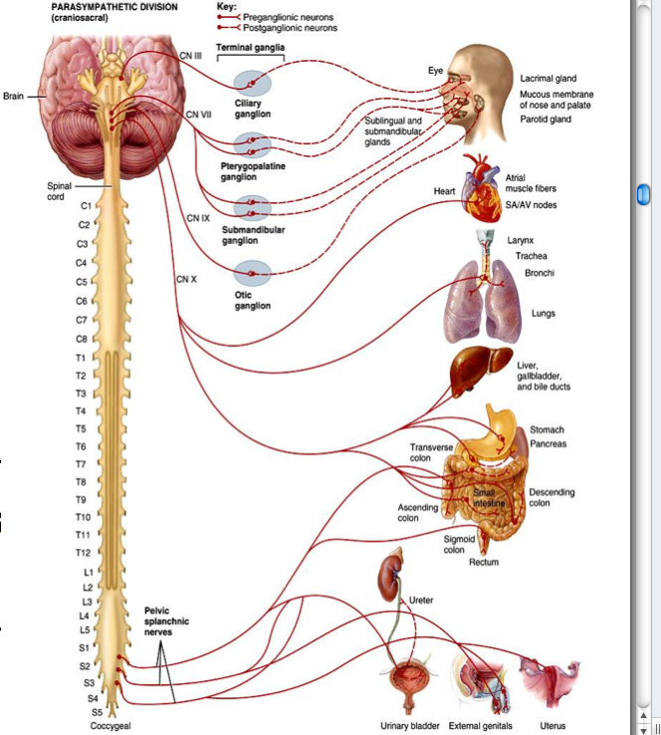
Parasympathetic Neurons
Cranial , facial, glossopharyngeal, & vagus
Sacral S2 – S4

Slide 6
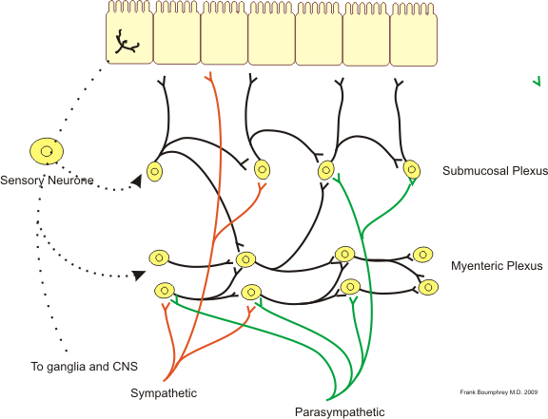
Enteric nervous system
Collection of NF (brain of Gut)
Act independently of CNS, control motility, exocrine & endocrine secretion, & microcirculation

Slide 7
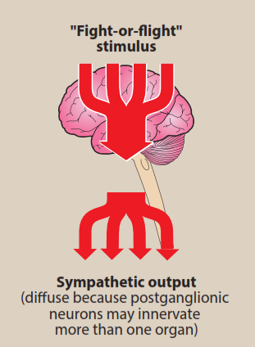
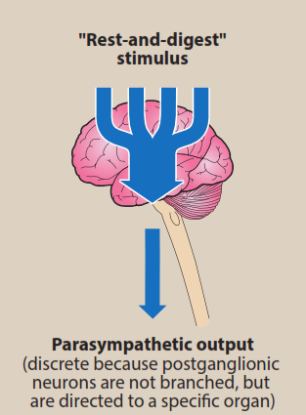
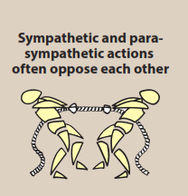

Slide 8
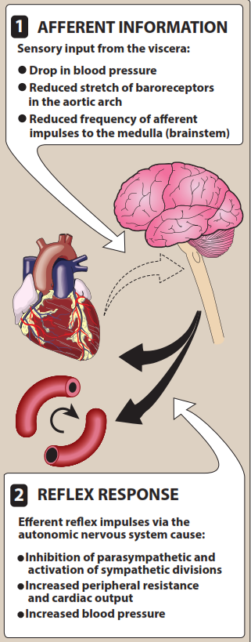
BaroreceptorReflex Arc

Slide 9
Characteristics of SNS & PSNS

Slide 10
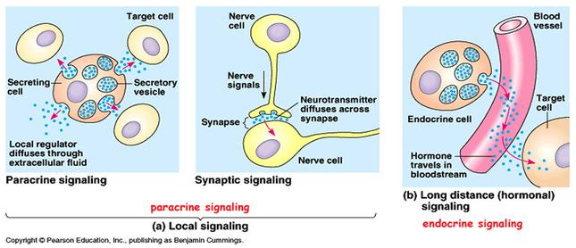
Chemical Signaling Between Cells

Slide 12
