Slide 1

Drug-Receptor Interactions and
Pharmacodynamics

Slide 2
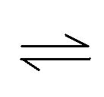
D-R Interact.ions and Pharmacodynamics
Pharmacodynamics
Describes the actions of drugs on the body and the influence of drug
concentration on the magnitude of the response
Signal Transduction
Ligands
Second Messenger
Drug-Receptor Complex
Drug + Receptor Drug-Receptor Complex Biologic Effect

Slide 3
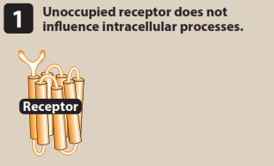
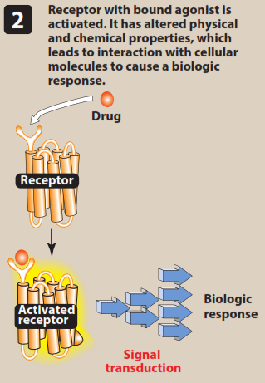
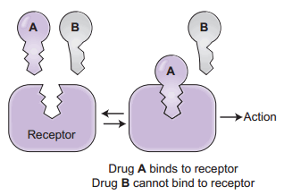
Receptor?????

Slide 4
Receptor
Any biologic molecule to which a drug binds and produces a measurable response.
enzymes, nucleic acids, and structural proteins can act as receptors for drugs or endogenous agonists
Most of receptors are ptn
Hydrophilic & hydrophobic ligands

Slide 5
Receptor States
Specificity
Magnitude of response
R (inactive) R *(active)
Agonist ???
Antagonist ???
Partial agonist ???
Others

Slide 6
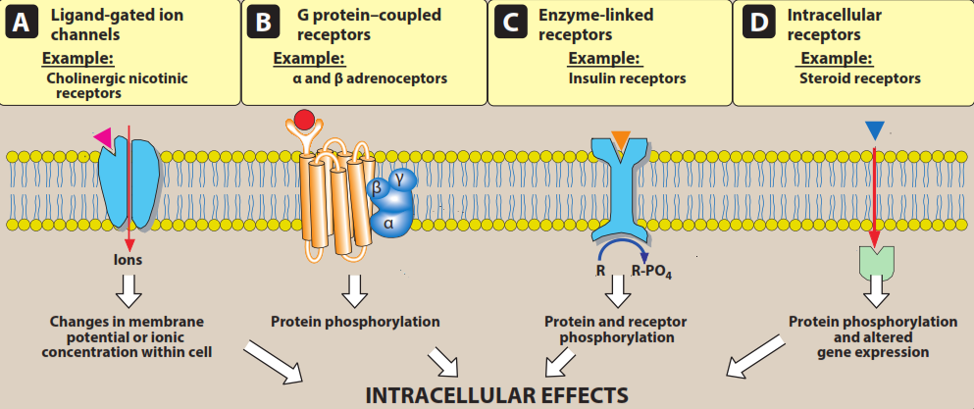
Receptor Families

Slide 7
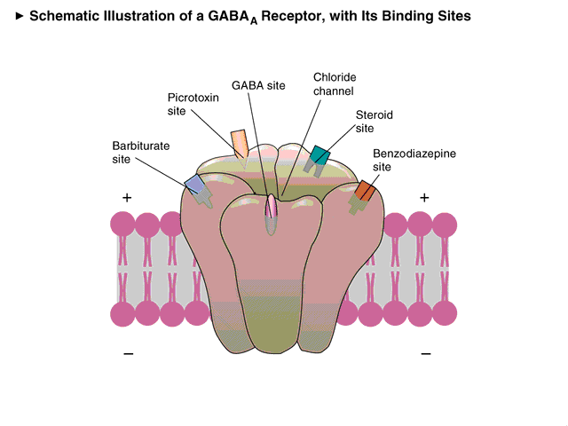
Transmembrane ligand-gated ion channels
(nicotinic, GABA & ion gated channels)
Schematic illustration of ACh receptors

Slide 8
Transmembrane G protein-coupled receptors
EC domain
IC domain interacts with G ptn or effector molecule
Many kinds of G ptns (Gs, Gi, Gq)
All composed of α, β & 𝛾 subunits
The responses lasts for several seconds to minutes

Slide 9
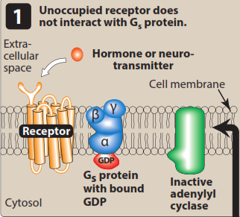
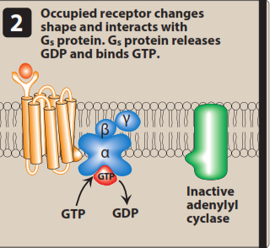
Transmembrane G protein-coupled receptors (cont.)

Slide 10
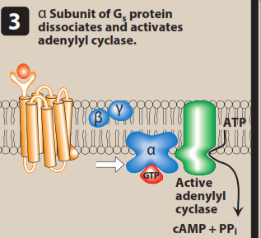
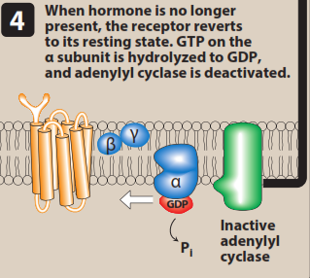

Slide 11
Transmembrane G protein-coupled receptors (cont.)

Slide 12
G proteins
A-
B-
G_{q}
G_{s}
Adenylyl cyclase
cAMP
Phospholipase C
DAG
IP₃

Slide 13
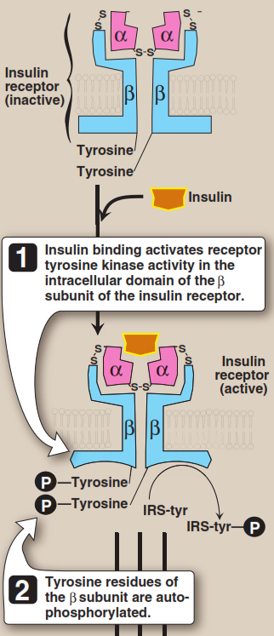
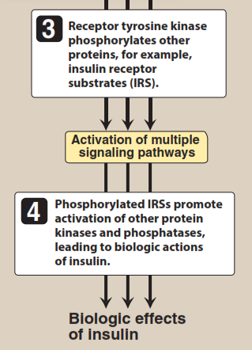
Enzyme-linked receptors
(Insulin Receptors)
Dimers or multisubunits
Lasts min to hrs
Ex., epidermal growth factor(EGF), platelet-derived growth factor (PDGF), atrial natriuretic peptide (ANP), insulin & others

Slide 14
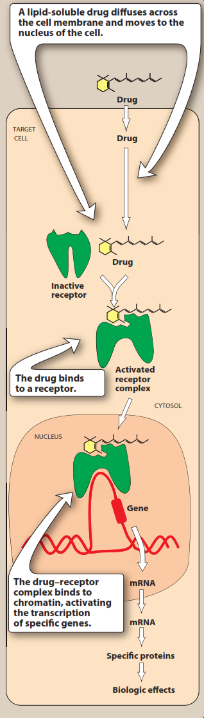
Intracellular receptors
Takes hours to days to give response
Examples: steroid H, structural pts, Es, RNA & ribosomes

Slide 15
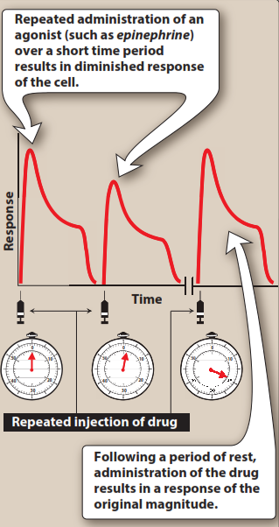
Characteristics of Signal Transduction
Signal Amplification
e.g. albuterol
Spare receptors
insulin spare Rs = 99%
β-adrenoceptors = 5-10%

Slide 16
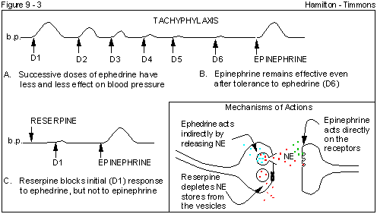

Desensitization, & Down-Regulation of Receptors
Tachyphlaxis: repeated administration of the agonist lead to decrease in responsiveness of Rs
Refractory
Up-regulation of receptors

