Slide 1
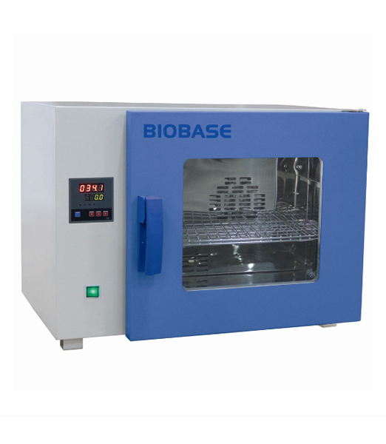
DRYING
Lab -5-

Slide 2
Drying
Drying
Drying :- is the removal of liquid from material by application of heat.
It is accomplished by
transfer of a liquid from a surface into an unsaturated vapor phase.

Slide 3
Purposes of drying:
1- Unit of process in pharmaceutical manufacturing
(e.g. preparation of granules then dispense as capsules or tablets).
2- Reduce bulk and weight lower the cost of transportation and storage.
3- Aid in preservation of animal and vegetable drugs by minimizing mold and bacterial growth in moisture laden material
4- facilitate comminution by increasing friability.

Slide 4
Classification of solids on drying behavior
1- Granular or crystalline solids (water is held in shallow and open surface pores as well as in interstitial spaces between particles that are easily accessible to the surface).
2- Amorphous, fibrous or gelatinous solids (moisture is an integral part of the molecular structure as well as being physically entrapped in fine capillaries and small interior pores).
Ex: calcium sulfate, zinc oxide, magnesium oxide
Ex: starch, insulin and aluminum hydroxide.
Note: Amorphous solids are difficult to dry than granular or crystalline solids.

Slide 5
Classification of dryers
1- Static-bed dryers- systems
A- tray and truck dryers
B- tunnel and conveyor dryer
C-oven
2- moving-bed dryers-systems
A. turbo-tray dryer
B. pan dryer
3- fluidized - bed dryers systems
4- pneumatic dryers system
5- specialized drying methods
A- Freeze dryer
B- microwave drying

Slide 6
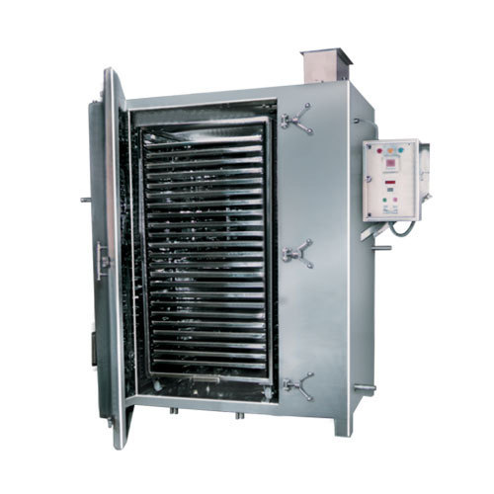
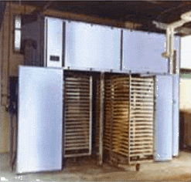
1- Static-bed dryers- systems
A- tray and truck dryers: it consist from cabinet in which the material dried is spread on tiers of trays .

Slide 7
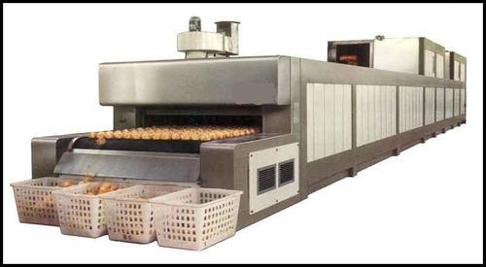
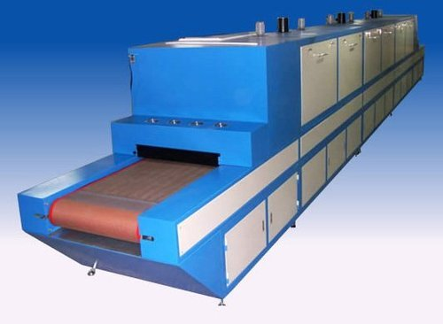
1- Static-bed dryers- systems
B- tunnel and conveyor dryer: an adaptation of truck dryer for continuous drying.

Slide 8
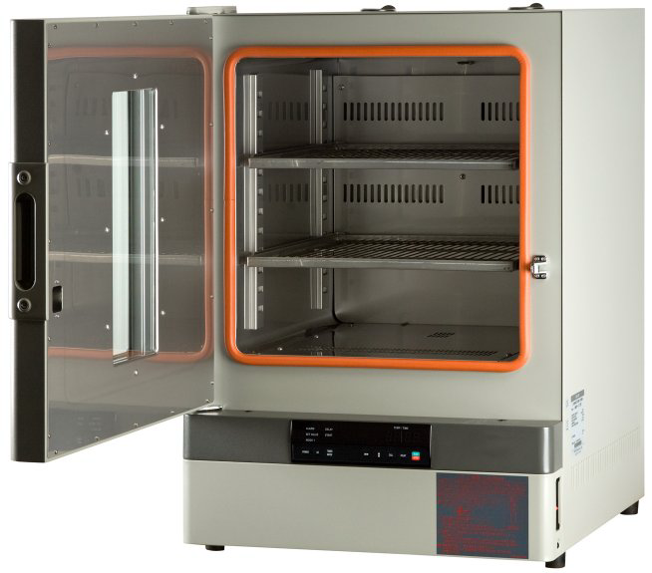
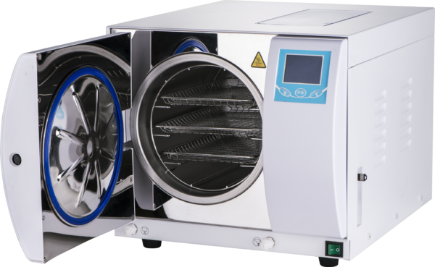
1- Static-bed dryers- systems
C- oven: including autoclave and dry oven

Slide 9
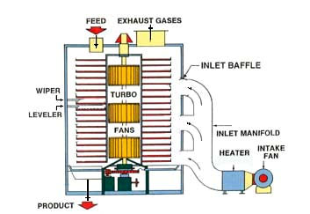
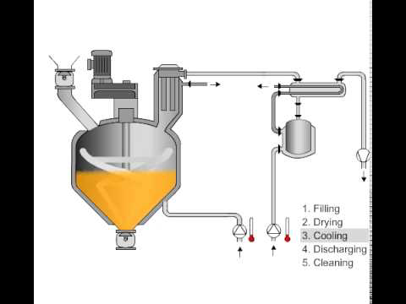
2- moving-bed dryers-systems
The drying particles are partially separated so that they flow over each other.
A. turbo-tray dryer
B. pan dryer

Slide 10
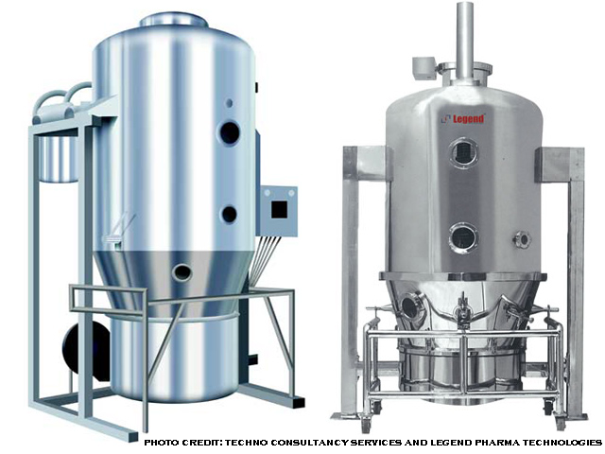
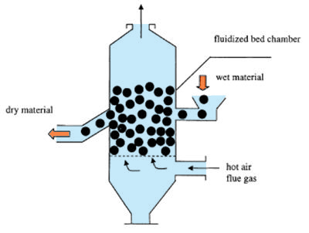
3- fluidized - bed dryers systems
Solid particles are partially suspended in upward moving gas steam.

Slide 11
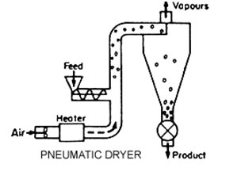
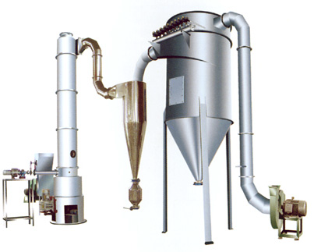
4- pneumatic dryers system
Drying particles are entrained and conveyed in a high velocity gas stream.

Slide 12
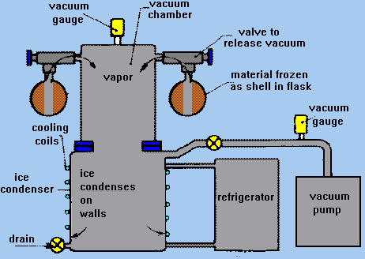
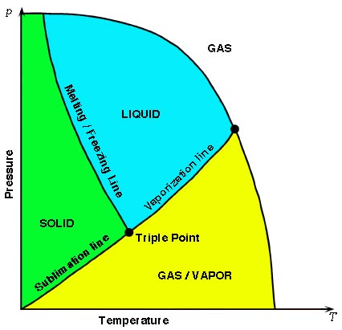
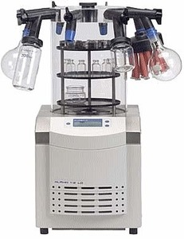
5- specialized drying methods
A- Freeze dryer

Slide 13
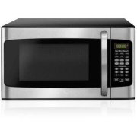
5- specialized drying methods
B- Microwave drying:- here instead of applying heat externally to material, energy in form of microwaves is converted into internal heat by interaction with material itself

Slide 14
Solids drying
The moisture in a solid can be expressed on a wet-weight or dry-weight basis.
Wet-weight basis: loss on drying
%LOD = wt. of water in sample × 100
total wt. of wet sample
Dry-weight basis: moisture content
%MC = wt. of water in sample × 100
wt. of dry sample

Slide 15

Example
If exactly 7 g of moist solid is brought to a constant dry weight of 5 g:
MC = $\frac{7−5}{5}$ x 100 = 40%
Whereas
LOD = $\frac{7−5}{7}$ x 100 = 28.57%

Slide 16


