Slide 1
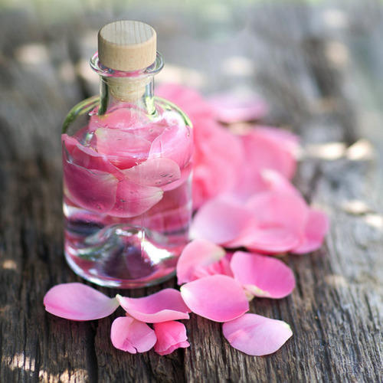
Aromatic Water
By
Assistant lect. Nora Zawar
Assistant lect. Zeina Dawood
Assistant lect Zahraa Amer

Slide 2
Simple Solution
Solutions: are liquid pharmaceutical preparations. Which contain one or more soluble chemical substance dissolved in one or more suitable solvent and produce single-phase system.

Slide 3
General procedure of preparation of simple solution
1. Weigh the solid ingredient and put it in a beaker.
2. Subtract the volume of liquid ingredient (in the formula ) from ¾ of the final volume of the prescription.
3. Dissolve the solid ingredients in the remaining amount of the vehicle.
4. Add the liquid ingredient.
5. Convert the content of the beaker into the measuring cylinder and complete the volume up to the required amount by the addition of the vehicle.
6. Transfer the content of the measuring cylinder to a wide mouth bottle and put the suitable label.

Slide 4
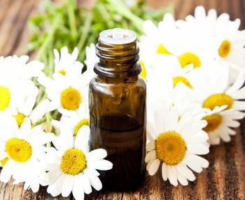
Aromatic Water
Are liquid pharmaceutical preparations of volatile oil or essential oil or volatile solid material .
Aromatic water have low therapeutic effect since small amount of volatile substance present in water.
They are used in pharmacy as pleasant and flavoring medium or vehicle for administration of water–soluble drugs in order to mask the undesirable taste and odor of the drugs.

Slide 5
Preparation of aromatic water
1. Distillation method
2. Solution method
3. Alternate solution method
4.dilution method.

Slide 6
1. Distillation method
Rose water, hamamels water, camphor water, peppermint water and orange flower water are prepared by this method because they are prepared directly from fresh plant materials.

Slide 7
2. Solution method
the essential oil which contains the aromatic material is agitated with purified water (2ml or 2gm of aromatic materials agitated with 1000ml of water ) in a closed container for 15 minutes then the mixture is set aside for at least 12 hour longer to permit the excess oil and solid substance to settle. then filter through wetted filter paper, Then pass enough purified water through the filter paper to make the product measure 1000 ml.

Slide 8
Pass the solution through filter paper in order to:
Prevent the passage of excess oil into the filtrate
Eliminate absorption of the dissolved aromatic by the filter paper.

Slide 9
The disadvantage of solution method
In spite of repeated filtration it is difficult to get clear preparation (the turbidity is related to the presence of fine particles of oil in the filtrate ) and this turbidity may be avoided by using boiling water and it consume time .

Slide 10
example on this method :
Chloroform water
Orange water
Cinnamon water
Anise water

Slide 11
Chloroform water
Chloroform oil 2ml
p.w 1000ml
It is prepared by solution method but without filtration .it is prepared by placing excess amount of chloroform in a bottle then add water and shake vigorously .some of chloroform dissolve in water and form aromatic water and excess will settle down on the bottom of the bottle because it is heavier than water (there is no clarification problem).

Slide 12
Uses of chloroform water:
it is used as a pharmaceutical aid (preservative, vehicle and general anesthetic).
Note: chloroform water is stored in light resistant bottle since the light will oxidize the chloroform to a poison gas (phosgene).

Slide 13
3. Alternate solution method
In this method the aromatic water is prepared by mixing 2ml of volatile oil with 15 gm of talc powder then add 1000ml of p.w
mix then filter .
this method offer time saving and clear solution example on this method is peppermint water.

Slide 14
Talc powder
It is inert insoluble substance used in alternate method because it function as filter aid (it adsorbs the excess amount of oil that cause turbidity ) and as distributing agent (it have the ability to break up aromatic substance into fine particles so the surface area exposed to the solvent increase so the solubility will increase.)

Slide 15
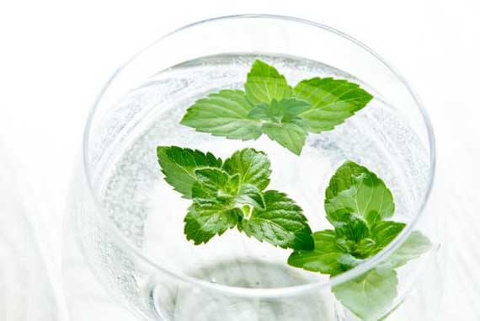
Peppermint water
Peppermint oil 2ml
Talc powder 15gm
P.W. 1000ml
weigh 15 gm of talc powder and put it in a beaker then add 2ml of peppermint oil and triturate well then add 1000ml of p.w. mix the content thoroughly then shake for 10 minutes and filter through wetted filter paper.

Slide 16
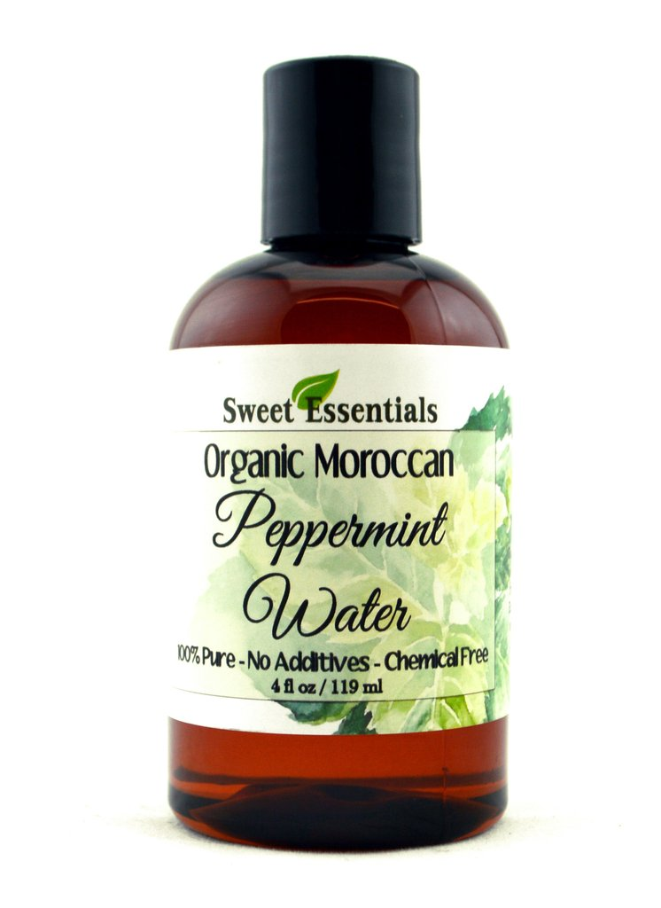
Uses of Peppermint water:
It is used as antispasmodic and carminative.
It is one of the most popular aqueous vehicle.
It is used as ingredient in mouth washes because menthol give a pleasant and cool sensation on mucous membrane.

Slide 17
4.Dilution method
1 volume of concentrated aromatic water is diluted with 39 volume of water to get diluted solution
example on this method is : Peppermint water.
Note: concentrated aromatic waters are 40 times stronger than ordinary aromatic water.

