Slide 2
Diabetes Mellitus
Chronic condition
Endocrine Disorder
Hyperglycemia
Impaired insulin secretion
Insulin resistance

Slide 3
Differences between type 1 and type 2 DM
Type 1 diabetes
β-cell destruction
Islet cell antibodies present
Strong genetic link
Age of onset usually below 30
Faster onset of symptoms
Patients usually not overweight
Insulin must be administered
Extreme hyperglycaemia causes diabetic ketoacidosis
Type 2 diabetes
No β-cell destruction
No islet cell antibodies present
Very strong genetic link
Age of onset usually above 40
Slower onset of symptoms
Patients usually overweight
Diet control and oral hypoglycaemic glycemic agent
Extreme hyperglycaemia causes hyperosmolar hyperglycaemic state

Slide 4
Type 1 DM
Genetic (1–2%) and Environmental factors
Circulating islet
cell antibodies (ICAs)
Precedes the onset
of clinical diabetes by as much as 3 years.
The final event that precipitates clinical diabetes may be caused by sudden stress, infection when the mass of β-cells in the pancreas falls below 5–10%.

Slide 5
Type 1 DM / Pathophysiology
Acute deficiency of insulin that leads to:
↑↑ Hepatic glycogenolysis,
↑ Gluconeogenesis,
↑ Hepatic glucose output,
↓ Glucose uptake by insulin-sensitive tissues
sudden stress, infection--- ↑ counter-regulatory hormones (glucagon, cortisol, catecholamine and growth hormone)→ increase hepatic glucose.

Slide 6
Type 2 DM
Strong genetic predisposition (5–10%)
Insulin resistance and β-cell dysfunction
85% of people with
type 2 diabetes are obese

Slide 7
Type 2 DM / Pathophysiology
Less acute --- Insulin production decreases over a sustained period.
Hyperinsulinaemia is able to maintain glucose levels for a period of time, but eventually β-cell function deteriorates and hyperglycaemia ensues.
Routin check for Impaired glucose tolerance (IGT), Impaired fasting glucose or hyperinsulinaemia may be detected before overt diabetes develops.
At the time of diagnosis, those with type 2 diabetes may have already lost about 50% of their β-cell function.

Slide 8
Pathophysiology of insulin resistance
Abdominal fat is resistant to the antilipolytic effects of insulin →→ release of excessive amounts of free fatty acids →→ insulin resistance in the liver and muscle →→ increase in gluconeogenesis in the liver and an inhibition of insulin-mediated glucose uptake in the muscle.
Excess fat →→ adipocytes become too large →→ unable to store additional fat →→ fat storage in the muscles, liver and pancreas, causing →→ insulin resistance in these organs.

Slide 9
Pathophysiology of insulin resistance
Adipose tissue causes the ↑ of some cytokines:
plasminogen activator inhibitor-1 (which is prothrombotic),
tumour necrosis factor-α and interleukin-6 (which are proinflammatory)
resistin (which causes insulin resistance).
Excess adipose tissue ↓ beneficial adipokine (adiponectin).
Adiponectin suppresses the attachment of monocytes to endothelial cells, thereby protecting against vascular damage.

Slide 10
Clinical manifestations
Polyuria (increased urine production, particularly noticeable at night)
Polydipsia (increased thirst).
Osmotic diuresis secondary to hyperglycaemia.
Fatigue due to an inability to utilise glucose and marked weight loss because of the breakdown of body protein and fat as an alternative energy source to glucose.
Blurred vision caused by a change in lens refraction
Higher infection rate, especially Candida, and urinary tract infections due to increased urinary glucose levels.

Slide 11
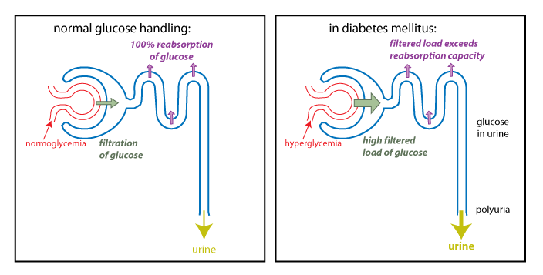

Slide 13
Diagnosis
With symptoms (polyuria, polydipsia and unexplained weight loss) plus:
Fasting serum glucose concentration ≥7.0 mmol/L
or serum glucose concentration ≥11.1 mmol/L 2 h after 75 g anhydrous glucose in an OGTT.
With no symptoms,
Diagnosis should not be based on a single glucose determination.
Glycated haemoglobin (HbA1c)

Slide 14
Symptoms of Hypoglycaemia + (table 44.4)
Autonomic
Sweating
Trembling
Tachycardia
Palpitations
Pallor
Other
Hunger/ Headache
Perioral tingling/numbness
Neuroglycopaenic
Faintness
Loss of concentration
Drowsiness
Visual disturbances
Abnormal behaviour (agitation, aggressiveness)
Confusion and Coma

Slide 15
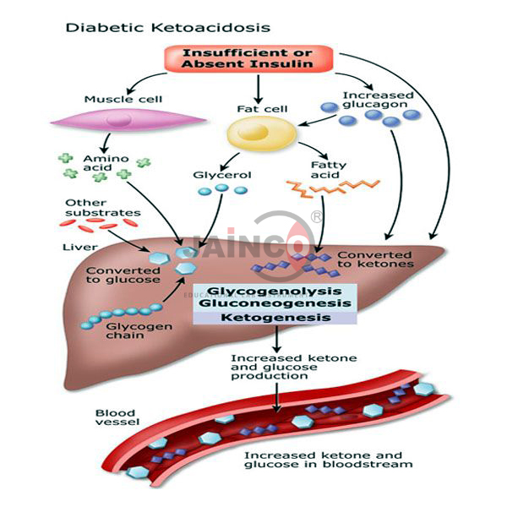
Diabetic ketoacidosis
Blood glucose level > 22 mmol/L

Slide 16
Hyperglycaemia
↑Ketones
Osmotic diuresis
Lowers serum volume
Hyperosmolarity
Stimulation of the vomiting center
Anorexia, nausea and vomiting
Potassium loss

Slide 17
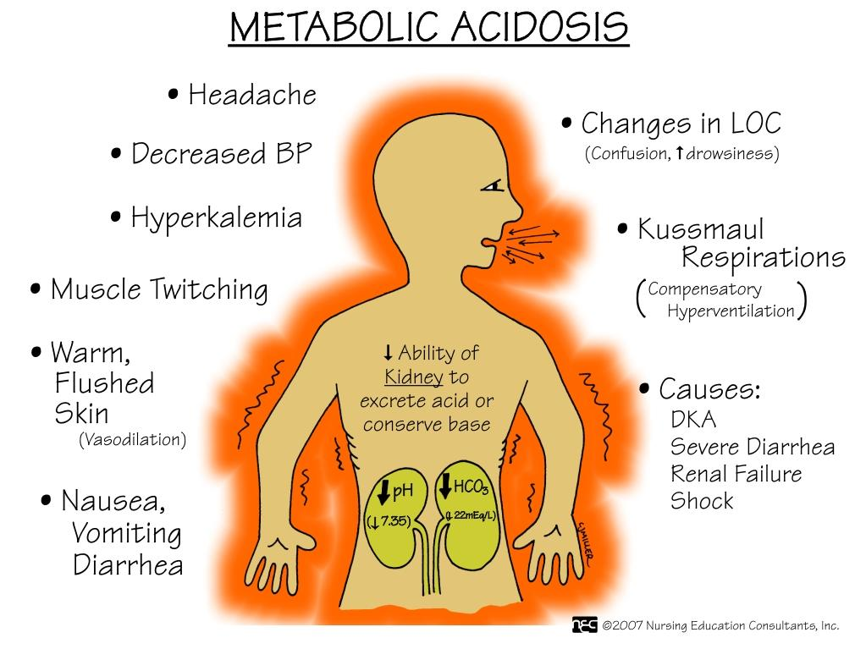

Slide 18
Hyperosmolar hyperglycemic state
No significant ketone production and therefore no severe acidosis.
Hyperglycemia → osmotic diuresis → dehydration → hyperosmolarity → increase blood viscosity and the risk of thromboembolism.
Factors precipitating HHS are infection, myocardial infarction, poor adherence with medication regimens or medicines which cause diuresis or impair glucose tolerance, for example, glucocorticoids.

Slide 19
Long-term diabetic complications
Macrovascular disease
Cardiovascular disease
Peripheral vascular disease
Microvascular disease
Retinopathy
Nephropathy
Peripheral neuropathy

Slide 20
Cardiovascular disease
The most common cause of death in people with type 2 diabetes
Silent myocardial infarction (infarction with no symptoms) is more common in those with diabetes
Cerebrovascular disease is also more commonly associated with diabetes
Hypertension is twice as common amongst the diabetic population. It affects over 80% of those with type 2 diabetes

Slide 21
Peripheral vascular disease
PVD affects the blood vessels outside the heart
It often affects the arteries of the legs
A cramping pain experienced on walking, due to reversible muscle ischaemia secondary to atherosclerosis.

Slide 22
Retinopathy
The main problem with retinopathy is that it is symptomless until the disease is far advanced.
Tight glycaemic control has been shown to prevent and delay the progression of retinopathy in patients with DM.

Slide 23
Nephropathy
In diabetic renal disease, the kidneys become enlarged and the glomerular filtration rate (GFR) initially increases.
Detection by GFR estimation and microalbuminuria
(ACE) inhibitors and/or (ARBs) are the treatments of choice, provide renal protective effects.

Slide 24
Peripheral neuropathy
progressive loss of peripheral nerve fibres resulting in nerve dysfunction.
sensory, motor and autonomic symptoms.

Slide 25
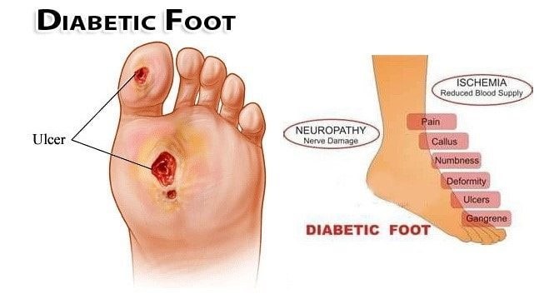
Macro- and microvascular disease combined
Foot problems often develop as a result of a combination of specific problems associated with having diabetes, that is sensory and autonomic neuropathy, PVD and hyperglycaemia.

Slide 26
There are three main types of foot ulcers:
Neuropathic ulcers occur when peripheral neuropathy causes loss of pain sensation.
Ischaemic ulcers result from PVD and poor blood supply causing a reduction in available nutrients and oxygen required for healing.
Ischaemic ulcers are painful and usually occur on the distal ends of the toes.
Most ulcers have elements of both neuropathy and ischaemia and are termed neuroischaemic.

Slide 27
Charcot arthropathy
This is an uncommon foot complication
caused by severe neuropathy. It results in chronic,
progressive destruction of joints with marked inflammation.
Reduced bone density leads to bone fractures, altered
foot shape and gross deformity

Slide 28
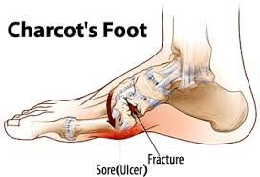
Charcot arthropathy
This is an uncommon foot complication caused by severe neuropathy. It results in chronic, progressive destruction of joints with marked inflammation.
Reduced bone density leads to bone fractures, altered foot shape and gross deformity

Slide 29
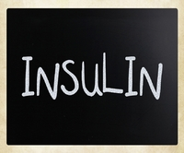
Management of T1DM

Slide 30
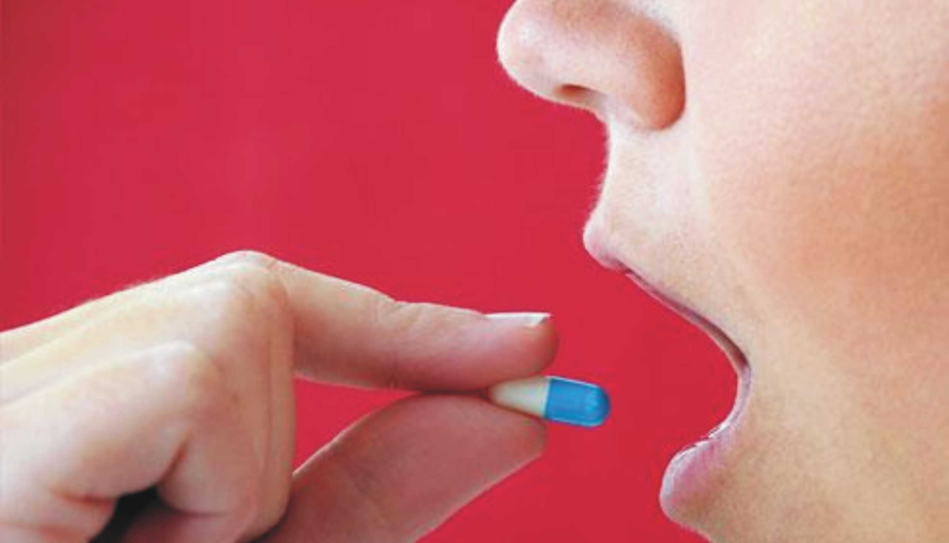
Management of T2DM

Slide 31
Sulfonylureas
Stimulate insulin release from the β-cells of the pancreas
Biguanides
Inhibit gluconeogenesis and increased insulin-stimulated glucose uptake
Thiazolidinedione
Bind to the PPARγ
and regulate the expression of multiple genes
Dipeptidyl pepidase-4 inhibitors
Meglitinides
Stimulate insulin release from the β-cells of the pancreas
Incretin Mimetics
bind to GLP-1 receptors and stimulate glucose dependent insulin release.
Alpha-Glucosidase Inhibitors
Inhibit the digestion of complex carbohydrates

