Slide 1
Tropane alkaloids
Pharmacognosy
3rd Class, 2nd Semester
LAB.3

Slide 2
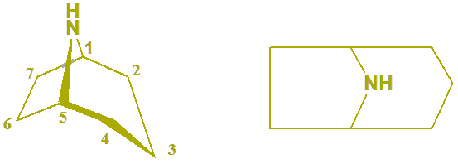
Introduction
They are ester alkaloids resulted from the coupling of organic acids with amino alcohol (Base).

Slide 3
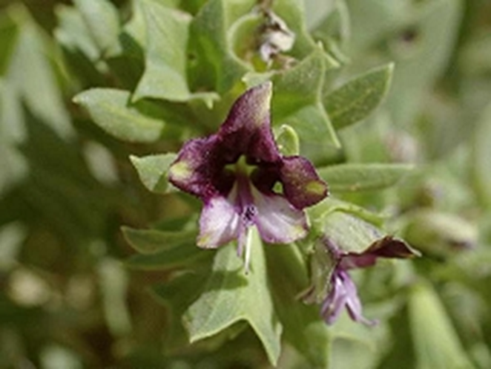
Tropane Alkaloids are classified into:
1- Solanaceous Tropane Alkaloids.
Occurred in:
Atropa, Datura, Hyoscyamus.
Main Alkaloids are:
Atropine (Strong base)
Hyoscyamine.
Hyoscine (Scopolamine)

Slide 4
Uses
The three Alkaloids are anticholinergic agents:
Decrease saliva and GIT secretions so used preoperative.
Decrease motility of smooth muscles so used as antispasmodics.
Stimulate respiratory system.
A mydriatic (causes dilatation of the eye pupil).
Atropine is the specific antidote to cholinergic agents by occupying receptor sites at parasympathetic nerve endings.
Hyoscine has more central effect so it is sedative and hypnotic.
Hyoscine is mainly used as antiemetic.

Slide 5
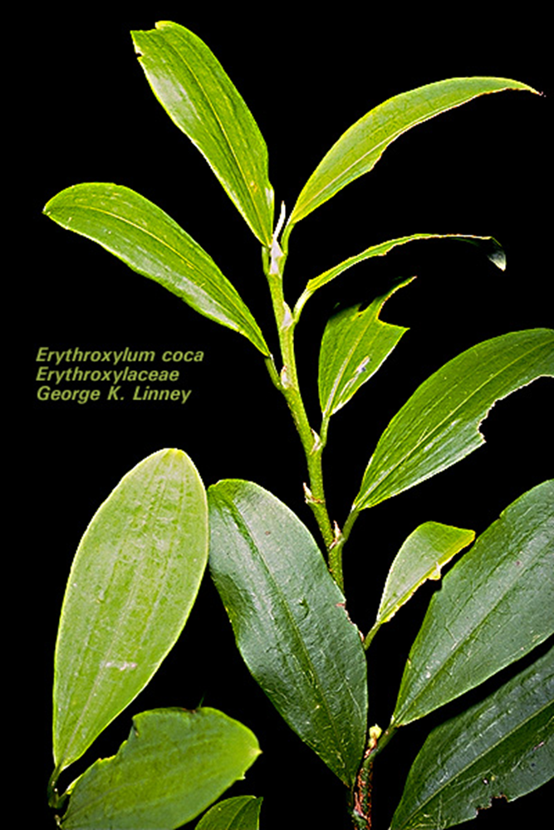
2- Erythroxylon Coca Alkaloids.
Occurrence:
Coca leaves contain about 2% total alkaloids.
Main Alkaloids are:
Cocaine.
Cinnamylcocaine.
α truxilline.

Slide 6
Uses
Cocaine was used as local anesthetic.
Cocaine has a CNS stimulant activity so is one of the widely abused drugs.

Slide 7
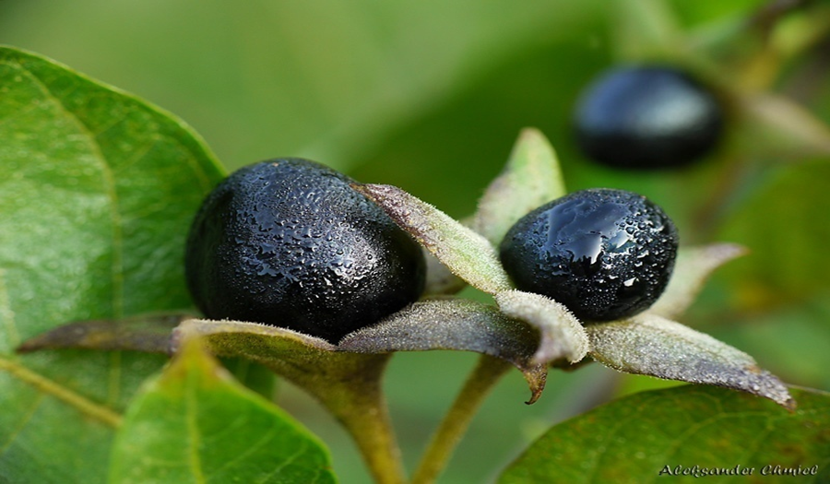
Atropa belladonna
Family Solanaceae

Slide 8
Belladonna leaf, also known as devils cherries, black cherry.
The belladonna leaf yield not less than 0.35% of alkaloids.
Native to Europe, North Africa, and Western Asia
The name "belladonna" comes from the Italian language, meaning "beautiful lady"

Slide 9
Toxicity
Belladonna is one of the most toxic plants.
All parts of the plant contain atropine alkaloids.
The greatest danger to children because they look attractive and have a somewhat sweet taste.
The root of the plant is generally the most toxic part.

Slide 10
The symptoms of belladonna poisoning
Blurred vision.
Loss of balance.
Headache, rash.
Dry mouth.
Slurred speech.
Confusion, hallucinations.

Slide 11
Constituents of belladonna are:-
Hyoscyamine and its isomer Atropine, which is formed during extraction procedure.
Also it contains Hyoscine (scopolamine) alkaloid, which is found in trace amounts.

Slide 12
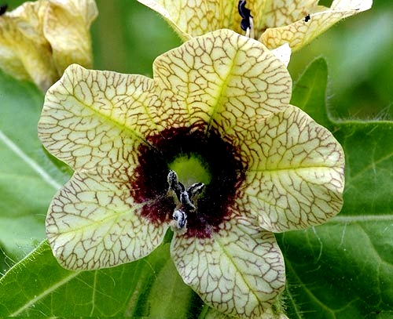
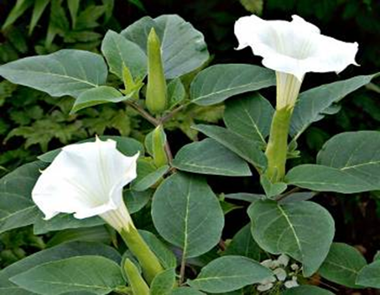
These alkaloids are also present in other plants as:-
Hyoscyamus niger and Datura stramonium
Family Solanaceae.

Slide 13
ISOLATION OF BELLADONNA ALKALOID
Extract 50 gm of datura leaves with alcohol 90% under reflux for one hour, The belladonna alkaloids are not affected by heat therefore the reflux condenser is used in its extraction.
Filter and evaporate the filtrate on a steam bath to a syrup liquid The evaporation step is to get rid of the ethanol solvent (since in the partition step you must have two immiscible layers ,if not this means that the ethanol is still present)

Slide 14
The concentrated filtrate add slowly, with stirring into 100ml of 2%HCL (Addition of 2%HCL is to convert the alkaloids present in the extract to alkaloidal salts (Alkaloids are extracted as their salts together with accompanying soluble impurities), the use of 2% not more, is to prevent the destruction of the alkaloid by concentrated HCL )
Washing by adding organic solvent to remove all the non polar impurities such as ether or hexane & separate two layers by separatory funnel.

Slide 15
Made alkaline by adding ammonium hydroxide solution
(according to litmus paper)
The addition of ammonium hydroxide is used to liberate free base.
Placed in a separator funnel

Slide 16
Extracted three time with 100 ml of chloroform
The use of chloroform is to extract the alkaloid base, as it is soluble in the organic solvent.

Slide 17
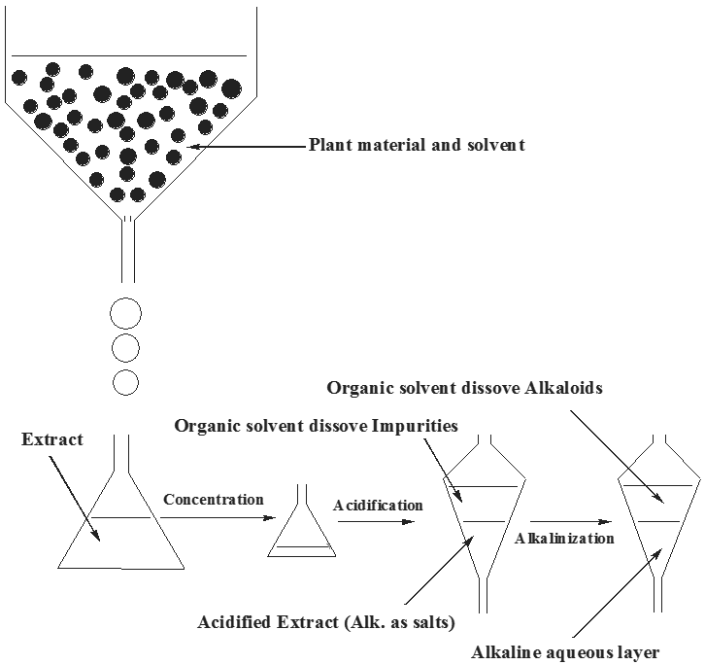

Slide 18
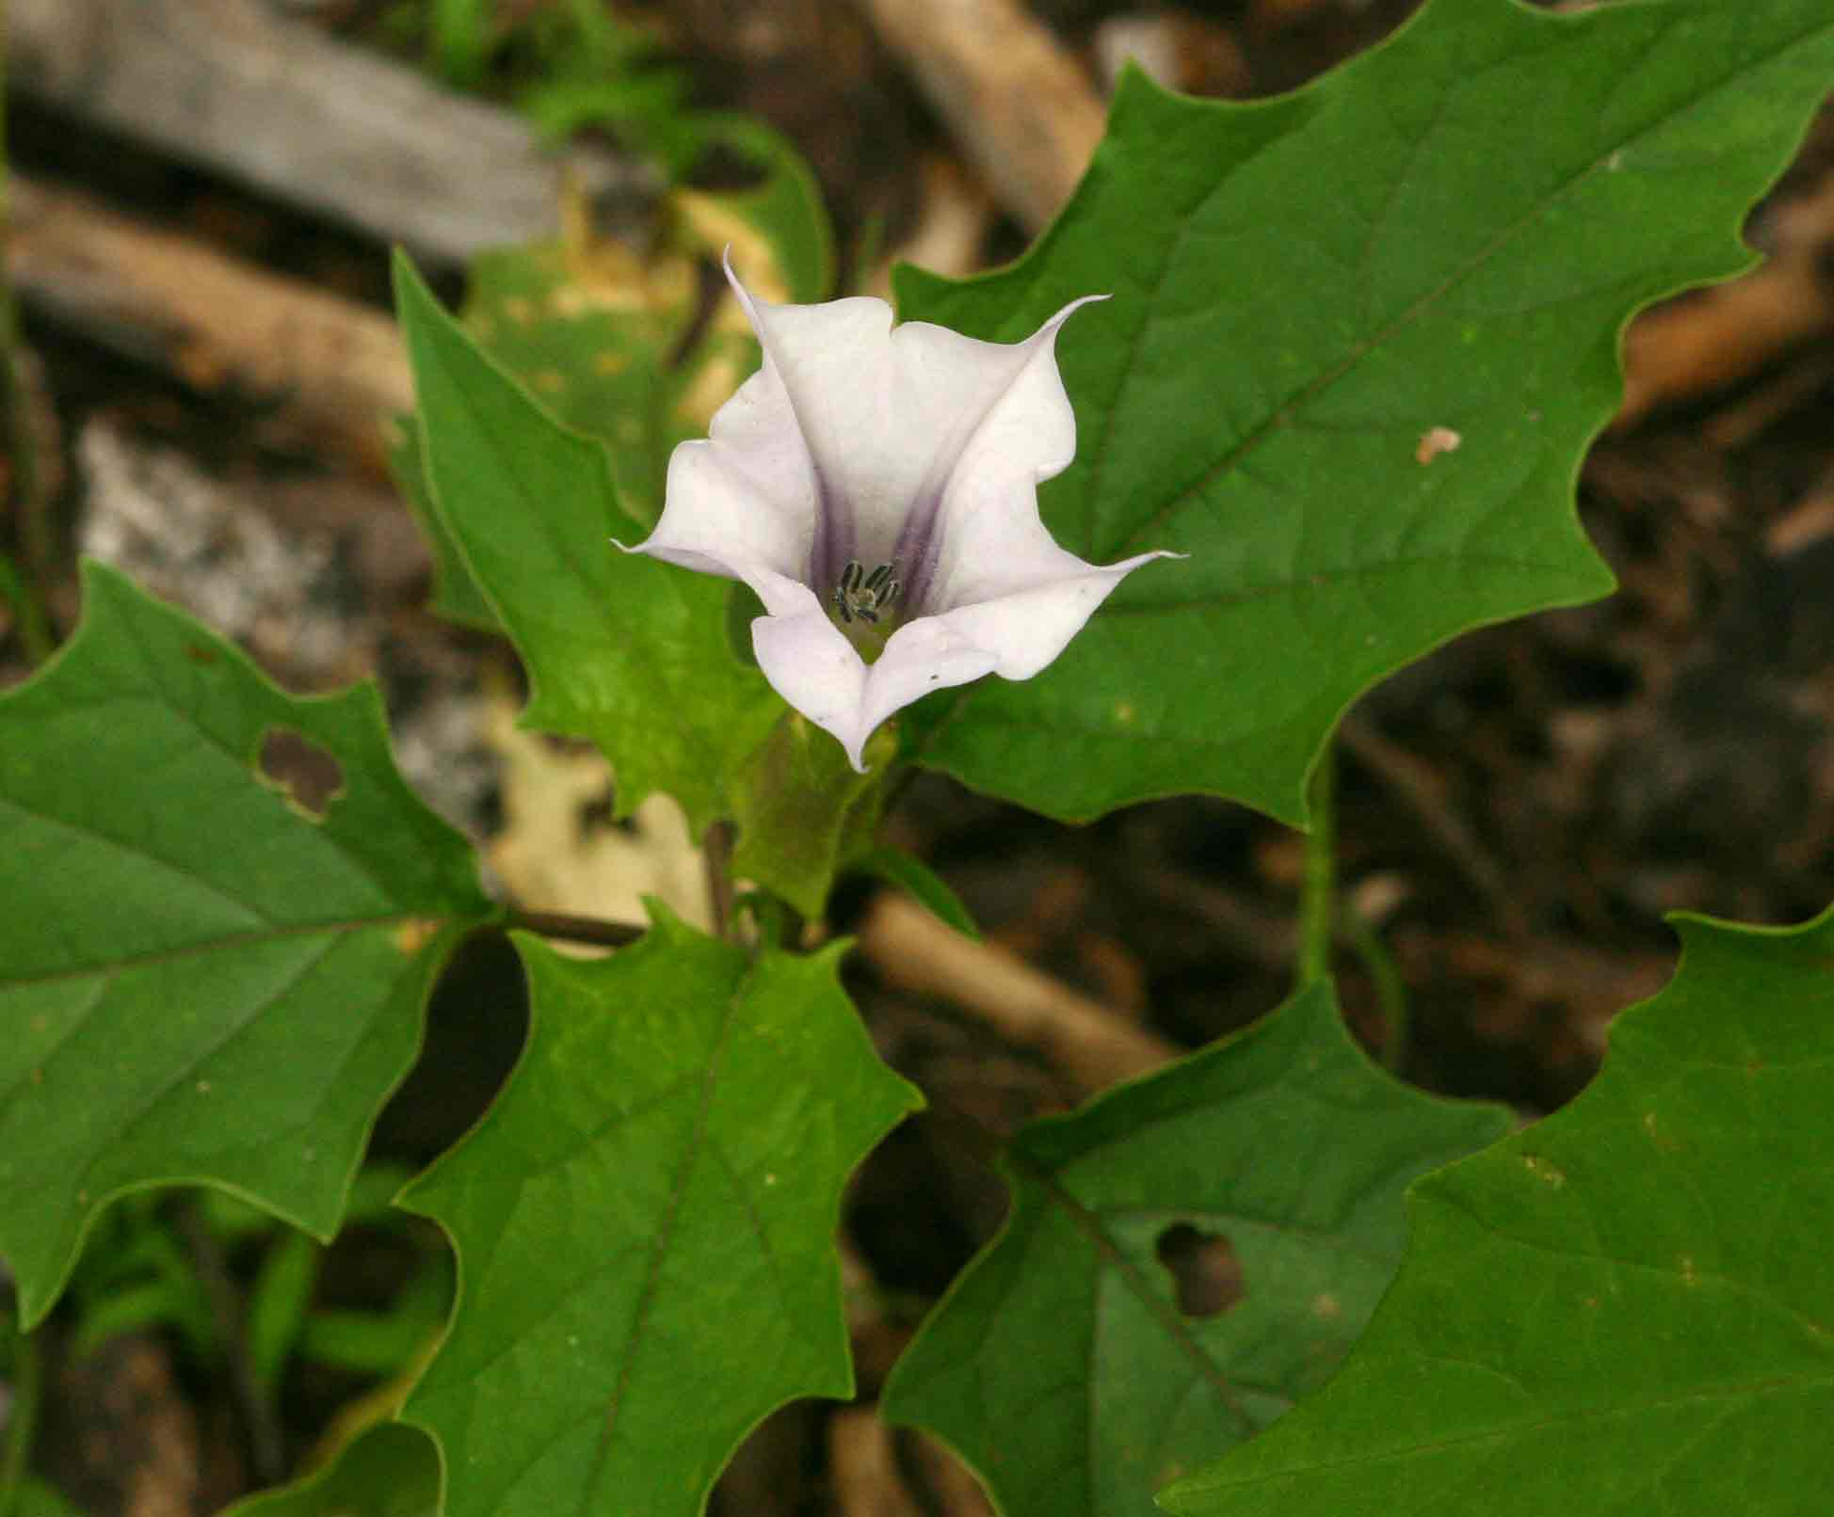
THANK YOU

