Slide 1
Dosage Form Design
Lecture 7 and 8
Dr. Athmar Dhahir Habeeb
PhD in Industrial pharmacy and drug delivery
athmar1978@uomustansiriyah.edu.iq
athmar1978@yahoo.com
athmar.habeeb.12@ucl.ac.uk

Slide 2
Chapter 4 \ Dosage Form Design: Pharmaceutical and Formulation Considerations
Objectives After reading this chapter, the student will be able to:
1. List reasons for the incorporation of drugs into various dosage forms
2. Compare and contrast the advantages/disadvantages of various drug dosage forms
3. Describe the information needed in preformulation studies to characterize a drug substance for possible inclusion into a dosage form
4. Describe the mechanisms of drug degradation and provide examples of each
5. Describe the five types of drug instability of concern to the practicing pharmacist
6. Describe the purpose and general protocol for accelerated stability studies
7. Summarize approaches employed to stabilize drugs in pharmaceutical dosage forms
8. Calculate rate reactions for various liquid dosage forms
9. Categorize various pharmaceutical ingredients and excipients

Slide 3
Introduction
Drug substances are seldom administered alone; rather they are given as part of a formulation in combination with one or more nonmedicinal agents that serve varied and specialized pharmaceutical functions.
Selective use of these nonmedicinal agents, referred to as pharmaceutical ingredients or excipients, produces dosage forms of various types.
The general area of study concerned with the formulation, manufacture, stability, and effectiveness of pharmaceutical dosage forms is termed pharmaceutics.
The proper design and formulation of a dosage form requires
consideration of the physical, chemical, and biologic characteristics of all of the drug substances and pharmaceutical ingredients to be used in fabricating the product.
The drug and pharmaceutical materials must be compatible with one another to produce a drug product that is stable, efficacious, attractive, easy to administer, and safe.
The product should be manufactured with appropriate measures of quality control and packaged in containers that keep the product stable.
The product should be labelled to promote correct use and be stored under conditions that contribute to maximum shelf life.

Slide 4
The need for dosage forms
The potent nature and low dosage of most drugs in use today precludes (not permits) any expectation that general public could safely obtain the appropriate dose of a drug from the bulk material.
Most drug substances are administered in milligram quantities, much too small to be weighed on anything but a sensitive prescription or electronic analytical balance.
For instance, how could lay person accurately obtain from a bulk supply the 325 mg of aspirin found in the common tablet? Not possible.
Yet compared with many other drugs, the dose of aspirin is formidable (Table 4.1).
For example, the dose of ethinyl estradiol, 0.05 mg, is 1/6,500 the amount of aspirin in an aspirin tablet. To put in another way, 6,500 ethinyl estradiol tablets, each containing 0.05 mg of drug, could be made from an amount of ethinyl estradiol equal to the amount of aspirin in just one standard tablet.

Slide 5
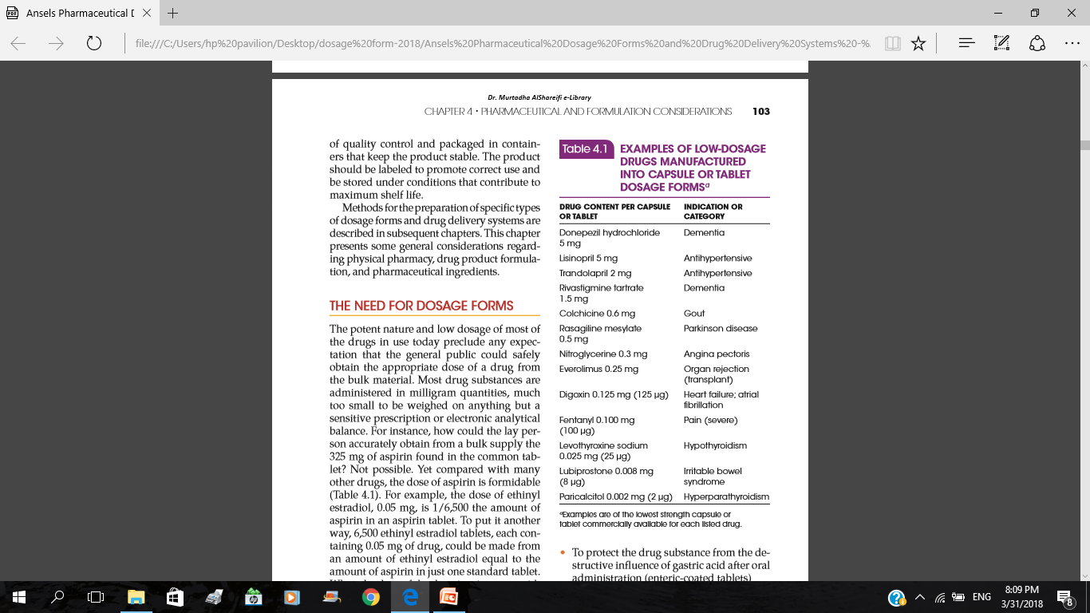
When the dose of the drug is minute, as with ethinyl estradiol, solid dosage forms such as tablets and capsules must be prepared with filler or diluents so that the dosage unit is large enough to pick up with the fingertips.

Slide 6
Besides providing the mechanism for the safe and convenient delivery of accurate dosage, dosage forms are needed for additional reasons:
To protect the drug substance from the destructive influences of atmospheric oxygen or humidity (coated tablets, sealed ampoules)
To protect the drug substance from the destructive influence of gastric acid after oral administration (enteric coated tablets)
To control the bitter, salty, or offensive taste or odor of a drug substance (capsule, coated tablets, flavored syrups)
To provide liquid preparations of substances that are either insoluble or unstable in the desired vehicle (suspensions)
To provide clear liquid dosage forms of substances (syrups, solutions)
To provide rate-controlled drug action (various controlled-release tablets, capsules, and suspensions)
To provide optimal drug action from topical administration sites (ointments, creams, trans-dermal patches, and ophthalmic, ear, and nasal preparations)
To provide for insertion of a drug into one of the body's orifices (rectal or vaginal suppositories)
To provide for placement of drugs directly in the bloodstream or body tissues (injections)
To provide for optimal drug action through inhalation therapy (inhalation aerosols)

Slide 7
General considerations in dosage form design
Before formulating a drug substance into a dosage form, the desired product type must be determined, then various initial formulations of the product are developed and examined for desired features (e.g., drug release profile, bioavailability, clinical effectiveness) and for pilot plant studies and production scale-up.
The formulation that best meet the goals for the product is selected to be its master formula. Each batch of product subsequently prepared must meet the specifications established in the master formula.
There are many different forms into which a medicinal agent may be placed for the convenient and efficacious treatment of disease.
Most commonly, a manufacturer prepares a drug substance in several dosage forms and strengths for the efficacious and convenient treatment of disease.
Before medicinal agent is formulated into one or more dosage forms, among the factors considered are such therapeutic matters as
the nature of the illness,
the manner in which it is treated (locally or through systemic action)
the age and anticipated condition of the patient.

Slide 8
Examples
If the medication is intended for systemic use and oral administration is desired, tablets and/or capsules are usually prepared because they are easily handled by the patient and are most convenient in the self-administration of medication.
If a drug substance has application in an emergency in which the patient may be comatose or unable to take oral medication, an injectable form of the medication may also be prepared.
Many other example of therapeutic of therapeutic situations affecting dosage form design could be cited, including motion sickness, nausea, and vomiting, for which tablets and skin patches are used for prevention and suppositories and injections for treatment.
The age of the intended patient also plays a role in the dosage form design.
For infant and children younger than 5 years of age, pharmaceutical liquids rather than solid forms preferred for oral administration. These liquids which are flavored aqueous solutions, syrups, or suspensions, are usually administered directly into infant's or child's mouth by drop, spoon, or oral dispenser or incorporated into child's food.
A single liquid paediatric preparation may be used for infants and children of all ages, with the dose of the drug varied by the volume administered.

Slide 9
When a young patient has a productive cough or is vomiting, gagging, or simple rebellious, there may be some question as to how much of the medicine administered is actually swallowed and how much is expectorated.
In such instance, injections may be required. Infant-size suppositories may also be employed, although drug absorption from the rectum is often erratic.
How to solve the difficulty of swallowing
During childhood and even adulthood, a person may have difficulty swallowing solid dosage forms, especially uncoated tablets, for this reason some medications are formulated as chewable tablets. Many of these tablets are comparable in texture to an after-dinner mint and break down into pleasant-tasting creamy material.
Newly available tablets dissolve in mouth in about 10 to 15 seconds; this allows the patient to take a tablet but actually swallow a liquid.

Slide 10
Capsules have been found by many to be more easily swallowed than whole tablets.
If a capsule is moistened in mouth before it is swallowed, it becomes slippery and readily slides down the throat with water.
Also, a teaspoonful of gelatine desert, liquid candy, or syrup placed in the mouth and partially swallowed before placing the solid dosage form in the mouth aids in swallowed them.
Also, if a person has difficulty swallowed a capsule; the contents may be emptied into a spoon, mixed with jam, honey, or other similar food to mask the taste of the medication and swallowed.
Medications intended for the elderly are commonly formulated into oral liquids or may be extemporaneously prepared into an oral liquid by the pharmacist.
However, certain tablets and capsules that are designed for controlled release should not be crushed or chewed, because that would interfere with their integrity and intended performance.

Slide 11
Problems and solutions for multiple medication therapy
Many patients, particularly the elderly, take multiple medications daily.
The more distinctive the size, shape, and color of solid dosage forms, the easier is proper identification of the medications.
Errors in taking medications among the elderly occur frequently because of their multiple drug therapy and impaired eyesight.
Dosage forms that allow reduced frequency of administration without sacrifice of efficiency are particularly advantageous.
Performulation Studies
Before the formulation of a drug substance into a dosage form, it is essential that it be chemically and physically characterized.
Physical Description
It is important to understand the physical description of a drug substance prior to dosage form development.
Most drug substances in use today are solid materials, pure chemical compounds of either crystalline or amorphous constitution. The purity of the chemical substance is essential for its identification and for evaluation of its chemical, physical, and biologic properties.

Slide 12
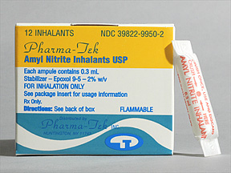
Chemical properties include structure, form, and reactivity.
Physical properties include such characteristics as its physical description, particle size, crystalline structure, melting point, and solubility.
Biologic properties relate to its ability to get to a site of action and elicit a biologic response.
Drugs can be used therapeutically as solids, liquids, and gases. Liquid drugs are used to a much lesser extent than solid drugs; gases, even less frequently.
Liquid drugs pose an interesting problem in design of dosage forms and delivery systems. Many liquids are volatile and must be physically sealed from atmosphere to prevent evaporation loss.
Amyl nitrate, for example, is clear yellowish liquid that is volatile even at low temperatures and is also highly flammable. It is kept for medicinal purposes in small sealed glass cylinders wrapped with gauze or another suitable material. When amyl nitrite is administered, the glass is broken between the fingertips, and the liquid wets the gauze covering, producing vapors that are inhaled by the patient requiring vasodilation.

Slide 13
Propylhexedrine is another volatile liquid that must be contained in a closed system. This drug is used as a nasal inhalant for its vasoconstrictor action. A cylinder roll of fibrous material is impregnated with propylhexedrine, and the saturated cylinder is placed in a suitable, usually plastic, sealed nasal inhaler. The inhaler's cap must be securely tightened each time it is used. Even then, the inhaler maintains its effectiveness for only a limited time because of the volatility of the drug.
Another problem associated with liquid drugs is that those intended for oral administration cannot generally be formulated into tablet form, the most popular form of oral medication.
An exception to this is the liquid drug nitroglycerin, which is formulated into sublingual tablets that disintegrate within seconds after replacement under the tongue. However, because the drug is volatile, it has a tendency to escape from the tablets during storage, and it is critical that the tablets be stored in a tightly sealed glass container.

Slide 14
Approaches
For the most part, when a liquid drug is to be administered orally and a solid form is desired, one of two approaches is used.
First, the liquid substance may be sealed in a soft gelatine capsule.
Vitamins A, D, and E, cyclosporine and ergoloid mesylates are liquids commercially available in capsule form.
Second, the liquid drug may be developed into a solid ester or salt form that will be suitable for tablets or drug capsules.
For instance, scopolamine Hydrobromide is a solid salt of the liquid drug scopolamine and is easily pressed into tablets.
Third approach to formulate liquids into solids is by mixing the drug with a solid or melted semisolid material, such as a high-molecular-weight polyethylene glycol. The melted mixture is poured into hard gelatine capsules to harden and the capsules sealed.

Slide 15
Advantages of liquid drugs
For certain liquid drugs, especially those taken orally in large doses or applied topically, their liquid nature may have some advantage in the therapy. For example,
15-mL doses of mineral oil may be administered conveniently as such.
Also, the liquid nature of undecylenic acid certainly does not hinder but rather enhances its use topically in the treatment of fungus infections of the skin,
however, for the most part, pharmacists prefer solid materials in formulation work because they can easily form them into tablets and capsules.
Why solid dosage forms are preferred ?
Formulation and stability difficulties arise less frequently with solid dosage form than with liquid preparations, and for this reason many new drugs first reach the market as tablet or dry-filled capsules.
Later, when the pharmaceutical problems are resolved, a liquid form of the same drug may be marked. This procedure is doubly advantageous, because for the most part physicians and patients alike prefer small, generally tasteless, accurately dosed tablets or capsules to the analogous liquid forms.

Slide 16
Therefore, marketing a drug in solid form first is more practical for the manufacturer and suits most patients.
It is estimated that tablets and capsules constitute the dosage form dispensed 70% of the time by community pharmacists, with tablets dispensed twice as frequently as capsules
Microscopic Examination
It gives an indication of particle size and size range of the raw material along with the crystal structure.
Photomicrographs of the initial and subsequent batch lots of the drug substance can provide important information in case of problems in formulation processing attributable to changes in particle or crystal characteristics of the drug.

Slide 17
Heat of vaporization
The use of vapor pressure is important in the following situations:
The operation of implantable pumps delivering medication
Aerosol dosage forms
The use of nasal inhalants (propylhexedrine with menthol and lavender oil-benzedrex) or treating nasal congestion.
Some volatile drugs can even migrate within a tablet dosage form so the distribution may not be uniform any longer. This may have an impact in tablet that are scored for dosing where the drug in one portion may be higher or lower than in the other portion.
Exposure of personal to hazardous drugs due to handling, spilling, or aerosolizing of the drugs that may vaporize (oncology agents) is another application as the increase in mobility of the hazardous drug molecules may be related to temperature of the environment.
Some drugs, such as carmustine, experience greater vapor pressures with increased temperature as compared to cyclophosphamide, etoposide, cisplatin, and 5-fluorouracil).
Note: particle size affects vapor pressure; the smaller the particle size, the greater the vapor pressure.

Slide 18
Melting point Depression
The melting point, or freezing point, of a pure crystalline solid is deﬁned as the temperature at which the pure liquid and solid exist in equilibrium. Drugs with a low melting point may soften during a processing step in which heat is generated, such as particle size reduction, compression, sintering, and so on
A characteristic of a pure substance is a defined melting point or melting range. If not pure, the substance will exhibit a change in melting point. (A pure chemical is ordinarily characterised by a very sharp melting peak).
This phenomenon is commonly used to determine the purity of a drug substance and in some cases the compatibility of various substances before inclusion in the same dosage form.
The addition of a second component to a pure compound (A), resulting in a mixture, will result in a melting point that is lower than that of the pure compound

Slide 19
Phase diagrams are normally two-component (binary) representations, as shown in the following figure
IV
Temperature
Eutectic point
II
III
I
Pure A
Composition
Pure B

Slide 20
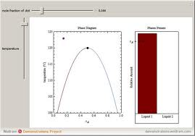
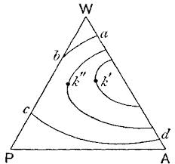
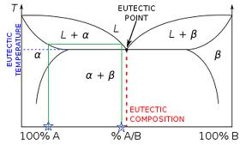
The Phase Rule
Phase diagrams are often constructed to provide a visual picture of the existence and extent of the presence of solid and liquid phases in binary, ternary, and other mixtures.

Slide 21
The Phase Rule
A phase diagram, or temperature-composition diagram, represents the melting point as a function of composition of two or three component systems.
The ﬁgure in previous slid is an example of such a representation for a two-component mixture. This phase diagram depicts a two-component mixture in which the components are completely miscible in the molten state and no solid solution or addition compound is formed in the solid state.
As is evident, starting from the extremes of either pure component A or pure component B, as the second component is added, the melting point of the pure component decreases. There is a point on this phase diagram at which a minimum melting point occurs (i.e., the eutectic point).

Slide 22
As is evident, four regions, or phases, in this diagram, represent the following:
I Solid A + solid B
II Solid A + melt
III Solid B + melt
IV Melt Each phase is a homogenous part of the system, physically separated by distinct boundaries.
A description of the conditions under which these phases can exist is called the Phase Rule, which can be presented thus:
F = C − P + X
where F is the number of degrees of freedom, C is the number of components, P is the number of phases, and X is a variable dependent upon selected considerations of the phase diagram (1, 2, or 3).
C describes the minimum number of chemical components to be speciﬁed to deﬁne the phases.
F is the number of independent variables that must be speciﬁed to deﬁne the complete system (e.g., temperature, pressure, concentration).

Slide 23
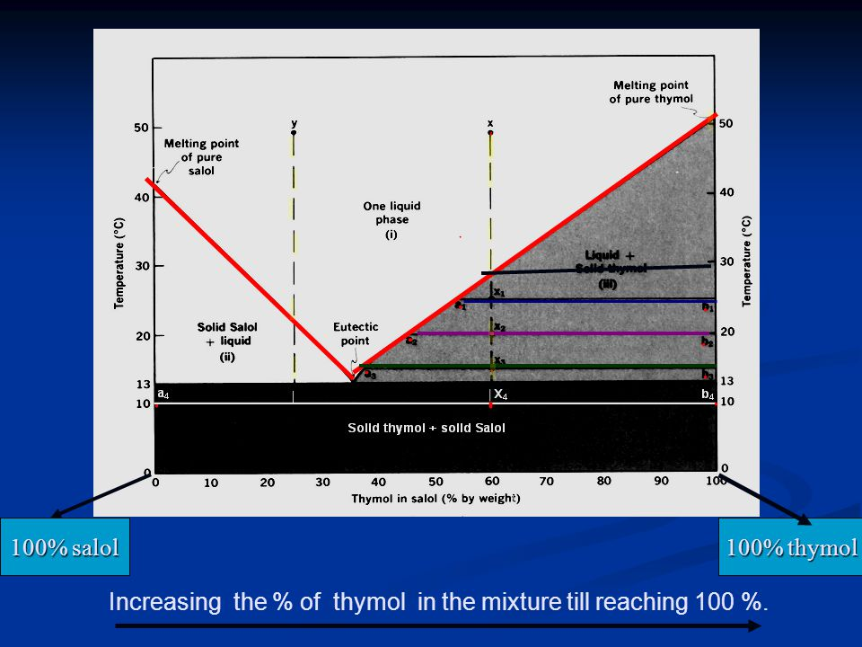

Slide 24
EXAMPLE 1: In a mixture of menthol and thymol, a phase diagram similar to that illustrated can be obtained. To describe the number of degrees of freedom in the part of the graph moving from the curved line starting at pure A, progressing downward to the eutectic point, and then following an increasing melting point to pure B, it is evident from this presentation that either temperature or composition will describe this system, since it is assumed in this instance that pressure is constant. Therefore, the number of degrees of freedom to describe this portion of the phase diagram is given thus: F = 2 − 2 + 1 = 1
In other words, along this line either temperature or composition will describe the system

Slide 25
EXAMPLE 2: When in the area of a single phase of the diagram, such as the melt (IV), the system can be described thus: F = 2 − 1 + 1 = 2
In this portion of the phase diagram, two factors, temperature and composition, can be varied without a change in the number of phases in the system.
EXAMPLE 3: At the eutectic point,
F = 2 − 3 + 1 = 0
and any change in the concentration or temperature may cause disappearance of one of the two solid phases or the liquid phase. Phase diagrams are valuable for interpreting interactions between two or more components, relating not only to melting point depression and possible liquefaction at room temperature but also the formation of solid solutions, coprecipitates, and other solid-state interactions

Slide 26
Particle Size
Certain physical and chemical properties of drug substances, including dissolution rate, bioavailability, content uniformity, taste, texture, color, and stability, are affected by the particle size distribution.
In addition, flow characteristics and sedimentation rates, among other properties, are important factors related to particle size.
It is essential to establish as early as possible how the particle size of the drug substance may affect formulation and efficacy of special interest is the effect of particle size on absorption.
Particle size significantly influences the oral absorption profiles of certain drugs, including griseofulvin, nitofurantoin, spironolactone, and procaine penicillin.
Also, satisfactory content uniformity in solid dosage forms depends to a large degree on particle size and the equal distribution of the active ingredient throughout the formulation.
Particle size is analysed using special instrument like Mastersizer 2000E particle size analyzer

Slide 27
Polymorphism
An important factor on formulation is the crystal or amorphous form of the drug substance.
Polymorphic forms usually exhibit different physicochemical properties, including melting point and solubility. Polymorphic forms in drugs are relatively common. It has been estimated that at least one third of all organic compounds exhibit polymorphism.
In addition to polymorphic forms, compounds may occur in noncrystalline or amorphous forms. The energy required for a molecule of drug to escape from a crystal is much greater than is required to escape from an amorphous powder, therefore, the amorphous form of a compound is always more soluble than a corresponding crystal form.
Evaluation of crystal structure, polymorphism, and solvate form is an important performulation activity. The changes in crystal characteristics can influence bioavailability and chemical and physical stability and can have important implications in dosage form process functions.
For example, it can be a significant factor relating to tablet formation because of flow and compaction behaviours, among others.
Various techniques are used to determine crystal properties. The most widely used methods are hot stage microscopy, thermal analysis, infrared spectroscopy, and X-ray diffraction.

Slide 28
Solubility
An important physicochemical property of a drug substance is solubility, especially aqueous system solubility.
A drug must possess some aqueous solubility for therapeutic efficacy. For a drug to enter the systemic circulation and exert a therapeutic effect, it must first be in solution.
Relatively insoluble compounds often exhibit incomplete or erratic absorption. If the solubility of the drug substance is less than desirable, consideration must be given to improve its solubility.
The methods to accomplish this depend on the chemical nature of the drug and the type of drug product under consideration.
Chemical modification of the drug into salt or ester forms is frequently used to increase solubility.
A drug's solubility is usually determined by the equilibrium solubility method, by which excess of the drug is placed in a solvent and shaken at a constant temperature over a long period until equilibrium is obtained. Chemical analysis of the drug content in solution is performed to determine degree of solubility.

Slide 29
Solubility and Particle Size
Although solubility is normally considered a physicochemical constant, small increase in solubility can be accomplished by particle size reduction
Solubility and pH
Another technique, if the drug is to be formulated into a liquid product, is adjustment of the pH of the solvent to enhance solubility.
However, for many drug substances pH adjustment is not an effective means of improving solubility. Weak acidic or basic drugs may require extremes in pH that are outside accepted physiologic limits or that may cause stability problems with formulation ingredients. Adjustment of the pH usually has little effect on the solubility of substances other than electrolytes.
In many cases, it is desirable to use cosolvents or other techniques such as complexation, or solid dispersion to improve aqueous solubility.

Slide 30
Solubility and pH
pH is one of the most important factors in the formulation process. Two areas of critical importance are the effects of pH on solubility and stability.
The effect of pH on solubility is critical in the formulation of liquid dosage forms, from oral and topical solutions to intravenous solutions and admixtures.
The solubility of a weak acid or base is often pH dependent. The total quantity of a monoprotic weak acid (HA) in solution at a speciﬁc pH is the sum of the concentrations of both the free acid and salt (A⁻) forms. If excess drug is present, the quantity of free acid in solution is maximized and constant because of its saturation solubility. As the pH of the solution increases, the quantity of drug in solution increases because the water-soluble ionizable salt is formed.
The expression is
ka
HA ↔ H⁺ + A–
Where ka is the is the dissociation constant.

Slide 31
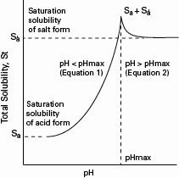


There may be a certain pH level reached where the total solubility (S_{T}) of the drug solution is saturated with respect to both the salt and acid forms of the drug, that is, the pH_{max}.
The solution can be saturated with respect to the salt at pH values higher than this, but not with respect to the acid. Also, at pH values less than this, the solution can be saturated with respect to the acid but not to the salt. This is illustrated in the accompanying ﬁgure.
To calculate the total quantity of drug that can be maintained in solution at a selected pH, either of two equations can be used, depending on whether the product is to be in a pH region above or below the pHmax.
The following equation is used when below the pH_{max}:
The next equation is used when above the pH_{max}:
Where Sa is the saturation solubility of the free acid and Sa’ is the saturation solubility of the salt form.

Slide 32
EXAMPLE
A pharmacist prepares a 3.0% solution of an antibiotic as an ophthalmic solution and dispenses it to a patient. A few days later the patient returns the eye drops to the pharmacist because the product contains a precipitate. The pharmacist, checking the pH of the solution and ﬁnding it to be 6.0, reasons that the problem may be pH related. The physicochemical information of interest on the antibiotic includes the following:
Molecular weight 285 (salt) 263 (free acid)
3.0% solution of the drug 0.1053 M solution
Acid form solubility (Sa) 3.1 mg/mL (0.0118 M)
Ka 5.86 × 10 ^{–6}
Using Equation 1, the pharmacist calculates the quantity of the antibiotic in solution at a pH of 6.0 (Note: pH of 6.0 = [H+] of 1 × 10^{–6})
S_{T} = 0.0118 [1+ (5.86 × 10 ^{–6} / 1 × 10^{–6}) ] = 0.0809 molar

Slide 33

From this the pharmacist knows that at a pH of 6.0, a 0.0809-M solution can be prepared. However, the concentration that was to be prepared was a 0.1053-M solution; consequently, the drug will not be in solution at that pH. The pH may have been all right initially but shifted to a lower pH over time, resulting in precipitation of the drug.
The question is at what pH (hydrogen ion concentration) the drug will remain in solution. This can be calculated using the same equation and information. The S_{T} value is 0.1053 M.
Or a pH of 6.135

Slide 34

The pharmacist prepares a solution of the antibiotic, adjusting the pH to above about 6.2, using a suitable buffer system, and dispenses the solution to the patient—with positive results.
An interesting phenomenon concerns the close relationship of pH to solubility. At a pH of 6.0, only a 0.0809-M solution could be prepared, but at a pH of 6.13 a 0.1053-M solution could be prepared. In other words, a difference of 0.13 pH units resulted in more drug going into solution at the higher pH than at the lower pH. In other words, a very small change in pH resulted in about 30% more drug going into solution.

Slide 35
Reference
Ansel’s pharmaceutical dosage forms and drug delivery systems , tenth edition

