Slide 1
To Human Anatomy
م.د. نادية حميد محمد
بكلوريوس طب وجراحة عامة/بورد علم الامراض

Slide 3
1.1 Several Terms used in Anatomy to indicate Anatomical Positions

Slide 5
than wrist

Slide 7
1.2 Terms to describe movements occurring at various joints

Slide 8
1. Flexion : Flexion is the movement where similar surfaces come nearer to each other reducing the angle between them.ex: Bending of fore arm near elbow.
2. Extension: It is the movement causing similar surfaces to go apart. Itis opposite to flexion. ex : Straightening of bent fore arm.
flexion decreases the angle between the bones, while extension increases the angle and straightens the joint. For the upper limb, all anterior-going motions are flexion and all posterior-going motions are extension. For the lower limb the vice versa
3. Adduction: It is the movement bringing the limb towards mid line.
4. Abduction: It is the movement taking the limb away from the midline.

Slide 9
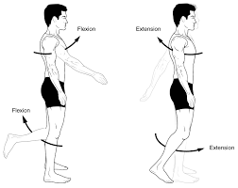

Slide 10
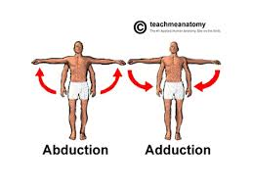

Slide 11
5. Rotation: It is the movement around central axis involving 3600.
6. Medial rotation = internal rotation: It is rotation towards medial direction.
7. Lateral rotation=external rotation: Rotation towards lateral direction is called lateral direction.
8. Circumduction: It is the movement involving flexion, abduction, extension and adduction occurring in sequence. it is a circular movement.

Slide 12
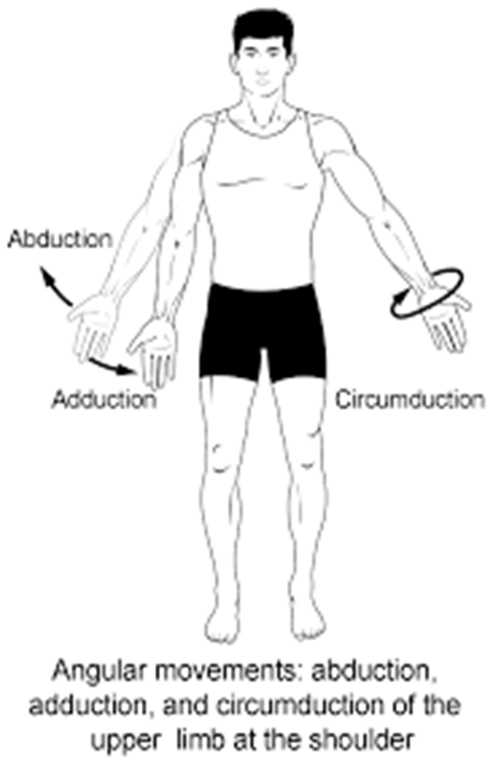

Slide 13
9. Supination and Pronation
Supination and pronation are movements of the forearm. In the anatomical position, the upper limb is held next to the body with the palm facing forward. This is the supinated position of the forearm. In this position, the radius and ulna are parallel to each other. Palms are anterior and the thumb directed laterally. When the palm of the hand faces backward, the forearm is in the pronated position, and the radius and ulna form an X-shape and the thumb directed medially.

Slide 14
10. Dorsiflexion and Plantar Flexion
Dorsiflexion and plantar flexion are movements at the ankle joint. when the soles (heel) are on ground, lifting the front of the foot and the dorsal aspect of the foot moves toward the anterior surface of the leg this is dorsiflexion, while lifting the soles (heel) of the foot from the ground or pointing the toes downward this is plantar flexion.

Slide 15
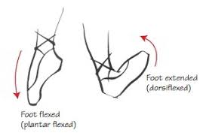

Slide 16
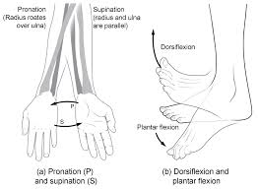

Slide 18
1.3 Regional Terms
1. Axial regions: include
Head
Neck
Trunk: which include:thorax and abdomin
2. Appendicular regions: include
Upper limbs
Lower limbs

Slide 19
1.4 Body Planes

Slide 23
1.6 Body Cavities

Slide 24
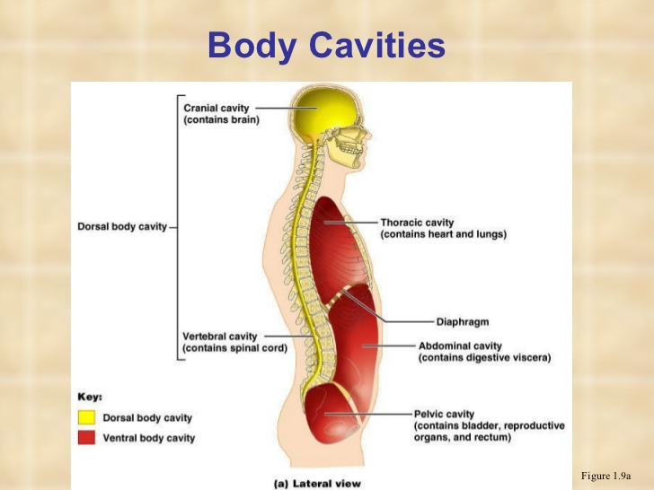

Slide 26
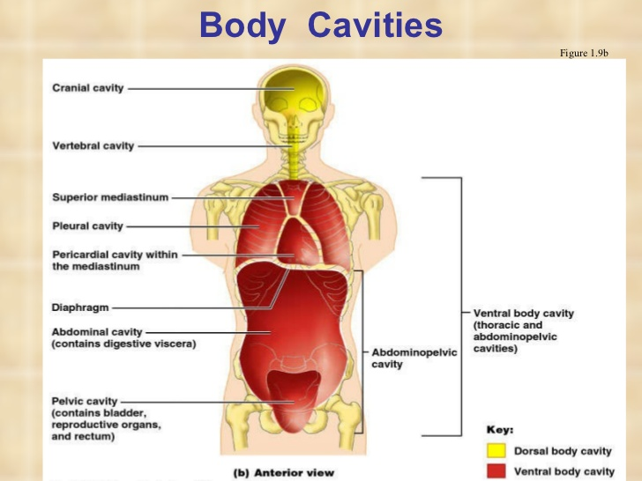

Slide 31
1.7 Body Membranes

Slide 33
For example

Slide 34
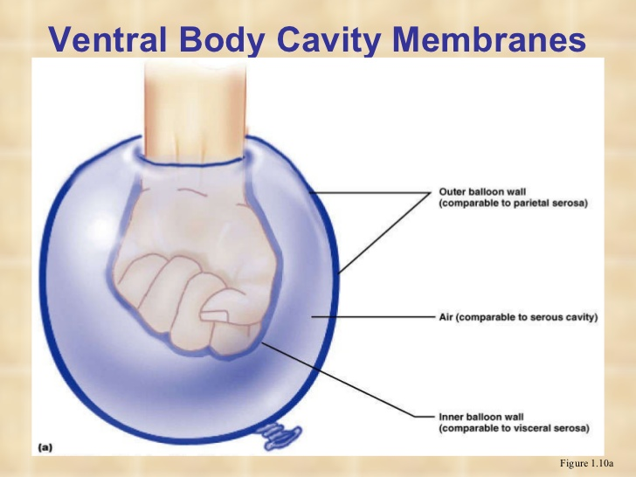

Slide 35
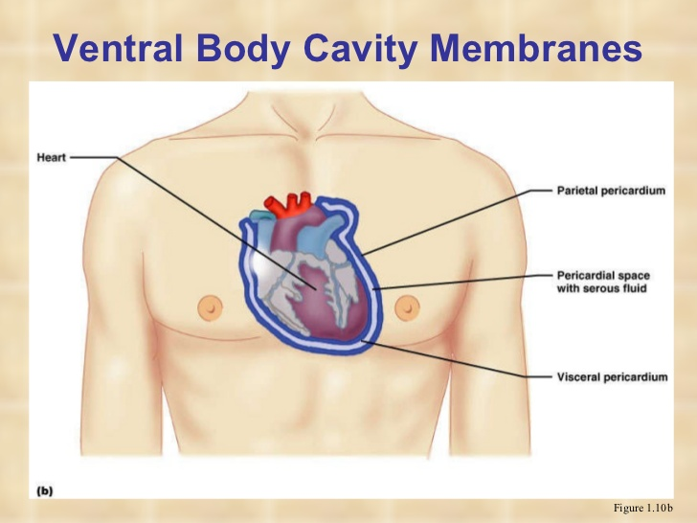

Slide 36
1.8 Abdominal Regions

Slide 40
Question:
Do you think there is variation in human anatomy from person to person?

