Slide 1
Lab 1
Laboratory apparatus
By :
م.م. نورا زاوار
م.م زينة داود
م. م زهراء عامر

Slide 2
The pharmaceutical preparation, as the final forms used for medication, must be effective and safe. It should be accurate quantitatively and qualitatively.

Slide 3
1
Quantitatively: It means the amount (wt or vol.) of the ingredient be accurate.
2
Qualitatively: It means the identity of the ingredient be certain.

Slide 4
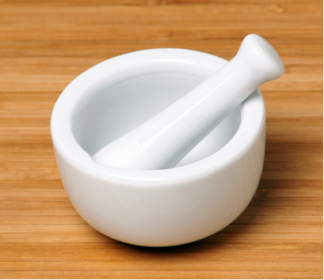
Instrument used in the lab .
Mortar and pestle
Mortar and pestle are implements used since ancient times to prepare ingredients or substances by crushing and grinding them into a fine paste or powder

Slide 5
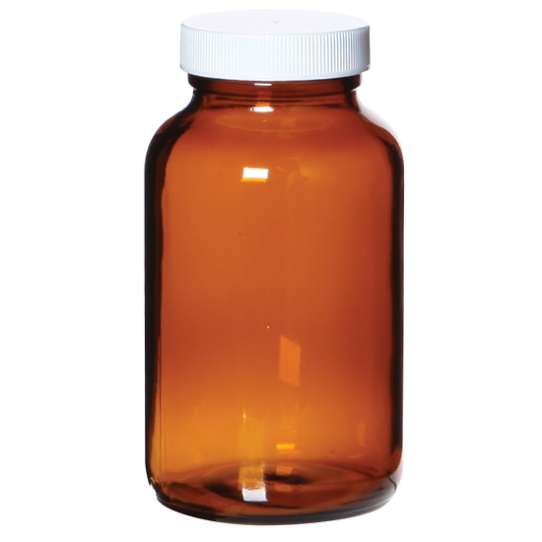
Instrument used in the lab .
Wide mouth bottle
are easier to fill and are recommended for the storage of solid, semi-solid and viscous liquid materials.

Slide 6
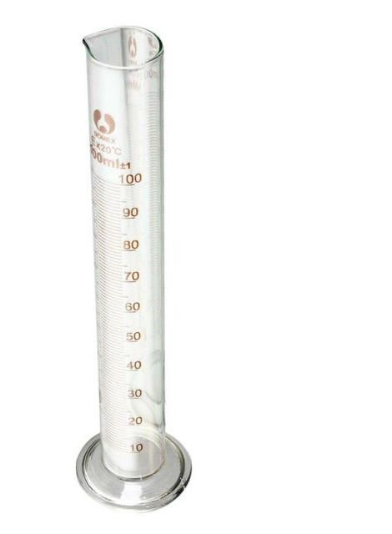
Instrument used in the lab .
Cylindrical measure cylinder
a relatively slim glass or plastic cylinder used specifically for calibrating beakers or measuring a liquid's volume. Graduated cylinders come in a variety of sizes such as 10 ml, 25 ml, 50 ml, 100 ml, 500 ml and 1,000 ml. Scientists take measurements by viewing, at eye-level, the lowest point of the convex dip that the liquid in the cylinder makes.

Slide 7
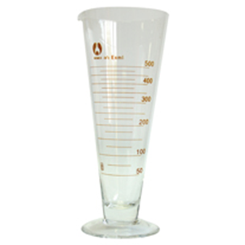
Instrument used in the lab .
Conical measure cylinder
is a type of laboratory glassware which consists of a conical cup with a notch on the top to allow for the easy pouring of liquids, and graduated markings on the side to allow easy and accurate measurement of volumes of liquid.

Slide 8
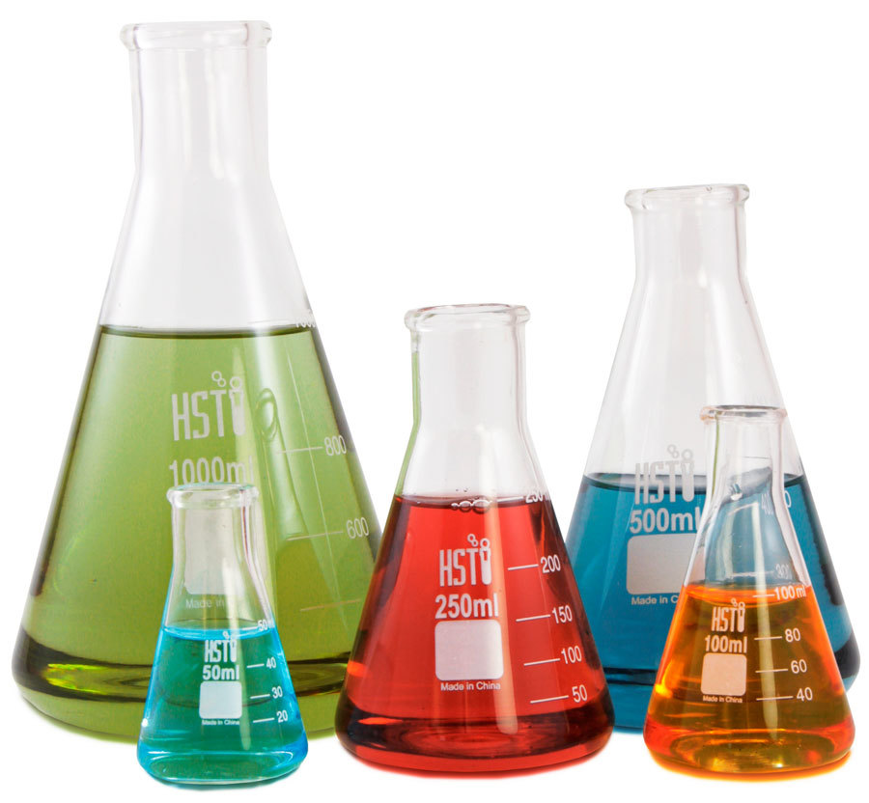
Instrument used in the lab .
Conical flask
This shape allows the flask to be sealed with a bung for heating purposes, while also allowing a researcher the freedom to shake or stir the flask without spilling liquid. The Erlenmeyer flask has diverse uses such as holding and measuring chemical liquid samples, but can also be used to mix, heat and boil chemicals.

Slide 9
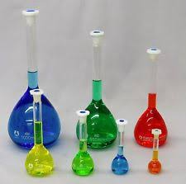
Instrument used in the lab .
Volumetric flask
(measuring flask or graduated flask) is a piece of laboratory apparatus, a type of laboratory flask, calibrated to contain a precise volume at a particular temperature. Volumetric flasks are used for precise dilutions and preparation of standard solutions.

Slide 10
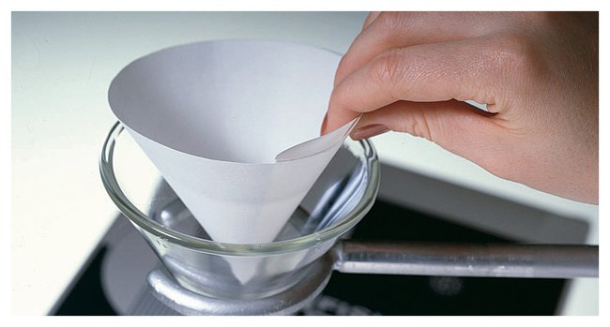
Instrument used in the lab .
Filter paper
Used for separation of different materials , especially the soluble from the non soluble ones

Slide 11
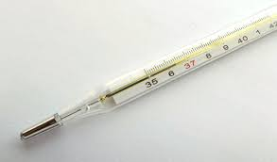
Instrument used in the lab .
Thermometer
Used to measure the temperature of the solutions , or work conditions

Slide 12
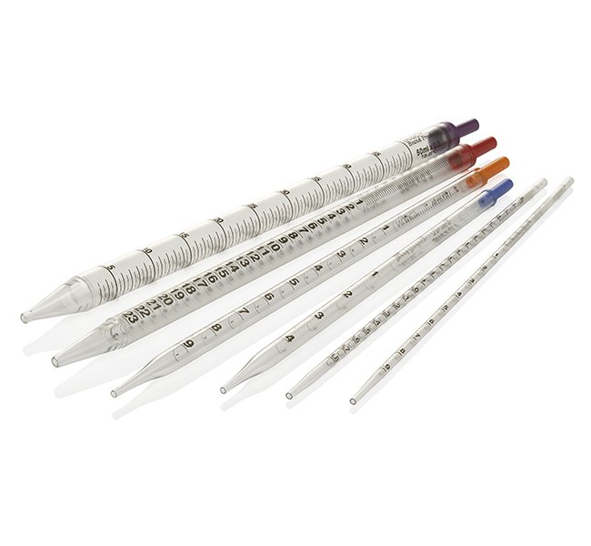
Instrument used in the lab .
Pipette
A pipet transfers relatively small amounts of liquid. In the most commonly used pipettes, experimenters draw liquid into one end of a glass or plastic cylinder by the prior squeezing of the rubber or plastic ball at the opposite end. The amount of liquid able to be drawn into the pipette is usually fixed, to enable accuracy in measurement.

Slide 13
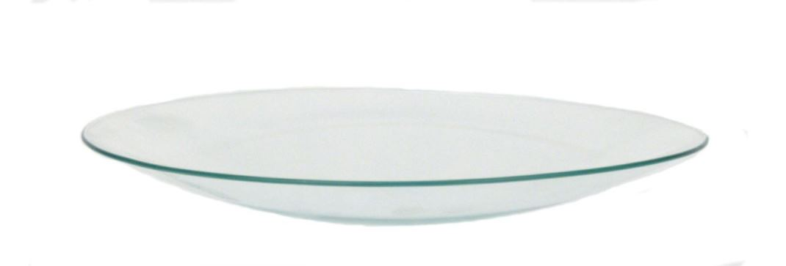
Instrument used in the lab .
Watch glass
a circular concave piece of glass used in chemistry as a surface to evaporate a liquid, to hold solids while being weighed, for heating a small amount of substance and as a cover for a beaker.

Slide 14
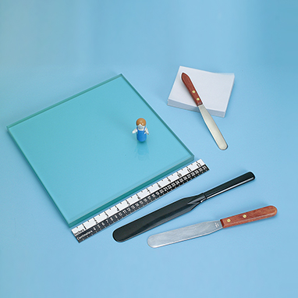
Instrument used in the lab .
Slab and spatula
Used for incorporation of drugs into creams, ointments or preparations of ointment bases or cream base

Slide 15
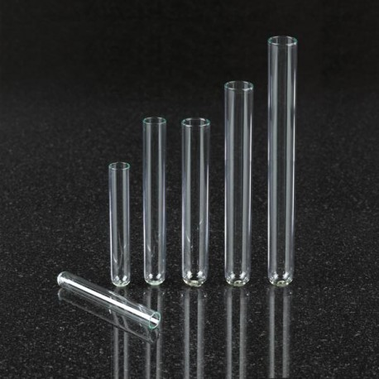
Instrument used in the lab .
Test tube
They are designed to hold small quantities of chemicals and feature a flared lip to make pouring easier. Test tubes can hold liquid or solid chemicals and can be used to contain small chemical reactions. The slimness of the test tube reduces the spread of any vapors that may be produced by the reaction.

Slide 16
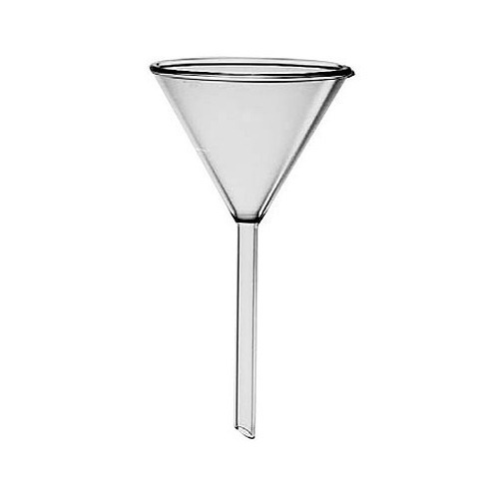
Instrument used in the lab .
Funnel
tube or pipe that is wide at the top and narrow at the bottom, used for guiding liquid or powder into a small opening.

Slide 17
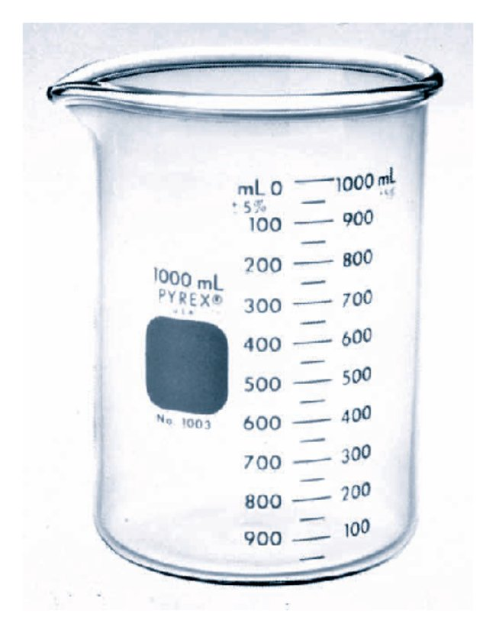
Instrument used in the lab .
Beaker
A beaker is a cylindrical glass or plastic vessel used for holding liquids. It is a multi-purpose piece of equipment used for containing a chemical reaction, measuring liquids, heating them over a Bunsen burner's flame or collecting them in a titration experiment.

Slide 18
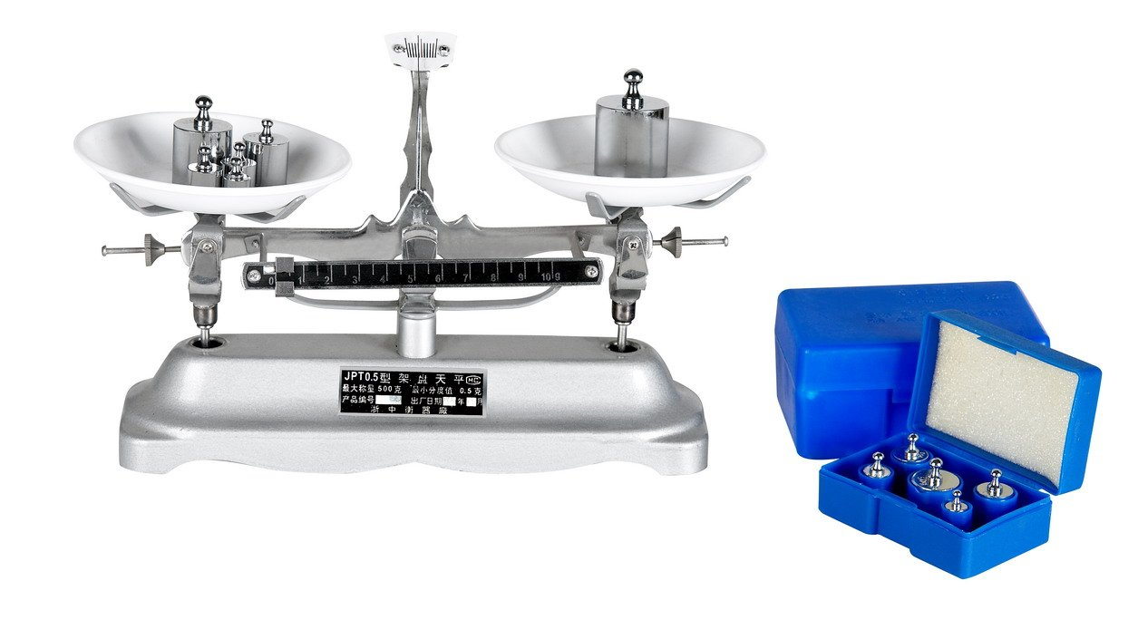
Instrument used in the lab .
Balance
A balance determines the mass of something, such as a dry chemical.

Slide 19
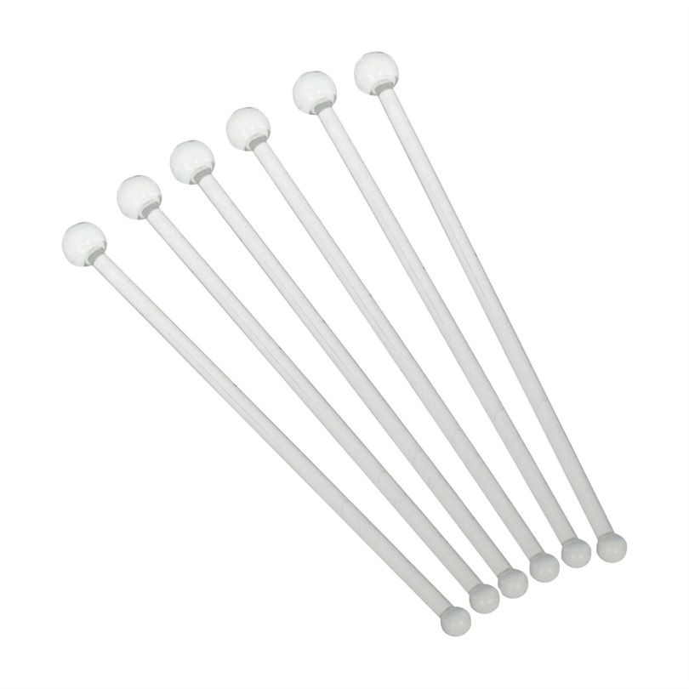
Instrument used in the lab .
Stirrer
used to mix chemicals and liquids for laboratory purposes. They are usually made of solid glass, about the thickness and slightly longer than a drinking straw, with rounded ends.

