Slide 1
Peptic Ulcer Disease

Slide 2
Dyspepsia
Persistent or recurrent pain or discomfort centered in the upper abdomen.
Not all patients with dyspepsia have peptic ulcer.
The most common causes of dyspepsia are
-non-ulcer or functional dyspepsia,
-GORD and
-peptic ulcer

Slide 3
Peptic ulcer disease
Peptic ulcer accounts for 10–15% of dyspepsia.
The term ‘peptic ulcer’ describes a discontinuity in the entire thickness of the gastric or duodenal mucosa that persists as a result of acid and pepsin in the gastric juice.

Slide 4
Pathogenesis
Those associated with Helicobacter pylori (95% PU, 80% DU)
Those associated with NSAIDs and aspirin (20% dyspepsia, 4% PU).

Slide 5
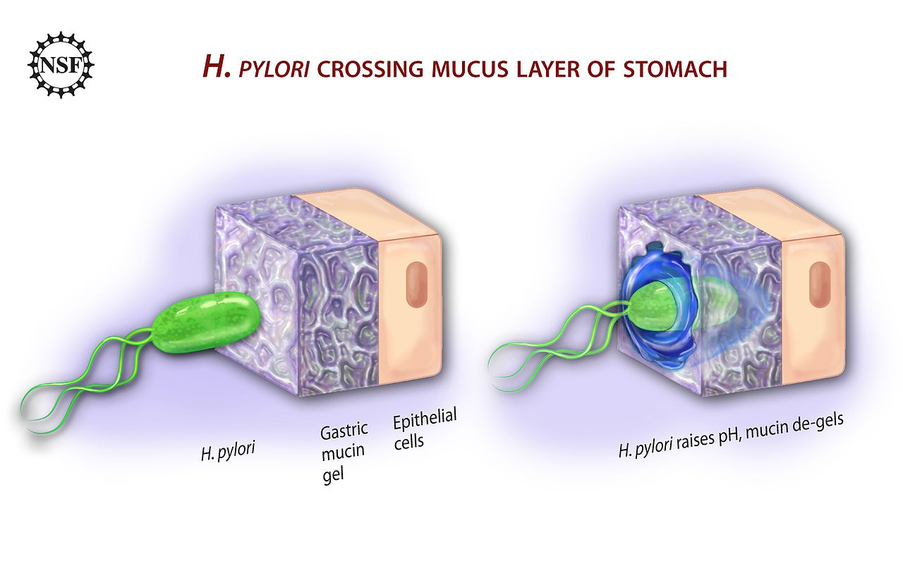

Slide 6
pathophysiology associated with H. pylori infection involves:
production of cytotoxin-associated gene A (CagA) proteins and vacuolating cytotoxins which activate the inflammatory cascade…
enzymes produced by H. pylori may cause tissue damage include: UREASE, haemolysins, neuraminidase and fucosidase.
gastrin homeostasis is also altered resulting in Long-standing hypergastrinaemia leads to an increased parietal cell mass…
All these cause inflammation and ulcer formation.

Slide 7
Pathogenesis of NSAI drugs
Superficial erosions and haemorrhages,
Silent ulcers detected at endoscopy and
Ulcers causing clinical symptoms and complications.

Slide 8
Box12.1-Risk factors for NSAID ulcers
Age greater than 65 years
Previous peptic ulceration/bleeding
High dose of NSAID or more than one NSAID (including aspirin).
Short-term history of NSAID use
Concomitant corticosteroid or anticoagulant use
Cardiovascular disease

Slide 9
Clinical manifestations the symptoms of peptic ulcer disease overlap with duodenal ulcer, gastric ulcer or functional dyspepsia.
Upper abdominal pain related to food----- duodenal ulcer.
Upper abdominal pain relieved with food ------gastric ulcer.
Anorexia, weight loss, nausea and vomiting, heartburn.
Complications of peptic ulcer disease may occur with or without previous dyspeptic symptoms----haemorrhage, chronic iron-deficiency anaemia, pyloric stenosis and perforation.

Slide 10
Patient assessment
Reflux-like dyspepsia
Heartburn plus dyspepsia
Acid regurgitation plus dyspepsia
Ulcer-like dyspepsia
Localised epigastric pain
Pain when hungry
Pain relieved by food
Pain relieved by antacids or acid-reducing drugs
Pain that wakens the patient from sleep
Pain with remission and relapses
Dysmotility-like dyspepsia
Upper abdominal discomfort (pain not dominant)
Early satiety
Postprandial fullness
Nausea
Retching or vomiting
Bloating in the upper abdomen (no visible distension)
Upper abdominal discomfort often aggravated by food
Unspecified dyspepsia

Slide 11
Fig. 12.4 (A) Decision algorithm for management of uninvestigated dyspepsia.
Fig. 12.4, (B) Decision algorithm for management of non-ulcer dyspepsia.

Slide 12
Investigations
Endoscopy
Radiology (Double-contrast barium)
H. pylori detection

Slide 13
Alarm features need endoscope
Dysphagia
Pain on swallowing
Unintentional weight loss
Gastro-intestinal bleeding or anaemia
Persistent vomiting
On NSAIDs or warfarin

Slide 14
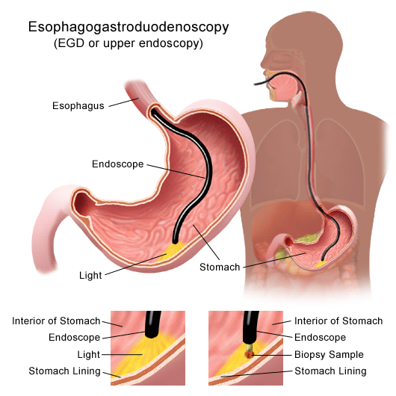
Endoscopy

Slide 15
H. pylori detection
Serological tests to detect antibodies,
[13C] urea breath tests.
Stool antigen tests.
Invasive tests requiring gastric antral biopsies include urease tests, histology and culture.

Slide 16
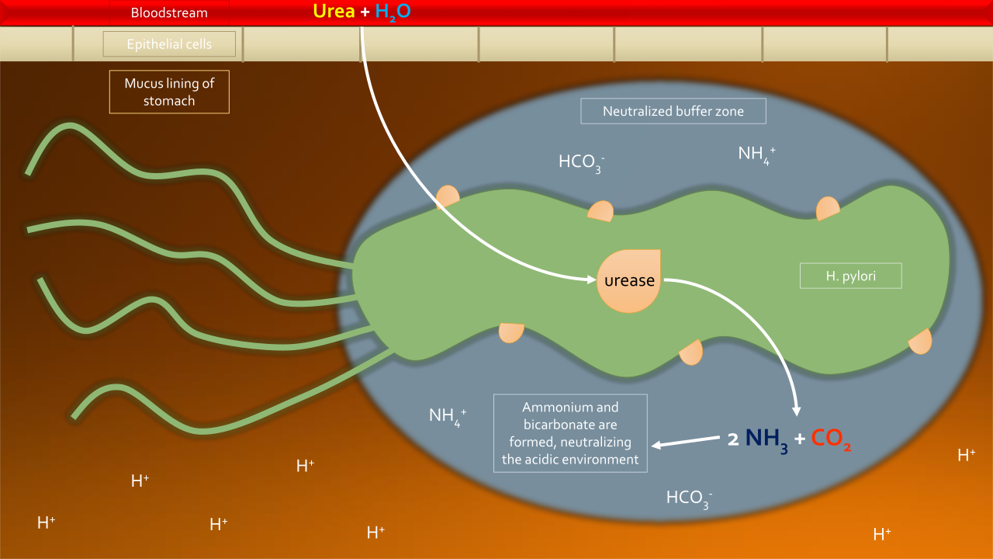
Urea Breath Test

Slide 17
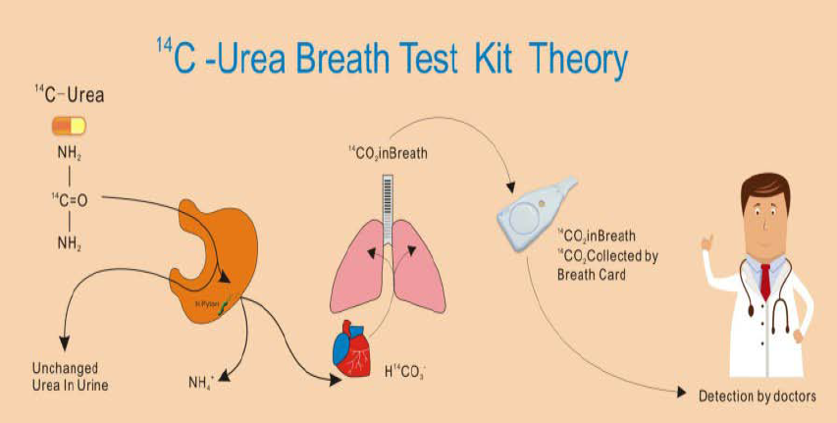

Slide 18
TREATMENT

Slide 19
Uncomplicated peptic ulcer disease
H. pylori eradication
Triple therapy consists of:
OCA: omeprazole 20 mg, clarithromycin 500 mg and amoxicillin 1 g
or
OCM: omeprazole 20 mg, clarithromycin 250 mg and metronidazole 400 mg.
See fig 12.5 A, B

Slide 20
Patients with persistent symptoms after eradication may need:
H. pylori status rechecked.
This should be carried out no sooner than 4 weeks after.
If the patient is H. pylori positive, an alternative eradication regimen.
If eradication was successful but symptoms persist, GERD or other causes of dyspepsia should be considered.

Slide 21
Complications of peptic ulcer disease
Bleeding peptic ulcer
(endoscopic haemostatic therapy+ PPI)
Pyloric stenosis

Slide 22
Prophylaxis of NSAID ulceration
NSAIDs should be avoided in patients who are at risk of gastro-intestinal toxicity Box12.1
NSAID should be stopped if dyspepsia develops.
patients with chronic rheumatological conditions and need NSAID…

Slide 23
co-therapy with acid-suppressing agents or
a synthetic prostaglandin analogue, or
substitution of a selective COX-2 inhibitor for a non-selective NSAID

Slide 24
Ulcer-healing drugs
Proton pump inhibitors
H2-receptor antagonists
Bismuth chelate
Sucralfate
Antacids

