Slide 1
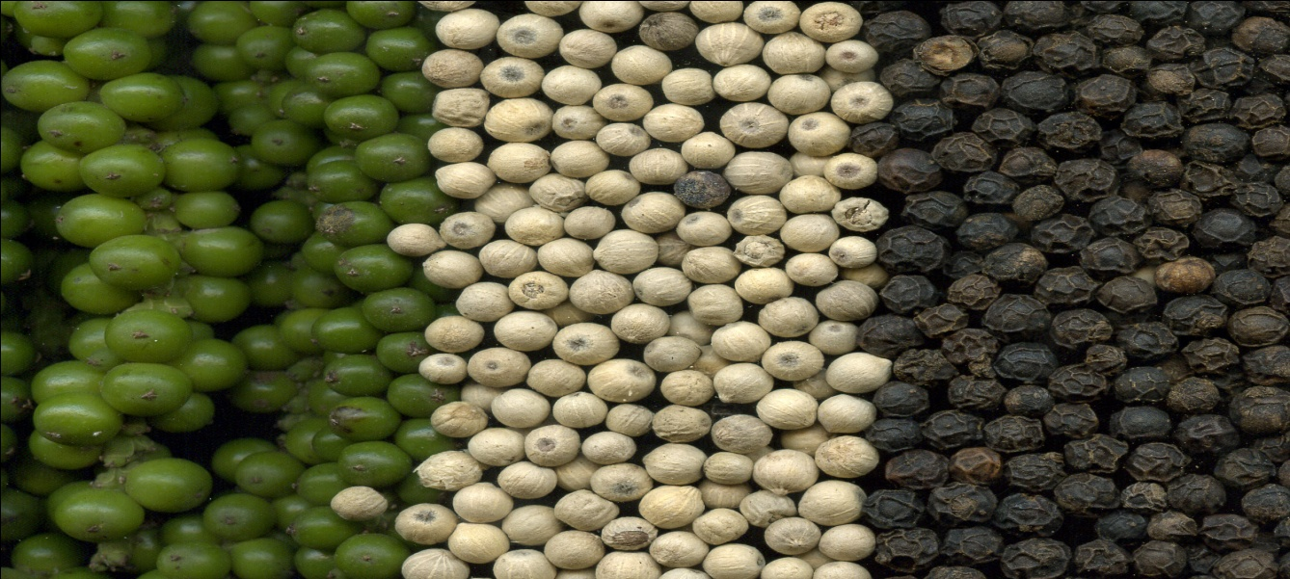
Identification of Black pepper alkaloid
Pharmacognosy 3rd Class, 2nd Semester
Lab.2

Slide 2
ANALYSIS OF PIPERINE ALKALOID
QUALTITATIVE ANALYSIS
QUANTITATIVE ANALYSIS
By weighting the crystals
Chemical Test Chromatography
Specific Test
T.L.C

Slide 3
Chemical Test
The Specific Test
Aim: - to indicate specifically the piperine alkaloid from other alkaloids.
Equipments and reagents:-
Petri-dish
Ethanol
1,3.5 tri nitrobenzene
Procedure:-
Take few crystals of piperine alkaloid
Dissolve in few mls of ethanol in a Petri-dish.
Add few drops of 1, 3, 5 tri nitrobenzene.
Results:-
Red precipitate occurs with melting point 130ºC.
Discussion:-
A complex will be formed between the piperine and 1, 3, 5 tri-nitrobenzene .

Slide 4
2) General Tests
1- Mayer's Test
Aim: - to indicate in general the alkaloid as other alkaloids.
Equipments and reagents :-
Petri-dish
Ethanol
HCL
Mayer's reagent
Procedure:-
Take few crystals of piperine alkaloid
Dissolve in few mls of ethanol in a Petri dish
Add two drops of HCL.
Add two drops of Mayer's reagent.
Results:-
White precipitation will occur.
2- Wagner's Reagent
3-Dragendorff's Reagent

Slide 5
T.L.C
Aim: - used to identify qualitatively the piperine alkaloids.
Equipments and reagents:-
Glass jar with its cover
Silica gel plates
Standard reagent
Spray reagent (dragendroffs reagent)
Mobile phase = (acetone: water: ammonia (90:7:3))
Capillary tube

Slide 6
Procedure:-
Prepare the mobile phase and put in the glass jar, cover the jar and leave it for 45 min.
Apply the sample and the standard by the use of capillary tube on the silica gel plate.
Leave the plate in the jar until the solvent reaches 3/4 of the plate. Remove the plate, dry and then spray with spraying reagent.
Results:-
Orange spots appear for both standard and sample.

Slide 7
THANK YOU

