Slide 1
Advanced Pharmaceutical Analysis
Introduction to Spectroscopy
Dr. Mohammed Al Amiedy

Slide 2
Introduction to spectroscopy
Less than one hundred years ago, structural determination was a difficult and time-consuming task
It was common for a chemist to spend years determining the structure of an unknown compound.
The invention of modern spectroscopic techniques has completely transformed the field of chemistry, and structures can now be determined in several minutes.
In order to understand how spectroscopy is used for structure determination, we must first review some of the basic features of light and matter.

Slide 3
The Nature of Light
Electromagnetic radiation (light) exhibits both wave-like properties and particle-like properties.
Consequently, electromagnetic radiation can be viewed as a wave or as a particle. When viewed as a wave, electromagnetic radiation consists of perpendicular oscillating, electric and magnetic fields
The wavelength describes the distance between adjacent peaks of an oscillating field
Frequency describes the number of wavelengths that pass a particular point in space per unit time.

Slide 4
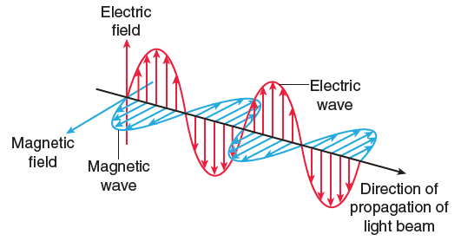
The Nature of Light

Slide 5
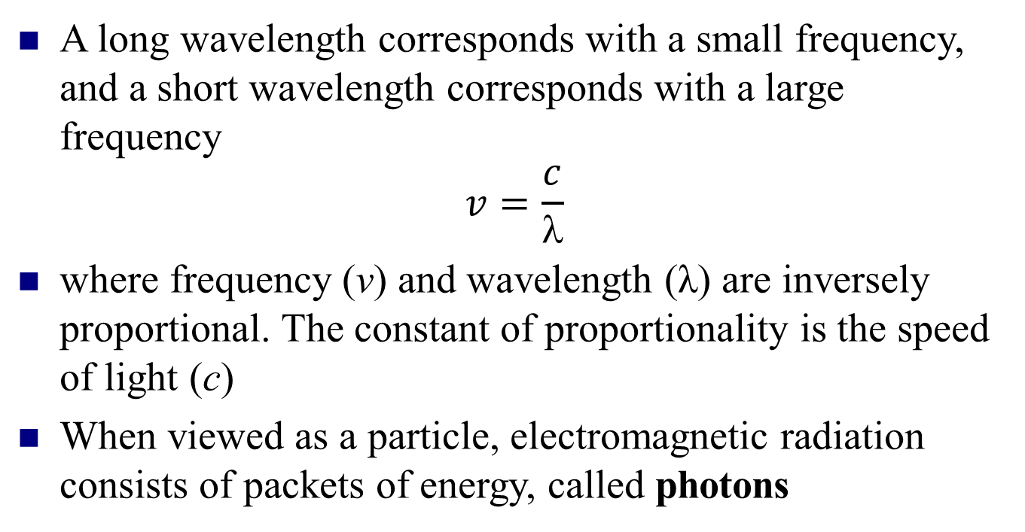
The Nature of Light
A long wavelength corresponds with a small frequency, and a short wavelength corresponds with a large frequency
$$v=\frac{c}{λ}$$
where frequency (ν) and wavelength (λ) are inversely proportional. The constant of proportionality is the speed of light (c)
When viewed as a particle, electromagnetic radiation consists of packets of energy, called photons

Slide 6
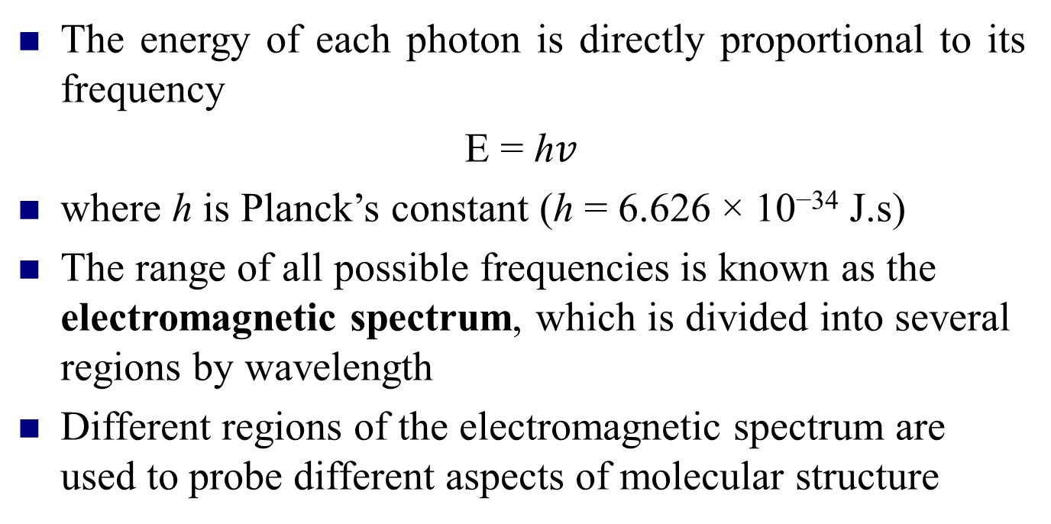
The Nature of Light
The energy of each photon is directly proportional to its frequency
E = h$v$
where h is Planck’s constant (h = 6.626 × 10⁻³⁴ J.s)
The range of all possible frequencies is known as the electromagnetic spectrum, which is divided into several regions by wavelength
Different regions of the electromagnetic spectrum are used to probe different aspects of molecular structure

Slide 7
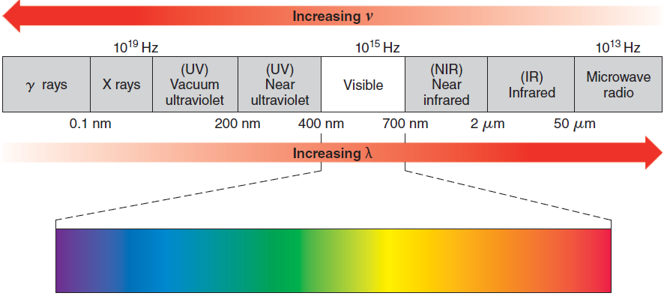
The Nature of Light

Slide 8
The Nature of Matter
The rotation of a molecule is restricted to specific energy levels
A molecule can only rotate at specific rates, which are defined by the nature of the molecule
Molecules can store energy in a variety of ways.
They rotate in space, their bonds vibrate like springs, their electrons can occupy a number of possible molecular orbitals, and so on.
For example, a bond in a molecule can only vibrate at specific energy levels.

Slide 9
The Nature of Matter
The horizontal lines in the diagram represent allowed vibrational energy levels for a particular bond.
The bond is restricted to these energy levels and cannot vibrate with an energy that is in between the allowed levels.
The difference in energy (ΔE) between allowed energy level is determined by the nature of the bond.

Slide 10
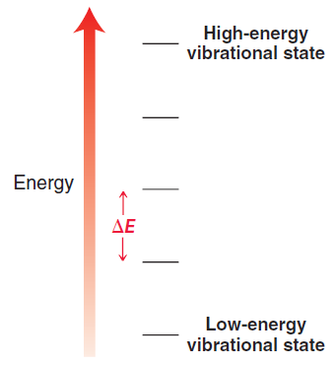
The Nature of Matter

Slide 11
The Interaction between Light and Matter
The vibrational energy levels for a particular bond are separated from each other by an energy gap(ΔE).
If a photon of light possesses exactly this amount of energy, the bond can absorb the photon to promote a vibrational excitation.
The energy of the photon is temporarily stored as vibrational energy until it is released back into the environment in the form of heat
Each form of spectroscopy uses a different region of the electromagnetic spectrum with a different kind of excitation

Slide 12
Introduction to NMR spectroscopy
NMR spectroscopy involves the study of the interaction between electromagnetic radiation and the nuclei of atoms.
A wide variety of nuclei can be studied using NMR spectroscopy, including ¹H, ¹³C, ¹⁵N, ¹⁹F, and ³¹P.
In practice, ¹H NMR spectroscopy and ¹³C NMR spectroscopy are used most often by organic chemists, because hydrogen and carbon are the primary constituents of organic compounds.

Slide 13
Introduction to NMR spectroscopy
In practice, ¹H NMR spectroscopy and ¹³C NMR spectroscopy are used most often by organic chemists, because hydrogen and carbon are the primary constituents of organic compounds.
Analysis of an NMR spectrum provides information about how the individual carbon and hydrogen atoms are connected to each other in a molecule.
This information enables us to determine the carbon hydrogen framework of a compound, much the way puzzle pieces can be assembled to form a picture.

Slide 14
Introduction to NMR spectroscopy
A nucleus with an odd number of protons and/or an odd number of neutrons possesses a quantum mechanical property called nuclear spin, and it can be probed by an NMR spectrometer.
Consider the nucleus of a hydrogen atom, which consists of just one proton and therefore has a nuclear spin.
A spinning proton can be viewed as a rotating sphere of charge, which generates a magnetic field, called a magnetic moment.

Slide 15
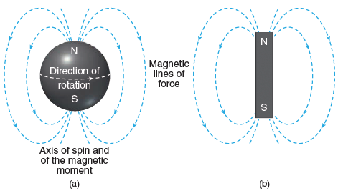
Introduction to NMR spectroscopy

Slide 16
Introduction to NMR spectroscopy
The magnetic moment of a spinning proton is similar to the magnetic field produced by a bar magnet.
The nucleus of a ¹²C atom has an even number of protons and an even number of neutrons and therefore does not possess this property.
In contrast, the nucleus of ¹³C has an odd number of neutrons
and therefore exhibits spin.
Our study of NMR spectroscopy will begin with 1H NMR spectroscopy and will conclude with ¹³C NMR spectroscopy.

Slide 17
Introduction to NMR spectroscopy
When the nucleus of a hydrogen atom (a proton) is subjected to an external magnetic field, the interaction between the magnetic moment and the magnetic field is measured, and the magnetic moment must align either with the field or against the field
A proton aligned with the field is said to occupy the alpha (α) spin state, while a proton aligned against the field is said to occupy the beta (β) spin state.
The two spin states are not equivalent in energy, and there is a measurable difference in energy (ΔE) between them

Slide 18
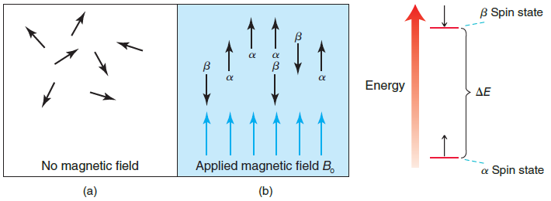
Introduction to NMR spectroscopy

Slide 19
Introduction to NMR spectroscopy
When a nucleus occupying the α spin state is subjected to electromagnetic radiation, an absorption can take place if the energy of the photon is equivalent to the energy gap between the spin states.
The absorption causes the nucleus to flip to the β spin state, and the nucleus is said to be in resonance, thus the term nuclear magnetic resonance.
When a strong magnetic field is employed, the frequency of radiation typically required for nuclear resonance falls in the radio wave region of the electromagnetic spectrum [called radio frequency (rf ) radiation].

Slide 20
Introduction to NMR spectroscopy
At a particular magnetic field strength, we might expect all nuclei to absorb the same frequency of rf radiation.
Luckily, this is not the case, as nuclei are surrounded by electrons.
In the presence of an external magnetic field, the electron density circulates, which produces a local (induced) magnetic field that opposes the external magnetic field

Slide 21
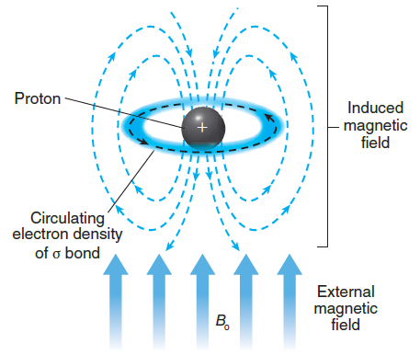
Introduction to NMR spectroscopy

Slide 22
Introduction to NMR spectroscopy
This effect is called diamagnetism. All materials possess diamagnetic properties, because all materials contain electrons.
This effect is extremely important for NMR spectroscopy. Without this effect, all protons would absorb the same frequency of rf radiation, and NMR spectroscopy would not provide us with any useful information.
When electron density circulates around a proton, the induced magnetic field has a small but important effect on the proton.

Slide 23
Introduction to NMR spectroscopy
The proton is now subjected to two magnetic fields—the strong, external magnetic field and the weak induced magnetic field established by the circulating electron density.
The proton therefore experiences a net magnetic field strength that is slightly smaller than the external magnetic field.
The proton is said to be shielded by the electrons.
Not all protons occupy identical electronic environments. Some protons are surrounded by more electron density and are more shielded, while other protons are surrounded by less electron density and are less shielded, or deshielded.

Slide 24
Introduction to NMR spectroscopy
As a result, protons in different electronic environments will exhibit a different energy gap between the α and β spin states and will therefore absorb different frequencies of rf radiation.
This allows us to investigate the electronic environment of each hydrogen atom in a molecule

