Slide 1
Antineoplastic agents
Pharmaceutical chemistry
Assist . Prof . Karima F. Ali
Al-mustansiriyah university
college of pharmacy

Slide 2
Anticancer drugs
The ability of drugs to kill cancer cells is generally believed to be because of their ability to induce the process of apoptosis. In high-dose therapy, cell death may occur by necrosis but this is also toxic to the patient. In a general sense the anti neoplastics target DNA or the process of DNA replication and stimulate apoptosis but the exact mechanisms by which this stimulation occurs are not known with certainty.
The effectiveness of the agents is reduced in cells where apoptosis fails to occur properly, and this is a property of many cancer cells. Normal cells with fully functioning apoptotic mechanisms may then become susceptible to the action of the anti neoplastics increasing the toxicity of the agents.

Slide 3
Drug classes
1.Alkylating Agents:
The alkylating agents are a class of drugs that are capable of forming covalent bonds with important biomolecules. The major targets of drug action are nucleophilic groups present on DNA (especially the 7-position of guanine); however, proteins and RNA among others may also be alkylated.

Slide 4
Alkylation of DNA is thought to lead to cell death, although the exact mechanism is uncertain. Potential mechanisms of cell death include activation of apoptosis caused by p53 activation and disruption of the template function of DNA.
The cancer cells have dysfunctional p53 so that even though the cell has been unable to replicate DNA error free, cell death via apoptosis does not occur. Cancer cells may become resistant to the effects of alkylating agents.

Slide 5
There are several potential nucleophilic sites on
DNA, which are susceptible to electrophilic attack by an alkylating agent (N-2, N-3, and N-7 of guanine, N-1, N-3, and N-7 of adenine, 0–6 of thymine, N-3 of cytosine).
The most important of these for many alkylating agents is the N-7 position of guanine whose nucleophilicity may be enhanced by adjacent guanine residues.

Slide 6
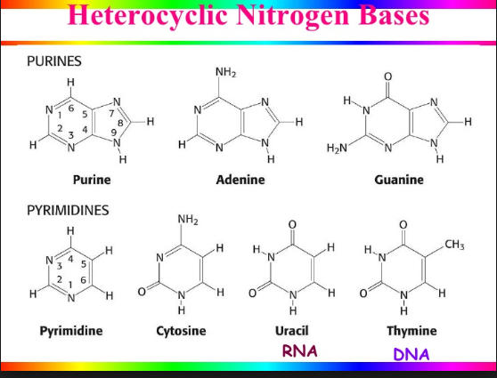

Slide 7
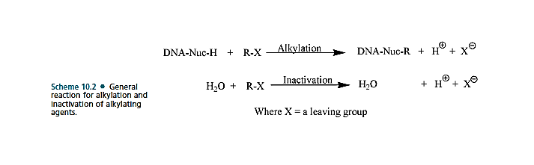
The general mechanism for alkylation involves nucleophilic attack by –N=, -NH2, -OH, -O-PO3H of DNA and RNA, while additional nucleophiles (-SH, COOH, etc.) present on proteins may also react.

Slide 8
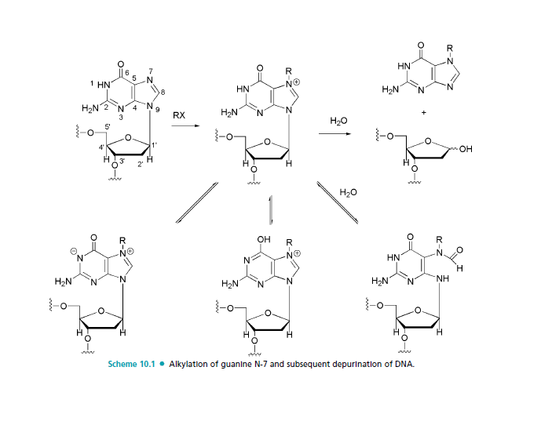

Slide 9
Nitrogen mustards
Mustards such as mechlorethamine are classified as dialkylating agents in that one mustard molecule can alkylate two nucleophiles.
The initial acid–base reaction is necessary to release the lone pair of electrons on nitrogen, which subsequently displaces chloride to give the highly reactive aziridinium cation.
Nucleophilic attack can then occur at the aziridinium carbon to relieve the small ring strain and neutralize the charge on nitrogen.

Slide 10
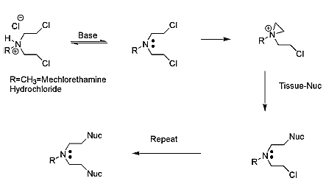
Alkylation of nucleophilic species by nitrogen mustards.

Slide 11
Mechlorethamine is highly reactive, in fact, too reactive and therefore nonselective, making it unsuitable for oral administration and necessitating direct injection into the tumor.
In cases of extravasation (drug escapes from the tumor into the underlying tissue), the antidote sodium thiosulfate (Na2S2O3), a strong nucleophile, may be administered.

Slide 12
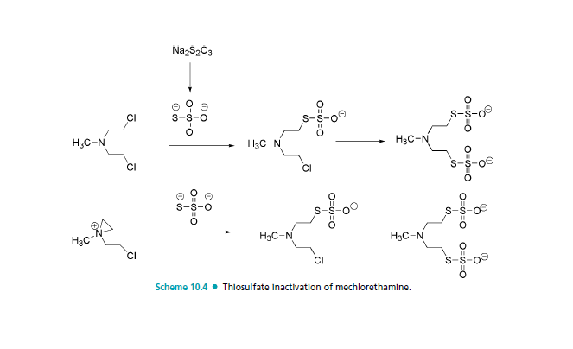
Thiosulfate inactivation of mechlorethamine.

Slide 13
Chlorambucil and Melphalan
The lack of selectivity of mechlorethamine led to attempts to improve on the agent. One rationale was to reduce the reactivity by reducing the nucleophilicity of nitrogen, thereby slowing aziridinium cation formation.
This could be accomplished by replacement of the weakly electron-donating methyl group with groups that were electron withdrawing (-I). This is seen in the case of chlorambucil and melphalan by Attachment of nitrogen to a phenyl ring.

Slide 14
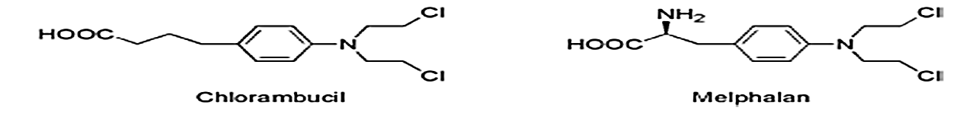
Reactivity was reduced such that these compounds could be administered orally. In the case of melphalan, attachment of the mustard functionality to a phenylalanine moiety was not only an attempt to reduce reactivity but also an attempt to increase entry into cancer cells by utilization of carrier mediated uptake.
Melphalan was found to utilize active transport to gain entry into cells, but selective uptake by cancer cells has not been demonstrated

Slide 15
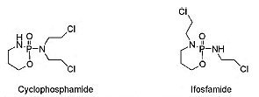
Cyclophosphamide and Ifosfamide
Attachment of more highly electron-withdrawing functionalities was utilized in the case of cyclophosphamide and ifosfamide. In these cases, aziridinium cation formation is not possible until the electron-withdrawing function has been altered.

Slide 16
The drug could be selectively activated in cancer cells because they were believed to contain high levels of phosphoramidase enzymes. This would remove the electron-withdrawing phosphoryl function and allow aziridine formation to occur.
The drug was activated by cytochrome P450 (CYP) isozymes CYP2B6 and CYP3A4/5 to give a carbinolamine that could undergo ring opening to give the aldehyde.

Slide 17
The increased acidity of the aldehyde -hydrogen facilitates a retro-Michael decomposition The ionized phosphoramide is now electron-releasing via induction and allows aziridinium cation formation to proceed.
To decrease the incidence of kidney and bladder toxicity, the sulfhydryl (MSH) containing agent mesna may be administered and functions to react with the electrophilic species that may be present in the kidney.

Slide 18
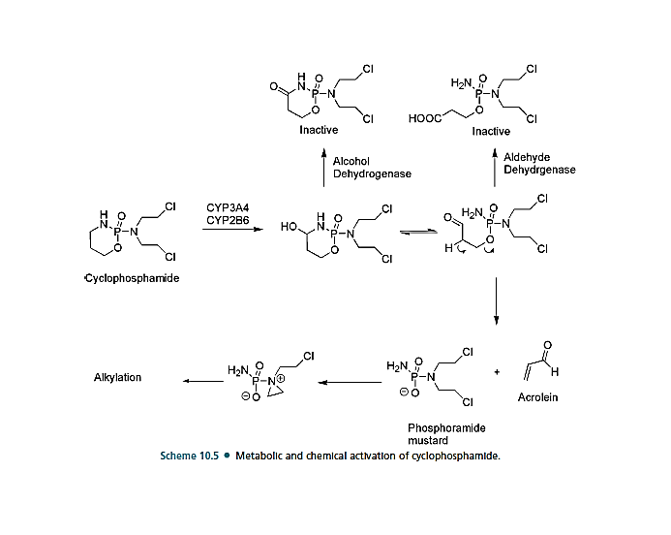
Metabolic and chemical activation of cyclophosphamide

Slide 19
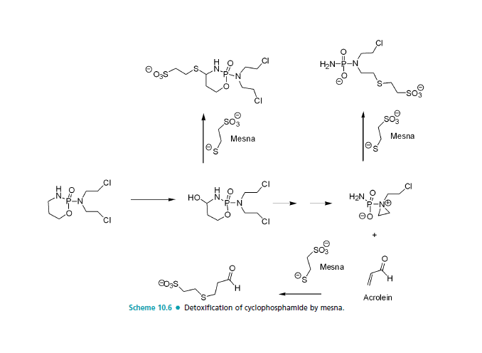
Detoxification of cyclophosphamide by mesna.

Slide 20
there are differences in the metabolism and activity of the agents. Both are administered as racemic mixtures as a result of the presence of a chiral phosphorus atom.
There appears to be little difference in the metabolic fate of the R- and S-isomers of cyclophosphamide, but in the case of ifosfamide, the R-isomer is converted to the required 4-hydroxy-ifosfamide 2 to 3 times faster than the S-isomer..

Slide 21
The S-isomer undergoes preferential oxidation of the side chain to give N-dechloroethylation, which removes the ability of the agent to cross-link DNA and also produces the neurotoxic and urotoxic chloroacetaldehyde.
An additional difference between cyclophosphamide and ifosfamide is the larger alkylating species that ultimately results after metabolic activation of ifosfamide. This results in the reactive form of ifosfamide having a higher affinity for DNA than the analogous form of cyclophosphamide and differences in the interstrand and intrastrand links that ultimately result.

Slide 22
Organoplatinum compounds
There are several organometallic compounds based on platinum that play a central role in many cancer treatment protocols. The first of these, cisplatin. Less reactive platinum compounds such as carboplatin and oxaliplatin in which the leaving group was incorporated into a chelate. satraplatin is currently in clinical trials. One advantage of these agents is the possibility of oral administration.
Satraplatin has shown similar activity when given orally to that of cisplatin given by injection.

Slide 23
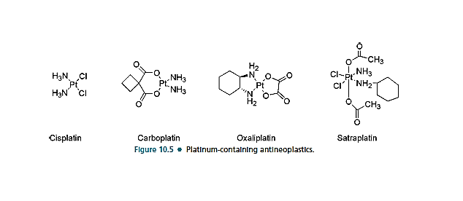
Platinum-containing anti neoplastics

Slide 24
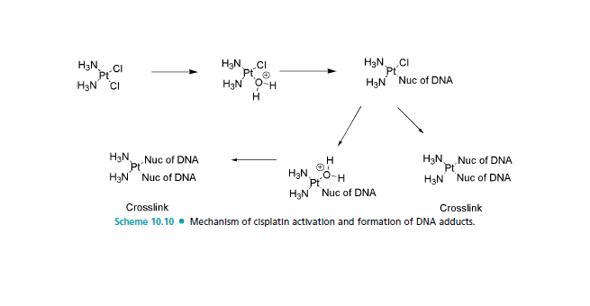
Mechanism of cisplatin activation and formation of DNA adducts.

Slide 25
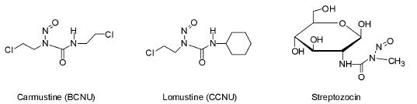
Nitrosoureas
Compound was based on the idea that its chemical
decomposition was leading to the formation of diazomethane (CH2N2) and subsequent alkylation of DNA, this led to the nitrosoureas, where it was found that activity could be enhanced by attachment of a 2-haloethyl substituent to both nitrogens

Slide 26
These compounds are reasonably stable at pH 4.5 but undergo both acid and base catalyzed decomposition at lower and higher pH, respectively.
There are several pathways of decomposition that are possible for these compounds, but the one that appears to be most important for alkylation of DNA involves:
Abstraction of the NH proton, which is relatively acidic (pKa 8–9).
Rearrangement to give an isocyanate and a diazohydroxide.

Slide 27
The diazohydroxide, upon protonation followed by loss of water, yields a diazo species that decomposes to a reactive carbocation.
The isocyanate functions to carbamylate proteins and RNA, whereas the carbocation is believed to be the agent responsible for DNA alkylation.

Slide 28
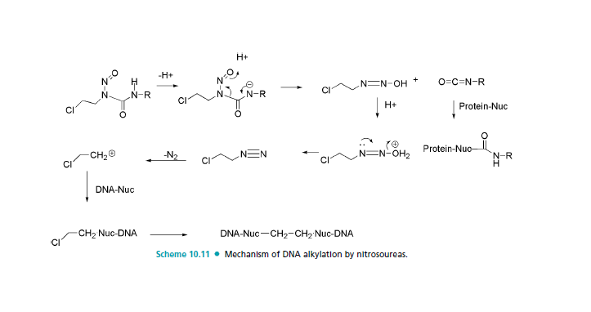
Nitrosoureas: Pathways of decomposition and DNA alkylation

Slide 29
Detoxification pathways of the nitrosoureas are also possible and can play a role in resistance to this group of agents.
The first of these involves dechlorination, which is facilitated by CYP participation.
The second route involves denitrosation,

Slide 30
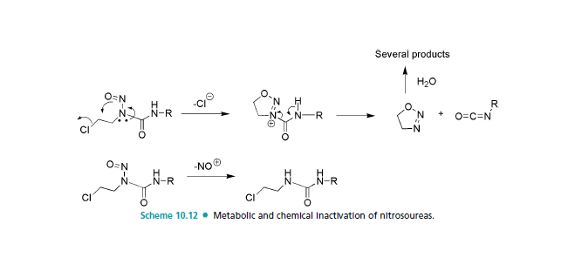
Detoxification pathways of the nitrosoureas

Slide 31
2.Antimetabolites
Most antimetabolites are effective cancer chemotherapeutic agents via interaction with the biosynthesis of nucleic acids.
Therefore, several of the useful drugs used in antimetabolite therapy are purines, pyrimidines, folates, and related compounds.
The antimetabolite drugs may exert their effects by several individual mechanisms involving enzyme inhibition at active, allosteric, or related sites.

Slide 32
The purine and pyrimidine antimetabolites are often compounds incorporated into nucleic acids and the nucleic acid polymers (DNA, RNA, etc.).
The antifolates are compounds designed to interact at cofactor sites for enzymes involved in the biosynthesis of nucleic acid bases.

Slide 33
A. Pyrimidine Drugs
The pyrimidine derivative 5-fluorouracil (5-FU) was designed to block the conversion of uridine to thymidine.
The normal biosynthesis of thymidine involves methylation of the 5-position of the pyrimidine ring of uridine.
The replacement of the hydrogen at the 5-position of uracil with a fluorine results in an antimetabolite drug, leading to the formation of a stable covalent ternary complex composed of 5-FU, thymidylate synthase (TS), and cofactor (a tetrahydrofolate species).

Slide 34
The metabolic activation (anabolism) of 5-FU required to produce the anticancer effects accounts for no more than 20% of the administered amount of drug in most patients.
Catabolic inactivation via the normal pathways for uracil consumes the remaining approximate 80% of the dose. The major enzyme of pyrimidine catabolism is dihydropyrimidine dehydrogenase (DPD), and 5-FU is a substrate for this enzyme.

Slide 35
Uracil is a substrate for this enzyme system also and has been dosed with 5-FU and 5-FU prodrugs in an attempt to saturate DPD and conserve active drug species.
Variability in the levels of DPD activity among the patient population is a major factor in the bioavailability of 5-FU. low bioavailability of 5-FU as a result of the catabolic
efficiency of DPD and other enzymes has lead to the development of unique dosing routes and schedules as well as
the development of prodrug forms of 5-FU

Slide 36
TS is responsible for the reductive methylation of deoxyuridine monophosphate (dUMP) by 5,10-methylenetetrahydrofolate to yield dTMP and dihydrofolate. Because thymine is unique to DNA, the TS enzyme system plays an important role in replication and cell division.
The tetrahydrofolate cofactor species serves as both the one-carbon donor and the hydride source in this system.

Slide 37
The initial step of the process involves the nucleophilic attack by sulfhydryl group of a cystine residue at the 6-position of dUMP. The resulting enolate adds to the methylene of 5,10- CH2-THF perhaps activated via the very reactive N-5- iminium ion .The iminium ion likely forms at N-5 and only after 5,10-CH2-THF binds to TS.
The iminium ion is likely formed at N-5 because it is the more basic of the two nitrogens, whereas N-10 is the better leaving group.

Slide 38
The loss of the proton at the 5-position of dUMP and elimination of folate yields the exocyclic methylene uracil species. The final step involves hydride transfer from THF and elimination to yield the enzyme, DHF, and dTMP.
Attempts at chemical modification of 5-FU to protect from catabolic events have produced several prodrug forms, which are converted via in vivo metabolic and/or chemical transformation to the parent drug 5-FU.
The carbamate derivative of 5-deoxy-5-fluorocytidine is known as capecitabine, and it is converted to 5-FU through a series of activation steps.

Slide 39
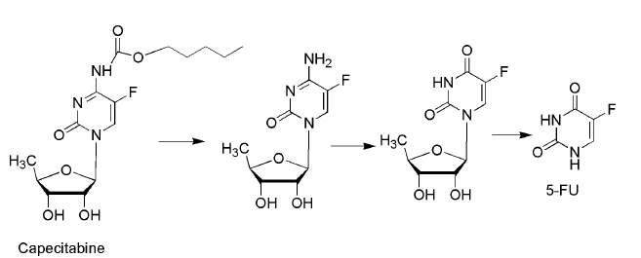
Metabolic activation of capecitabine to 5-FU.

Slide 40
The tetrahydrofuran derivative tegafur is slowly converted to 5-FU but requires quite high doses to
reach therapeutic plasma concentrations.
Esters of the N-hydroxymethyl derivative of tegafur show greater anticancer activity than tegafur.

Slide 41
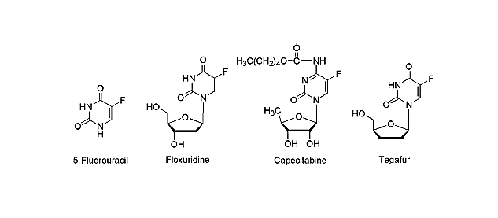
Pyrimidine Drugs

Slide 42
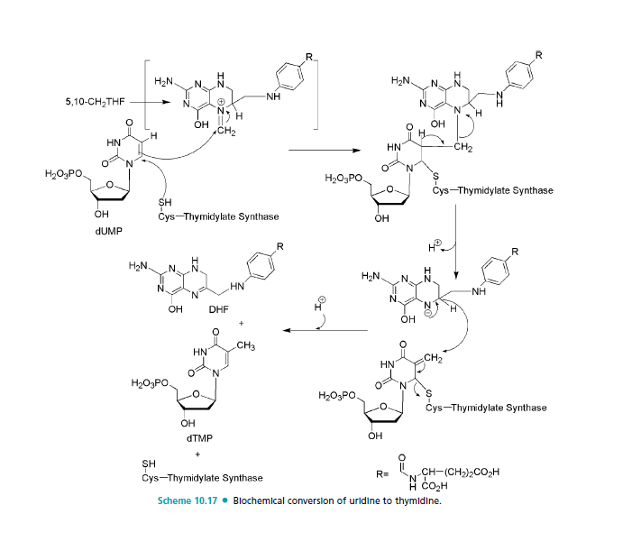

Slide 43
5-Fluorouracil is activated by conversion to the corresponding nucleotide species, 5-fluoro-2-deoxyuridylic acid.
The resulting 5-fluoro-2-deoxyuridylic acid is a powerful inhibitor of thymidylate synthetase , the enzyme that converts 2-deoxyuridylic acid to thymidylic acid.

Slide 44
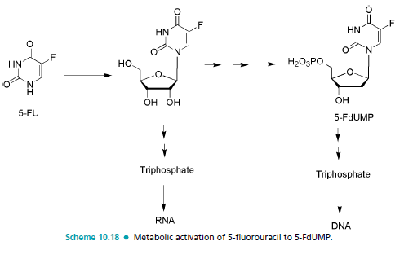

Slide 45
In the inhibiting reaction, the sulfhydryl group of TS adds via conjugate addition to the 6-position of the fluorouracil moiety. The carbon at the 5-position then binds to the methylene group of 5,10-Methylene tetrahydrofolate following initial formation of the more electrophilic form of folate the N-5-iminium ion.
In the normal process, this step is followed by the elimination of dihydrofolate from the ternary complex, regeneration of the active enzyme species, and the product thymidine.

Slide 46
Central to this process is the loss of the proton at the 5- position of uracil to form the exocyclic methylene uracil species.
The 5-fluorine is stable to elimination, and a terminal product results, involving the enzyme, cofactor, and substrate, all covalently bonded.

Slide 47
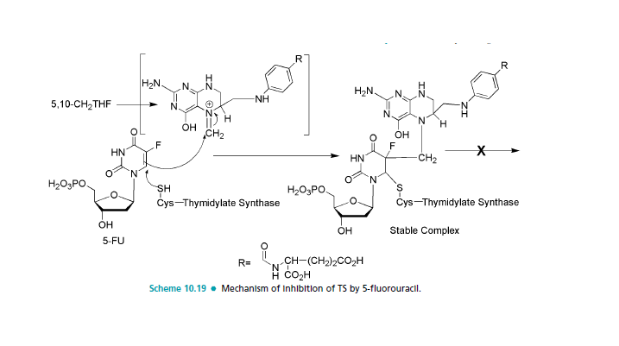

Slide 48
Cytarabine and gemcitabine
Pyrimidine analogs as antimetabolites for cancer therapy have been developed based on the cytosine structure as well. Modification of the normal ribose or deoxyribose moiety has produced useful drug species such as cytarabine (ara-C) and gemcitabine. Cytosine arabinoside (ara-C or cytarabine) is simply the arabinose sugar instead of ribose, and the only difference in structure is the epimeric hydroxyl group at the 2-position of the pentose sugar.

Slide 49
Mechanism of action may include a slowing of the DNA chain elongation reaction via DNA polymerase or cellular inefficiencies in DNA processing or repair after incorporation.
Gemcitabine is the result of fluorination of the 2`- position of the sugar moiety. After its anabolism to diphosphate and triphosphate metabolites, it inhibits ribonucleotide reductase and competes with 2-deoxycytidine triphosphate for incorporation into DNA.
The mechanism of action for gemcitabine is likely similar to that of ara-C including alteration of the rate of incorporation into DNA as well as the rate of DNA processing and repair.

Slide 50
Modification of the pyrimidine ring has also been explored for the development of potential anticancer drugs based on antimetabolite theory.
Several pyrimidine nucleoside analogs have one more or one less nitrogen in the heterocyclic ring. They are known as azapyrimidine or deazapyrimidine nucleosides. 5-Azacytidine is an example of a drug in this category
The mode of action of this compound is complex involving reversible inhibition of DNA methyl transferase, and this lack of methylated DNA activates tumor suppressor genes. In certain tumor systems, it is incorporated into nucleic acids, which may result in misreading or processing errors.

Slide 51
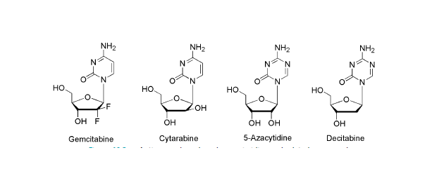
Anticancer drugs based on pyrimidine and related compounds

Slide 52
B. Purine Drugs
The design of antimetabolites based on purine structure began with isosteric thiol/sulfhydryl group to replace the 6-hydroxyl group of hypoxanthine and guanine.
One of the early successes was 6-mercaptopurine (6-MP), the thiol analog of hypoxanthine.

Slide 53
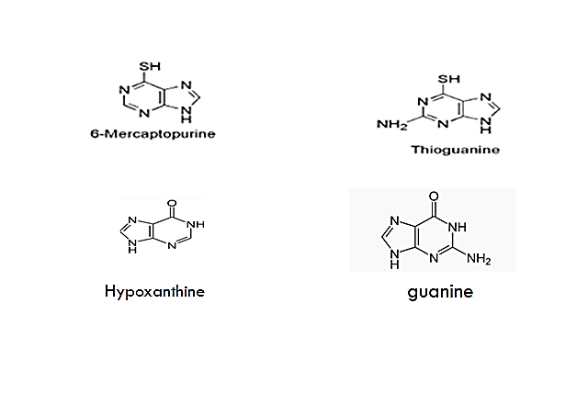
Anticancer drugs based on purines and related compounds

Slide 54
The antineoplastic activity of these purines as well as most antimetabolites depends on the relative rates of enzymatic activation and inactivation of these compounds in various tissues and cells.
The mechanism of action of 6-mercaptopurine includes incorporation of 6-mercaptopurine into DNA and RNA via the triphosphate metabolite (inhibition of purine biosynthesis).
. This incorporation inhibits synthesis and function of the resulting modified DNA or RNA.
The parent drug is inactive and requires phosphorylation for activity.

Slide 55
Inhibition of the enzymes responsible for the catabolic breakdown of the purine drugs can potentiate the drug’s antineoplastic activity.
Allopurinol is a potent inhibitor of xanthine oxidase and is often used as an adjuvant in purine anticancer drug therapy. Allopurinol increases both the potency and the toxicity of 6-mercaptopurine.
Its main importance is that it prevents the uric acid kidney toxicity caused by the release of purines from destroyed cancer cells.

Slide 56
Heterocyclic derivatives of 6-mercaptopurine, such as azathioprine, were designed to protect it from catabolic reactions.
Adenine arabinoside (Vidarabine) contains the sugar, D-arabinose, which is epimeric with D-ribose at the 2-position. This structural change makes it a competitive inhibitor of DNA polymerase, and this activity accounts for its antineoplastic activity as well as its antiviral action.

Slide 57
Adenine arabinoside and some of its derivatives are limited in their antitumor effect by susceptibility to adenosine deaminase.
The addition of fluorine to the sugar moiety(clofarabine) has produced some purine-based drugs with resistance to the catabolic activity of adenosine deaminase.
2-fluoro derivative, fludarabine, is also stable to this enzyme.

Slide 58
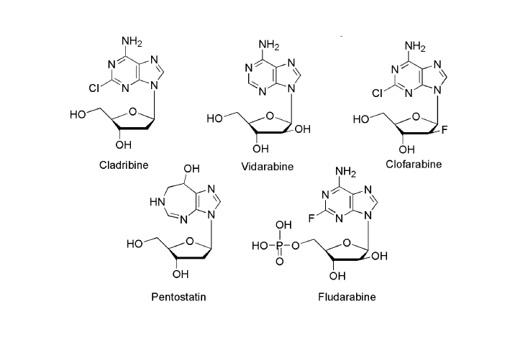
Anticancer drugs based on purines and related compounds.

Slide 59
This purine requires bioactivation to its ribonucleotide, 6-thioinosinate (6-MPMP), by the enzyme HGPRT. (hypoxanthine-guanine phosphoribosyl transferase).
The resulting nucleotide is a potent inhibitor of an early step in basic purine biosynthesis, the conversion of 5-phosphoribosylpyrophosphate into 5- phospho ribosylamine

Slide 60
Pathways of inactivation
purine antimetabolites 6-MP major pathways of inactivation include S-methylation via thiopurine-S methyl- transferase (TPMT) and oxidation by the enzyme xanthine oxidase (XO). Xanthine oxidase converts the drugs to the inactive thiouric acid.

Slide 61
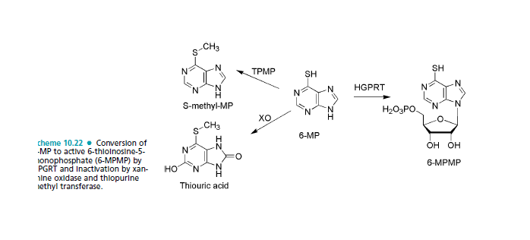
Conversion of 6-MP to active 6-thioinosine-5-monophosphate (6-MPMP) by
HPGRT and inactivation by xanthine oxidase and thiopurine methyl transferase.
Inactivation
Activation

Slide 62

C.Folates
Folic acid is substrate of the enzyme DHFR (dihydrofolate reductase ). The reduced folates are necessary for biosynthesis of several purines and pyrimidines.

Slide 63
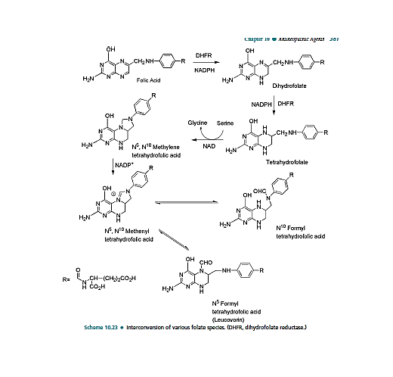

Slide 64
Methotrexate
Methotrexate is the classic antimetabolite of folic acid structurally derived by N-methylation of the para-amino benzoic acid residue (PABA) and replacement of a pteridine hydroxyl by the bioisosteric amino group.
The conversion of –OH to -NH2 increases the basicity of N-3 and yields greater enzyme affinity.

Slide 65
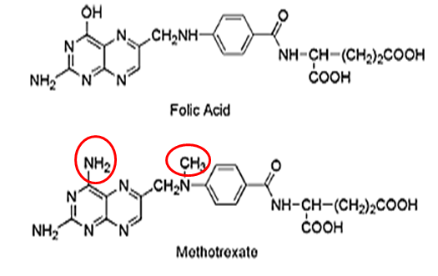

Slide 66
Methotrexate
This drug competitively inhibits the binding of the substrate folic acid to the enzyme DHFR, resulting in reductions in the synthesis of nucleic acid bases, perhaps most importantly, the conversion of uridylate to thymidylate as catalyzed by thymidylate synthetase. In addition, purine synthesis is inhibited because the N-10-formyl tetrahydrofolic acid is a formyl donor involved in purine synthesis.

Slide 67
Methotrexate is a broad-spectrum antineoplastic agent commonly used in the treatment of acute lymphoblastic and myeloblastic leukemia and other lymphomas and sarcomas.
The major side effects seen are bone marrow suppression, pulmonary fibrosis, and GI ulceration.

Slide 68
Antibiotics and natural products
A variety of the anticancer agents available today are derived from natural sources with several of these being obtained from microbial sources (antibiotics).
Many of the antineoplastic antibiotics are produced by the soil fungus Streptomyces. Both the antibiotic and natural product classes have multiple inhibitory effects on cell growth; however, they primarily act to disrupt DNA function and cell division.

Slide 69
There are several mechanisms by which these agents target DNA, including intercalation, alkylation, and strand breakage either directly or as a result of enzyme inhibition.
The drug–DNA interaction is further stabilized by side chains attached to the intercalation species. The side chains often include a cationic moiety, which may form ionic bonds with the anionic phosphate backbone. Alternative modes of stabilization may occur through a combination of van der Waals interaction or hydrogen bonds.

Slide 70
The overall result of these interactions is to cause a local bend or kink in DNA resulting in a local shape distortion. This may produce several effects but is often associated with inhibition of normal DNA function.

Slide 71
Actinomycins
The actinomycins are a group of compounds that are isolated from various species of Streptomyces, all of which contain the same phenoxazone chromophore but differ in the attached peptide portion.
Dactinomycin binds noncovalently to double-stranded DNA by partial intercalation between adjacent guanine cytosine bases resulting in inhibition of DNA function.

Slide 72
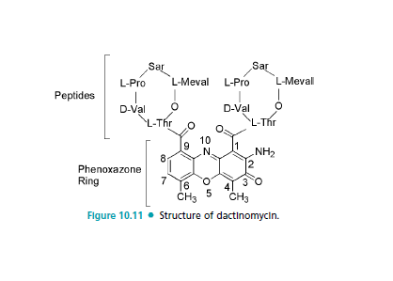

Slide 73
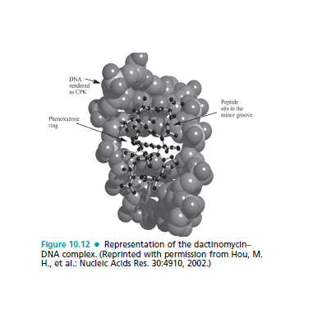
Dactinomycin-DNA Complex

Slide 74
The primary effect of this interaction is the inhibition of DNA-directed RNA synthesis and specifically RNA polymerase. DNA synthesis may also be inhibited, and the agent is considered cell cycle specific for the G1 and S phases.
The drug has been found to bind to single-stranded DNA and double-stranded DNA without adjacent GpC sequences. It has been suggested that binding to single-stranded DNA may occur as the strands separate during transcription, and this may be responsible for the inhibition of RNA polymerase.

Slide 75
There are several mechanisms of its action that are responsible for its cytotoxic and antitumor action, these being associated with DNA functionality, leading to RNA and, consequently, protein synthesis inhibition. The two main mechanisms are intercalation to DNA and the stabilization of cleavable complexes of topoisomerases I and II with DNA, in which a phenoxazone ring localizes between GpC base pair sequence in DNA and polypeptide lactones rings occupy a position in the minor groove of the DNA helix or the drug penetrates to a place in the DNA structure where topoisomerase binds with DNA, respectively. Moreover, the slow dissociation of actinomycin D from DNA complexes

Slide 76
Anthracyclines
The anthracycline antibiotics are characterized
by a planar oxidized anthracene nucleus fused to a cyclohexane ring that is subsequently connected via a glycosidic linkage to an amino sugar.
The mechanism by which the anthracyclines exhibit their cytotoxic effects initially focused on the ability of the compounds to associate with DNA resulting from intercalation of their planar ring system reinforced by auxiliary binding of the amino sugar.

Slide 77
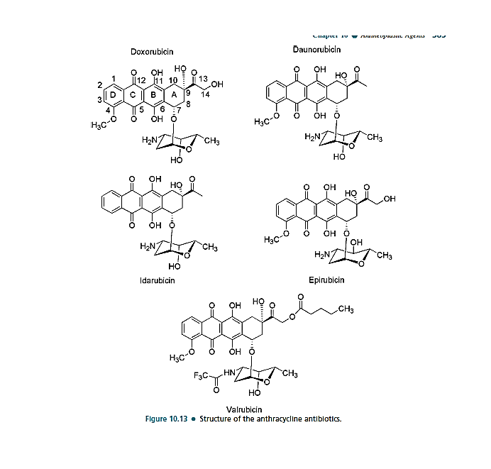

Slide 78
Epipodophyllotoxins
The epipodophyllotoxins are semisynthetic derivatives of podophyllotoxin, which is isolated from the may apple (mandrake) root and functions as an inhibitor of microtubule function.
Chemical modification has led to compounds with a different mechanism of action, which involves inhibition of topoisomerase enzymes.
The change in mechanism was associated with removal of the 4-methyl group of podophyllotoxin. Further alteration in podophyllotoxin involved the addition of the glycosidic portion of the molecules.

Slide 79
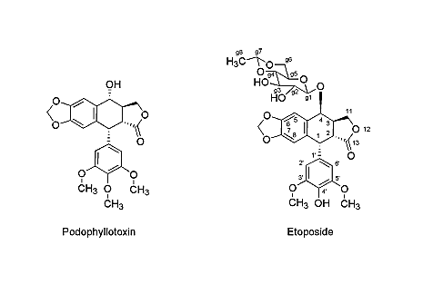
Epipodophyllotoxins

Slide 80
Bleomycin
Bleomycin is a glycopeptide antibiotic complex isolated from Streptomyces verticillus initially by Umezawa. Bleomycin binds Fe+2 through multiple interactions with the amino terminal end of the peptide chain.
Bleomycin may itself initiate the release of iron necessary for this complexation. Interaction with DNA subsequently occurs through the bithiazole portion of the molecule, which intercalates between G-C base pairs with a preference for genes undergoing transcription.

Slide 81
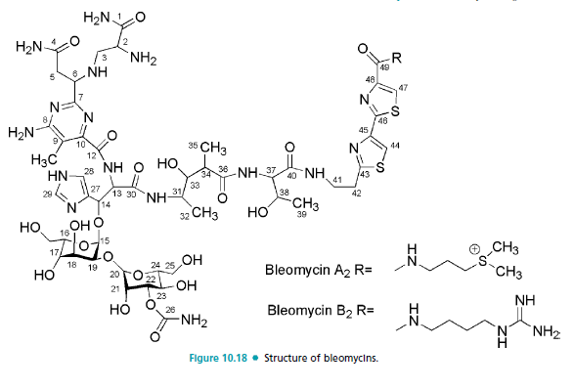
Bleomycin

Slide 82
Mitomycin c
Mitomycin C is considered the prototype of the bioreductive alkylating agents. Mitomycin is sometimes included as an alkylating agent but is included here because it is a naturally occurring material. The drug contains what would appear to be reactive functionalities, including the quinone and aziridine functionalities, both or which would be thought to be susceptible to nucleophilic attack; however, the reactivity of these functionalities is reduced because of steric and electronic effects in the parent molecule

Slide 83
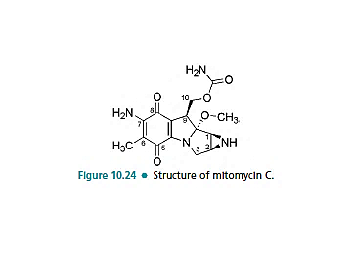
Mitomycin c

Slide 84
Plant products: Vinca Alkaloids
The alkaloids are composed of a catharanthine moiety containing the indole subunit and the vindoline moiety containing the dihydroindole subunit joined by a carbon–carbon bond. Vincristine and vinblastine differ only in the group attached to the dihydroindole
nitrogen, which is a methyl group in vinblastine and a formyl group in vincristine.
Vinorelbine is a semisynthetic material resulting from loss of water across the 3՝,4՝ bond and first prepared by the use of a modified Polonovski reaction of vinblastine followed by hydrolysis.

Slide 85
The vincas bind to tubulin disrupting formation and function of the mitotic spindle.
The mitotic spindle is composed of the microtubules, which function as part of the cell’s cytoskeleton and are important in maintaining cellular shape. They are also involved in transport within the cell and cell signaling as well as playing
a pivotal role in the movement of chromosomes during mitosis.

Slide 86
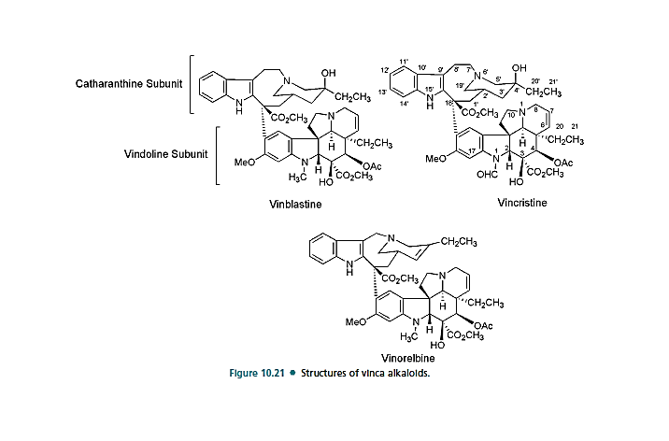
Vinca Alkaloids

Slide 87
Taxanes
The taxanes, specifically, taxol (or paclitaxel) was isolated from the bark of the pacific yew tree, proved to be active against various cancer models; These drugs bind to beta-tubulin subunits of microtubules. Paclitaxel is one of several cytoskeletal drugs that target tubulin. The major difference between Colchicine and Paclitaxel is that Colchicine inhibits the microtubule assembly whereas Paclitaxel stabilizes and protects microtubule against disassembly

Slide 88
Mechanism of Actions
Microtubules are cellular components that act as a skeleton for the cell. For cell division to occur, microtubules need to depolymerise back to tubulin. After that, tubulins repolymerise to form the spindle of cell division. The movement of the replicated chromosomes during mitosis depends on the spindle and therefore, the depolymerization of microtubules.

Slide 89
Paclitaxel or Taxol enhances the polymerization of tubulin to stable microtubules and also interacts directly with microtubules, stabilizing them against depolymerization. Hence, it interferes with the spindle formation process. Chromosomes are unable to move to the opposite sides of the dividing cells. Cells division is inhibited and eventually, cell death is induced

Slide 90
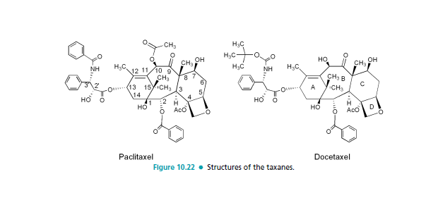

Slide 91
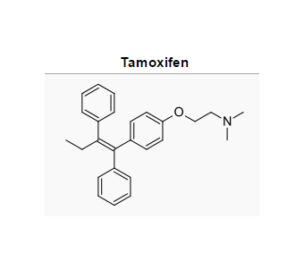
Hormones and their antagonists
Tamoxifen is an antagonist of the estrogen receptor in breast tissue via its active metabolite, 4-hydroxytamoxifen which have 30-100 times more affinity with the estrogen receptor than tamoxifen itself. preventing estrogen from binding to its receptor, blocking cancer cell growth.

Slide 92
4-Hydroxytamoxifen binds to estrogen receptors competitively (with respect to the endogenous agonist estrogen) in tumor cells and other tissue targets, producing a nuclear complex that decreases DNA synthesis and inhibits estrogen effects. It is a nonsteroidal agent with potent antiestrogenic properties which compete with estrogen for binding sites in breast and other tissues.

Slide 93
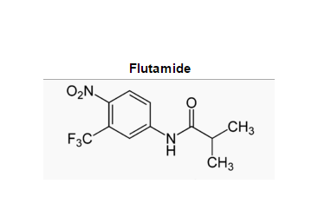
Flutamide
Flutamid is an oral, non steroidal antiandrogen drug primarily used to treat prostate cancer. It acts as a silent antagonist of the androgen receptor (AR), competing with testosterone and its powerful metabolite, dihydrotestosterone (DHT) for binding to ARs in the prostate gland.

Slide 94


