Slide 1
Drugs Affecting the Central Nervous System
Ass
Asst Prof Dr Inam S. Arif
isamalhaj@yahoo.com
Pharm.dr.isamalhaj@uomustansiriyah.edu.iq

Slide 3
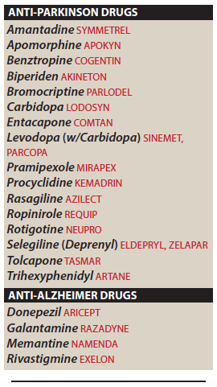
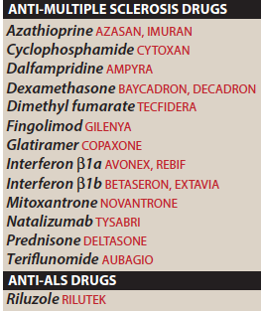

Slide 4
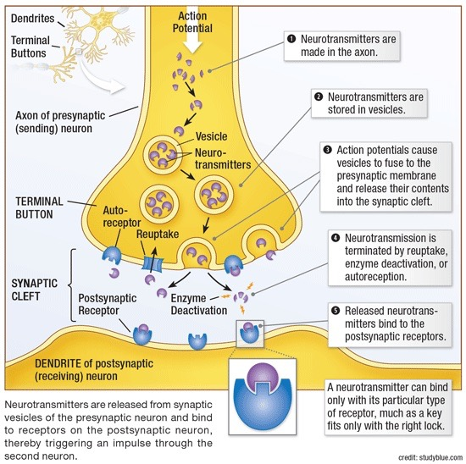

Slide 5
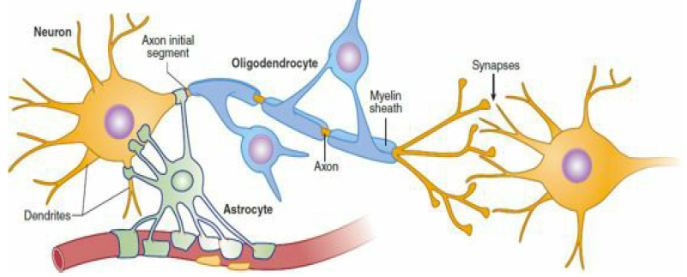

Slide 6
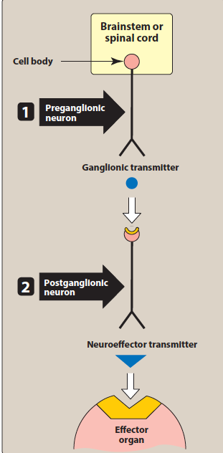
Efferent neurons in ANS

Slide 7
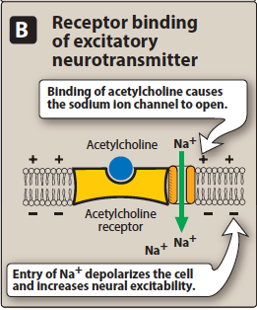
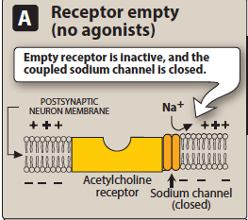

Slide 8
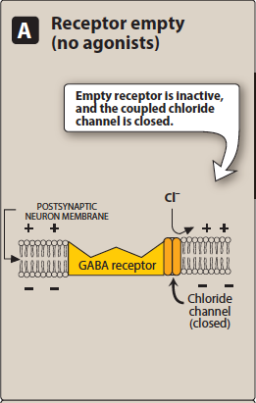
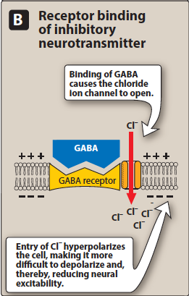

Slide 9
Neurodegenerative Diseases
Parkinson’s Disease
Multiple Sclerosis
Alzheimer’s Disease
Amyotrophic Lateral Sclerosis
Progressive loss of selected neutrons in discrete brain areas disorders of movement, cognition or both

Slide 10
Bradykinesia or slowness of movement is one of the three main signs of Parkinson’s, along with tremor and rigidity (It describes slowness in carrying out, rather than initiating, movements. Up to 98% of all people with Parkinson’s experience slowness of movement.
Dyskinesia is an involuntary movement that you cannot control. It can affect just one part of the body, like the head or an arm, or it can affect your entire body. Dyskinesia can range from mild to severe and painful, and interfere with normal daily activities. It can also differ in the frequency and the time of day that it occurs.
Wearing off
Initially levodopa may control symptoms well with only 2-3 daily doses. However, over time patient will start to experience changes in motor and non-motor symptoms, usually around 3-4 hours after a dose of levodopa, as the medication literally wears off and symptoms re-emerge or worsen. Symptoms then typically improve 15-45 minutes after the next dose is taken.

Slide 11
Gait is our manner or pattern of walking. When we walk our body is normally upright, neither leaning forwards nor backwards, with an even stride and arms swinging at the sides. When we hold ourselves in this upright position our centre of gravity is held so we should have good balance.
‘Parkinsonian gait’ is a distinctive, less steady walk that arises from changes in posture, slowness of movement (bradykinesia) and a shortened stride. This is characterized by some, but not necessarily all, of the following:
a tendency to lean forwards in a stooped position when walking
the head dropped forwards, with shoulders down
feet dragging on the ground, resulting in shuffling steps
a reduced length of stride
a reduced arm swing

Slide 12
Parkinson’s Disease
A progressive neurodegenerative disease that adversely affects motor neuron control.
Major early symptoms are tremor at rest, bradykinesia, muscle rigidity, and flat facial affect.
If untreated, the condition worsens, leading eventually to complete immobility and early mortality.
The prevalence is approximately 2% in persons older than 65 years

Slide 13
Parkinson’s Disease
Characterised by:
tremor
muscular rigidity
bradykinesia
postural & gait abnormalities
Sadly, symptoms don’t appear until > 80% of neutrons have died

Slide 15
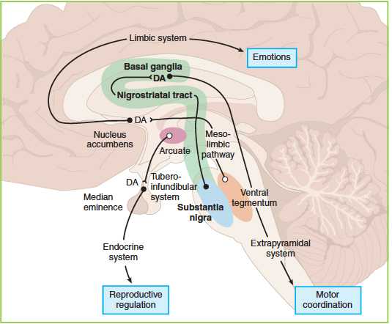
Etiology of Parkinson’s Disease

Slide 16
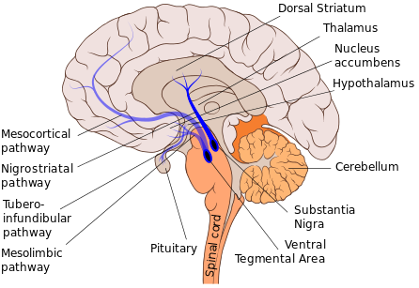

Slide 17
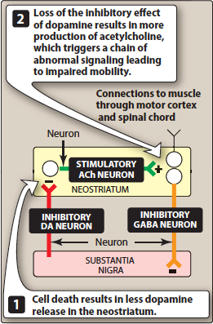

Slide 18
Secondary Parkinsonism
Phenothiazines & haloperidol / pseudoparkinsonism

Slide 20
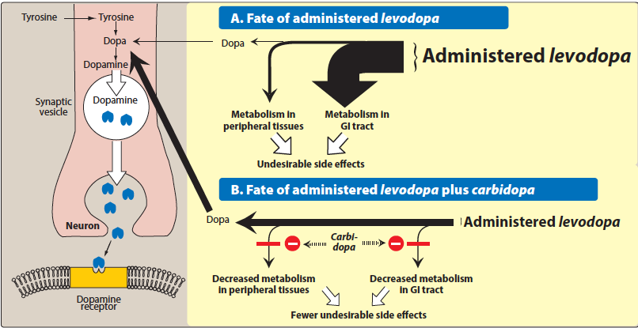
Drugs used in Parkinson’s Disease
1- Levodopa and Carbidopa

Slide 21
Levodopa and Carbidopa, cont.
decrease rigidity, tremor & other symptoms
clear beneficial respond 1st few yrs of treatment
decline response during 3rd - 5th yr of therapy
stop treatment gradually
well abs. on empty stomach (high ptn diet?????)
t1/2 of l-dopa is 1- 2 hrs———-troublesome “on-off”

Slide 22
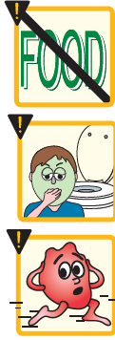
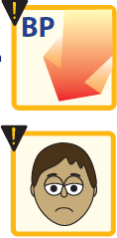
Levodopa and Carbidopa, cont.
Adverse effects:
Peripheral effects
N, V, anorexia,
tachycardia, vent. extrasystole,
hypotension
mydriasis
blood dycrasias & +ve Coomb’s test
brownish urine & saliva
CNS effects
visual & auditory hallucination
dyskinesia
mood changes & depression

Slide 23
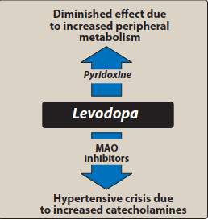
Drug-Drug Interactions
vit B6
MAOIs/phenelzine
Psychotic patients
Cardia patients
Antipsychotic agents

Slide 24
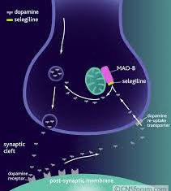
2-Selegiline (Deprenyl)& Rasagiline
Selective MAOI type B???
Given with l-dopa???
Low potential for hypertensive crisis
Metabolised to amphet. + methamphet.???
Rasagiline, selective irrev. MAOI in brain, X5
Not metabolised to amphetamine

Slide 25
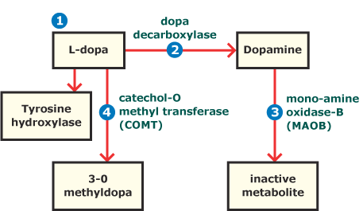
3- Catechol-O-methyltransferse inhibitors
Entacapone & Tolcapone
Selective & reversible inhibitors of COMT
Readily abs, not affected with food
Extensive pl ptn binding
Tolcapone has long duration of action
Extensively metabolized by liver
Diarrhoea, postural hypos., nausea, anorexia, dyskainesea, hallucination, liver necrosis
Entacapone doesn’t have this toxicity

Slide 26
4- Dopamine Receptor Agonist
Ergot derive. (Bomocriptine)
Non-ergot derive.
Ropinirole
Pramipexole
Rotigotine
Apomorhhine
Bromocriptine
Pramipexole
Ropinirole

Slide 27
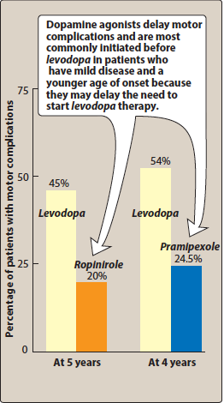

Slide 28
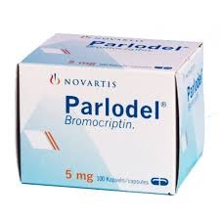
Bromocriptine
similar to l-dopa
hallucination, confusion, delirium, nausea & orthstatic hypotension more common
less dyskinesia
caution with patients with psychiatric problems, MI,peripheral vascular disease

Slide 29
Apomorhhine, Pramipexole, Ropinirole & Rotigotine
Pramipexole & Ropinirole / oral
Apomorphine (injectable)
Rotigotine / transdermal/ once daily
Apomorphine used in hypomobility “off” phenomenon
Alleviate motor problems, delay need to l-dopa & reduce dose
No effect on CVS problems
Nausea, hallucinate,insomnia, constipation & orthostatic hypos.
Cimetidine ???
Fluoroquinolone antibiotic???

Slide 30
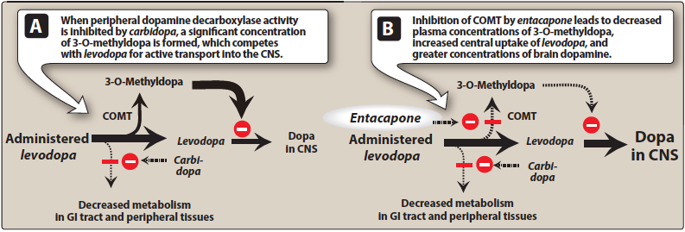

Slide 31
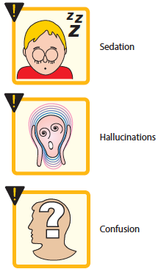
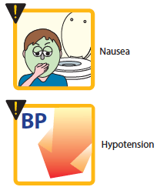
Side Effects of DA Agonists

Slide 32
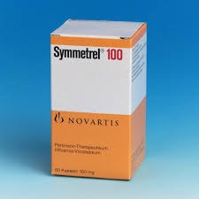
5- Amantadine
Antiviral
Increase DA release
Block cholinergic receptors
Inhibit NMDA
Side Effects:
Low doses: restlessness, agitation, confusion
& hallucination
high doses:Acute toxic psychoses Orthostatic
hypotension, urinary retention, dry mouth
Less efficacy than l-dopa

Slide 33
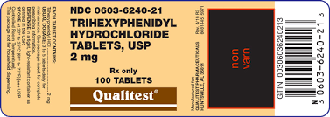
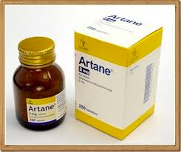
6- Antimuscarinic Agents
Trihexyphenidyl, Benztropine, Procyclidine, Biperidine
low efficacy
adjuvant therapy
induces mood changes, xerostomia, constipation, visual disturbances
Interfere with GIT peristalsis
CI: glaucoma, prostate hyperplasia, pyloric stenosis

Slide 34
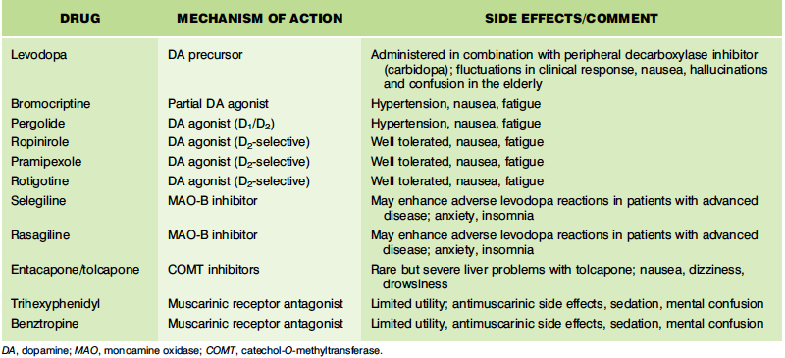

Slide 35
Drugs used in Alzheimer’s disease
a neurodegenerative disorder characterized by progressive impairment of short-term memory, language, and thought processes.
Functions are typically lost in the reverse order in which they were attained.
In advanced stages, patients cannot perform simple activities of
daily life.
Diagnosis is usually made 3 years or more after symptom onset, and life expectancy is approximately 7 to 10 years after diagnosis.
Dementia in Alzheimer involves
accumulation of B-amyloid
formation of neurofibrillary tangles aggregates of hyperphosphorylated tau protein
loss of cortical neurones,mainly cholinergic

Slide 36
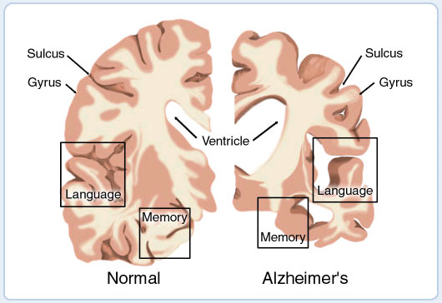

Slide 37
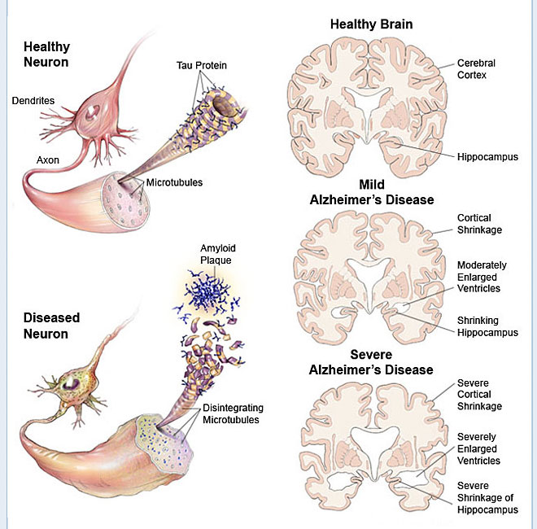
How the Brain and Nerve Cells Change During Alzheimer's Disease Medical illustration showing how the brain and nerve cells change during Alzheimer's

Slide 38
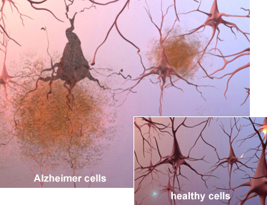
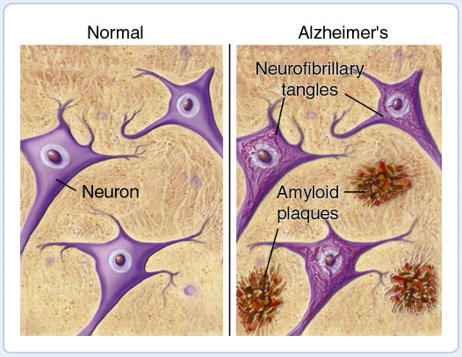

Slide 39
Drugs used in Alzheimer’s disease
Therapy:
cholinergic enhancement
prevent excitotoxic action of NMDA glutamate
1- Acetylcholinesterase inhibitors:
Donepezil, Galantamine, rivastigmine
SE: NVD, anorexia, tremor, bradycardia, muscle cramps
2- NMDA R antagonist:
Glutamate stimulation—————disturbed memories
—————-N degeneration o apoptosis (Ca⁺²)
Memantine / NMDA antag. / well tolerated
SE: confusion, agitation, restlessness
Given in combination with ACEIs

Slide 40
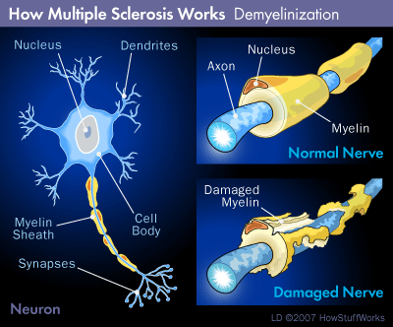
Drugs Used in Multiple sclerosis
Autoimmune inflammatory demyelinateddisease

Slide 41
A-Disease-modifying therapies
(decrease relapse, prevent accumulation of disability)
Modify immune response by inhibiting WBC mediated inflammatory processes
which result in myelin damage
1-Interferone β1a, interferone1β1
reduce inflame. response to demyelination of nerves
2- Glatiramer:
synthetic polypeptide & act as decoy to T-cell attack
3- Fingolimod
alter lymphocyte migration
SE: 1st- dose bradycardia
4- Dimethylfumarate
affect cellular to oxidative stress

Slide 42
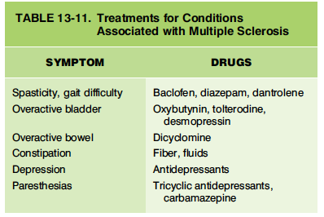
Disease-modifying therapies
5- Natalizumab: monoclonal Ab
6- Mitoxantrone: cytotoxic agent
B-Symptomatic treatment:
Dalfampridine, oral K+ chan. blocker, reduce spasticity

Slide 43
Quiz
1- Strategies for Controlling/ reducing fluctuation in response of L-dopa.
2- Is it possible to use metoclopramide to treat nausea & vomiting produced by l-dopa?
3- Which type of receptors are involved in controlling motor effects of l-dopa?
4- Which would you prefer in the treatment of the drug-induced form of parkinsonism:
-Levodopa -Bromocriptine -Benztropine -Dopamine

