Slide 1
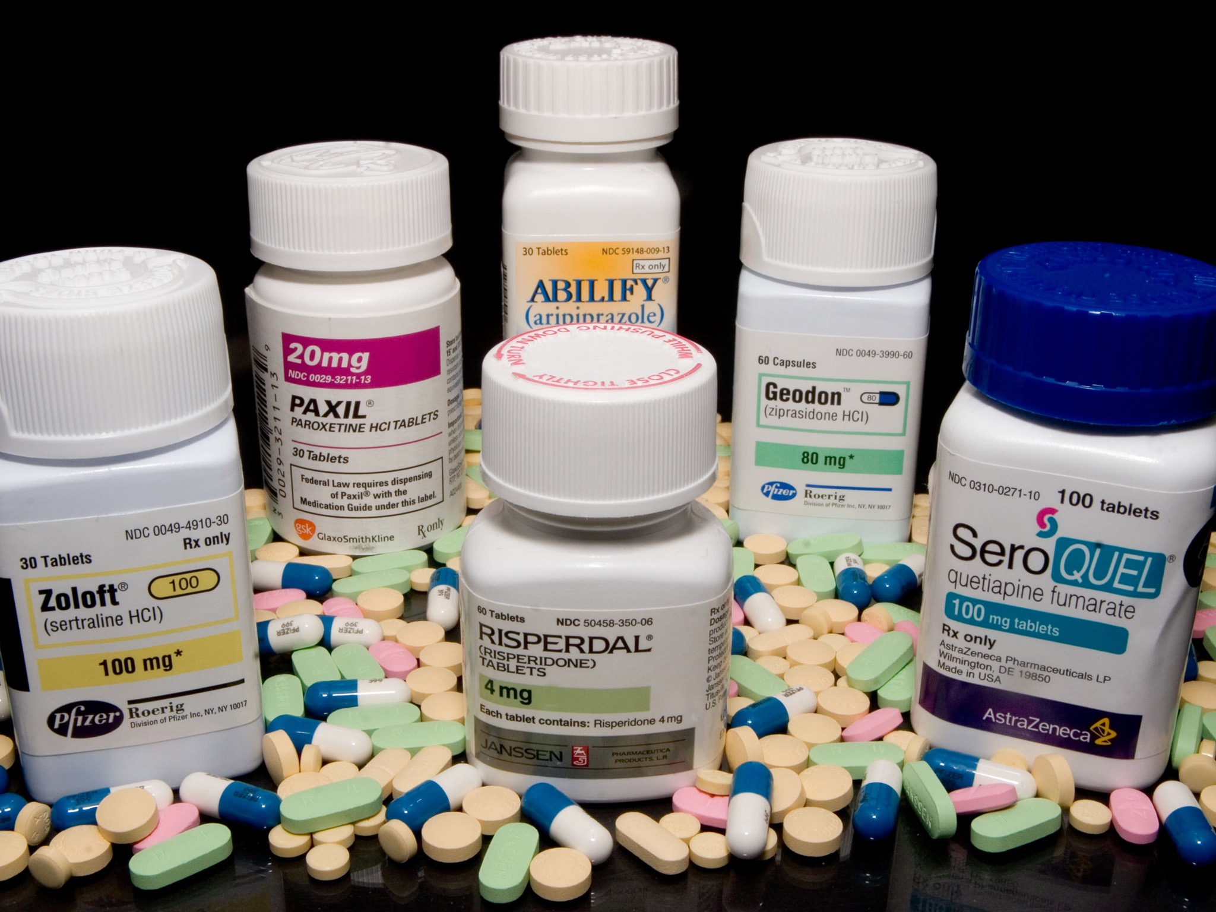
Antipsychotic Drugs
(Neuroleptics, Major Tranquillisers)
Asst Prof Dr Inam S. Arif
isamalhaj@yahoo.com
Pharm.dr.isamalhaj@uomustansiriyah.edu.iq

Slide 2
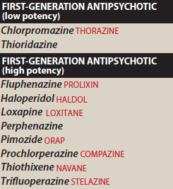
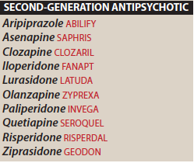

Slide 3
Antipsychotics, Neuroleptics or Major Tranquilizers
Primarily used to treat schizophrenia, also effective another psychotic & manic state
They are not curative and do not eliminate chronic thought disorders
Decrease intensity of hallucinations & delusions & help persons with schizophrenia to cope with environment

Slide 4
Schizophrenia
a type of chronic psychosis characterized by
delusions, hallucinations (often in the form of voices),
& thinking or speech disturbances
The onset of illness is often during late adolescence or early adulthood
occurs in about 1% of the population and is a chronic and disabling disorder
has a strong genetic component and probably reflects some fundamental biochemical abnormality, possibly a dysfunction of the mesolimbic or mesocortical dopaminergic neuronal pathways

Slide 5
AntipsychoticDrugs
divided into first- and second-generation agents
1st -generation drugs are further classified as “low potency” or “high potency.”
This classification does not indicate clinical effectiveness of the drugs, but rather specifies affinity for the dopamine D2 receptor, which, in turn, may influence the adverse effect profile of the drug.

Slide 6
First Generation Antipsychotics:
Conventional,traditional
Competitive inhibit. of D2 Rs
Associated with EPS (extrapyramidal symptoms)
Haloperidol / bind tightly to DA neuroreceptors /EPS
Chlorpromazine / bind weakly to DA neuroreceptors
Second Generation Antipsychotics “atypical” anti- psychotics
Lower incidence of EPS
High risk of metabolic SE (diabetes, hyperholesterolemia, weight gain
blockade of both 5-HT & DA and, perhaps, other receptors

Slide 7
General notes
2nd generation / 1st line for schizophrenia ???
1st & 2nd have almost equal efficacy
10% - 20% insufficient response to 1st & 2nd generation (Refractory patients)
Ref. patient / clozapine
Clozapine / bone marrow sup, seizures, CV disorders, agranulocytosis

Slide 8
Mechanism of Action
1- DA antagonism (D2)
2- 5-HT block (5-HT_{2A})
Clozapen D1, D4, 5-HT2, M, ⍺ / D2 antag.
Risperidone 5-HT_{2A} > D2
Olanzepine
Aripiprazole (2nd generation) / partial agonist D2, 5HT1A
& antag. 5-HT2A
Quetiaine / D2 block > 5-HT2A (low EPS ???)

Slide 9
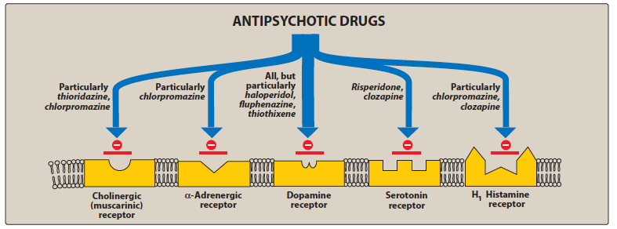

Slide 10
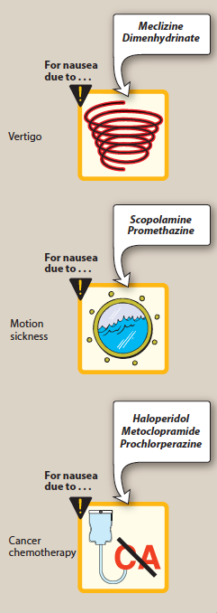
Actions of Antipsychotics
1- Antipsychotic effect
reduce hallucination & delusions (+ve symptoms)
blunted affect, apathy, cognitive impairment (-ve)
2- EPS (DA block)
dystonia, Parkinson like responses, tadive dyskinesia
3-Antiemetic effect
aripiprazole / D2 block
4- anticholinergic effects
thioridazine, chlorpromazine, clozapine & olanzapine
5- Other effects
orthostatic hypotension
poikilothermic
prolactine release
sedation / chlorpromazine, olanzapine, quetiapine, and clozapine
Sexual dysfunction

Slide 11
Therapeutic Uses
1- Treatment of Schizophrenia
1st generation
atypical + 5-HT antag.
2-Prevention of nausea & vomiting
prochlorperazine
3- Other uses
tranquillisers
intractable hiccups / chlorpromazine
motor tics / pimozide
Lurasidone & quetiapine/bipolar depression
Paliperidone / schizoaffective disorder
Aripiprazole, quetiapine / refractory depression

Slide 12
Absorption and metabolism
After oral administration, /show variable absorption, unaffected by food (except for ziprasidone and paliperidone, the absorption of which is increased with food).
readily pass into the brain and have a large volume
They are metabolized to many different metabolites, usually by the cytochrome P450 system in the liver, particularly the CYP2D6, CYP1A2, and CYP3A4 isoenzymes
paliperidone is the active metabolite of risperidone, and the antidepressant amoxapine is the active metabolite of loxapine
Fluphenazine decanoate, haloperidol decanoate, risperidone microspheres, paliperidone palmitate, aripiprazole monohydrate, and olanzapine pamoate are long-acting injectable (LAI) formulations of antipsychotics

Slide 13
Adverse effects
Extrapyramidal symptoms
Blocking dopamine receptors alters this balance, causing a relative excess of cholinergic influence, which results in extrapyramidal motor effects
Parkinson- like symptoms of bradykinesia, rigidity, and tremor usually occur within weeks to months of initiating treatment/benztropine
Thioridazine shows fewer EPS ???
Haloperidol and fluphenazine high EPS
Akathisia may respond better to β blockers (for example, propranolol) or benzodiazepines, rather than anticholinergic medications

Slide 14
Tardive dyskinesia
Long-term treatment with antipsychotics can cause this motor disorder
A prolonged holiday from antipsychotics may cause the symptoms to diminish or disappear within a few months.
Tardive dyskinesia is postulated to result from an increased number of dopamine receptors that are synthesized as a compensatory response to long-term dopamine receptor blockade

Slide 15
Neuroleptic malignant syndrome: This potentially fatal reaction to antipsychotic drugs is characterized by muscle rigidity, fever, altered mental status and stupor, unstable blood pressure, and myoglobinemia.
Treatment necessitates discontinuation of the antipsychotic agent and supportive therapy.
Administration of dantrolene or bromocriptine may be helpful ????
Other effects:
Drowsiness occurs due to CNS depression and antihistaminic effects, confusion, antimuscarinic exacerbation of preexisting diabetes or hyperlipidemia

Slide 16
Cautions and contraindications:
may lower the seizure threshold and should be used cautiously in patients with seizure disorders or those with an increased risk for seizures, such as withdrawal from alcohol.
Maintenance treatment
Patients who have had two or more psychotic episodes secondary to schizophrenia should receive maintenance therapy for at least 5 years, and some experts prefer indefinite therapy.

