Slide 1
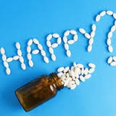
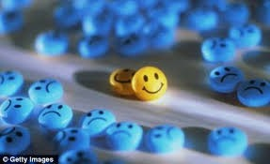
Antidepressants

Slide 2
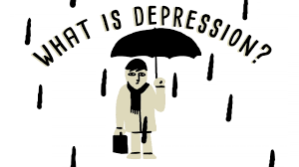
Antidepressants
Depression: feelings of sadness & hoplessness,
as well as, inability to experience pleasure in usual activities, changes in sleep patterns & appetite, loss of energy & suicidal thoughts
Mania (opposite behavior):enthusiasm, anger, rapid
thought & speech patterns, extreme self-confidence,
& impaired judgment
Biogenic amine theory???

Slide 3
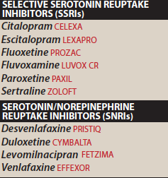
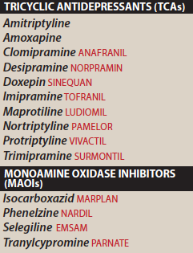
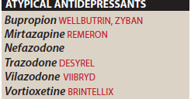
Antidepressants

Slide 4
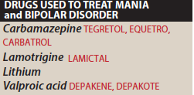

Slide 5
MECHANISM OF ANTIDEPRESSANT DRUGS
Antidepressant drugs potentiate, either directly or indirectly, the actions of NE &/or 5-HT in the brain
The biogenic amine theory
Mania is caused by an overproduction of these neurotransmitters.

Slide 6
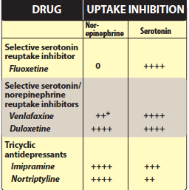
Selective serotonin Reuptake Inhibitors (SSRIs)
Higher selectivity to 5-HT (3000 x 5-HT> NE)
low activity on M, H1, ⍺-adrenergic??
Replaced TCA & MAOIs
Fluoxetine, Citalopram, Escitalopram, Fluvoxamine, Paroxetine, Sertaline

Slide 7
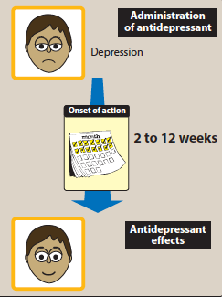
2 weeks for improvement in mood up to 12 weeks

Slide 8
Therapeutic Uses
Depression
Obsessive-compulsive disorder
Panic disorder
Generalised anxiety disorder
Premenstrual dysphoric disorder
Bulimia nervosa

Slide 9
Pharmacokinetics
Well absorbed orally, 2-8 hrs., t1/2=16-36 hrs
Food, sertaline???
Hepatic metabolism
Fluoxetine (S-norfluoxetine), sustained prep.
Fluoxetine & paroxetine inhibitors of CYP2D6 / TCA
CYP2C9/19, CYP3A4 / SSRI???

Slide 10
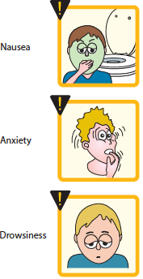
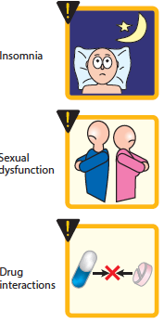
Adverse Effects
Headache, sweating, anxiety, agitation
GIT disturbances (NVD)
Weakness, fatigue, sleep disturb.
Drug-Drug interaction
Hyponatremia

Slide 11
Sleep disturbance
paroxetine, fluvoxamine / sedating
fluoxetine, sertaline / activating
Sexual Disturbance
libido, delayed ejaculation, anorgasmia
(change or move to bupropion, mirtazapine)
Use in Children & Teenagers
(1/50 suicidal ideation)
fluoxetine, sertaline, fluvoxamine / obsessive disorders
fluoxetine, escitalopram / childhood depression
Overdose
citalopram/ QT prolongation, seizures, serotonine syndrome
Discontinuation Syndrome
fluoxetine / long t1/2
(headache, malaise, flu-like symptoms, agitation, irritability

Slide 12
Serotonine/Norepinephrine Reuptake Inhibitors (SNRI)
Venlafaxine, Desvenlafaxine, Levomilnacipran, & Duloxetine
potent inhibitor (at med., & high doses)
treating depression in patients are not responding to SSNRIs
little activity at α -adrenergic, M,or H receptors
SE: N,headache sexual dysfunction, increase HR & BP

Slide 13
Venlafaxine:
is a potent inhibitor of 5-HT and, at medium to higher doses, is an inhibitor of norepinephrine reuptake
minimal inhibition of the CYP450 isoenzymes and is a substrate of the CYP2D6 isoenzyme
Desvenlafaxine:
is the active, demethylated metabolite of venlafaxine.
The most common side effects of venlafaxine are nausea, headache, sexual dysfunction, dizziness, insomnia, sedation, and constipation
At high doses, there may be an increasein blood pressure and heart rate.

Slide 14
Duloxetine
inhibits 5-HT & NE reuptake at alldoses.
It is extensively metabolized in the liver to inactive metabolites
GI side effects, nausea, dry mouth, and constipation. Insomnia, dizziness, somnolence, sweating, and sexual dysfunction
may increase blood pressure or heart rate.
is a moderate inhibitor of CYP2D6 isoenzymes and may increase concentrations of drugs metabolized by this pathway, such as antipsychotics.

Slide 15
Atypical antidepressants
Mixed group of agents (bupropion, mirtazapine, nefazodone, trazodone, vilazodone and vortioxetine)
Bupropion
weak DA & NE reuptake inhibitor
used to decrease craving & attenuating withdrawal symptom in patients trying to quit nicotine
SE: dry mouth, sweating, nervousness, tremor, and dose dependent increased risk for seizures.
very low incidence of sexual dysfunction
metabolized by the CYP2B6 pathway
relatively low risk for drug–drug interactions???
inhibit CYP2D6
should be avoided in patients at risk for seizures & who have eating disorders such as bulimia

Slide 16
Mirtazapine (enhances 5-HT & NE transmission)
antagonist to presynaptic ⍺ 2 to 5-HT2 R
No antiM, SE Marked sedation
Nefazadone & Trazadone
weak inhibitors of 5-HT reuptake
block postsynaptic 5-HT 2⍺
Sedative (H1 blocking effect), hepatotoxicity (nefazodone)
Trazadone / off label / insomnia
⍺1 antagonist?????

Slide 17
Tricyclic Antidepressants
Block 5-HT & NE
Amitriptyline, imipramine, doxepin, clomipramine (3◦ amine)
Nortriptyline, desipramine (2◦ amine)
Maprotyline, amoxapen (tetracyclic)
Mechanism of Action:
TCAs and Amoxapine are potent SNRIs
Maprotiline & Desipramine are relatively selective inhibitors of NE reuptake.
block 5-HT, α -adrenergic, H receptors & M receptors
Amoxapine also blocks 5-HT2 & DA 2 receptors
Used for moderate o severe depression
Imipramine / bed-wetting in children
Amitriptyline / prevent migraines
Low doses (Doxeoin)/ insomnia

Slide 18
Tricyclic Antidepressants
Well absorbed orally / lipophilic /CNS
widely distributed
Hepatic metabolism
SE:
Muscarinic blockade
Alpha adrenergic block
caution with patient with mania
Narrow TI

Slide 19


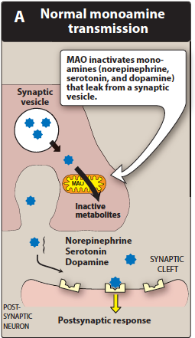
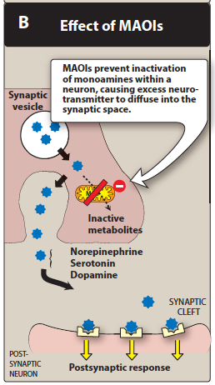
Mononamin Oxidase Inhibitors
Phenelzine, tranylcypromine, selegeline, isocarboxazide

Slide 20
Mononamin Oxidase Inhibitors
irreversible complex
act centrally & peripherally
effect is delayed several wks (2)
phenelzine, tranylcypromine , isocarboxazid & Selegiline
used for persons who are unresponsive to TCA
well abs. orally
Drug-food interaction (tyramine)
hypertensive crisis,, headache, stiff neck, - - -
phentolamine & prazocin used to treat tyramine induced

Slide 21
Mononamin Oxidase Inhibitors (cont.)
form stable complexes with the enzyme, causing irreversible inactivation (accumulation of NE, 5-HT & DA)
Brain, GIT & liver ( catalyzes oxidative deamination of drugs and potentially toxic substances, such as tyramine)
High incidence of drug–drug and drug–food interactions
Selegiline / transdermal patch may produce less inhibition of gut and hepatic MAO at low doses because it avoids first-pass metabolism.
Response delayed for several weeks
Selegiline and tranylcypromine have an amphetamine-like stimulant effect that may produce agitation or insomnia.

Slide 22
Therapeutic uses
Pharmacokinetics
Adverse effects
drug–food and drug–drug interactions
hypertensive crisis, with signs and symptoms such as occipital headache, stiff neck, tachycardia, nausea, hypertension, cardiac arrhythmias, seizures and, possibly, stroke.
Phentolamine and prazosin
drowsiness, orthostatic hypotension, blurred vision, dry mouth, and constipation.
CI: combination with other antidepressants

Slide 23
Treatment of Mania
Lithium
for acute & prophylaxis
low TI
Unknown mechanic
SE: headache, dry mouth, polyuria, poldepsia, tremor, - - - etc
Thyroid function may be decreased and should be monitored
Other Drugs:
Antiepileptic drugs?carbamazepine, valproic acid, - - - -etc.

