Slide 1
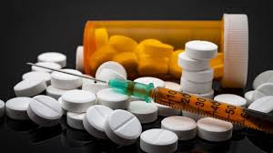
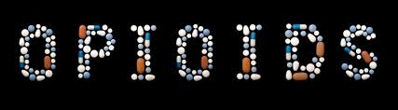
Opiods

Slide 2
Opioids
Pain is an unpleasant sensation that can be either acute or chronic and is a consequence of complex neurochemical processes in the peripheral and central nervous systems (CNS
Alleviation of pain depends on the type of pain:
Nociceptive, e.g. mild to moderate arthritic pain, nonopioid analgesics such as NSAI
Neuropathic pain, treated with opioids, anticonvulsants, TCA, or SNRIs

Slide 3
Natural, semisynthetic, or synthetic cpds produce morphine-like effects
Classified into chemical classes based on their chemical structure
Clinically this is helpful in identifying opioids that have a greater chance of cross-sensitivity in a patient with an allergy to a particular opioid

Slide 5
Opioids
All opioids act by binding to specific opioid receptors in the CNS to produce effects mimic the action of endogenous peptide neurotransmitters (e.g., Endorphins, Enkephalins, and Dynorphins)
The primary use is to relieve intense pain, whether that pain results from surgery, injury, or chronic disease
Unfortunately, widespread availability of opioids has led to abuse of those agents with euphoric properties
Antagonists that reverse the actions of opioids are also clinically important for use in cases of overdose

Slide 6
Many receptor families, designated as μ (mu), κ (kappa), and δ (delta)
Each receptor family exhibits a different specificity for the drug(s) it binds
The analgesic properties of the opioids are primarily mediated by the μ receptors that modulate responses to thermal, mechanical, and chemical nociception
The κ receptors in the dorsal horn also contribute to analgesia by modulating the response to chemical and thermal nociception.

Slide 7
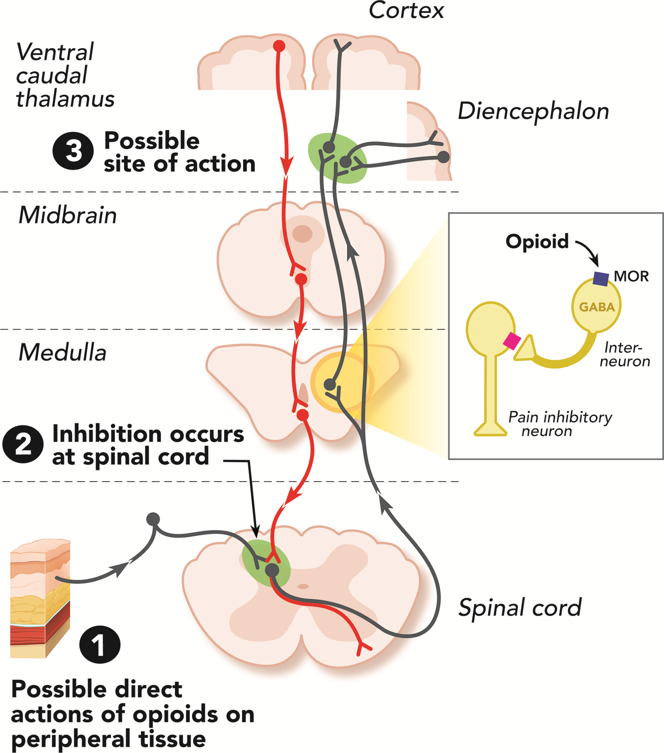

Slide 8
Enkephalins interact selectively with δ receptors in the periphery
All three opioid receptors are members of the G ptn–coupled R family and inhibit adenylyl cyclase
They are also associated with ion channels, increasing postsynaptic K+ efflux (hyperpolarization) or reducing presynaptic Ca2+ influx, thus impeding neuronal firing and transmitter release

Slide 9
Opioid Agonists / Morphine
The major analgesic drug contained in crude opium / strong μ R agonist
Currently available opioids have various differences in
receptor affinity
pharmacokinetic profiles
routes of administration
adverse effect profiles

Slide 10
Morphine
Mechanism of action:
interact stereospecifically with opioid receptors on the membranes of certain cells in the CNS, GIT & urinary bladder
Acts at κ receptors in lamina I and II of the dorsal horn of the spinal cord
It decreases the release of substance P, which modulates pain perception in the spinal cord
inhibit the release of many excitatory transmitters from nerve terminals carrying nociceptive (painful) stimuli

Slide 11
Actions
a. Analgesia:
relief of pain without the loss of consciousness by altering the brain’s perception of pain
Patients treated with opioids are still aware of the presence of pain, but the sensation is not unpleasant
b. Euphoria:
powerful sense of contentment and well-being
Euphoria may be caused by disinhibition of DA-containing neurons
of the ventral tegmental area.
c. Respiration:
respiratory depression by reduction of the sensitivity of respiratory center neurons to CO₂
This can occur with ordinary doses of morphine in patients who are opioid-naïve Respiratory depression is the most common cause of death in acute opioid overdoses
Tolerance to this effect does develop quickly with repeated dosing, which allows the safe use of morphine for the treatment of pain when the dose is correctly titrated

Slide 12
Depression of cough reflex: Both Morphine and Codeine have antitussive properties
Cough suppression does not correlate closely with the analgesic and respiratory depressant properties of opioid drugs
Rs involved in the antitussive action is different from those involved in analgesia.
e. Miosis: The pinpoint pupil characteristic of morphine /stimulation of μ and κ
There is little tolerance to the effect, and all morphine abusers demonstrate pinpoint pupils. [Note: This is important diagnostically, because many other causes of coma and respiratory depression produce dilation of the pupil.]
f. Emesis: Morphine directly stimulates the CRTZ in the area postrema that causes vomiting.

Slide 13
g. GIT:
Morphine relieves diarrhea by decreasing the motility and increasing the tone of the intestinal circular smooth muscle
Morphine also increases the tone of the anal sphincter
Overall, morphine and other opioids produce constipation, with little tolerance developing. [Note: A nonprescription laxative combination of the stool softener docusate with the stimulant laxative senna is useful to treat opioid-induced constipation.]
Morphine can also increase biliary tract pressure due to contraction of the gallbladder and constriction of the biliary sphincter.

Slide 14
i. CVS:
Morphine has no major effects on BP or HR at lower dosages. With large doses, hypotension and bradycardia may occur
Because of respiratory depression CO₂ retention, cerebral vessels dilate and increase cerebrospinal fluid pressure
Therefore, morphine is usually contraindicated in individuals with head trauma or severe brain injury.
Activation of the opioid receptor decreases Ca2+
influx in response to incoming action potential. This decreases release of excitatory neuro- transmitters, such as glutamate.

Slide 15
i. Histamine release: Morphine releases Histamine from mast cells causing urticaria, sweating, and vasodilation. Because it can cause bronchoconstriction, morphine should be used with caution in patients with asthma.
j. Hormonal actions: Morphine increases GH release and enhances prolactin secretion. It increases ADH and leads to urinary retention.
k. Labor: Morphine may prolong the second stage of labor by transiently decreasing the strength, duration, and frequency of uterine contractions.

Slide 16
Pharmacokinetics:
Significant 1st pass effect, so, given by IV, IM & Sc
Linear pharmacokinetics
Rapid distribution
Infants for addicted mothers suffer from withdrawal symptoms
Poor crossing to BBB, except for fentanyl & methadone
Conjugate glucoronic Acid, morphine-6-glucoronide is active
Duration of action 4-5 hrs

Slide 17
Adverse effects:
With most μ agonists, severe respiratory depression can occur and may result in death from acute opioid overdose
If opioids are used, respiration must be closely monitored
Used with caution in patients with asthma, liver disease, or renal dysfunction
Tolerance and physical dependence:
Repeated use produces tolerance to the respiratory depressant, analgesic, euphoric, and sedative effects of morphine
Tolerance usually does not develop to the pupil-constricting and constipating effects of the drug
Withdrawal produces a series of autonomic, motor, and psychological responses, although it is rare that the effects cause death.
Drug interactions: Drug interactions with morphine are rare
the depressant actions of morphine are enhanced by phenothiazines, MAOIs & TCA

Slide 18
Codeine
Codeine is a naturally occurring opioid that is a weak analgesic compared to morphine
It should be used only for mild to moderate pain
The analgesic actions of codeine are derived from its conversion to morphine by the CYP450 2D6 enzyme system
Drug interactions associated with the CYP450 2D6 enzyme system may alter the efficacy of codeine or potentially lead to toxicity
Codeine is commonly used in combination with acetaminophen for management of pain
Codeine exhibits good antitussive activity at doses that do not cause analgesia. [Note: In most nonprescription cough preparations, codeine has been replaced by drugs such as dextromethorphan, a synthetic cough depressant that has relatively no analgesic action and a relatively low potential for abuse in usual antitussive doses.]

Slide 19
Oxycodone and oxymorphone
semisynthetic derivative of morphine
It is orally active and is sometimes formulated with aspirin or acetaminophen
Its oral analgesic effect is approximately twice that of morphine
Oxycodone is metabolized via the CYP450 2D6 and 3A4 enzyme systems and excreted via the kidney
Abuse of the sustained-release preparation (ingestion of crushed tablets) has been implicated in many deaths
It is important that the higher-dosage forms of the latter preparation be used only by patients who are tolerant to opioids
Oxymorphone
is a semisynthetic opioid analgesic
When given parenterally it is approximately ten times more potent than morphine
The oral formulation has a lower relative potency and is about three times more potent than oral morphine
available in both immediate-acting and extended-release oral formulations. This agent has no clinically relevant drug–drug interactions associated with the CYP450 enzyme system.

Slide 20
Hydromorphone and hydrocodone
orally active, semisynthetic analogs of morphine and codeine, respectively
Oral hydromorphone is approximately 8-10X > potent than morphine
Preferred over morphine in renal dysfunction / less accumulation of active metabolites
Hydrocodone is the methyl ether of hydromorphone
weaker analgesic than hydromorphone, with oral analgesic efficacy comparable to that of morphine
This agent is often combined with acetaminophen or ibuprofen to treat
moderate to severe pain
Used as an antitussive
metabolized in the liver to several metabolites, one of which is hydromorphone via the actions of CYP450 2D6. Metabolism to hydromorphone can be affected by drug–drug interactions.

Slide 21
Fentanyl
Synthetic opioid chemically related to meperidine, 100X the analgesic potency of morphine /used for anesthesia
Highly lipophilic / rapid onset and short duration of action (15 to 30 minutes)
Combined with LA to provide epidural analgesia for labor and postoperative pain
IV fentanyl is used in anesthesia for its analgesic and sedative effects
Oral transmucosal preparation / used in cancer patients with breakthrough pain
Transdermal patch must be used with caution because death resulting from hypoventilation has been known to occur
[Note: The transdermal patch creates a reservoir of the drug in the skin. Hence, the onset is delayed at least 12 hours, and the offset is prolonged.]
Fentanyl is metabolized to inactive metabolites by the CYP450 3A4 system
The drug and inactive metabolites are eliminated through the urine.

Slide 22
Sufentanil, Alfentanil, & Remifentanil
Synthetic opioid agonists related to fentanyl
Differ in potency and metabolic disposition
Sufentanil > potent than fentanyl, whereas the other two are less potent and shorter acting
Mainly used for their analgesic and sedative properties during surgical procedures requiring anesthesia.

Slide 23
Methadone
Synthetic, orally / μ receptors agonist
Induces less euphoria and has a longer duration of action.
An antagonist of NMDA R & NSRIs
Used for both nociceptive and neuropathic pain
Used in the controlled withdrawal of dependent abusers from opioids and heroin
Oral methadone is administered as a substitute for the opioid of abuse, and the patient is then slowly weaned from methadone
The withdrawal syndrome with methadone is milder but more protracted (days to weeks) than that with other opioids
Unlike morphine, methadone is well absorbed after oral administration
It increases biliary pressure and is also constipating, but less so than morphine.

Slide 24
Rapid oral absorp., metabolized by liver, & excr. By urine
Very lipophilic, leading to accumulation in the fat tissues
t_{1/2} 12 to 40 hours
Overdose is possible
Metabolism is variable because it relies on multiple CYP450 isoenzymes, some of which are affected by known genetic polymorphisms and are susceptible to many drug–drug interactions.
Produce physical dependence like that of morphine, but has less neurotoxicity than morphine due to the lack of active metabolites.
Methadone can prolong the QT interval
Should be used with caution in patients with a family or personal history of QT prolongation or those taking other medications that can prolong the QT interval.

Slide 25
Meperidine
Lower-potency synthetic opioid structurally unrelated to morphine
Used for acute pain and acts primarily as a κ agonist, with some μ agonist activity Very lipophilic and has anticholinergic effects, resulting in an increased incidence of delirium as compared to other opioids
Duration of action is slightly shorter than that of morphine and other opioids
Has an active metabolite (normeperidine) that is renally excreted
Due to the short duration of action and the potential for toxicity, meperidine should only be used for short-term (≤ 48 hours) management of pain
Other agents are generally preferred.
Serotonin syndrome has also been reported in patients receiving both meperidine and selective serotonin reuptake inhibitors (SSRIs).

Slide 26
Partial Agonists & Mixed Agonist-Antagonists
Partial agonists bind to the opioid receptor, but have less intrinsic activity
There is a ceiling to the pharmacologic effects of these agents
Mixed agonist–antagonists
The effects of these drugs depend on previous exposure to opioids
In individuals who have not received opioids (naïve patients), mixed agonist–antagonists show agonist activity and are used to relieve pain

Slide 27
Buprenorphine
Partial agonist, acting at the μ receptor, precipitate withdrawal in users of morphine
A major use is in opioid detoxification, because it has shorter and less severe withdrawal symptoms compared to methadone
It causes little sedation, respiratory depression, or hypotension, even at high doses
Approved for office- based detoxification or maintenance
Given sublingually, parenterally, or transdermally and has a long duration of action because of its tight binding to the μ receptor
Buprenorphine tablets are indicated for the treatment of opioid dependence and are also available in a combination product containing buprenorphine and naloxone. Naloxone was added to prevent the abuse of buprenorphine via IV administration
The injectable form and the once-weekly transdermal patch are indicated for the relief of moderate to severe pain
Metabolized by the liver and excreted in bile and urine
Adverse effects include respiratory depression that cannot easily be reversed by naloxone and decreased (or, rarely, increased) blood pressure, nausea, and dizziness.

Slide 28
Pentazocine
agonist on κ receptors & weak antagonist at μ and δ receptors
promotes analgesia by activating receptors in the spinal cord/used to relieve moderate pain
orally or parenterally
produces less euphoria compared to morphine
In higher doses, the drug causes resp. depression and decreases the activity of the GI tract
High doses increase BP, hallucinations, nightmares, dysphoria, tachycardia, and dizziness
does not antagonize resp. dep. of morphine/precipitate a withdrawal syndrome in a morphine abuser
Tolerance and dependence develop with repeated use
Pentazocine should be used with caution in patients with angina or coronary artery disease???

Slide 29
Nalbuphine & Butorphanol
Mixed opioid agonist–antagonists
Like pentazocine, limited role in the treatment of chronic pain.
Butorphanol /nasal /used for severe headaches/abuse
Neither agent is available for oral use
Psychotomimetic effects is less than that of pentazocine
Nalbuphine does not affect the heart or increase blood pressure, in contrast to pentazocine and butorphanol
Exhibit a ceiling effect for respiratory depression

Slide 30
Tapentadol
Centrally acting analgesic
Agonist at the μ opioid receptor & NRIs
Used to manage moderate to severe pain, both chronic and acute.
Mainly metabolized to inactive metabolites via glucuronidation, and it does not inhibit or induce the CYP450 enzyme system
Because tapentadol does not produce active metabolites, dosing adjustment is not necessary in mild to moderate renal impair-ment
Should be avoided in patients who have received MAOIs within the last 14 days
It is available in an immediate-release and extended-release formulation.

Slide 31
Tramadol
Centrally acting analgesic binds to the μ opioid receptor
Undergoes extensive metabolism via CYP450 2D6, leading to an active metabolite / much higher affinity for the μ receptor than the parent compound
Weakly inhibits reuptake of NE & 5-HT
Used to manage moderate to moderately severe pain
Respiratory depressant activity is less than that of morphine
Partially reverse the analgesia produced by tramadol or its active metabolite
Anaphylactoid reactions have been reported
Overdose or drug–drug interactions with medications, such as SSRIs, MAOIs, and TCAs lead to toxicity /CNS excitation and seizures
As with other agents that bind the μ opioid receptor, tramadol has been associated with misuse and abuse.

Slide 32
Antagonists
produces no profound effects in normal individuals
patients dependent on opioids, antagonists rapidly reverse the effect of agonists, such as morphine or any full μ agonist, and precipitate the symptoms of opioid withdrawal

Slide 33
Naloxone
Used to reverse the coma and respiratory depression of opioid overdose
Rapidly displaces all receptor-bound opioid molecules and, therefore, is able to reverse the effect of a morphine overdose
Within 30 sec of IV injection of naloxone, the respiratory depression and coma characteristic of high doses of morphine are reversed, causing the patient to be revived and alert
t_{1/2} of 30 to 81 minutes/a patient may lapse back into respiratory depression
Competitive antag. at μ, κ, and δ Rs, 10X higher affinity for μ than for κ receptors
This may explain why naloxone readily reverses respiratory depression with only minimal reversal of the analgesia that results from agonist stimulation of κ receptors in the spinal cord
Little to no clinical effect seen with oral naloxone, but, IV, opioid antagonism occurs, and the patient experiences withdrawal. This is why naloxone has been combined with oral opioids to deter IV drug abuse

Slide 34
Naltrexone
Similar to those of naloxone
Longer duration of action than naloxone/a single oral dose of
Naltrexone in combination with clonidine (and, sometimes, with buprenorphine) is used for rapid opioid detoxification
Although it may also be beneficial in treating chronic alcoholism by an unknown mechanism, benzodiazepines and clonidine are preferred.
Hhepatotoxicity.

